Slide 1
Predicting Covid-19 Data
Austin Lackey, Chien Lin and Jin Peng

Slide 2
The Monte Carlo Study:
Mathematical prediction of the time evolution of the COVID-19 pandemic in Italy by a Gauss error function and Monte Carlo simulations
Author: Ignazio Ciufolini, Antonio Paolozzi

Slide 3
Introduction : Ciufolini and Paolozzi’s Study
The time evolution of the number of cumulative diagnosed positive cases and fatalities in China approximates the distribution of a gauss error function: $a+b*erf\left(c*x−d\right)$.
Performed the function on Italy data to approximate the number of cases.
Performed 150 Monte Carlo simulations to predict the day in which the peak of the number of daily cases in Italy occurs.

Slide 4
China Simulation

Slide 5
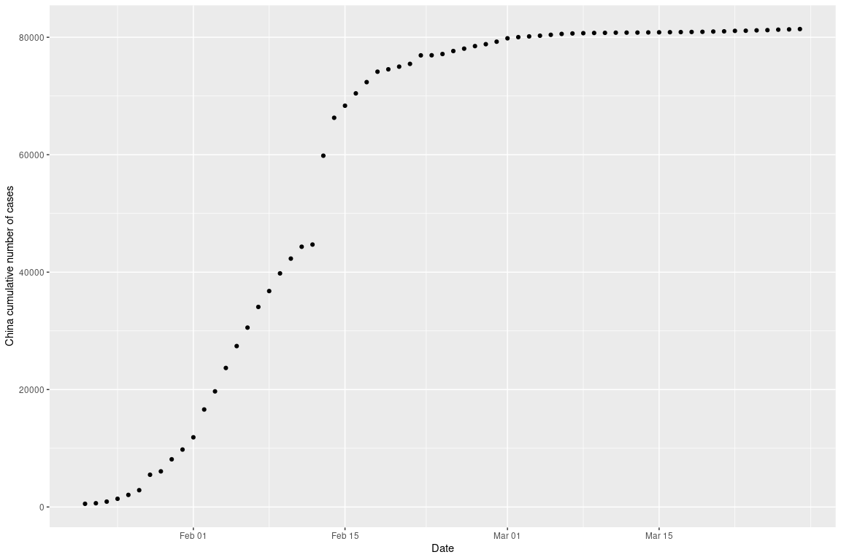
Available Official Data (Positive Cases)

Slide 6
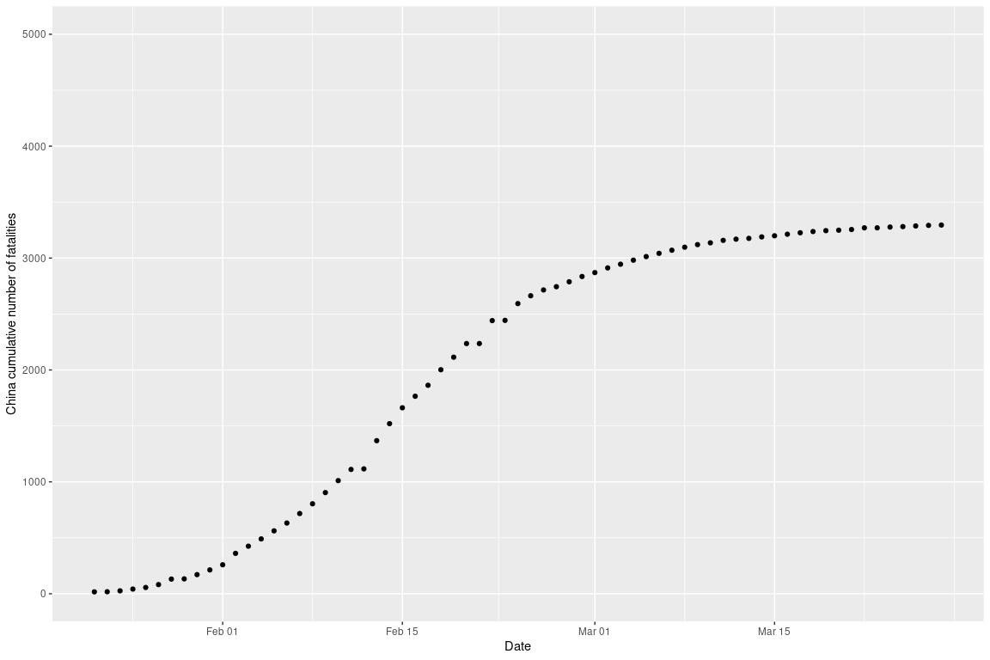
Available Official Data (Fatalities)

Slide 7
Fit by the Gauss Error Function
Apply an $nls$ function to determine the nonlinear (weighted) least-squares estimates of the four parameters $a,b,c,d$ of a Gauss error function model: $a+b*erf\left(c*x−d\right)$.
model <- nls(total_cases ~ gauss_fn(days,a,b,c,d), data=china, start=list(a=10000,b=10000,c=0.1,d=1))

Slide 8
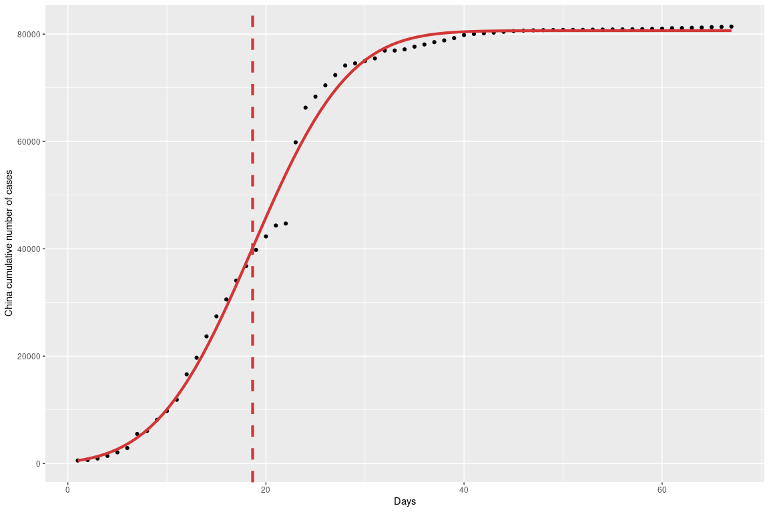
Fit by the Gauss Error Function and Peak Day (Positive Cases)

Slide 9
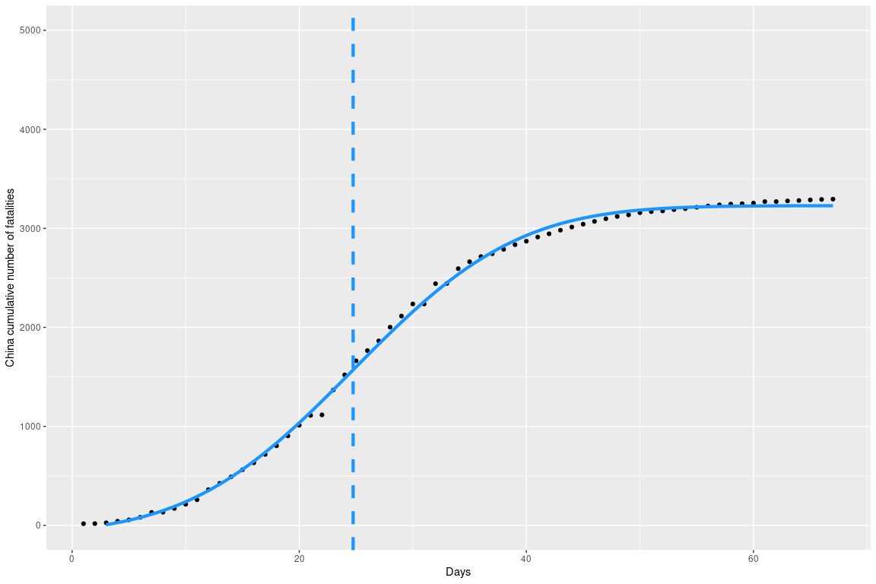
Fit by the Gauss Error Function and Peak Day (Fatalities)

Slide 10
Italy Simulation

Slide 11
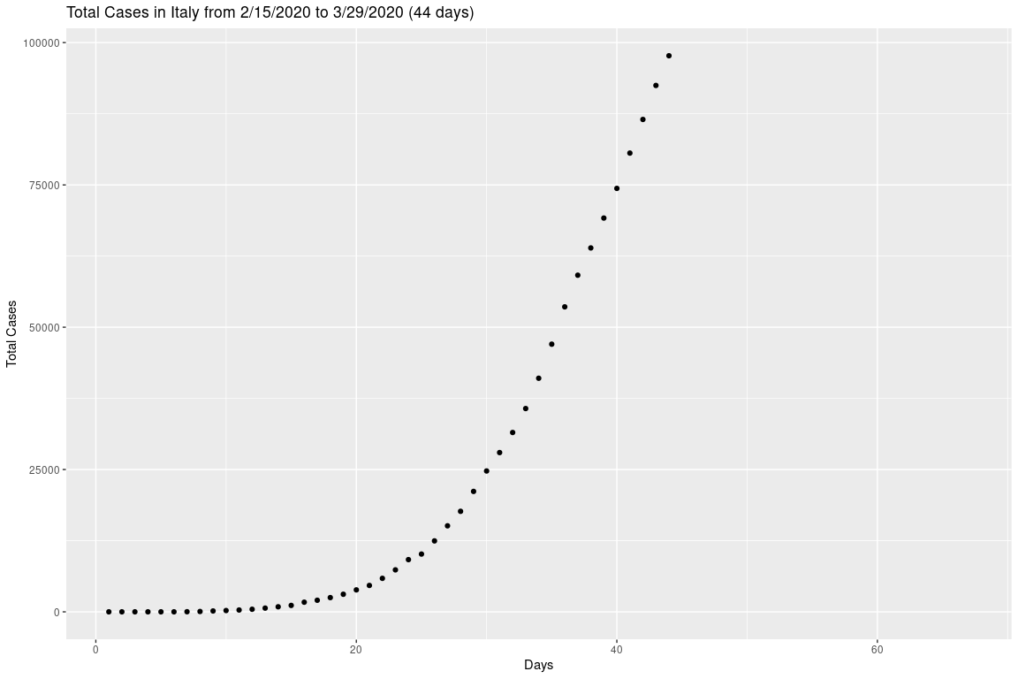
Initial Data for Cases in Italy

Slide 12
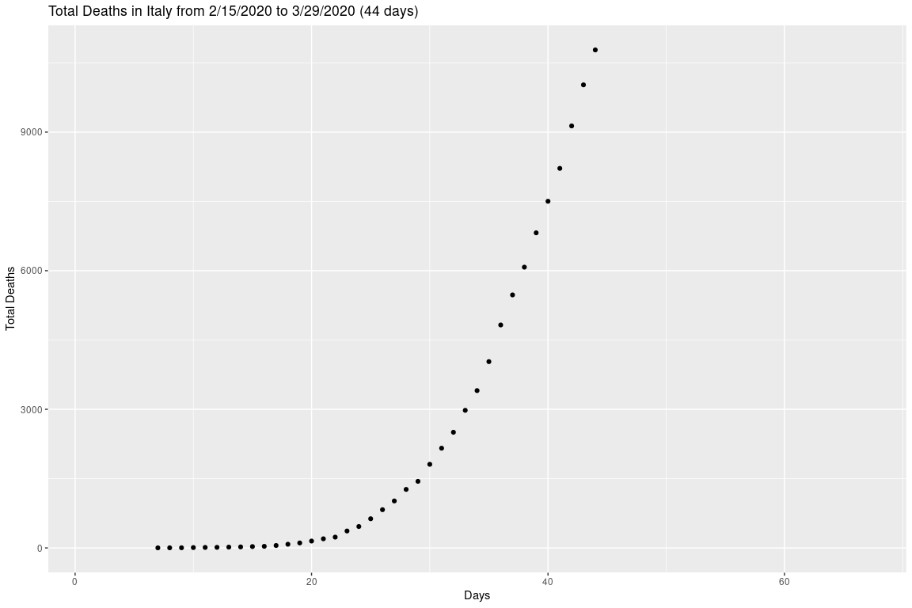
Initial Data for Fatalities in Italy

Slide 13
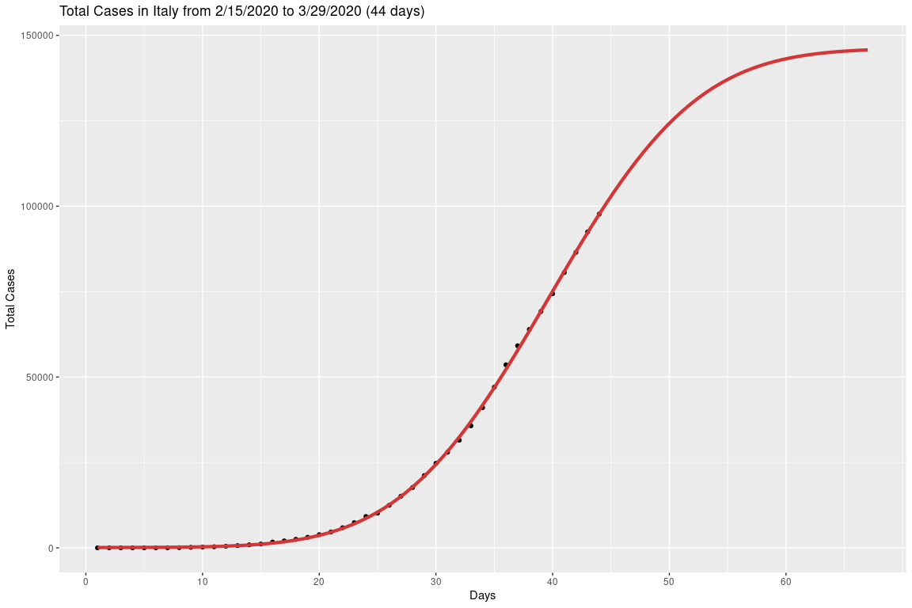
Fitting Gauss Error Function to Positive Cases in Italy

Slide 14
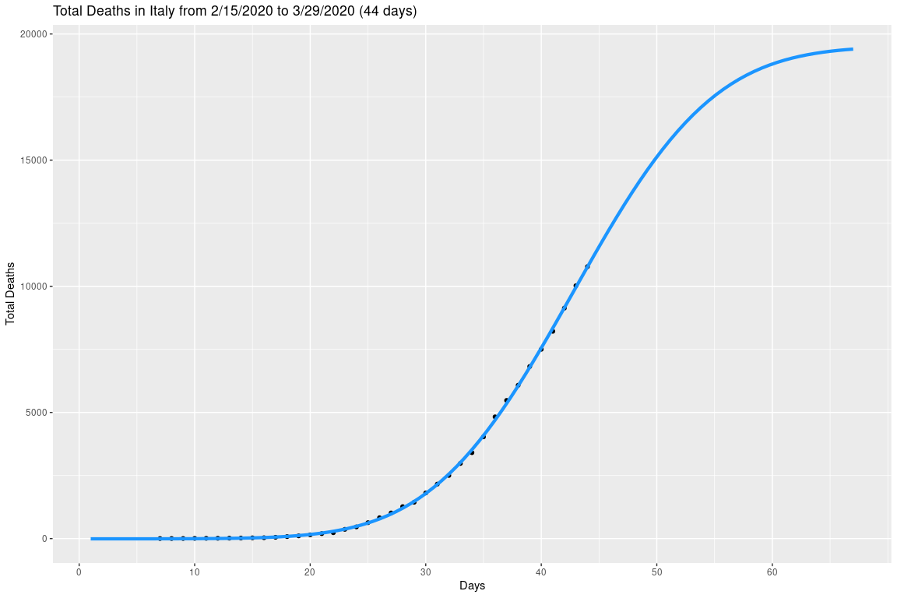
Fitting Gauss Error Function to Fatalities in Italy

Slide 15
Overview of the Monte Carlo Simulation
Create a random matrix : m X n
m = number of random outcomes (chosen to be 150)
n = number of observed days (n = 1,…,j)
Each # in the matrix is a Gaussian distribution with mean = 1 and sigma = 0.1
multiply each column (j) by the # of total cases (or deaths) that corresponds to each day j
Each of the 150 simulations were fitted with the Gauss error function
Then determined the date of the flex for each simulation

Slide 16
Using MonteCarlo Simulation to predict the day of flex
The mean of the day of flex for cases is 40.59 days and the standard deviation is 5.222832 days.
The mean of the day of flex for fatalities is 43.46 days and the standard deviation is 5.228381 days.

Slide 17
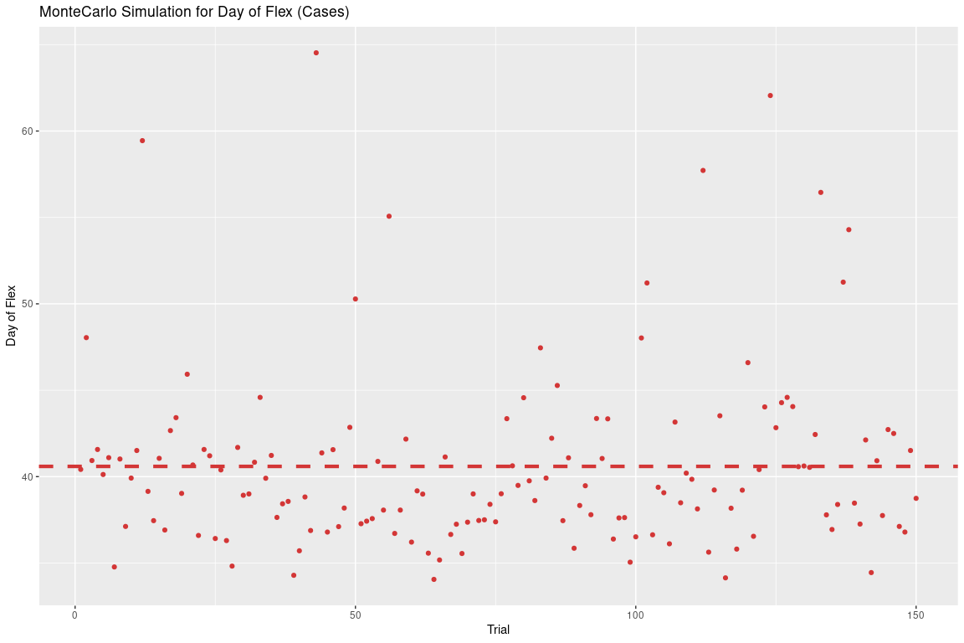
MonteCarlo Simulation Data (Cases) (150 trials)
Each red dot corresponds to the day of occurrence of the flex obtained with each of the 150 Monte Carlo simulations

Slide 18
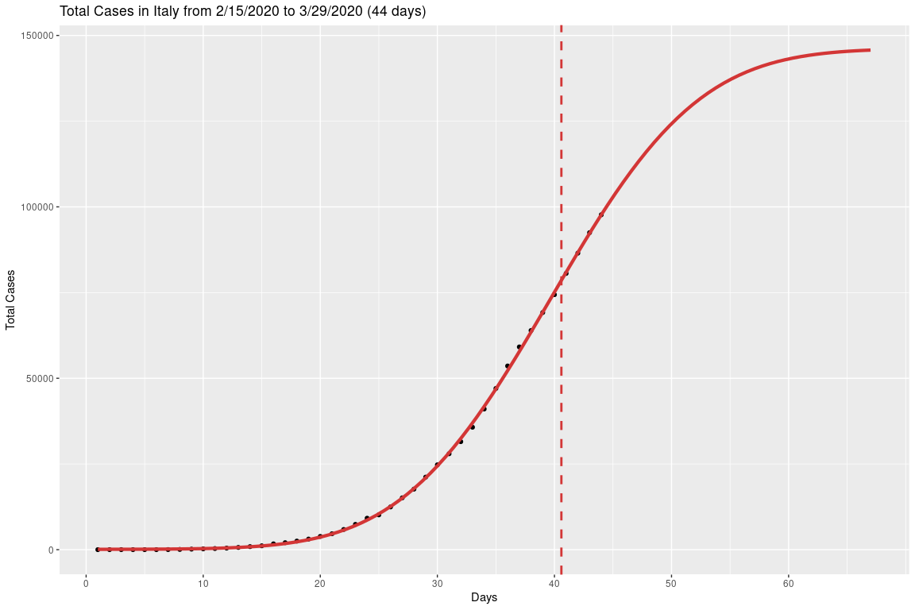
Applying the day of flex indicator to the plot (Cases)

Slide 19
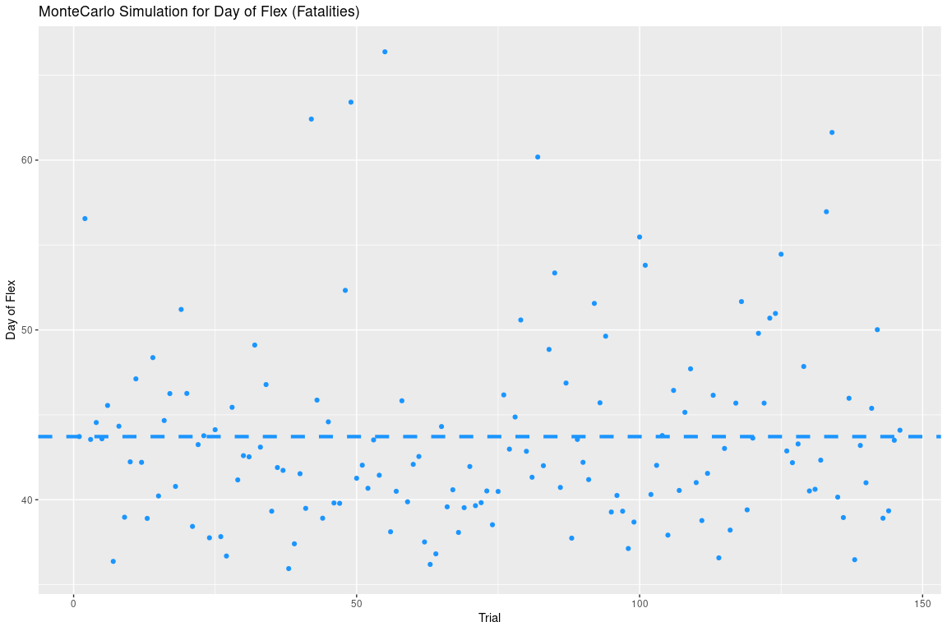
MonteCarlo Simulation Data (Fatalities) (150 trials)

Slide 20

Applying the day of flex indicator to the plot (Fatalities)

Slide 21
Australia Simulation

Slide 22
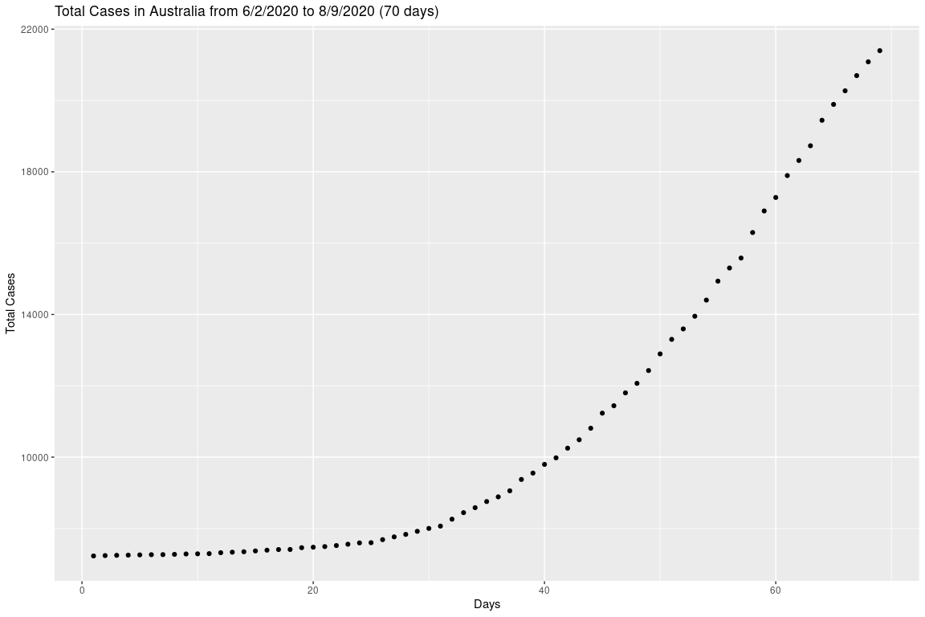
Initial Data for Australia (Cases)

Slide 23
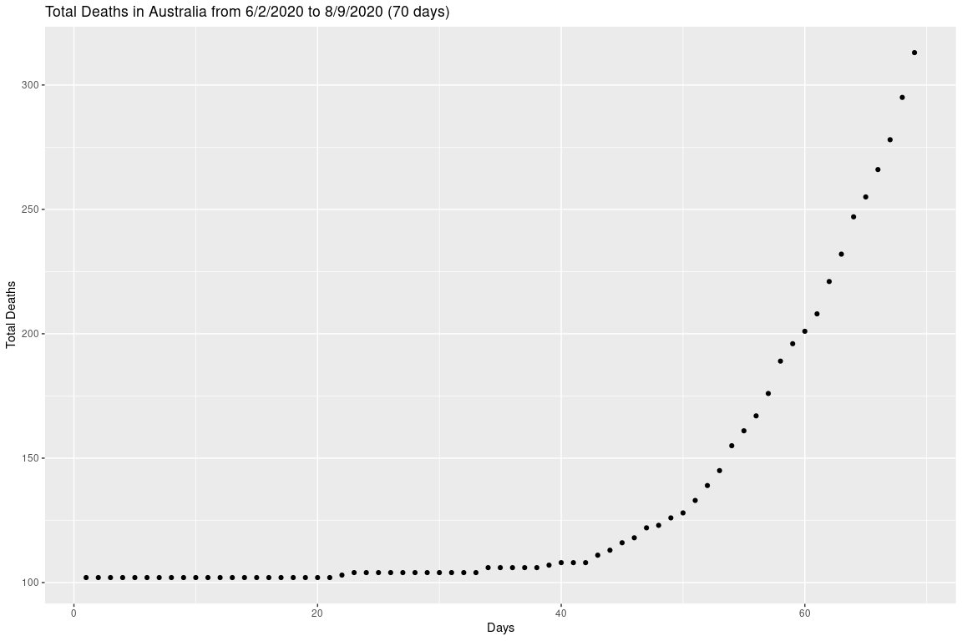
Initial Data for Australia (Fatalities)

Slide 24
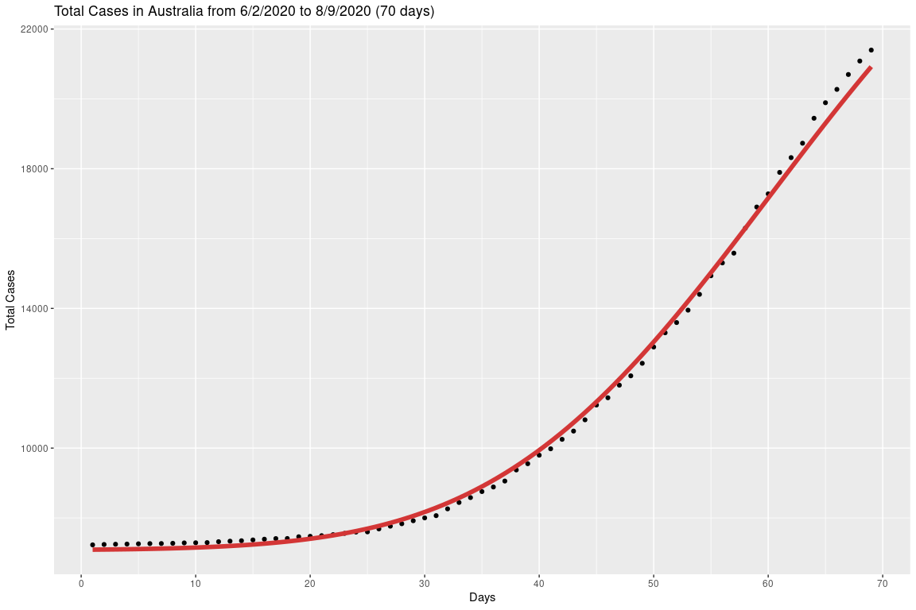
Fitting a Gauss Error Function to Australia Data (Cases)

Slide 25
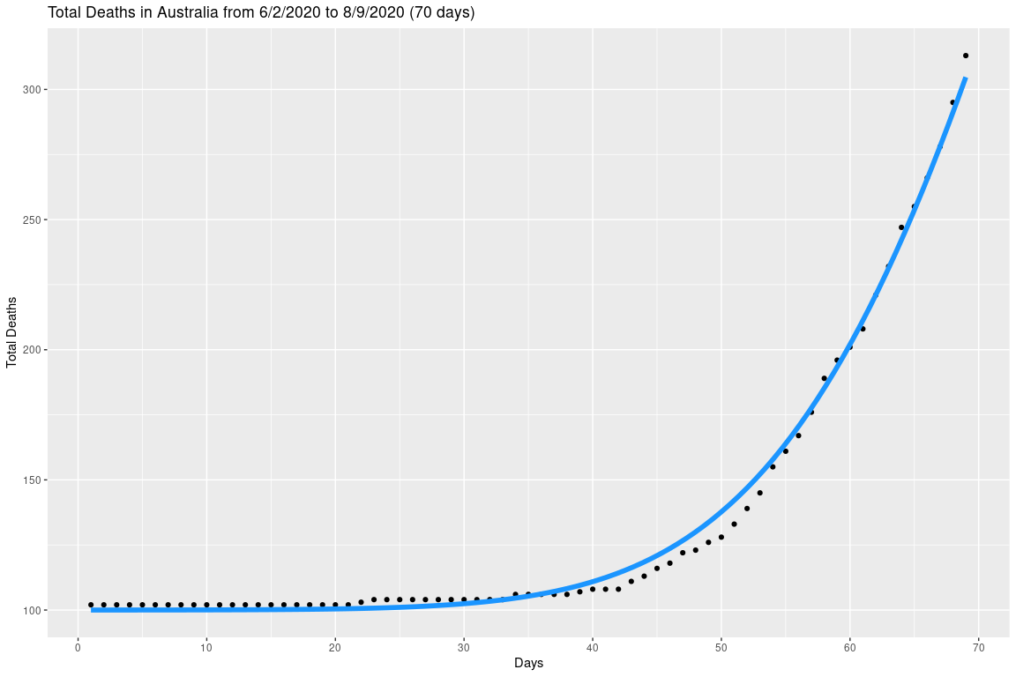
Fitting a Gauss Error Function to Australia Data (Fatalities)

Slide 26
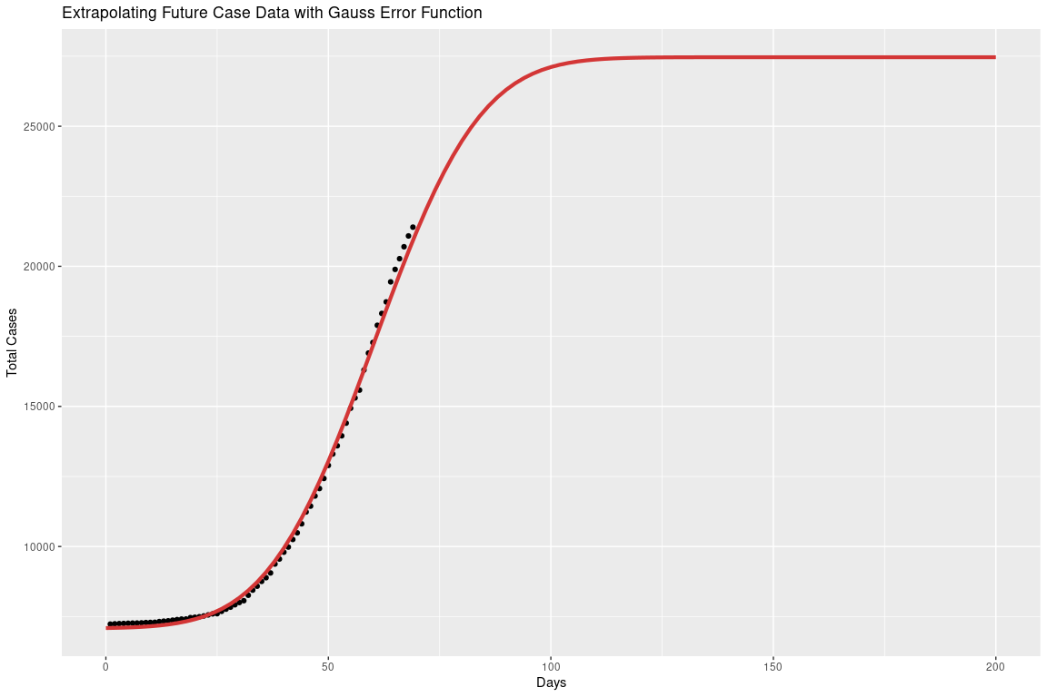
Applying the function to the future dataset (Cases)

Slide 27
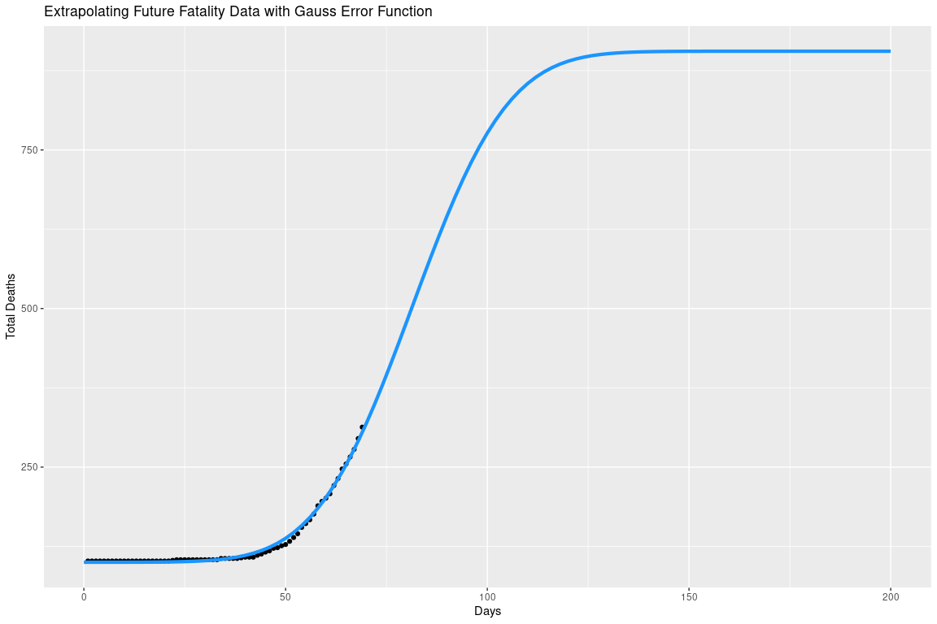
Applying the function to the future dataset (Fatalities)

Slide 28
MonteCarlo Simulation for Australia’s Day of Flex

Slide 29
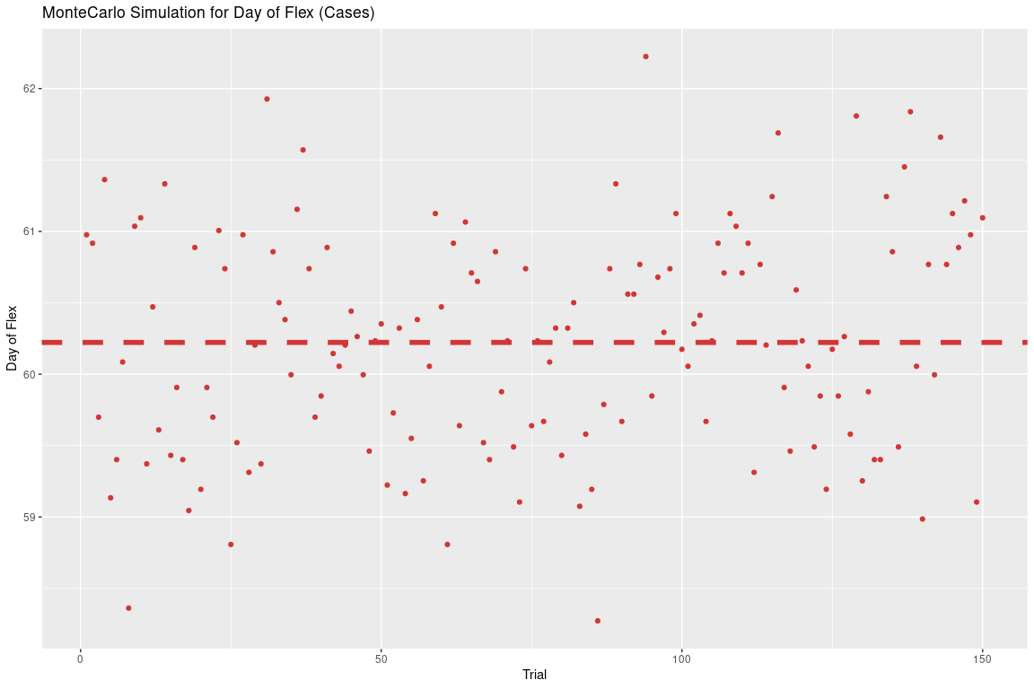
MonteCarlo Simulation Data (Cases) (150 trials)

Slide 30
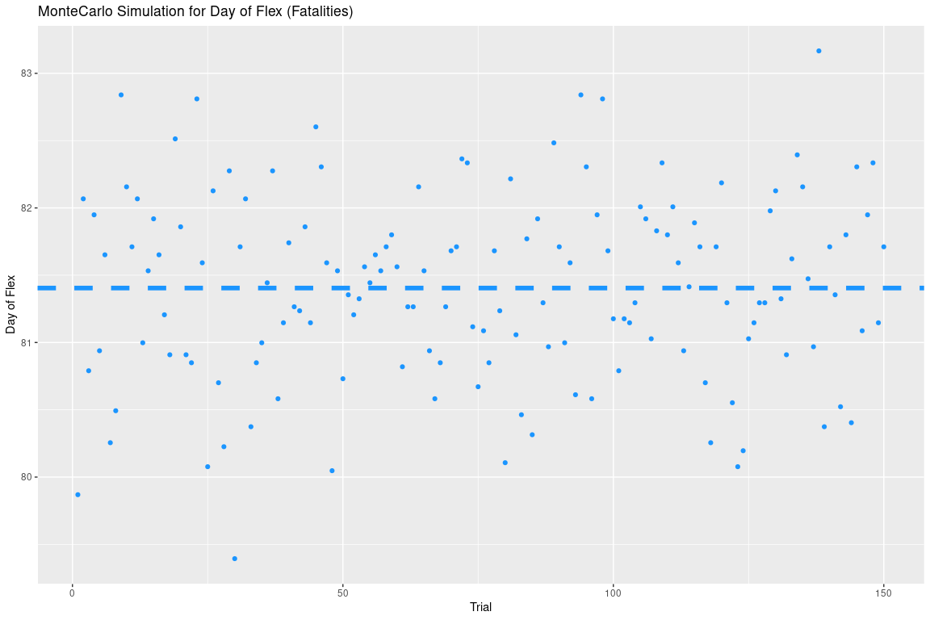
MonteCarlo Simulation Data (Fatalities) (150 trials)

Slide 31
Using MonteCarlo Simulation to Predict the Day of Flex
The mean of the day of flex for cases is 60.22 days and the standard deviation is 0.77 days.
The mean of the day of flex for fatalities is 81.4 days and the standard deviation is 0.69 days.

Slide 32
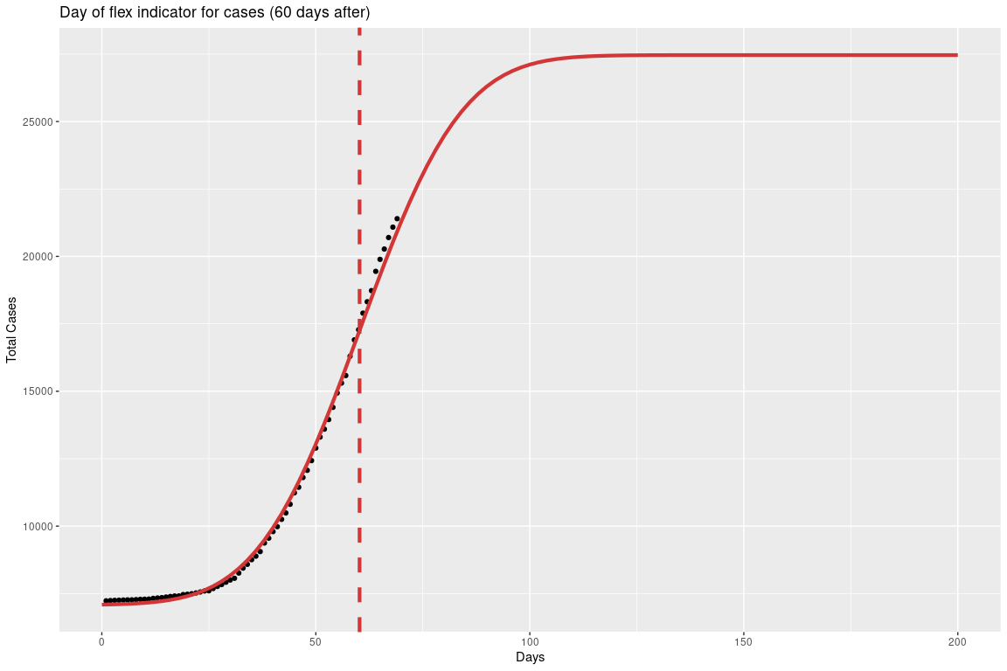
Applying the day of flex indicator to the data (Cases)

Slide 33
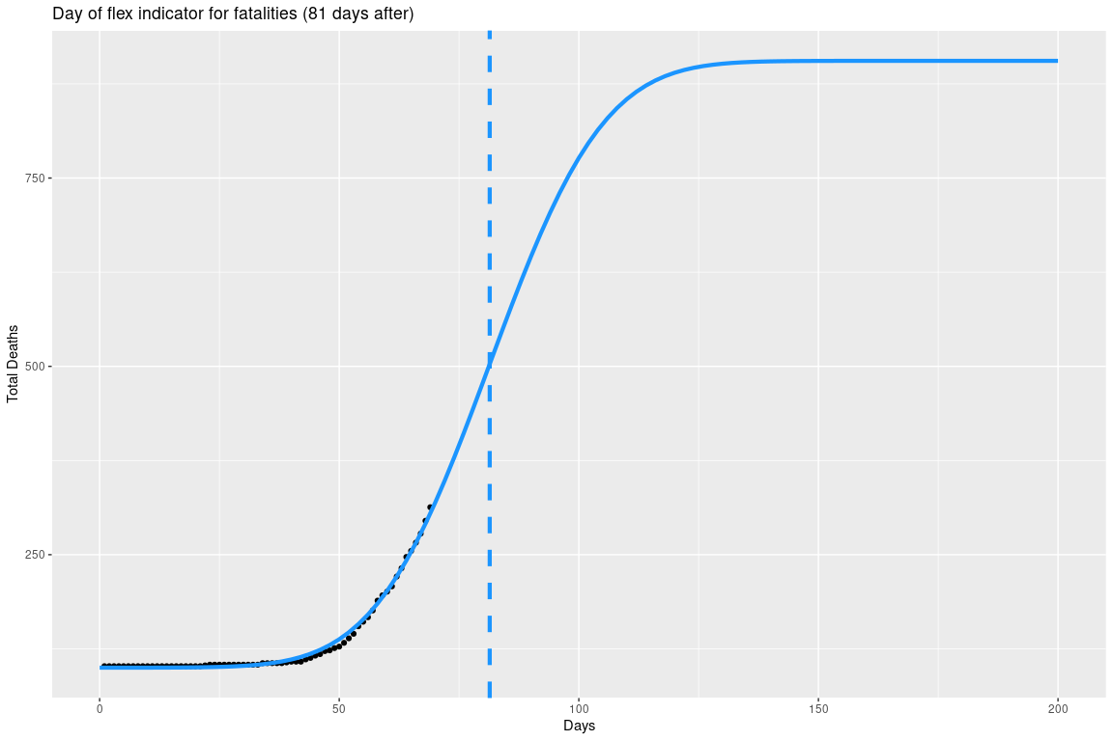
Applying the day of flex indicator to the data (Fatalities)

Slide 34
Confirming Results with entire dataset

Slide 35
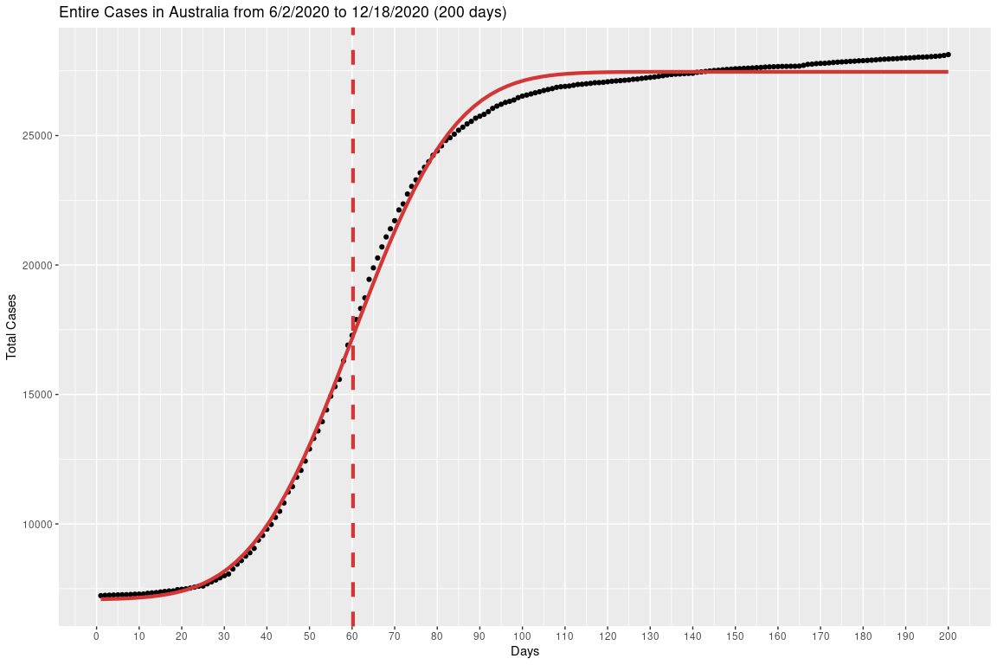
Entire data (Cases)

Slide 36
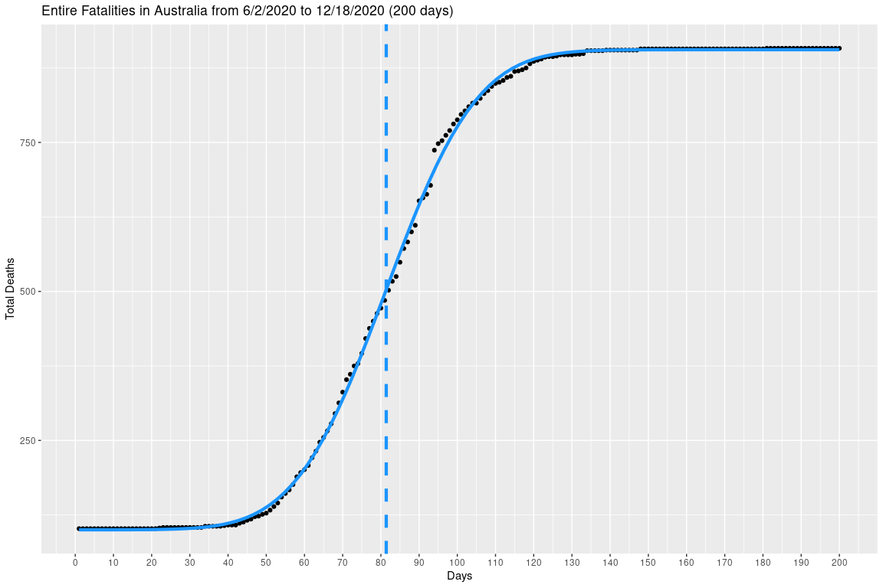
Entire data (Fatalities)

Slide 37
Interesting Anomaly with United States Data

Slide 38
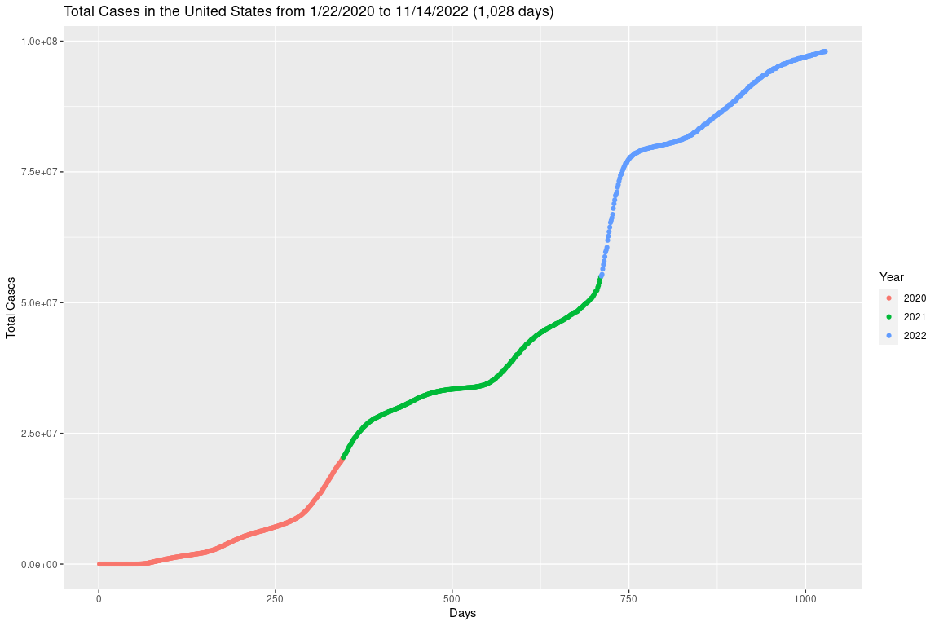
All United States Data (Cases)

Slide 39
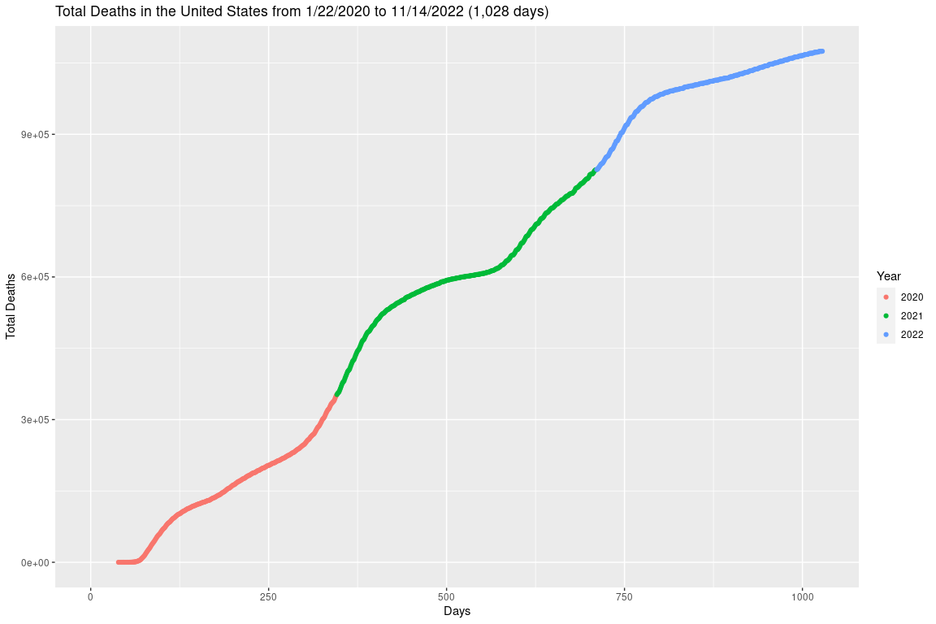
All United States Data (Fatalities)

Slide 40
Conclusion
The day of flex indicator is a good indicator to predict the time of the peak of the pandemic (for most countries).
The gauss error function is a good for countries like…
China, Italy and Australia
The gauss error function is not a good fit for countries like…
United States
Any other countries who may have different covid restrictions
MonteCarlo simulations are neccesary due to the uncertainty of the data.

Slide 41
Works Cited
Link to the study:
I. Ciufolini, A. Paolozzi, Prediction of the time evolution of the Covid-19 Pandemic in Italy by a Gauss Error Function and Monte Carlo simulations. Submitted to BioRxiv on 03.26.2020 and transferred on 03.27.2020 to MedRxiv. https://doi.org/10.1101/2020.03.27.20045104
Link to the covid data used:
https://covid19.who.int/
Source to find the second derivative of fitted function:
https://proofwiki.org/wiki/Derivative_of_Error_Function

