Slide 1
Predicting Covid Data
Austin Lackey, Chien Lin and Jin Peng

Slide 2
The Monte Carlo Study:
Mathematical prediction of the time evolution of the COVID-19 pandemic in Italy by a Gauss error function and Monte Carlo simulations
Author: Ignazio Ciufolini, Antonio Paolozzi

Slide 3
Introduction : Ciufolini and Paolozzi’s Study
The number of cumulative diagnosed positive cases and fatalities in China approximates a gauss error function: $a+b*erf\left(c*x−d\right)$.
Used the function to approximate the number of cumulative positive cases in Italy
Performed a 150 Monte Carlo simulations to predict the day in which the peak of the number of daily cases in Italy occurs.
This study do not take into account factors such as daily nasopharyngeal swabs, medical, social distancing, etc.

Slide 4
China Simulation

Slide 5
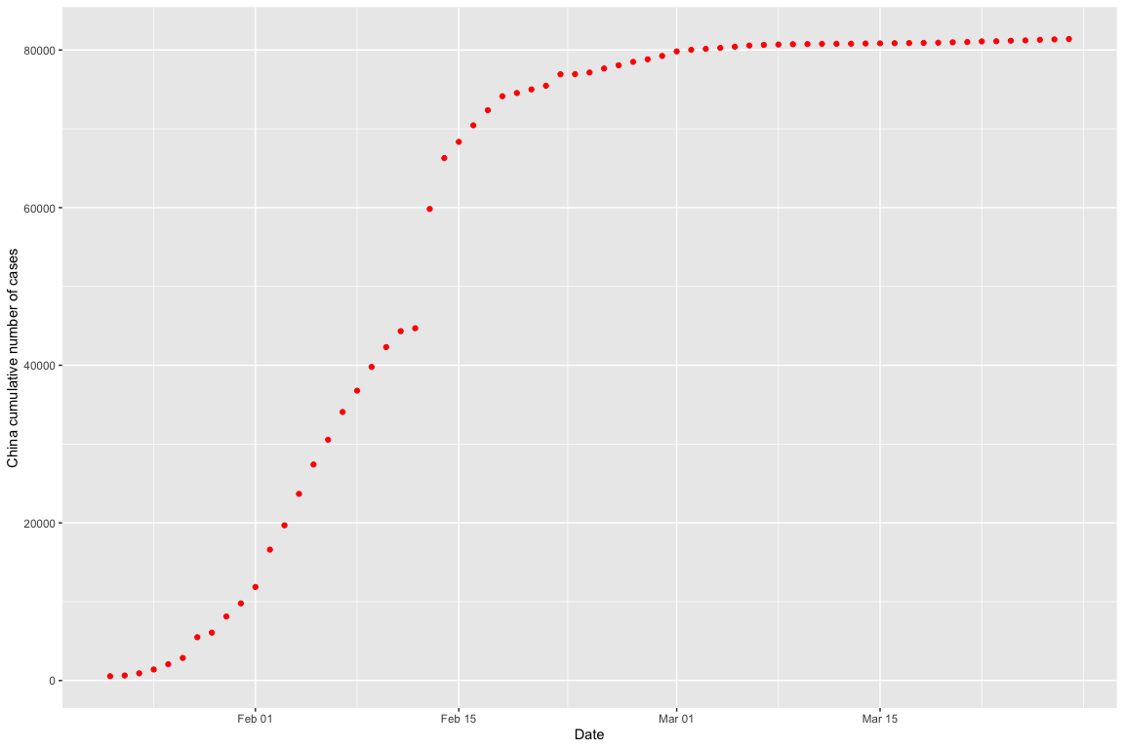
Available Official Data (Positive Cases)

Slide 6
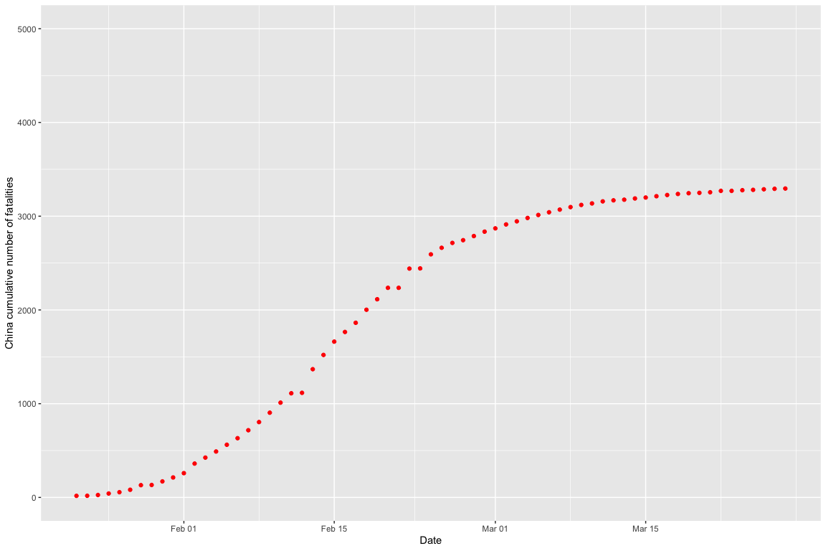
Available Official Data (Fatalities)

Slide 7
Fit by the Gauss Error Function
Apply $nls$ function to determine the nonlinear (weighted) least-squares estimates of the four parameters $a,b,c,d$ of a Gauss error function model: $a+b*erf\left(c*x−d\right)$.
model <- nls(total_cases ~ gauss_fn(days,a,b,c,d), data=china, start=list(a=10000,b=10000,c=0.1,d=1))

Slide 8
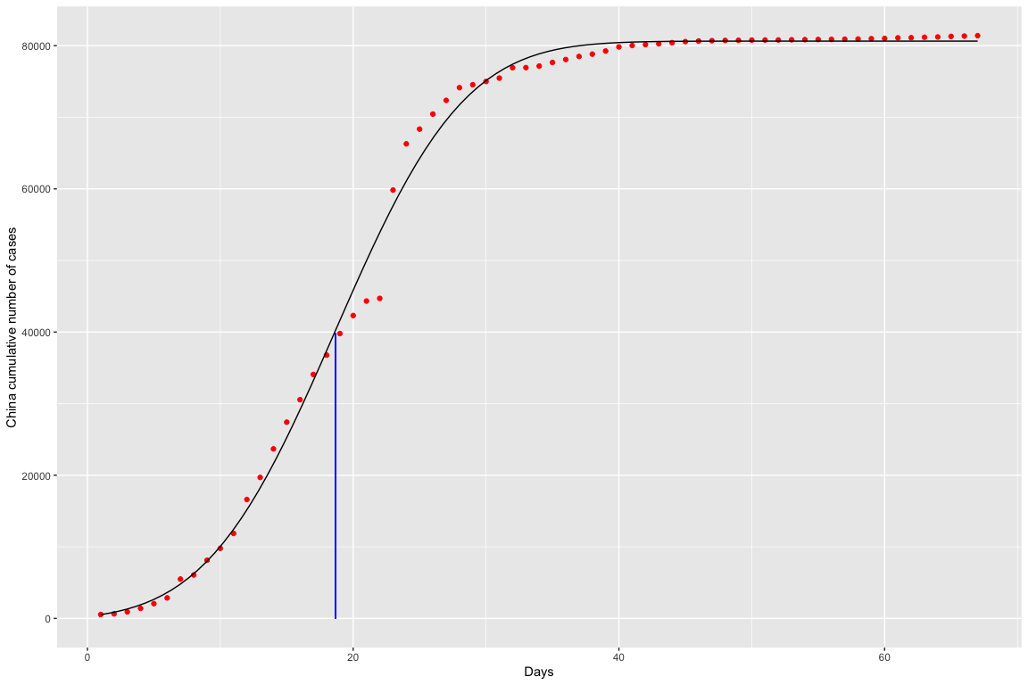
Fit by the Gauss Error Function and Peak Day (Positive Cases)

Slide 9
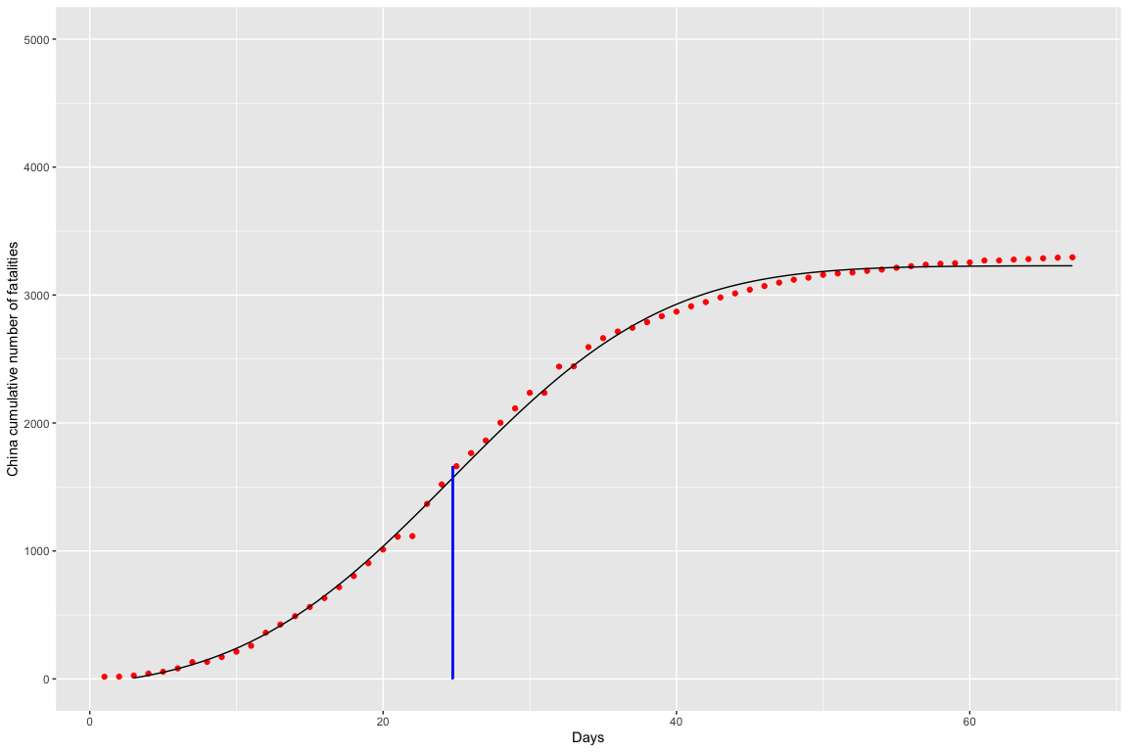
Fit by the Gauss Error Function and Peak Day (Fatalities)

Slide 10
Italy Simulation

Slide 11
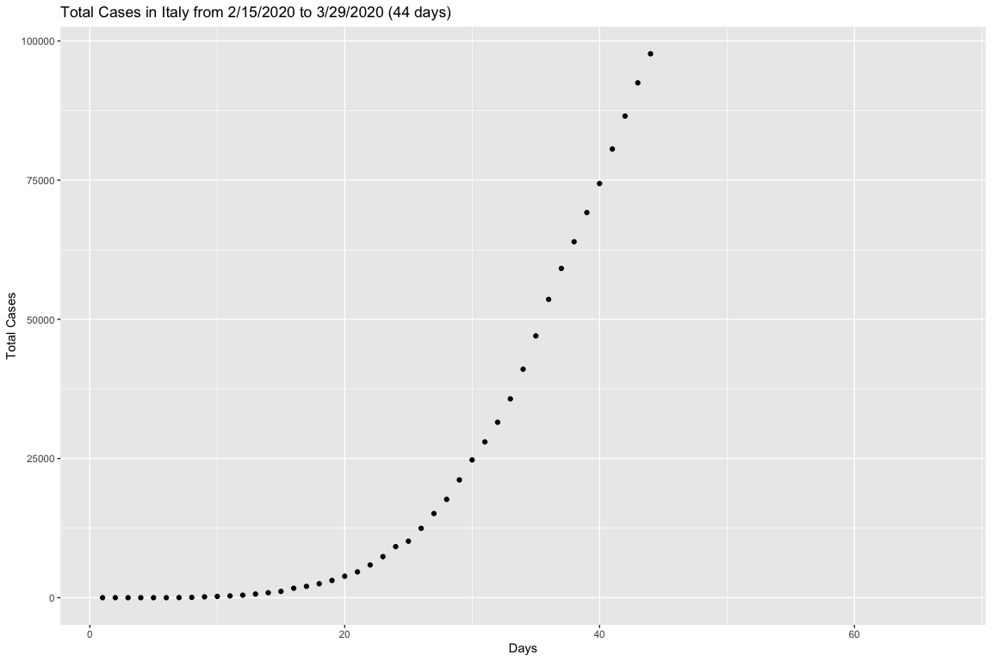
Initial Data for Cases in Italy

Slide 12
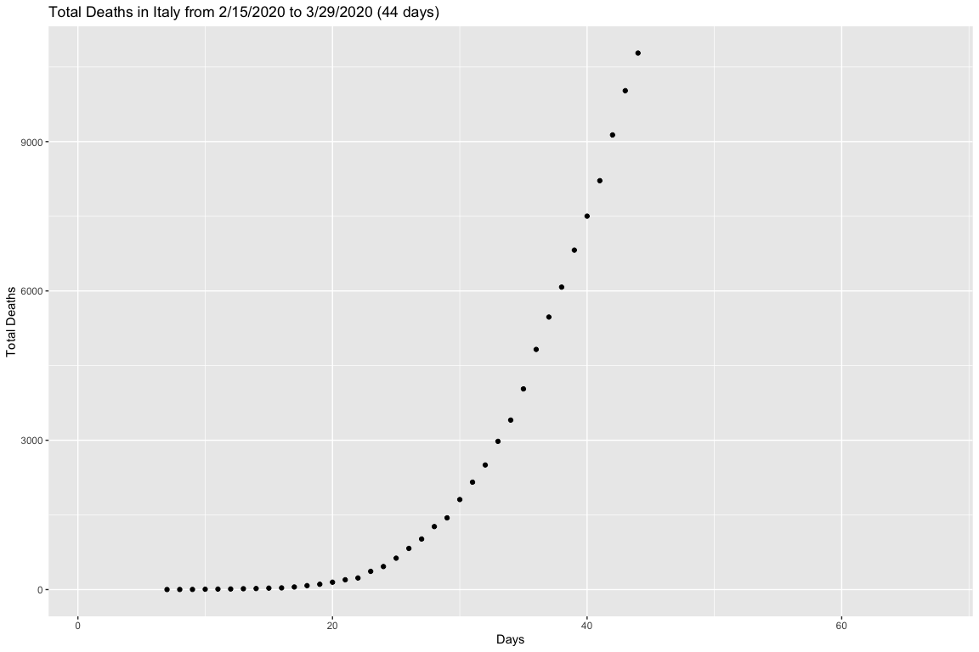
Initial Data for Fatalities in Italy

Slide 13
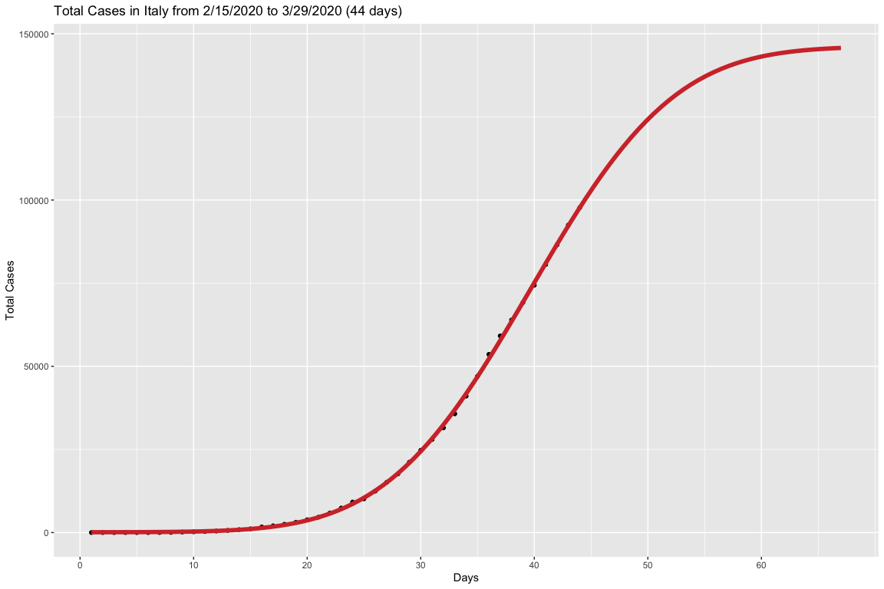
Fitting Gauss Error Function to Positive Cases in Italy

Slide 14
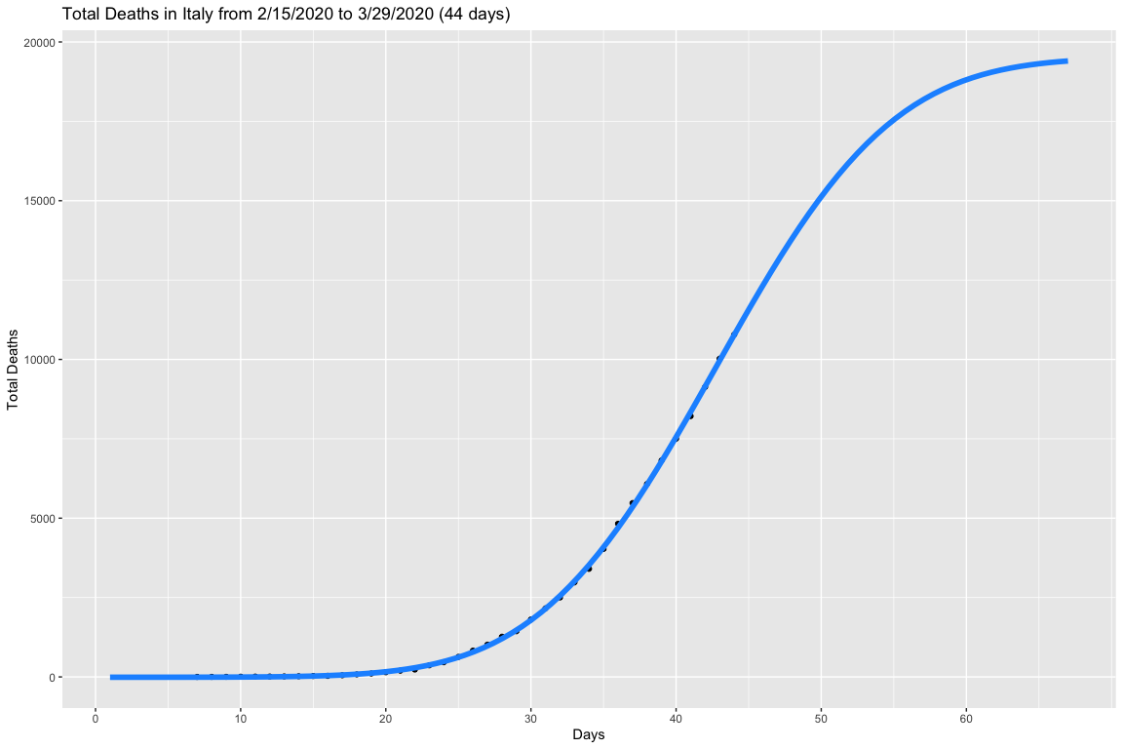
Fitting Gauss Error Function to Fatalities in Italy

Slide 15
Overview of the Monte Carlo Simulation
create a random matrix : m X n
m = number of random outcomes (chosen to be 150)
n = number of observed days (n = 1,…,j)
each # in the matrix is a Gaussian distribution with mean = 1 and sigma = 0.1
multiply each column (j) by the # of total cases (or deaths) that corresponds to each day j
add more…

Slide 16
Using MonteCarlo Simulation to predict the day of flex
The mean of the day of flex for cases is 40.59 days and the standard deviation is 5.222832 days.
The mean of the day of flex for fatalities is 43.46 days and the standard deviation is 5.228381 days.

Slide 17
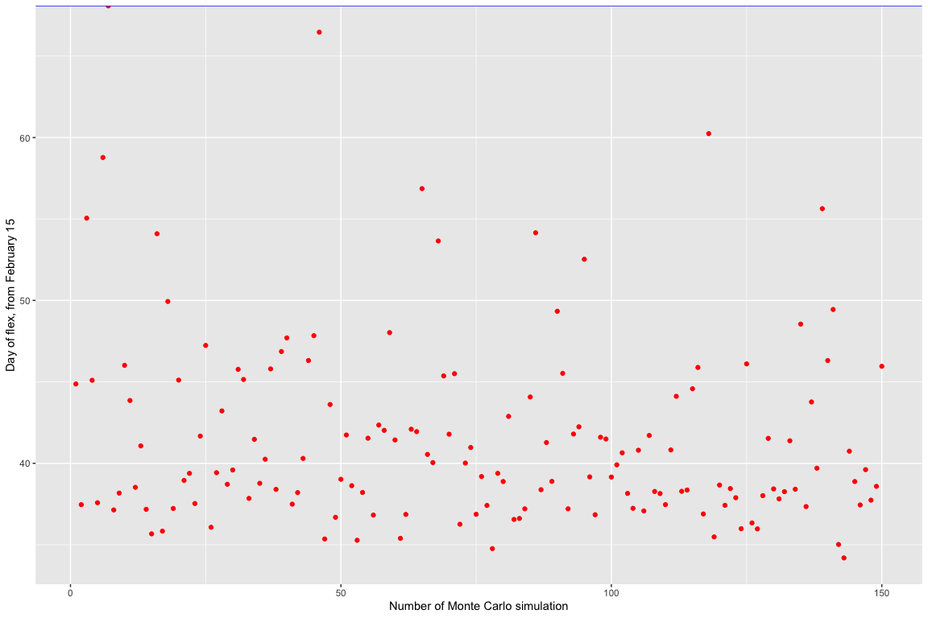
150 Monte Carlo simulations plotted
“Each red dot corresponds to the day of occurrence of the flex obtained with each of the 150 Monte Carlo simulations”

Slide 18

Applying the day of flex indicator to the plot (Cases)

Slide 19

Applying the day of flex indicator to the plot (Fatalities)

Slide 20
Australia Simulation

Slide 21
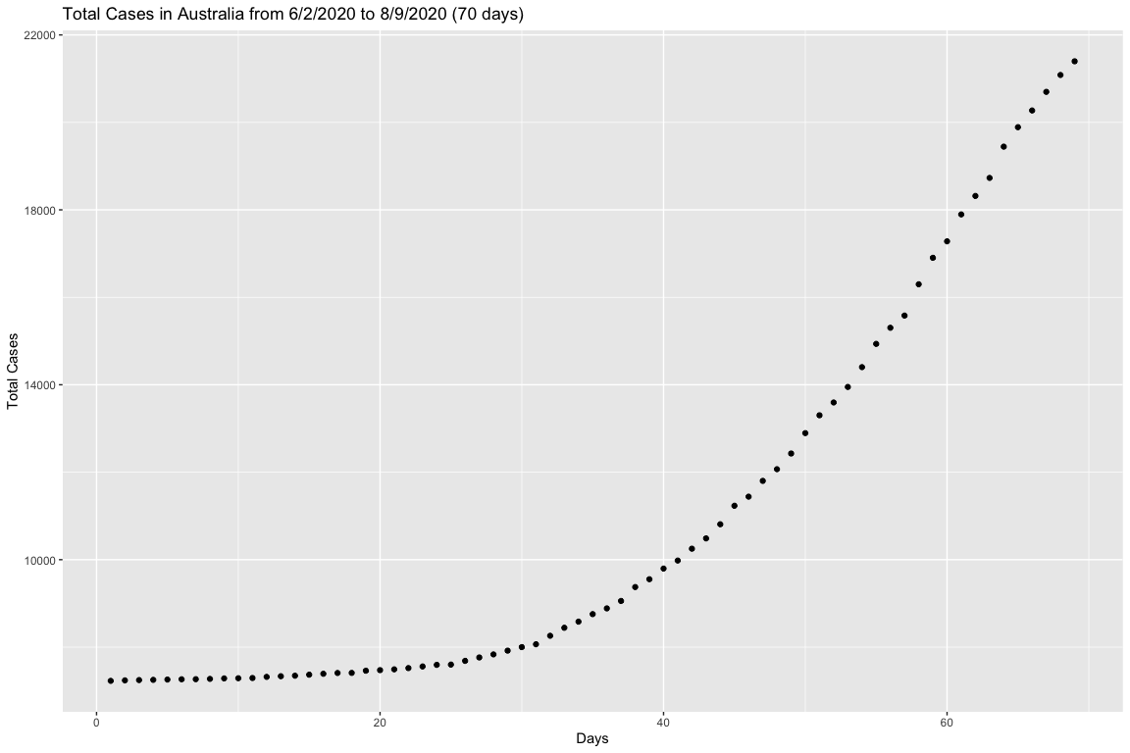
Initial Data for Cases in Australia

Slide 22
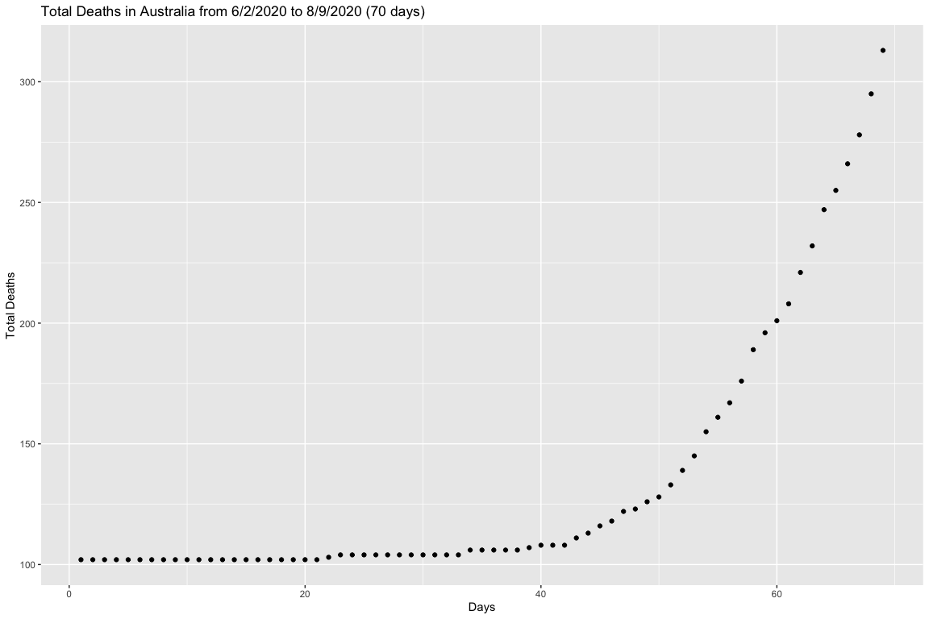
Initial Data for Fatalities in Australia

Slide 23
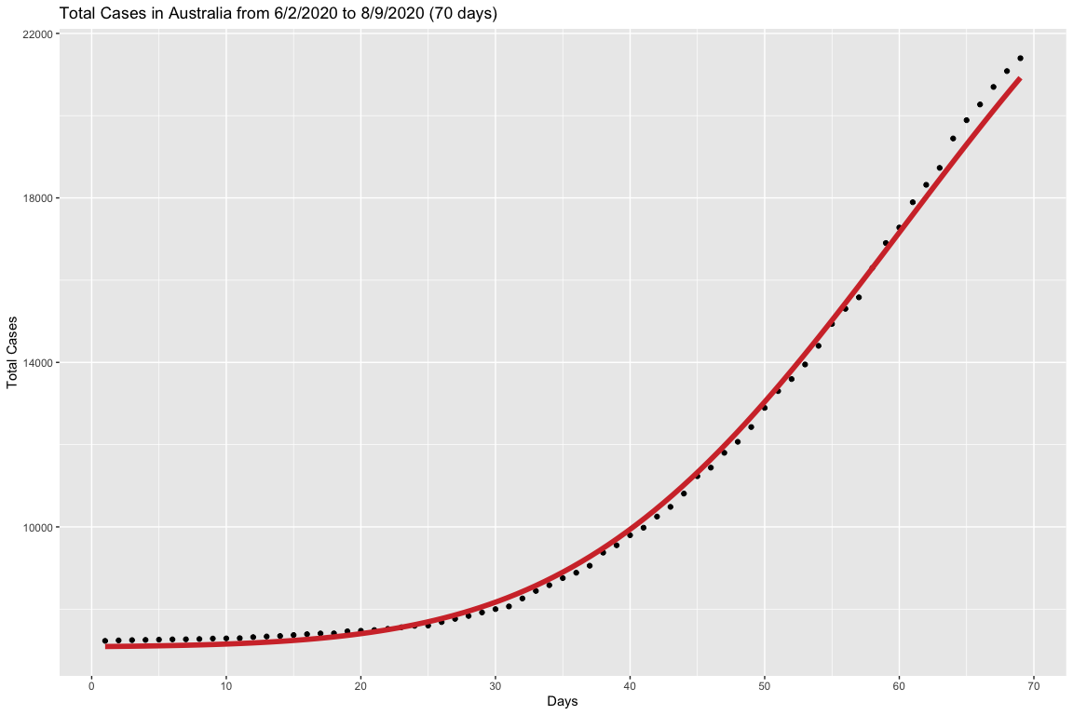
Fitting Gauss Error Function to Cases in Australia

Slide 24
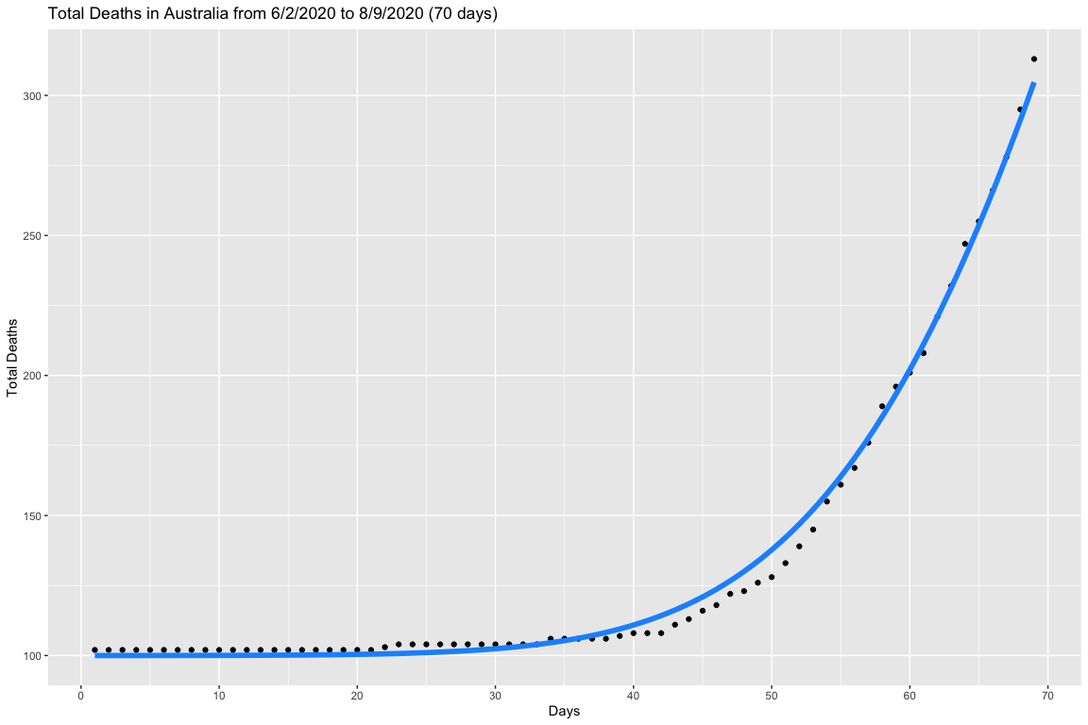
Fitting Gauss Error Function to Fatalities in Australia

Slide 25
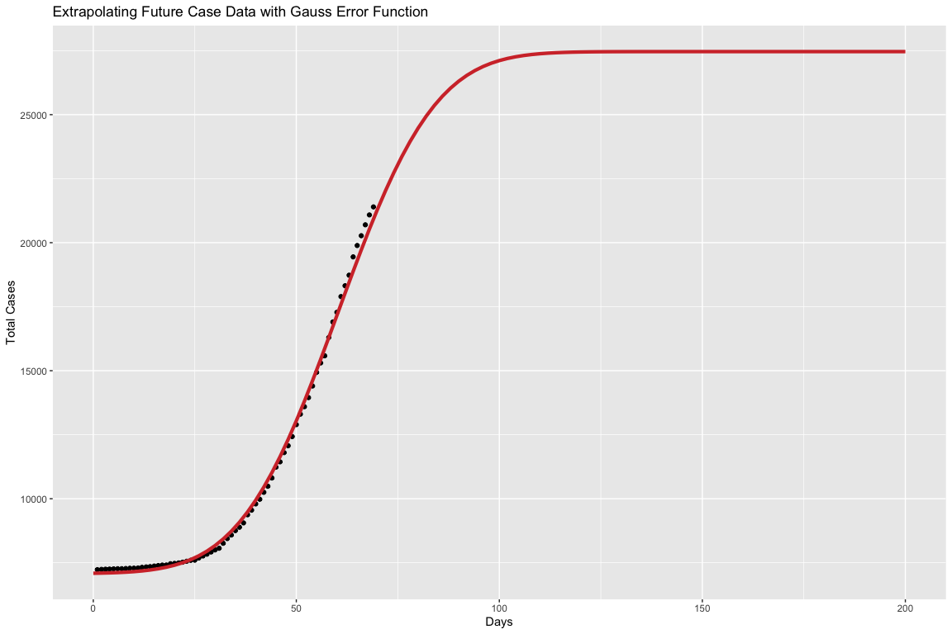
Applying the function to the future cases dataset

Slide 26
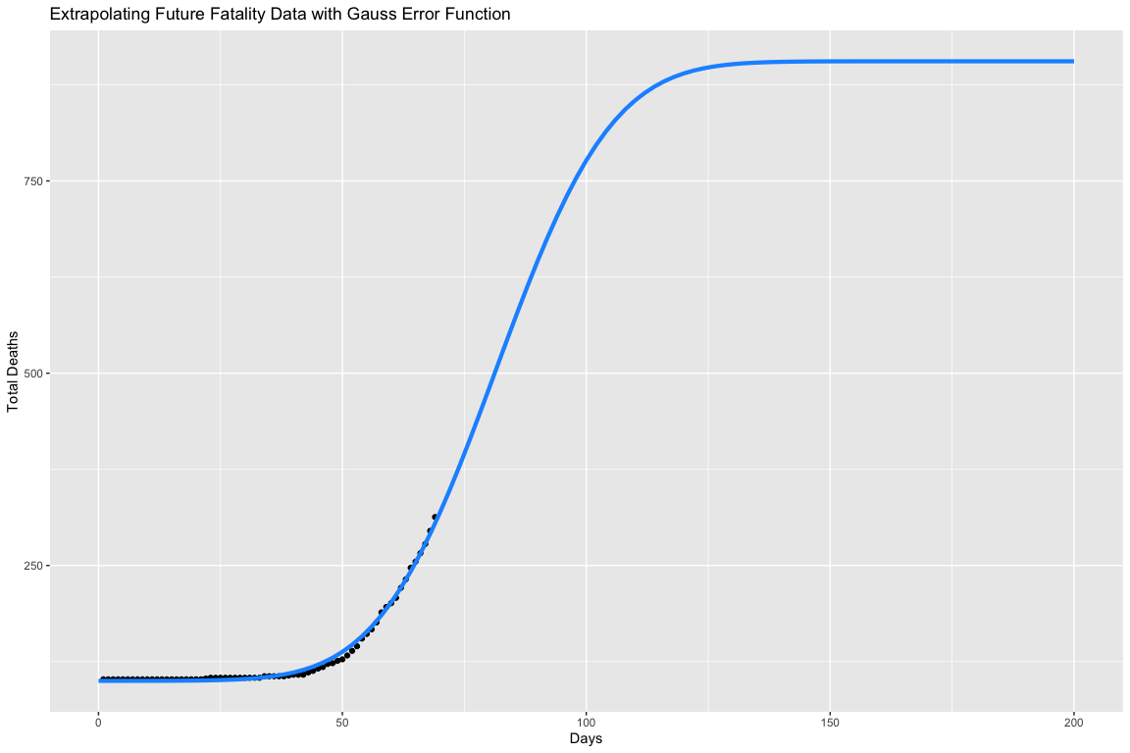
Applying the function to the future fatalities dataset

Slide 27
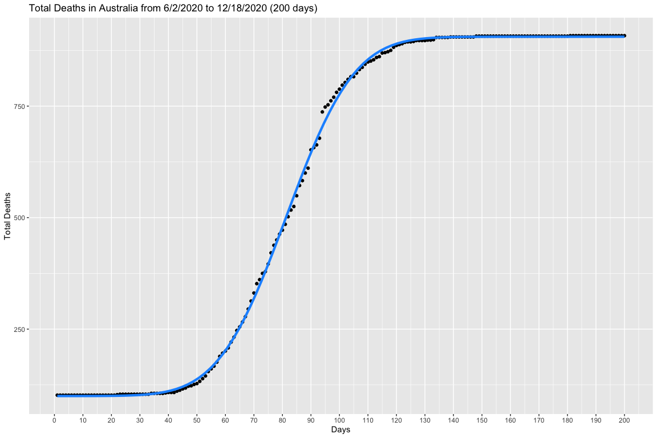
Applying the function to the whole fatalities dataset

Slide 28
Using MonteCarlo Simulation to predict the day of flex
The mean of the day of flex for cases is 60.22 days and the standard deviation is 0.77 days.
The mean of the day of flex for fatalities is 81.4 days and the standard deviation is 0.69 days.

Slide 29
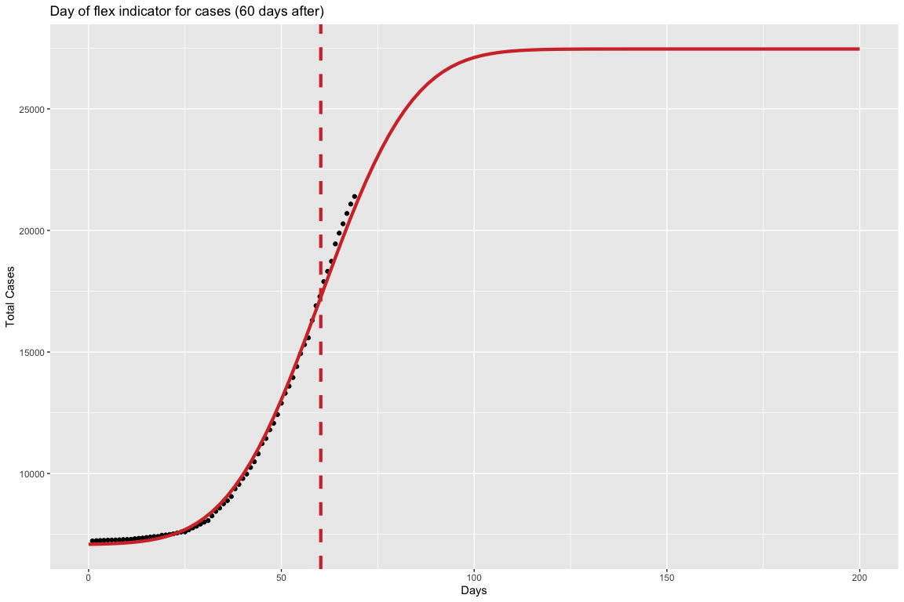
Applying the day of flex indicator to the data (Cases)

Slide 30
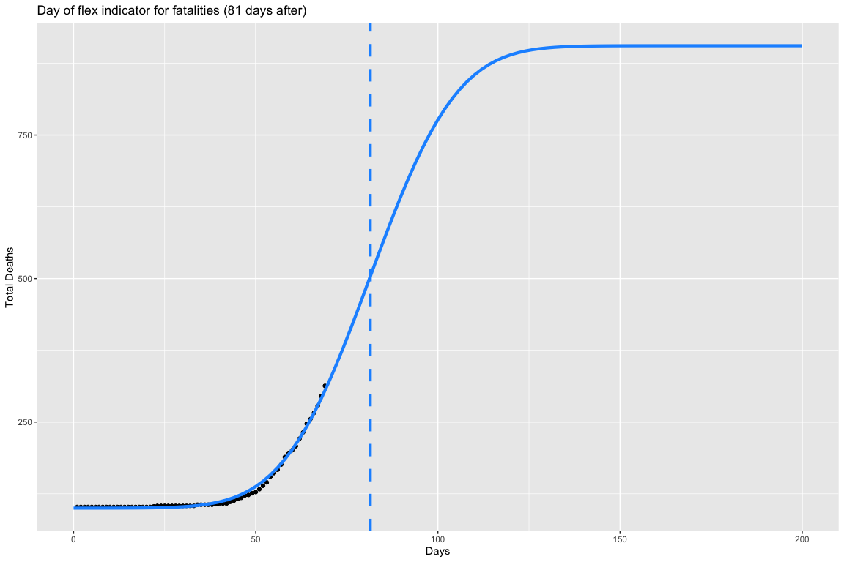
Applying the day of flex indicator to the data (Fatalities)

Slide 31
Confirming Results with entire dataset

Slide 32
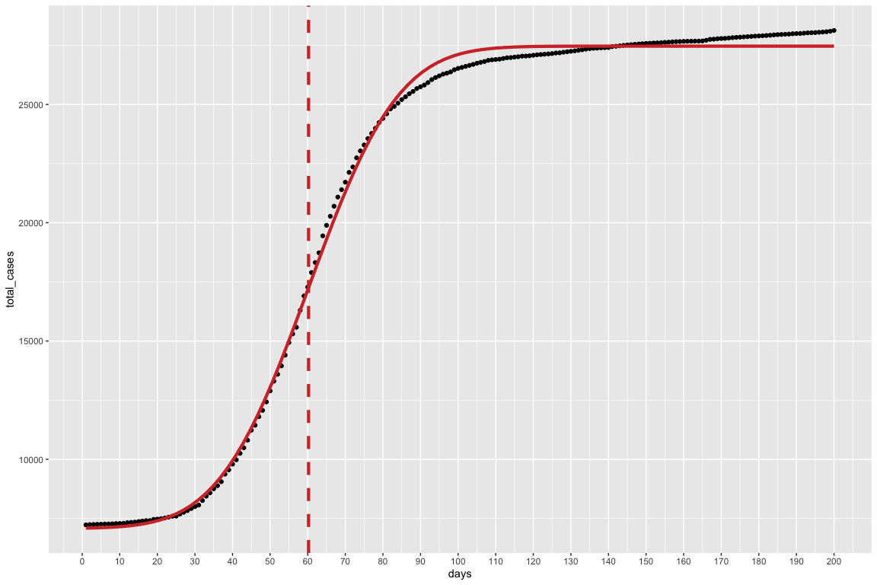
Entire cases data

Slide 33
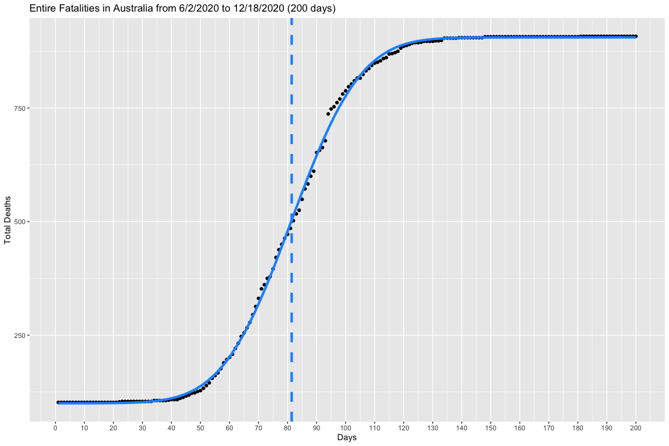
Entire fatality data

Slide 34
Interesting Anomaly with United States Data

Slide 35
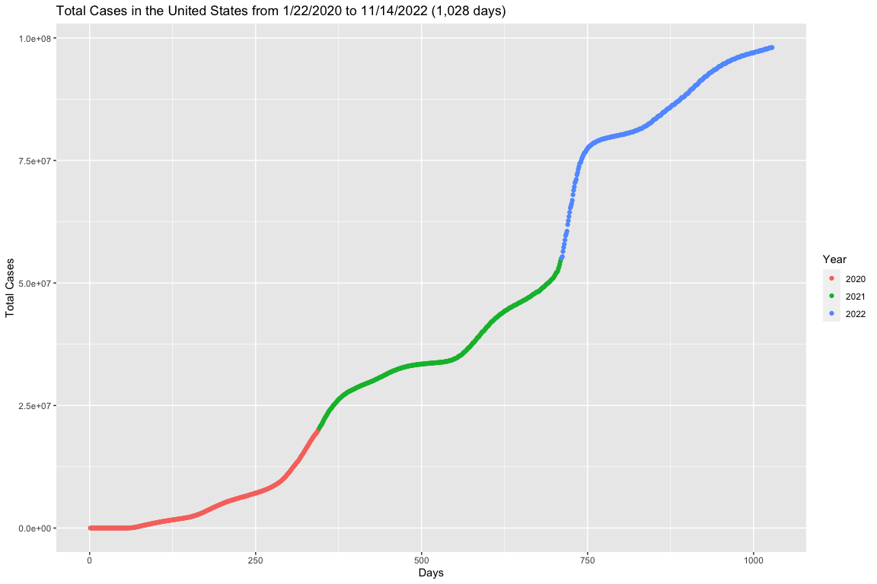
All Case Data

Slide 36
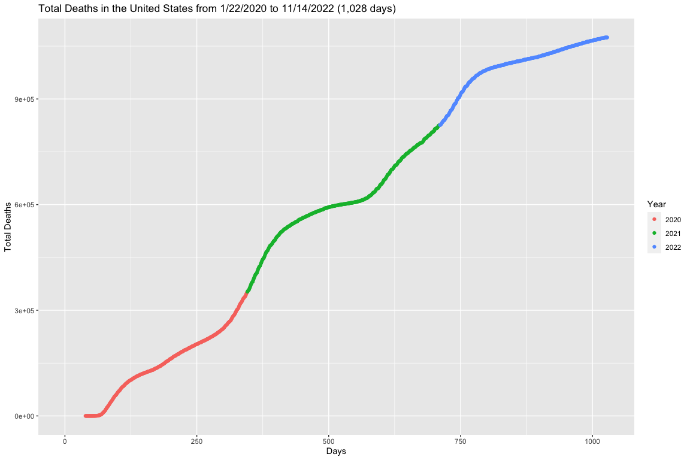
All Fatality Data

Slide 37
Conclusion

Slide 38
Works Cited
Link to study:
I. Ciufolini, A. Paolozzi, Prediction of the time evolution of the Covid-19 Pandemic in Italy by a Gauss Error Function and Monte Carlo simulations. Submitted to BioRxiv on 03.26.2020 and transferred on 03.27.2020 to MedRxiv. https://doi.org/10.1101/2020.03.27.20045104
Link to covid data:
https://covid19.who.int/
source to find the second derivative of fitted function:
https://proofwiki.org/wiki/Derivative_of_Error_Function

