Slide 1
INTRODUCTION TO REGRESSION ANALYSIS

Slide 2
INTRODUCTION TO REGRESSION ANALYSIS
LEARNING OBJECTIVES
Define simple linear regression and assumptions
Build a linear regression model using a dataset that meets the linearity assumption using the sci-kit learn library
Understand and identify multicollinearity in a multiple regression.

Slide 3
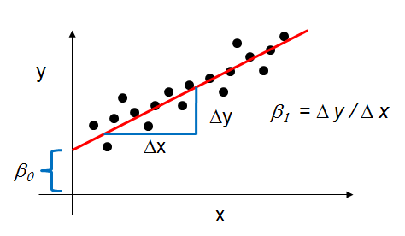
SIMPLE LINEAR REGRESSION
Definition: Explanation of a continuous variable given a series of independent variables
The simplest version is just a line of best fit: y = mx + b
Explain the relationship between x and y using the starting point b and the power in explanation m.

Slide 4
OPENING
INTRODUCTION TO REGRESSION ANALYSIS

Slide 5
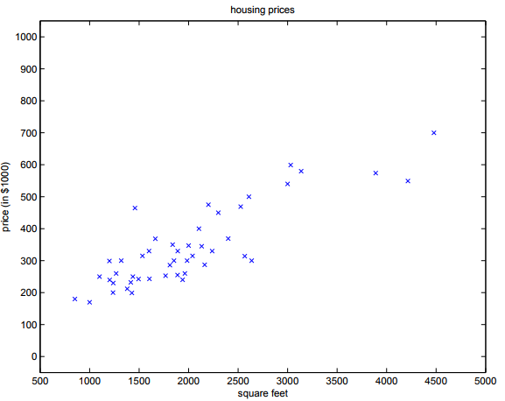
SIMPLE LINEAR REGRESSION
Motivation: suppose we have a dataset giving the living areas and prices of 47 houses from Portland, Oregon
How can we learn to predict the prices of other houses in Portland, as a function of the size of their living areas?
Living Area (feet sq) | Price (1000$s)
2104 | 400
1600 | 330
2400 | 369
1416 | 232
… | …

Slide 6
INTRODUCTION
SIMPLE LINEAR REGRESSION

Slide 7
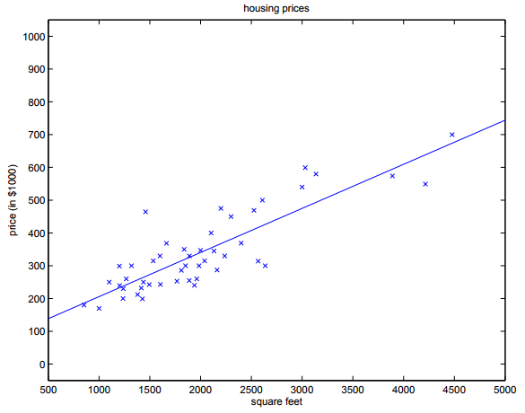
SIMPLE LINEAR REGRESSION
Let’s go back to the housing price data set. Our hypothesis is that housing price, y, is a linear function of square footage, x, which gives us the following equation:
Y = mx + b
Y = Housing Price
x = Square Footage
m = ?
b = ?

Slide 8
SIMPLE LINEAR REGRESSION
How do we get our slope and y-intercept?
Which of these lines best fits our data?
y = 80 + 0.1575x
y = 100 + 0.187x
y = 110 + 0.147x

Slide 9
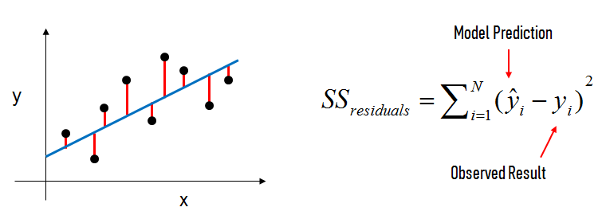

SIMPLE LINEAR REGRESSION
Draw a line that minimizes the sum of the residuals between the predicted point and the actual point => Ordinary Least Squares (OLS)
Where = mx + b for the i^{th} observation of N observations

Slide 10
Checks
SIMPLE LINEAR REGRESSION ASSUMPTIONS

Slide 11
SIMPLE LINEAR REGRESSION
Linear regression works best when:
The data is normally distributed (but doesn’t have to be)
X’s significantly explain y (have low p-values)
X’s are independent of each other (low multicollinearity)
Resulting values pass linear assumption (depends upon problem)
If data is not normally distributed, we could introduce bias.

Slide 12
OPENING
EVALUATE MODEL FIT

Slide 13
WHAT IS R-SQUARED? WHAT IS A RESIDUAL?
R-squared and Residuals
R-squared is the central metric introduced for linear regression
Which model performed better, one with an r-squared of 0.79 or 0.81?
R-squared measures explain variance.
But does it tell the magnitude or scale of error?
We’ll explore loss functions and find ways to refine our model.

Slide 14
CONCLUSION
REVIEW

Slide 15
CONCLUSION
What is simple linear regression?
How do we come up with the coefficients?
What does the slope and intercept mean?

