Slide 1
INTRODUCTION TO LOGISTIC REGRESSION

Slide 2
TODAY’S LEARNING OBJECTIVES
INTRODUCTION TO LOGISTIC REGRESSION
Logistic Regression & decision boundaries
Gradient Descent and how it fits into Logistic Regression
Evaluate a model using metrics such as classification accuracy/error, confusion matrix, ROC/AUC curves, and loss functions
Build a Logistic Regression using sklearn

Slide 3

WHERE ARE WE IN THE MACHINE LEARNING UNIVERSE?

Slide 4
DEMO
WHY NOT
LINEAR REGRESSION?

Slide 5
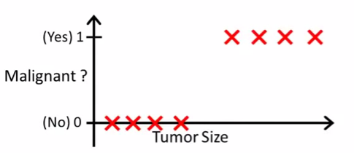
LOGISTIC REGRESSION
Motivation: suppose we want to predict whether a tumor is malignant or benign based on its size.

Slide 6
LOGISTIC REGRESSION
Would Linear Regression work?
Decision Boundary
Find where y = 0.5 => x = 2
Anything larger than 2 we will classify as a malignant tumor
Anything less than 2 we will classify as a benign tumor
0.5
X = 2
What types of problems can you foresee with this technique?

Slide 7

LOGISTIC REGRESSION
Problem 1
Suppose we have another training example, p
Because OLS is minimizing the residuals, it stretches out the line and moves our decision boundary!
These points are now classified as benign!
P
0.5
X = 6

Slide 8
LOGISTIC REGRESSION
Problem 2
Linear Regression outputs predictions < 0 or > 1
Decision Boundary
We want a model that predicts values between 0 and 1
We want a decision boundary AKA “anything past this is class A and anything before it is class B”

Slide 9
INTRODUCTION
LOGISTIC REGRESSION

Slide 10

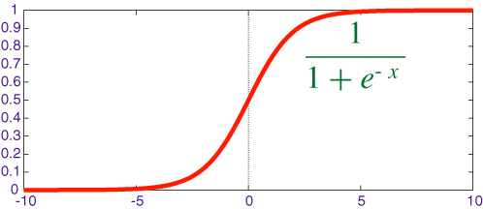
LOGISTIC REGRESSION
We will use Logistic Regression to predict a binary response (0 or 1).
We use the Sigmoid/Logistic function to output probabilities for our predictions. It has the functional form of
This is called our Link function.
We need it in order to find optimal parameters in our model
A standard rule is to classify our “1” class as anything with a probability > 0.5 and our “0” class anything below that.
The point at which the probability = 0.5 is called the decision boundary.
Decision Boundary

Slide 11
TRANSFORMING LINEAR REGRESSION
Intuition: the “linearity” of logistic regression is in the decision boundary we develop. You can imagine it as a line (in 2-D) that separates the two classes.
Questions you’re still thinking
How do we develop this line and what’s the criteria for it? How does it relate to the Sigmoid function?
X2
X1

Slide 12

TRANSFORMING LINEAR REGRESSION
Question: how do we develop the decision boundary?
X2
Layman’s definition
We fit a line that best “divides” the two classes
Mathematical definition
We fit a line such that we minimize the sum of the residuals between the true label and the “strength” (aka probability) of our guess.
X1

Slide 13


TRANSFORMING LINEAR REGRESSION
X2
We can also rewrite the equation as this:
If then we predict 1.
if then we predict 0
X1

Slide 14


TRANSFORMING LINEAR REGRESSION
Question: how does our decision boundary relate to the sigmoid function?
X2
Where
X1
The sigmoid function outputs values from [0,1] that represent the “strength” aka probability of our prediction

Slide 15

KNOWLEDGE CHECK
Why is Linear Regression not an appropriate tool to use in classification?
How does Logistic Regression account for the failings of Linear Regression?
What is the main criteria for how Logistic Regression develops its decision boundary?
How does the Sigmoid function relate to the decision boundary?
EXERCISE

Slide 16
INTRODUCTION
INTERPRETING
LOGISTIC REGRESSION

Slide 17
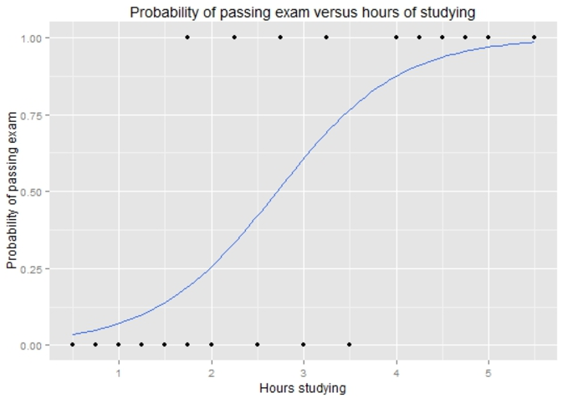

TRANSFORMING LINEAR REGRESSION
Example: how does the number of hours spent studying affect the probability that the student will pass the exam?

Slide 18


TRANSFORMING LINEAR REGRESSION
For a student who studies 2 hours, the equation gives an estimated probability of passing an exam at 0.26:
While someone that studies for 4 hours, their probability of passing is 0.87:
0.87
0.26

Slide 19
TRANSFORMING LINEAR REGRESSION
Standard rule is to predict the “1” class if the probability > 0.5
What would you predict for a student that studies 2 hours?
What would you predict for a student that studies 4 hours?
0.87
0.26

Slide 20

TRANSFORMING LINEAR REGRESSION
How do we interpret the coefficients?
For every 1 hour increase in studying, a student multiplies their odds of passing an exam by:

Slide 21
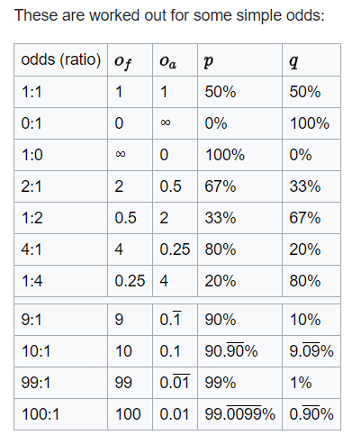
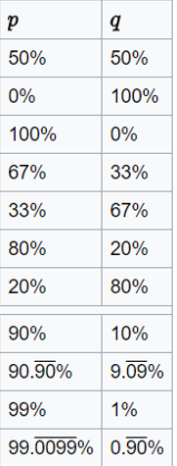
TRANSFORMING LINEAR REGRESSION
Odds represent the likelihood that an event will take place.
What would be the odds for an event will a p = 0.75?
What about the odds for something with a p = 0.40?

Slide 22
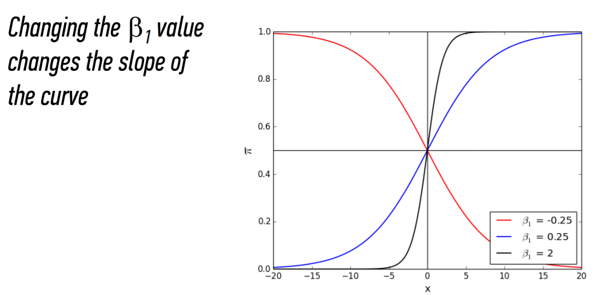


TRANSFORMING LINEAR REGRESSION
The bigger the
the steeper the curve
The smaller the more gradual the curve

Slide 23
GUIDED PRACTICE
NEVER
TELL ME THE ODDS

Slide 24
ACTIVITY: NEVER TELL ME THE ODDS
ANSWER THE FOLLOWING QUESTIONS
EXERCISE
Given a standard deck of cards, calculate the probability and odds of obtaining the following cards
The 2 of clubs
Any diamond card
A face card (any J, Q, K)
What do each of these measures tell you about how likelihood of each scenario?

Slide 25
INDEPENDENT PRACTICE
MULTICLASS
LOGISTIC REGRESSION

Slide 26
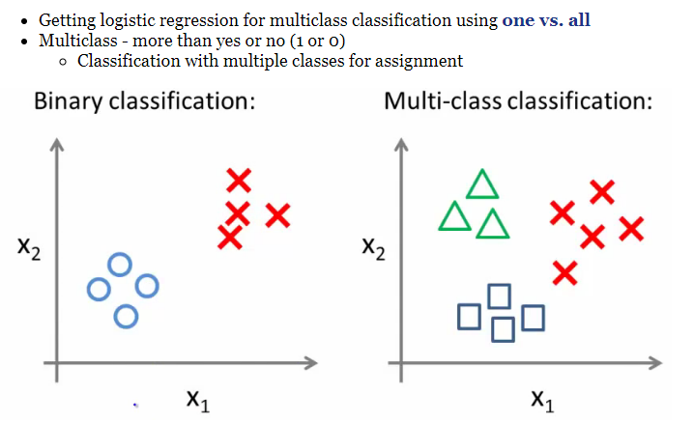
MULTICLASS LOGISTIC REGRESSION

Slide 27
MULTICLASS LOGISTIC REGRESSION
One vs. all classification
Split the training set into three separate binary classification problems
X2
X2
X2
X1
Circle vs. everything else (squares and triangles)
Squares vs. everything else (circles and triangles)
Squares vs. everything else (circles and triangles)

Slide 28
MULTICLASS LOGISTIC REGRESSION
Overall
Train a logistic regression classifier for each class, i.
Make predictions based on which ever model outputs the highest probability for y=1
X2
X1

Slide 29

KNOWLEDGE CHECK
DIRECTIONS (5 minutes)
Suppose we’re trying to predict whether a widget is defective based on its manufacturing time in hours, x₁ , and number of dongles, x₂. We run a Logistic Regression (where a “1” means the widget is defective and “0” means it is not defective) on a dataset and get the following sigmoid function:
What’s the probability of a defective dongle when the manufacturing time is 2 hours and there are 5 dongles?
What happens to the odds of a widget being defective as we increase the number of dongles by 1 unit?
What happens to the odds of a widget being defective as we increase the manufacturing time by 1 unit?
EXERCISE

Slide 30
INTRODUCTION
GRADIENT DESCENT

Slide 31
GRADIENT DESCENT
Intuition: how do we find the decision boundary that best separates our two classes?
AKA what are the coefficients for the linear boundary?
We want to build a decision boundary that best divides the two classes. There are two ways we can think of this:
We fit a line such that we minimize the sum of the residuals between the true label and the “strength” (aka probability) of our guess.
(2) We optimize the probabilities
We make our probabilities as large as possible when y = 1.
We make our probabilities as small as possible when y = 0.
Y
Y = -2.5x + 30
Y = -2.3x + 20
Y = -3x + 40
X

Slide 32
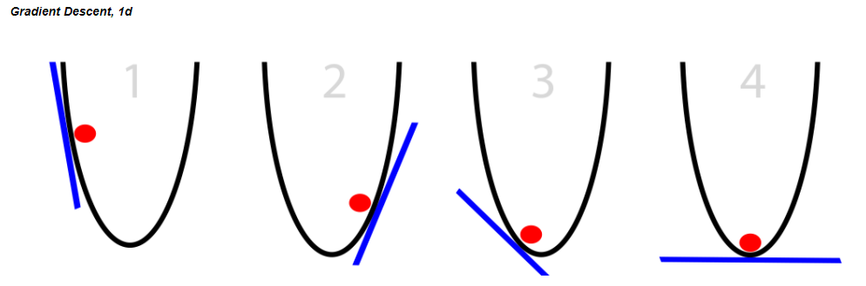
GRADIENT DESCENT
Gradient Descent is an iterative process that we use to pick our decision boundary
You can see it as almost a guess and check – do these sets of coefficients minimize the error between my guess and the true point? If no, then keep looking for better coefficients. If yes, then stop!
The y-axis represents the residuals AKA the cost function, and the x-axis represents our parameters for the decision boundary
Notice how there is only one point that minimizes the cost function

Slide 33
GRADIENT DESCENT
A random linear solution is provided as a starting point (usually a "flat" line or solution)
The solver then attempts to find a next step: we take a step in any direction and measure each performance.
If the solver finds a better solution (optimizing toward a metric such as mean squared error), this is the new starting point.
Repeat these steps until the performance is optimized and no "next steps" perform better. The size of the steps will shrink over time.
Because we’ve minimized the residuals at this point, the set of parameters we use to define our decision boundary are here!

Slide 34
LOGISTIC REGRESSION
Advantages of logistic regression
Highly interpretable (if you remember how)
Model training and prediction are fast
No tuning is required (excluding regularization)
Features don't need scaling
Can perform well with a small number of observations
Outputs well-calibrated predicted probabilities
Disadvantages of logistic regression
Presumes a linear relationship between the features and the log-odds of the response
Performance is (generally) not competitive with the best supervised learning methods
Can't automatically learn feature interactions

Slide 35
INTRODUCTION
QUESTIONS

Slide 36
INTRODUCTION
EXERCISE:
PREDICTING DEFAULT

Slide 37
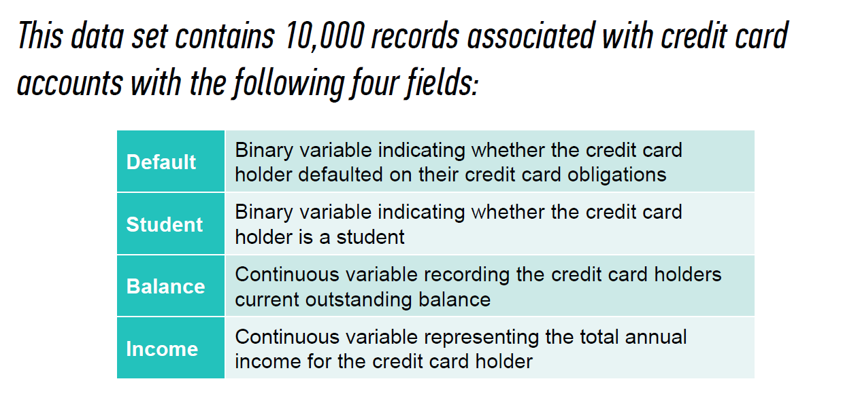
EXERCISE

Slide 38
CONCLUSION
TOPIC REVIEW

Slide 39
REVIEW QUESTIONS
What’s the link function is used in logistic regression?
What criteria do we use to create our decision boundary?
What do the coefficients in a logistic regression represent? How does the interpretation differ from ordinary least squares? How is it similar?
How do we implement a multivariate logistic regression?
How does True Positive Rate and False Positive Rate help explain accuracy?

Slide 40
LESSON
EXIT TICKET

