Slide 1
DATABASES
(and the cloud!)

Slide 2
DATABASES
LEARNING OBJECTIVES
Understanding of the uses and differences of databases
Accessing databases from Pandas
Broad understanding Cloud Platforms
Big Data Concepts

Slide 3
COURSE
PRE-WORK

Slide 4
PRE-WORK REVIEW
There will be multiple ways to run the exercises:
Using Postgres Exercises
Setting up local Postgres
Install Postgres. If brew is installed, this should be as simple as brew install postgres
Use Wagon
Create an account at https://www.wagonhq.com/ and download the software.

Slide 5
OPENING
DATABASES

Slide 6
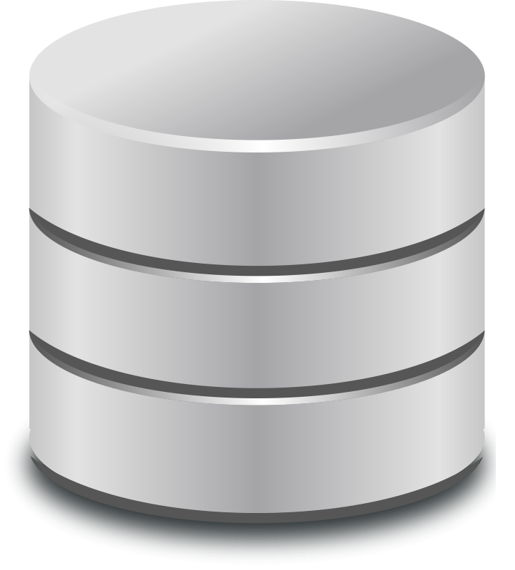
DATABASES
Today’s lesson will be on databases and the SQL query language.
Databases are the standard solution for data storage. They’re far more robust than text and CSV files.
They come in many flavors, but we’ll explore the most common: relational databases.

Slide 7
DATABASES
Relational databases also come in different varieties, but almost all use SQL as a basis for querying (i.e. retrieving) data.
Most analyses typically involve pulling data from a database.

Slide 8
INTRODUCTION
DATABASES

Slide 9
DATABASES
Databases are computer systems that manage the storage and querying of datasets.
They provide a way to organize the data on disk (i.e. hard drive) and efficient methods to retrieve information. Databases allow a user to create rules that ensure proper data management and verification.
Typically, retrieval is performed using a query language, a mini programming language with a few basic operators for data transformation.
The most common query language is SQL (Structured Query Language).

Slide 10
DATABASES
A relational database is based on links between data entities or concepts.
Typically, a relational databases is organized into tables.
Each table should correspond to one entity or concept. Each table is similar to a single CSV file or Pandas dataframe.
For example, consider an application like Twitter. Our two main entities are Users and Tweets. For each of these, we would have a separate table.

Slide 11
DATABASES
A table is made up of rows and columns, similar to a Pandas dataframe or Excel spreadsheet.
Each table has a specific schema, a set of rules for what goes in each table. These specify which columns are contained in the table and what type of data is in each column (e.g. text, integers, decimals, etc).
Users Table Schema
user_id | char
user_sign_up_date | date
user_follower_count | int

Slide 12
DATABASES
This means you can’t add text data to an integer column in that database.
The additional type information make this constraint stronger than the header of a CSV file.
For this reason and many others, databases allow for stronger consistency of the data and are often a better solution for data storage.

Slide 13
DATABASES
Each table typically has a primary key column. This column has a unique value per row and serves as the identifier for the row.
A table can have many foreign keys as well. A foreign key is a column that contains values to link the table to the other tables.
These keys that link the table together define the relational database.

Slide 14
DATABASES
For example, the tweets table may have as columns:
tweet_id - the primary key tweet identifier
tweet_text
user_id - a foreign key to the users table
Users Table Schema
user_id | char
user_sign_up_date | date
user_follower_count | int
Tweets Table Schema
tweet_id | int
tweet_text | char
user_id | int

Slide 15
DATABASES
MySQL and Postgres are popular variants of relational databases and are widely used. Both are open-source and available for free.
Alternatively, many companies use proprietary software such as Oracle or Microsoft SQL databases.
While these databases offer many of the same features and use the same SQL language, the latter two offer some maintenance features and support that large companies find useful.

Slide 16
NORMALIZED VS DENORMALIZED DATA
Once we start organizing our data into tables, we start to separate it into normalized and denormalized setups.
Normalized structures have a single table per entity and use many foreign keys or link tables to connect the entities.
Denormalized structures have fewer tables that combine different entities.

Slide 17
NORMALIZED VS DENORMALIZED DATA
With our Twitter example, a normalized structure would place users and tweets in different tables.
Users Table Schema
user_id | char
user_sign_up_date | date
user_follower_count | int
Tweets Table Schema
tweet_id | int
tweet_text | char
user_id | int

Slide 18
NORMALIZED VS DENORMALIZED DATA
A denormalized structure would put them both in one table.
Twitter Table Schema
tweet_id | int
tweet_text | char
user_id | int
user_sign_up_date | date
user_follower_count | int

Slide 19
NORMALIZED VS DENORMALIZED DATA
Denormalized structures:
Duplicates a lot of information
Makes data easy to access since it’s all in one table
Normalized structures:
Save storage space by separating information
Requires joining of table to access information about two different entities, a slow operation

Slide 20
ALTERNATIVE DATABASES
While relational databases are the most popular and broadly used, specific applications may require different data organization.
You don’t need to know every variety, but it’s good to know some overall themes.

Slide 21
KEY-VALUE STORES
Key-Value databases are nothing more than very large and very fast hashmaps or dictionaries.
These are useful for storing key based data, e.g. a count of things per user or customer, a last visit per customer.
Every entry in these databases has two values, a key and a value. We can retrieve any value based upon its key.

Slide 22
KEY-VALUE STORES
This is exactly like a python dictionary, but it can be larger than your memory (i.e. RAM). So these systems use smart caching algorithms to ensure frequently or recently accessed items are quickly accessible.
Popular key-value stores include Cassandra and MemcacheDB (pronounced mem-cash-dee-bee).

Slide 23
NOSQL OR DOCUMENT DATABASES
“NoSQL” databases are those that don’t rely on a traditional relational table setup and more flexible in their data organization.
Typically they actually do have SQL querying abilities but model their data differently.

Slide 24
NOSQL OR DOCUMENT DATABASES
Relational Structure
NoSQL Data Structure
user_id | user_name | user_hobby_1 | user_hobby_2 | user_age
13123 | robby_g | guitar | cars | 25
18423 | jt1235 | football |  | 31
{
“user_id”: 13123,
“user_name”: “robby_g”,
“user_hobbies”: [“guitar”, “cars”],
“user_age”: 25
}
{
“user_id”: 18423,
“user_name”: “jt1235”,
“user_hobbies”: [“football”],
“user_age”: 31
}

Slide 25
NOSQL OR DOCUMENT DATABASES
They may organize data on an entity level, but often have denormalized and nested data setups.
This nested data layout is often similar to that in JSON documents.
Popular databases include MongoDB and CouchDB.

Slide 26
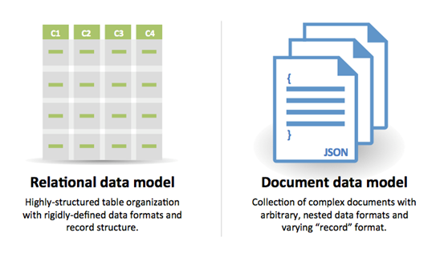
NOSQL OR DOCUMENT DATABASES

Slide 27
NOSQL OR DOCUMENT DATABASES
The following is an example of the storage document for a tweet.
{
"created_at": "Mon Sep 24 03:35:21 +0000 2012",
"id_str": "250075927172759552",
"entities": {
"hashtags": [
{
"text": "freebandnames",
"indices": [
20,
34
]
}
],
"user_mentions": [
]
}
}

Slide 28

ACTIVITY: KNOWLEDGE CHECK
In the following examples, which might be the best storage or database solution? Why?
An application where a user can create a profile
An online store
Storing the last visit date of a user
ANSWER THE FOLLOWING QUESTIONS
EXERCISE
DELIVERABLE
Answers to the above questions

Slide 29
ACTIVITY: KNOWLEDGE CHECK
ANSWER THE FOLLOWING QUESTIONS
EXERCISE
Consider a dataset from Uber with the following fields:
In a group, discuss how you would design a relational database to support this data? List the tables you would create, the fields they would contain, and how they would link to other tables.
User ID
User Name
Driver ID
Drive Name
Ride ID
Ride Time
Pickup Latitude
Pickup Longitude
Pickup Location Entity
Dropoff Longitude
Dropoff Latitude
Dropoff Location Entity
Miles
Travel Time
Fare
CC Number
DELIVERABLE
Your database schema design

Slide 30
DEMO
ACCESSING DATABASES FROM PANDAS

Slide 31
ACCESSING DATABASES FROM PANDAS
While databases provide many analytical capabilities, often it’s useful to pull the data back into Python for more flexible programming.
Large, fixed operations would be more efficient in a database, but Pandas allows for interactive processing.
For example, if you just want to aggregate login or sales data to present a report or dashboard, this operation is operating on a large dataset and not often changing.
This would run very efficiently in a database vs connecting to Python.

Slide 32
ACCESSING DATABASES FROM PANDAS
However, if we want to investigate the login or sales data further and ask more interactive questions, then using Python would come in very handy.
import pandas as pd from pandas.io import sql
Pandas can be used to connect to most relational databases.

Slide 33
ACCESSING DATABASES FROM PANDAS
In this demonstration, we will create and connect to a SQLite database. SQLite creates portable relational databases saved in a single file.
These databases are stored in a very efficient manner and allow fast querying, making them ideal for small databases or databases that need to be moved across machines.
Additionally, SQLite databases can be created with the setup of MySQL or Postgres databases.

Slide 34
ACCESSING DATABASES FROM PANDAS
We can create a SQLite databases as follows.
import sqlite3 conn = sqlite3.connect('dat-test.db')
This creates a file, dat-test.db, which will act as a relational/SQL database.

Slide 35
WRITING DATA INTO A DATABASE
Data in Pandas can be loaded into a relational database. For the most part, Pandas can use the databases column information to infer the schema for the table it creates.
Let’s return to the Rossmann sales data and load it into our database.
import pandas as pd data = pd.read_csv('../../../lesson-15/assets/dataset/rossmann.csv', low_memory=False) data.head()

Slide 36
WRITING DATA INTO A DATABASE
Data is moved to the database with the to_sql command, similar to the to_csv command.
to_sql takes several arguments.
name - the table name to create
con - a connection to a database
index - whether to input the index column
schema - if we want to write a custom schema for the new table
if_exists - what to do if the table already exists. We can overwrite it, add to it, or fail

Slide 37
WRITING DATA INTO A DATABASE
The following code loads the Rossmann sales data to our database.
data.to_sql('rossmann_sales', con=conn, if_exists='replace', index=False)

Slide 38
READING FROM A DATABASE
If we already have data in the database, we can use Pandas to query our database.
Querying is done through the read_sql command in the sql module.
import pandas as pd from pandas.io import sql sql.read_sql('select * from rossmann_sales limit 10', con=conn)
This runs the query passed in and returns a dataframe with the results.

Slide 39
ACTIVITY: KNOWLEDGE CHECK
ANSWER THE FOLLOWING QUESTIONS
EXERCISE
Load the Rossmann Store metadata in rossmann-stores.csv and create a table in the database with it.
DELIVERABLE
Created table for store metadata

Slide 40
DEMO
SQL SYNTAX: SELECT, WHERE, GROUP BY, JOIN

Slide 41
SQL OPERATORS: SELECT
Every query should start with SELECT. SELECT is followed by the names of the columns in the output.
SELECT is always paired with FROM, which identifies the table to retrieve data from.
SELECT <columns> FROM <table>
SELECT * denotes returning all of the columns.

Slide 42
SQL OPERATORS: SELECT
Rossmann Stores example:
SELECT Store, Sales FROM rossmann_sales;

Slide 43
ACTIVITY: KNOWLEDGE CHECK
ANSWER THE FOLLOWING QUESTIONS
EXERCISE
Write a query for the Rossmann Sales data that returns Store, Date, and Customers.
DELIVERABLE
The requested query

Slide 44
SQL OPERATORS: WHERE
WHERE is used to filter a table using a specific criteria. The WHERE clause follows the FROM clause.
SELECT <columns> FROM <table> WHERE <condition>
The condition is some filter applied to the rows, where rows that match the condition will be output.

Slide 45
SQL OPERATORS: WHERE
Rossmann Stores example:
SELECT Store, Sales FROM rossmann_sales WHERE Store = 1;
SELECT Store, Sales FROM rossmann_sales WHERE Store = 1 and Open = 1;

Slide 46
ACTIVITY: KNOWLEDGE CHECK
ANSWER THE FOLLOWING QUESTIONS
EXERCISE
Write a query for the Rossmann Sales data that returns Store, Date, and Customers for stores that were open and running a promotion.
DELIVERABLE
The requested query

Slide 47
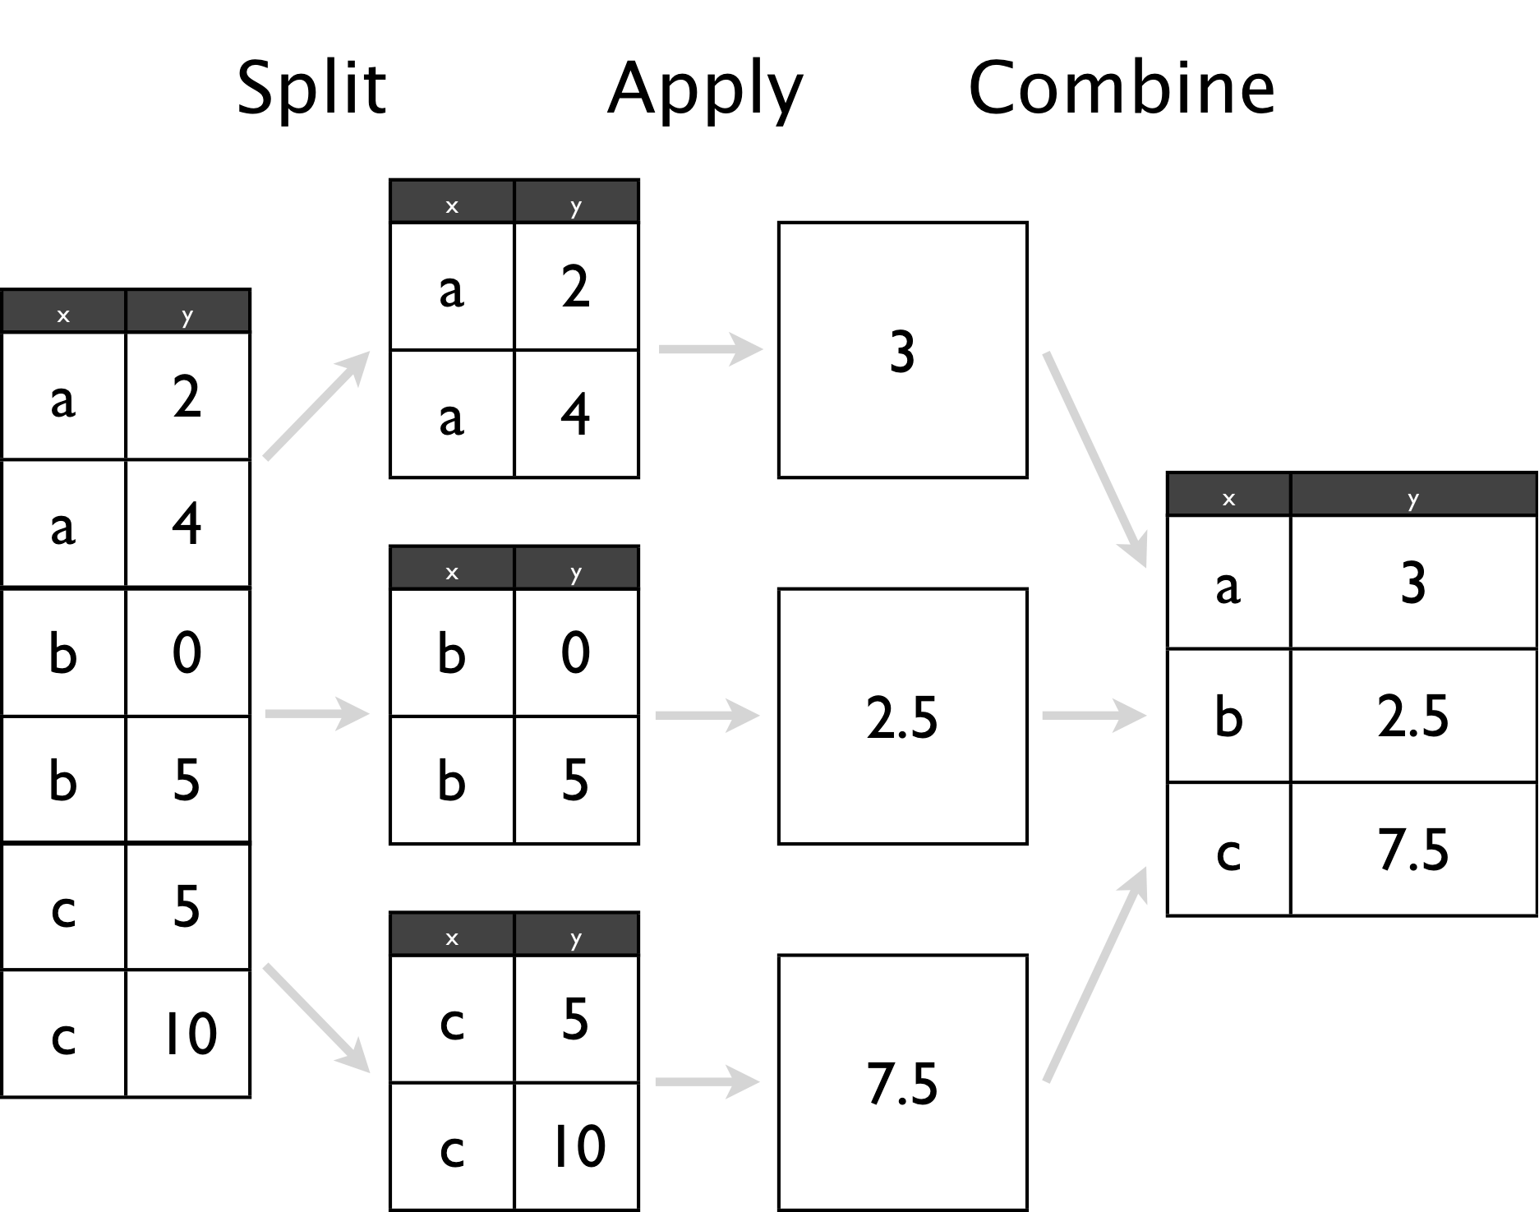
SQL OPERATORS: GROUP BY
GROUP BY allows us to aggregate over any field in the table by applying the concept of Split Apply Combine.
We identify some key with which we want to segment the rows. Then, we roll up or compute some statistics over all of the rows that match that key.

Slide 48
SQL OPERATORS: GROUP BY
GROUP BY must be paired with an aggregate function, the statistic we want to compute in the rows, in the SELECT statement.
COUNT(*) denotes counting up all of the rows. Other aggregate functions commonly available are AVG (average), MAX, MIN, and SUM.
If we want to aggregate over the entire table, without results specific to any key, we can use an aggregate function in the SELECT clause and ignore the GROUP BY clause.

Slide 49
SQL OPERATORS: GROUP BY
Rossmann Stores example:
SELECT Store, SUM(Sales), AVG(Customers) FROM rossmann_sales GROUP BY Store WHERE Open = 1;

Slide 50
ACTIVITY: KNOWLEDGE CHECK
ANSWER THE FOLLOWING QUESTIONS
EXERCISE
Write a query that returns the total sales on the promotion and non-promotion days.
DELIVERABLE
The requested query

Slide 51
SQL OPERATORS: ORDER BY
ORDER BY is used to sort the results of a query.
SELECT <columns> FROM <table> WHERE <condition>
ORDER BY <columns>
You can order by multiple columns in ascending (ASC) or descending (DESC) order.

Slide 52
SQL OPERATORS: ORDER BY
Rossmann Stores example:
SELECT Store, SUM(Sales) as total_sales, AVG(Customers) FROM rossmann_sales GROUP BY Store WHERE Open = 1; ORDER BY total_sales desc;
COUNT(*) AS cnt renames the COUNT(*) value to cnt so we can refer to it later in the ORDER BY clause.

Slide 53
SQL OPERATORS: JOIN
JOIN allows us to access data across many tables. We specify how a row in one table links to another.
SELECT a.Store, a.Sales, s.CompetitionDistance FROM rossmann_sales a JOIN rossmann_stores s
ON a.Store = s.Store
Here, ON denotes an inner join.

Slide 54
SQL OPERATORS: JOIN
By default, most joins are an Inner Join, which means only when there is a match in both tables does a row appear in the results.
If we want to keep the rows of one table even if there is no matching counterpart, we can perform an Outer Join.
Outer joins can be LEFT, RIGHT, or FULL, meaning keep all of the left rows, all the right rows, or all the rows, respectively.

Slide 55

SQL OPERATORS: JOIN

Slide 56
INDEPENDENT PRACTICE
PANDAS AND SQL

Slide 57
ACTIVITY: PANDAS AND SQL
DIRECTIONS (40 minutes)
EXERCISE
Load the Walmart sales and store features data.
Create a table for each of those datasets.
Select the store, date and fuel price on days it was over 90 degrees.
Select the store, date and weekly sales and temperature.
What were average sales on holiday vs. non-holiday sales?
What were average sales on holiday vs. non-holiday sales when the temperature was below 32 degrees?
DELIVERABLE
Answers to the above questions

Slide 58
CONCLUSION
While this was a brief introduction, databases are often at the core of any data analysis. Most analysis starts with retrieving data from a database.
SQL is a key language that any data scientist should understand.
SELECT: Used in every query to define the resulting columns
WHERE: Filters rows based on a given condition
GROUP BY: Groups rows for aggregation
JOIN: Combines two tables based upon a given condition

Slide 59
CONCLUSION
Pandas can be used to access data from databases as well. The result of the queries will end up in a Pandas dataframe.
There is much more to learn about query optimization if one dives further!

Slide 60
SYSTEMS:
INFRASTRUCTURE

Slide 61
CONCLUSION
Pandas can be used to access data from databases as well. The result of the queries will end up in a Pandas dataframe.
There is much more to learn about query optimization if one dives further!

Slide 62
DATA SOURCES (SO FAR)
We’ve talked about a few types of databases:
Relational (SQL)
Document Store (NoSQL)
Key-Value
But where are those servers?

Slide 63
SERVER LOCATIONS
Three general options:
Local
On your machine (what we did today)
On Premises (“on-prem”)
Hosted in physical servers you own (generally)
Cloud
AWS, Azure, Google Cloud, Digital Ocean

Slide 64
ON-PREM
The original solution.
Expensive
Hardware, Software Licenses, Support Staff, Security
Decreasingly popular as cloud gets better
What advantages / use cases are there for on-prem?

Slide 65
VMs, PaaS, and SaaS
CLOUD INFRASTRUCTURE

Slide 66
CLOUD HOSTING OPTIONS
VMs
Rented by the hour (sometimes pro-rated)
Pay for:
More Memory
More CPU
More Storage
Availability
Add-ons (GPUs?)
Platform/Software as a Service
Performance as a feature
Pay for use
Subscription/Fee model
Low-maintenance

Slide 67

CLOUD SERVICE PROVIDERS
https://aguruit.wordpress.com/2017/01/19/cloud-compare-aws-vs-azure-vs-google/

Slide 68
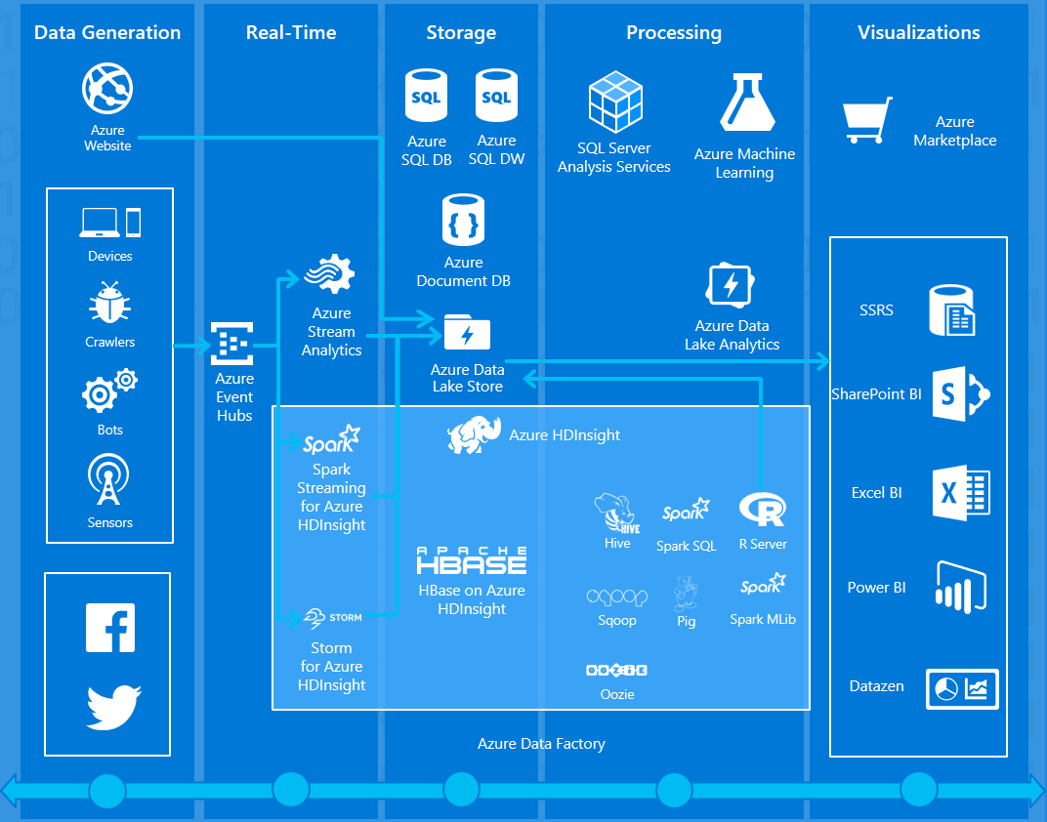
MIX AND MATCH
Cloud workflows might comprise several VM and PaaS/SaaS components
AWS/Azure/GCE do their best to provide everything you would want within their ecosystems

Slide 69
STORAGE
No Database? No Problem
‘Bucket’ Storage
S3
Azure Blob
Google Cloud Storage
Like your own, private, more complicated GoogleDrive/OneDrive/Dropbox

Slide 70
ENTERPRISE DATA
Some names you might come across:
SAP HANA
Oracle DB
BusinessObjects
Hyperion
IBM DB2

Slide 71

Hadoop, MapReduce, & Spark
Apache Hadoop is an opensource framework for:
“Big Data”
Distributed processing
Large-scale analytics
Storage
Has become synonymous with:
MapReduce process
HDFS (Hadoop Distributed File System)

Slide 72
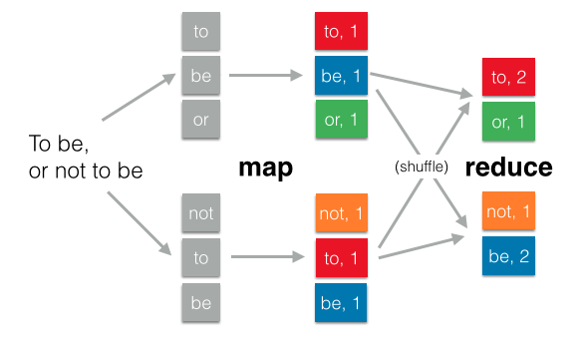
Map Reduce
Process for performing an operation across large data sources that are located across files/machines/locations/etc.
Map <SPACE!> Reduce = Idea
MapReduce (no space) = Google Tech

Slide 73
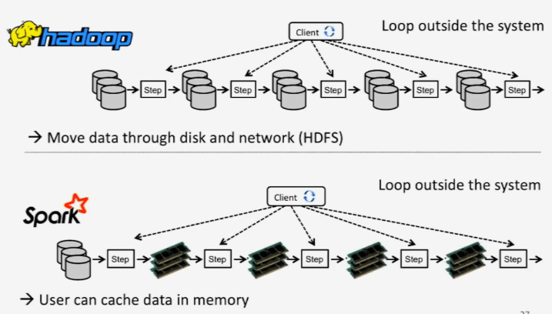
Spark
Faster than Hadoop MR
Uses memory instead of disk writes
ITERATES IN MEMORY
Master/Slave setups
Flexibility

Slide 74
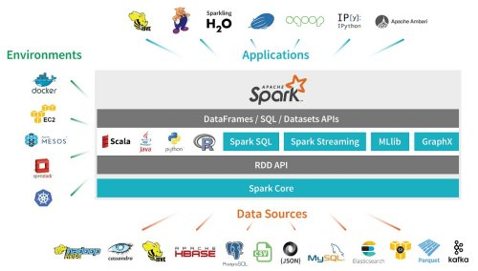
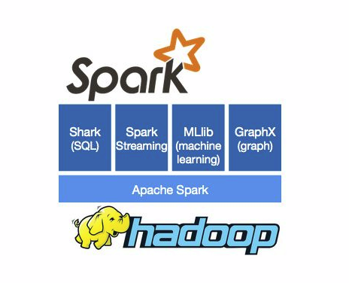
All Together Now

