Slide 2
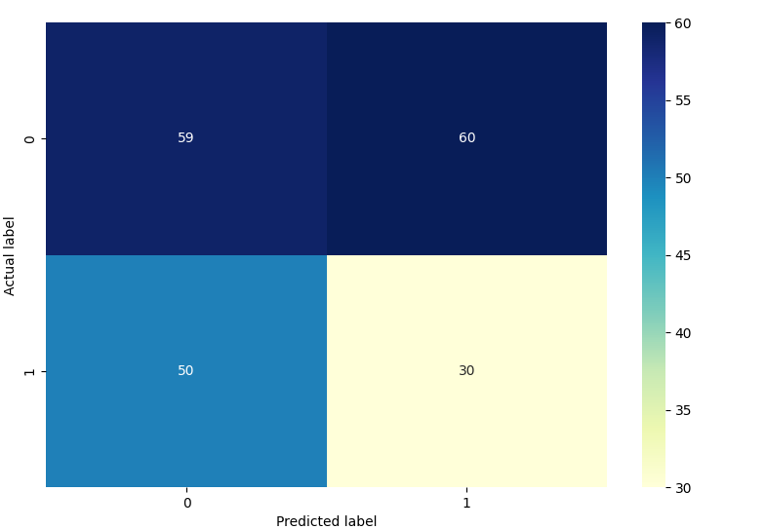
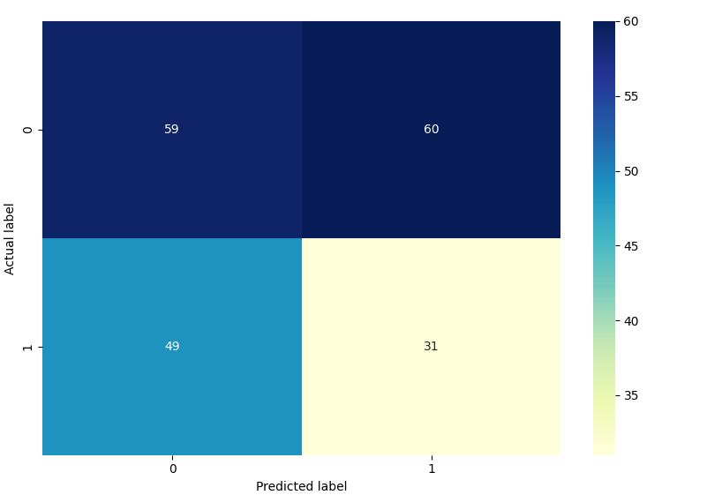
Logistic Regression
Full dataset (~1000 events) with Binary Classification
Standardized using mean and scaling to unit variance
Inconclusive optimal C search with little success using Logistic Regression
Conducted both with and without a Regularizer (L2 Norm)

Slide 3
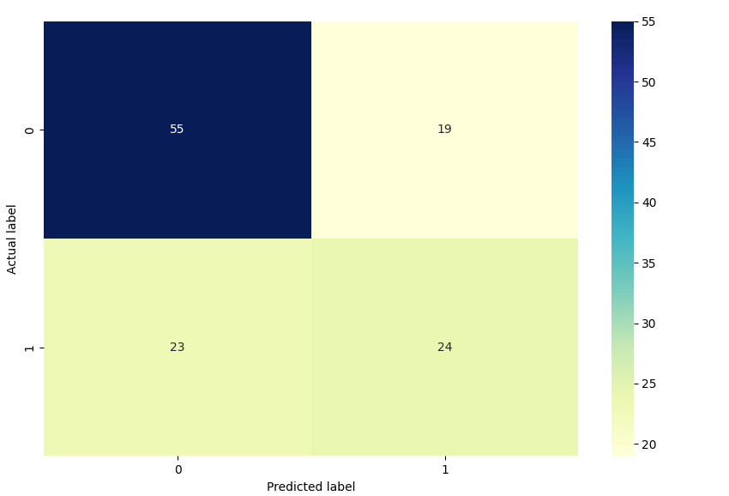
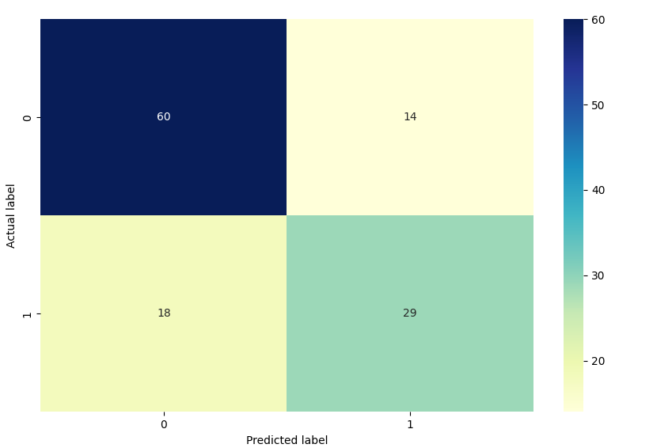
Logistic Regression
Full dataset (~600 events) with Binary Classification, with additional features such as win streaks.
Standardized using mean and scaling to unit variance
Optimal C of ~0.03 with Train/Test Error 0.33/0.37, Overall score of 0.70 after validation of C
L2 Regularizer
Adding in B365 data increased score to 0.73

Slide 4
PCA
PCA with B365 Bookeeper odds became the top principal component at 0.16 of the explained variance, with the next highest principal component of 0.10.
'B365A', 'chanceCreationPassing', 'defencePressureClass', 'HomeTeamWinStreak', 'defenceTeamWidthClass', 'AST', 'buildUpPlayDribblingClass', 'AwayTeamDrawStreak', 'HomeTeamDrawStreak', 'buildUpPlaySpeed', 'chanceCreationShootingClass', 'buildUpPlaySpeedClass', 'chanceCreationCrossingClass', 'AwayTeamWinStreak'

