Slide 1

OA Internship .NET Project
Austin Li

Slide 2


01
What I created

Slide 3
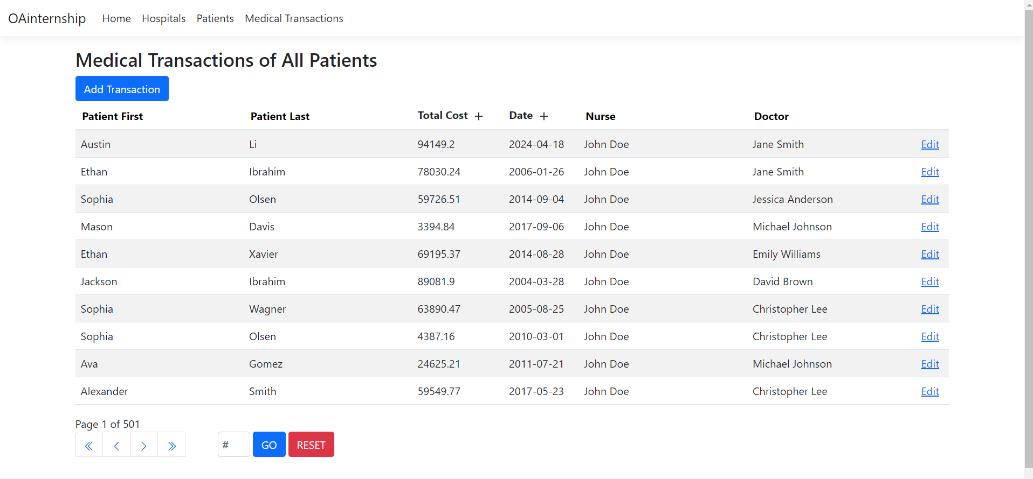
Medical Transactions table of my website

Slide 4

Database with backend and frontend integration
Cross table referencing
Filtering
Paging
Editing functionality
Adding functionality
What I Incorporated:

Slide 5


02
What I Learned

Slide 6

Technologies I Learned
The Visual Studio development environment
Database first approach
MVC and CRUD
C#
MSSQL

Slide 7

Work Skills I Gained
Setting up my Linkedin
Scheduling Weekly Meetings
Time management
Communication
Working Smarter not Harder

Slide 8

Challenges Faced
Visual Studio Environment
Database integration with models
Time management
Being Innovative

Slide 9
03
Going Forward

Slide 10
04
THANKS FOR LISTENING!

