Slide 1


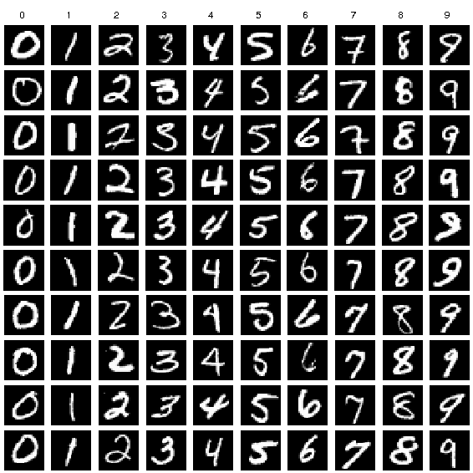
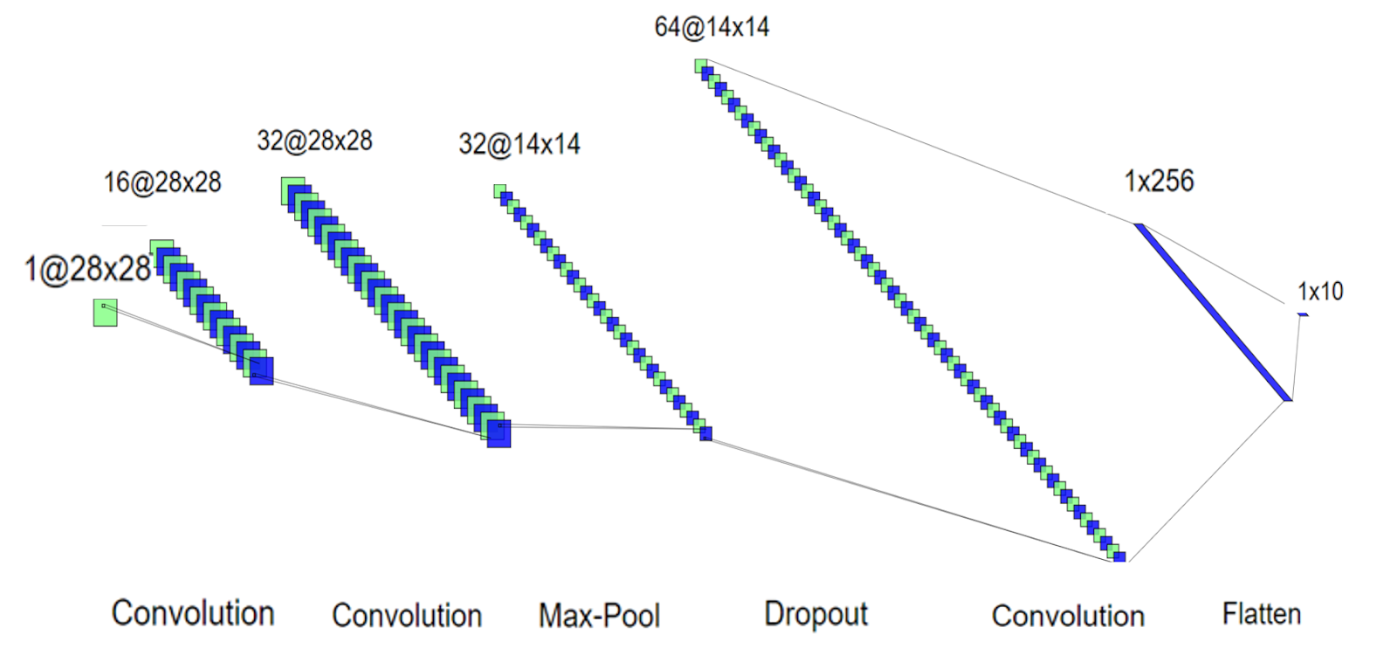
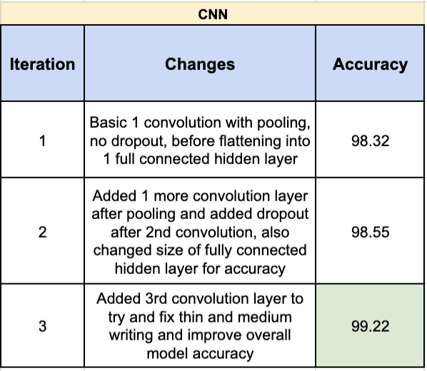
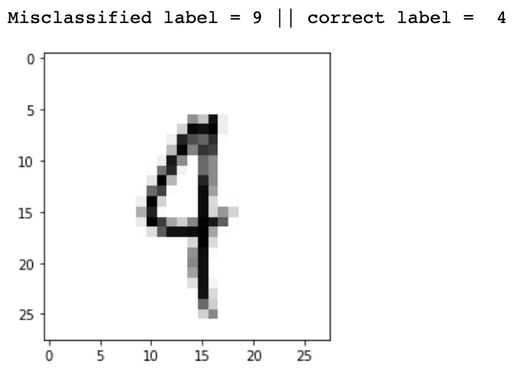
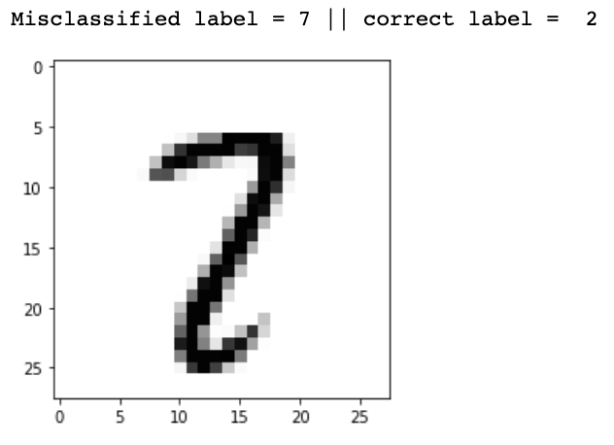
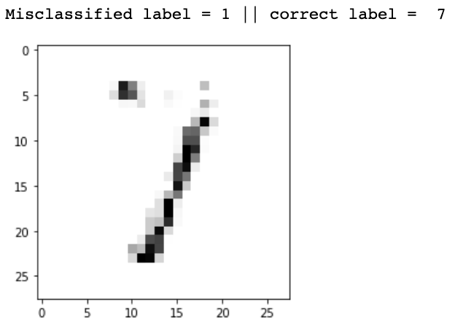
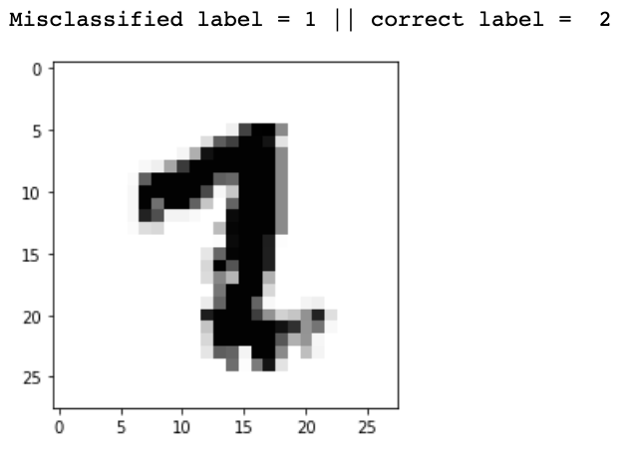
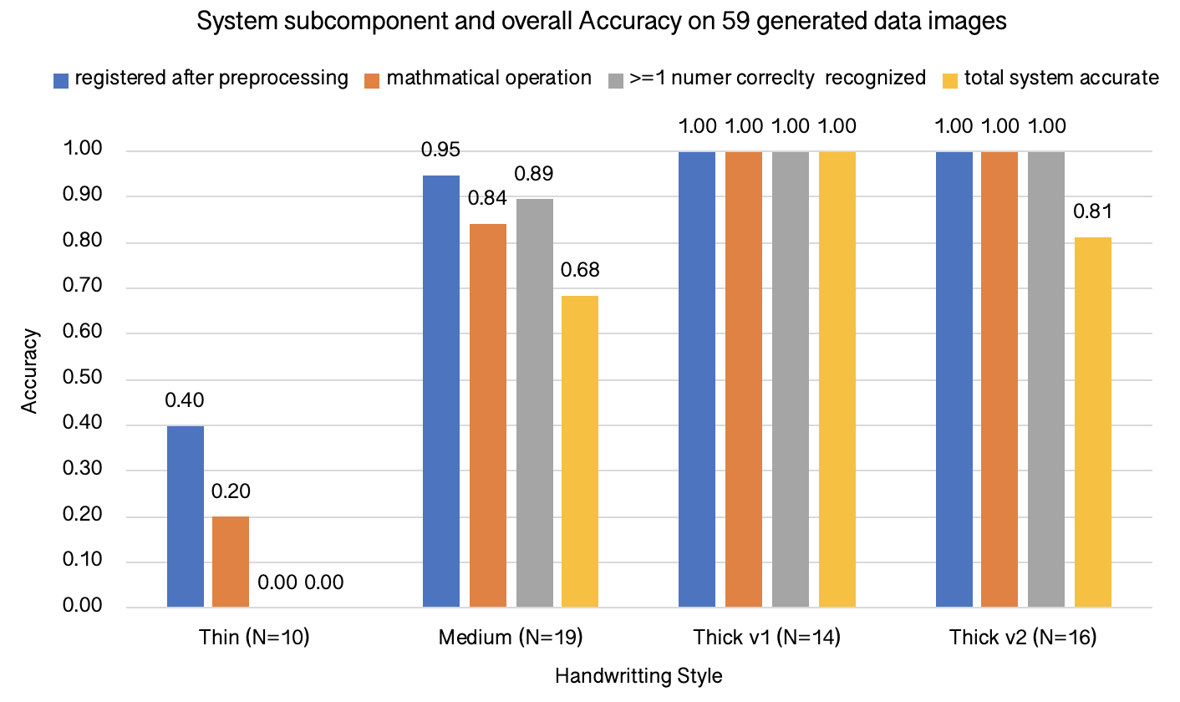
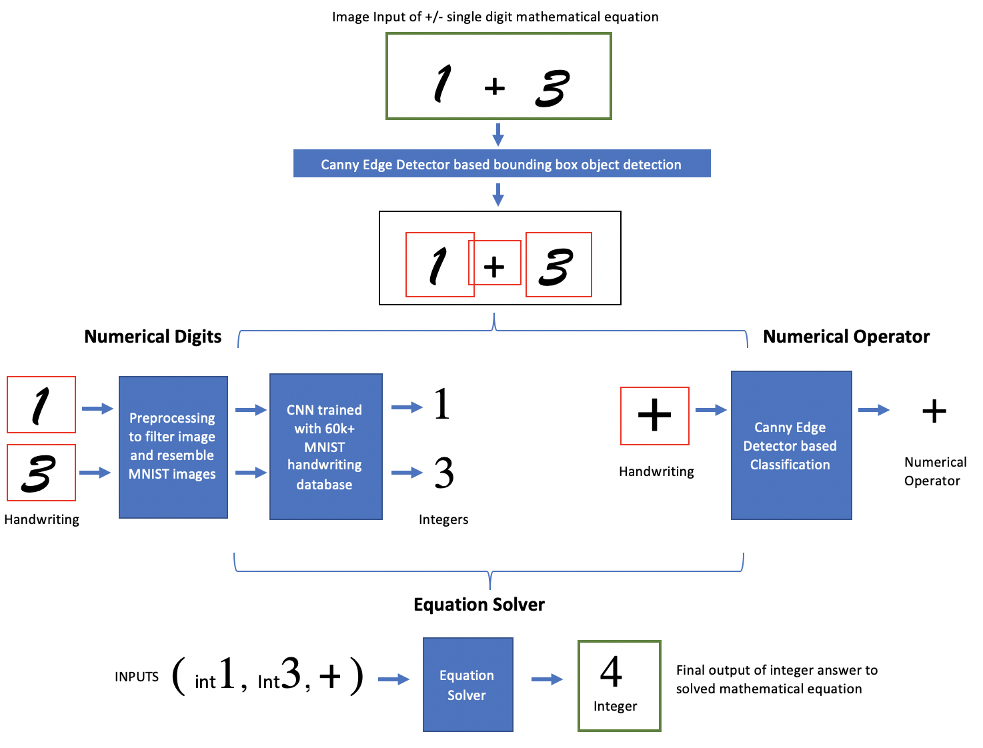
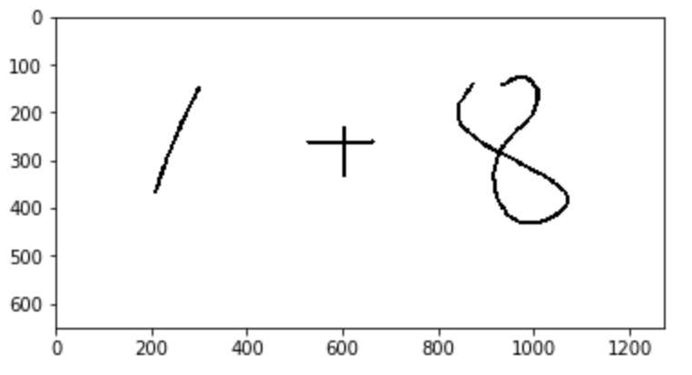
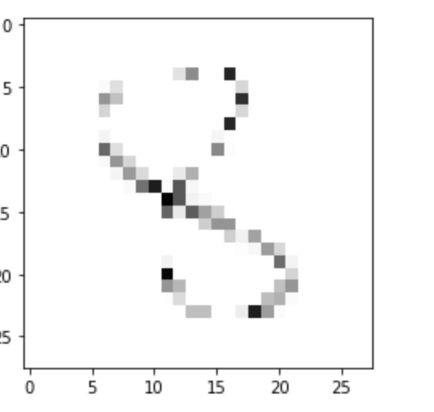
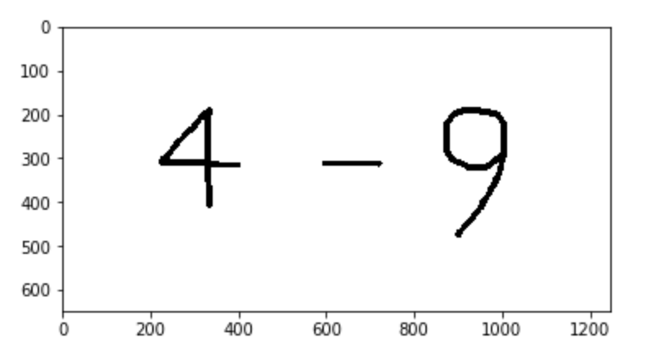
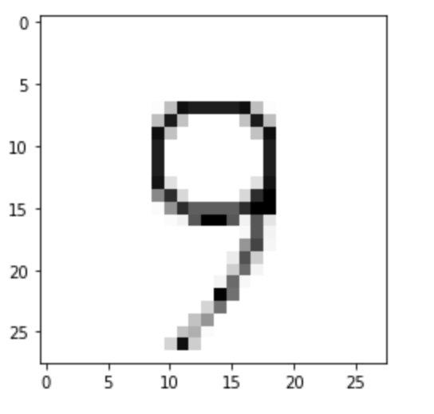
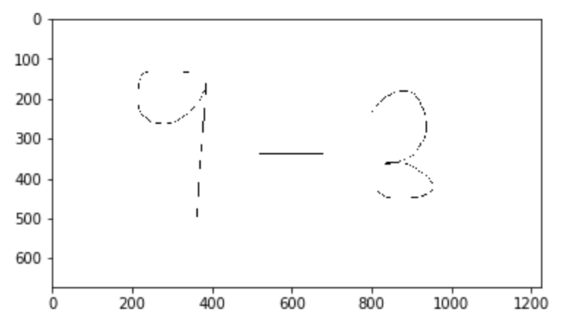
Creating a Handwritten Equation Solver System using CNNs and Canny Edge Detection
Preeti Iyer, Matthew Hetrick, Austin Mejia, Princeton University, Department of Computer Science, Princeton, NJ | COS 429
ABSTRACT
CNN & RESULTS
As an interesting application of object detection, image classification, and neural networks our team sought to develop a handwritten-equation solver. This system was three-fold: first, a means to identify and isolate number and mathematical symbols as distinct elements; second, a network that can accurately label said elements; and third, a logical process to compute the given equation. The model ultimately developed utilizes a modified Canny Edge Detection in combination with a CNN to process input.
Testing reveals that the model was able to yield varying accuracies for different types of inputs. Elements were isolated near perfect accuracy after preprocessing, with labeling reaching close to 100 % accuracy. Continued work would increase the complexity of recognized symbols and allow for more elements in the input.
We built a CNN using the MNIST database of handwriting images which includes 60K training images and 10K testing images from American Census Bureau employees and American high school students. The data preparation (advised by the official MNIST documentation) included grey-scaling, normalizing, and re-scaling the image. Our model was built using the Keras API and TensorFlow for the backend. We experimented with different 3 architectures , iterating to get more accurate results (see Figure X) and ultimately chose the one shown in the Figure X.
BACKGROUND AND RELEVANT WORK
Handwriting recognition has been booming in recent years. With new tablets and smart pens coming out every year, programs that interpret writing are becoming ubiquitous in modern technology. Moreover, predictive and assistive handwriting interpreters hold much promise for a variety of applications including disability assistance and IoT notebook incorporation. Therefore, we were seeking to design a product that would be able to fit into this burgeoning milieu.
We realized that there are many handwriting recognizers, such as MyScript and WIRIS, that recognize mathematical handwriting but none can solve equations on the level of a WolframAlpha or SymboLab. We thought it would be exciting to try and fit into that space in which a program can combine mathematical logic with handwriting recognition to solve an equation.
We referenced the MNIST database, a collection of over 60K images of various handwriting, to help us inform the architecture of our pipeline, preprocessing methodologies, and approach.
After refining our CNN, we got an accuracy over 99% which we thought was robust enough to then be adapted to our own data (see below). We sought to further understand the < 1% of images which were being misclassified, and found that once processed a lot of these images resembled structure that had important features of the numbers they were incorrectly classified as – such as a 2 that had a short bottom line and resembled a 7, a 4 which had a seemingly circular top that looked more like a 9, and so on. In general most of these cases were a result of extremely thin or messy handwriting or numbers that had disjoint elements and threw off the network, something we kept in mind as we proceeded. Some misclassification examples are shown to the right
SYSTEM OVERVIEW
OVERALL SYSTEM RESULTS & CONCLUSION
Below is a high level understanding of our system which inputs a picture of a handwritten mathematical equation and outputs an integer answer.
OVERALL RESULTS:
To evaluate our total system, we had to generate our own data. We generated 59 images of varying handwriting asking our group members and friends to write single digit addition and subtraction equations in varying thicknesses with their dominant and non-dominant hands. We then evaluated our system on a variety of different tiers of accuracy understand the performance of all subparts of our system (whether the system was able to correct detect bounding boxes and was correctly preprocessed (Step one and pre CNN preprocessing), whether it correctly classified the mathematical operation, whether it correctly recognized/classified at least 1 image, and whether the whole pipeline was accurate (all steps to output the correct math answer.
It was seen that the thicker handwritten was best detected by our system , as we found the thin handwritten was often unable to be picked up / processed correctly. Also between the two thick variants v1 was done with dominant hands (more stable /precise) and v2 was done with non-dominant hands; as expected the neater handwriting had higher accuracy.
STEP ONE
STEP TWO
EXAMPLES:
8- Image that was denoted “medium”, clearly not enough dark pixel points for model to use- classified this as a 3
STEP THREE
CONCLUSION:
This equation was denoted “thick” and had the right consistency for accurate classification
By building the full pipeline for a handwriting equation solver we were able to understand many of the challenges involved with this type of image detection / classification. While the MNIST database provided a great dataset for us to build a very accurate CNN, preprocessing our own images to resemble that of the MNIST data was very difficult and with more field research we found papers that question how replicable MNIST handwriting data truly is. By iterating over our preprocessing methods and CNN we were able to make an accurate system for thick and stable handwriting, but found that our system was not ultimately robust to detect all kinds of handwriting.
For the preprocessing we used a methodology similar to the MNIST preprocessing (normalization, shifting by center of mass, resizing, etc.). Our CNN is described in more detail in the following section. The Numerical operator classification used canny edge detection and scale of dimensional ratios to decide if the equation was addition or subtraction.
9-3 too thin and light that after resizing, no images were boxed by our boxing algorithm
We would like to thank the Thomas Jefferson Hospital for the data and initial groundwork for the study and the course staff for giving us the tools and support needed to complete this work.
9-3 too thin and light that after resizing, no images were boxed by our boxing algorithm

