Slide 1

Some More C++ Basics
Adam Sweeney
Engineering Educator, EECS
Fall 2017

Slide 2

Introduction
Finish Chapter 2 of textbook
First homework assigned

Slide 3

Agenda
Flow of Control
Program Style

Slide 4
FLOW OF CONTROL

Slide 5
Flow of Control
Programs often need to take different actions based on input
The order in which a program executes its statements is the flow of control
We can control a program’s flow of control

Slide 6
Flow of Control (cont.)
Consider the following:
A program that calculates gross pay of hourly employees
Sounds simple since pay = rate * hours worked
Also needs to pay time and a half for any overtime worked
Is it possible to handle this with a single equation?

Slide 7
Flow of Control (cont.)
Consider the following:
A program that calculates gross pay of hourly employees
Sounds simple since pay = rate * hours worked
Also needs to pay time and a half for any overtime worked
Is it possible to handle this with a single equation?
Nope
We will need to calculate gross pay using two different formulas

Slide 8
Flow of Control (cont.)
Program should use a specific formula based on hours worked
To the demo!

Slide 9
Flow of Control (cont.)
Syntax of if-else
Also allowed
if (BOOLEAN_EXPRESSION)
[Statement]
else
[Statement]
if (BOOLEAN_EXPRESSION) [Statement]
else [Statement]

Slide 10
Flow of Control (cont.)
Notes about if-else
Else is not required
Previous examples are valid when each branch only contains a SINGLE statement
What if each branch requires many steps?

Slide 11
Flow of Control (cont.)
Notes about if-else
Else is not required
Previous examples are valid when each branch only contains a SINGLE statement
What if each branch requires many steps?
Use a compound statement
Compound statements are contained within { } braces
Possible to write many lines of code within { }
C++ will treat it as a single statement

Slide 12
Flow of Control (cont.)
Compound Statement demo

Slide 13
Flow of Control (cont.)
Compound Statement notes
Curly brace placement is up to the programmer, a different placement is used in the next example

Slide 14
Flow of Control (cont.)
Something computers are great at is doing the same thing over and over and over and…
How do we code that kind of repetition?

Slide 15
Flow of Control (cont.)
Something computers are great at is doing the same thing over and over and over and…
How do we code that kind of repetition?
Loops!
Will cover two methods today, another next week

Slide 16
Flow of Control (cont.)
while loop
The Boolean expression is evaluated
If true, the body (statements inside the { } ) of the loop is executed
The Boolean expression is evaluated…
The loop is repeated until the expression evaluates to false
while (BOOLEAN_EXPRESSION) {
[Statement(s)]
}

Slide 17
Flow of Control (cont.)
do-while loop
The body of the loop is executed
The Boolean expression is evaluated
If true, the body of the loop is executed…
do {
[Statement(s)]
} while(BOOLEAN_EXPRESSION);

Slide 18
Flow of Control (cont.)
What is the major difference between while and do-while loops?

Slide 19
Flow of Control (cont.)
What is the major difference between while and do-while loops?
while loops can be executed a minimum of zero times
do-while loops can be executed a minimum of one time
Loop demos

Slide 20
Flow of Control (cont.)
What is the major difference between while and do-while loops?
while loops can be executed a minimum of zero times
do-while loops can be executed a minimum of one time
Loop demos
REMEMBER: DO NOT MIX UP = and ==

Slide 21
PROGRAM STYLE

Slide 22
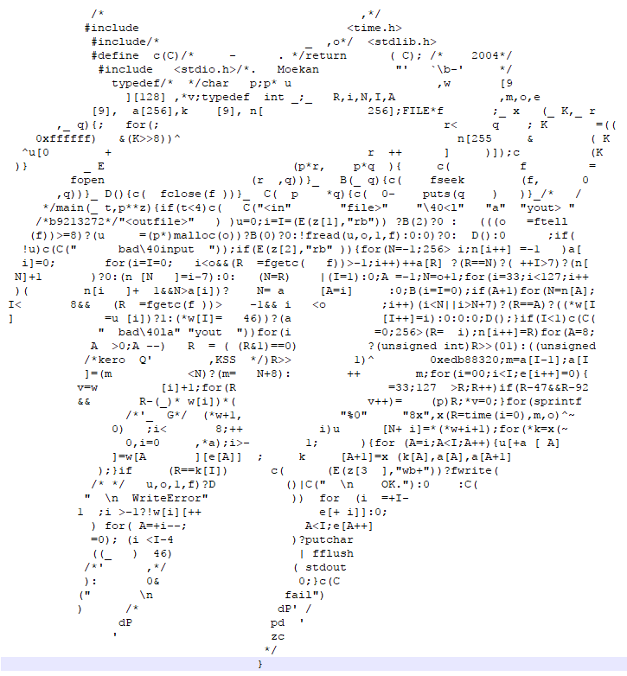
Program Style?

Slide 23
Program Style
What do we mean by “style?”
How the code looks
Code is hard to read
That of other people
Your own code later in the same day
Or even a couple hours later!
It is important to write code that can be understood
There are some generally universal standards
Still flexible

Slide 24
Program Style (cont.)
Whitespace
Compilers don’t care about whitespace
We do
Proper indentation
Separating code into logical groups
Proper indentation is part of homework grading, should be free points

Slide 25
Program Style (cont.)
Comments
Proper comments can make understanding code simpler
Overly verbose/frequent or spartan comments can make code more difficult to read
Requirements for this course lean toward a higher frequency of comments
Necessary because I want to see your understanding of the code you write
Blocks should all have a descriptive comment

Slide 26
Program Style (cont.)
Naming
Smart naming goes a long way toward making code easy to understand
Variable names should be descriptive object names
i.e., nouns; variables hold data related to a thing
Function names should have an action word
Functions do things
Choosing good names is harder than it seems
What are possible differences between functions named findTax and calculateTax?

Slide 27
Program Style (cont.)
Constants
Sometimes we will need to work with a specific number
To avoid confusion in the middle of code, we can “name” the number
The name will be used in the code, and the meaning will be clearer
const means that the program can’t change the value; i.e., constant
const int NUM_BRANCHES = 10;

Slide 28
Program Style (cont.)
Consistency
In naming, indentation, brace placement, etc.
Where there are options, like brace placement, pick one and be consistent
As long as each submission is consistent, you are free to try different styles

