Slide 1

Chapter 1’s
Presenter’s Name
Title, Department
Date

Slide 2

Introduction
Chapter 1 from textbook
Chapter 1 from Think Like a Programmer
No homework (yet)

Slide 3
Agenda
Computer Systems
Problem Solving
My First Program
Testing & Debugging

Slide 4

COMPUTER SYSTEMS

Slide 5
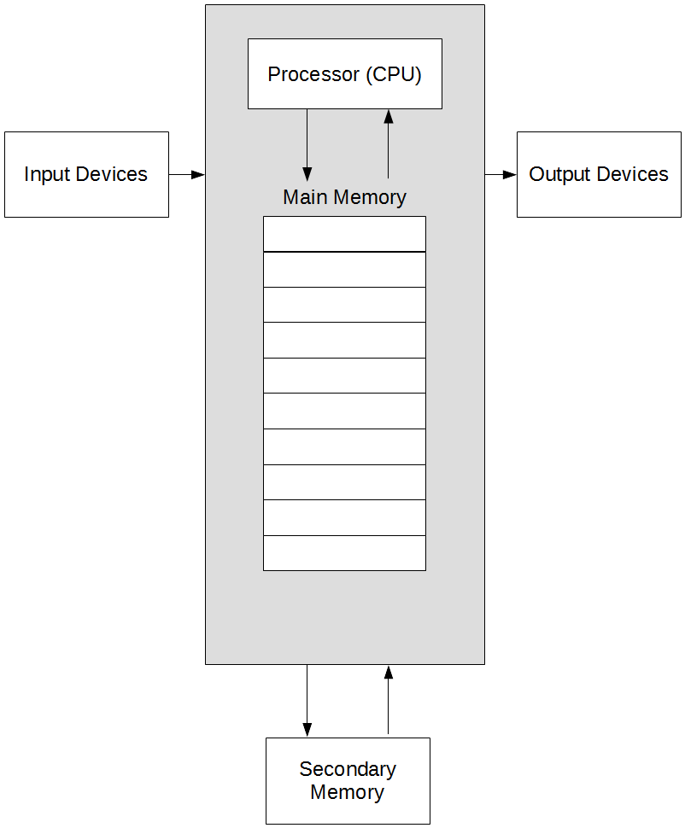
Computer Systems

Slide 6
Computer Systems (cont.)
Input devices allow communication of information to the computer
Keyboard/mouse
Output devices allow communication of information from the computer
Screen, Printer
Secondary memory
Hard drives, flash drives, etc.

Slide 7
Computer Systems (cont.)
Main memory
For us, just considering the RAM
Main memory is divided into numbered memory locations
Each location can hold a single byte of information
1 byte == 8 bits
1 bit == 1 xor 0 (bit means binary digit)
Most data won’t fit in a single byte

Slide 8
Computer Systems (cont.)
Main memory (cont.)
Table below summarizes sizes of common data types that will be encountered in this course
When considering the address of an int, we only care about the first occupied memory address
Compiler handles the rest for us
Type | Size
bool, char | 1 byte
int, unsigned int | 4 bytes
double | 8 bytes

Slide 9
PROBLEM SOLVING

Slide 10
Problem Solving
The hardest part of this course is not writing code
The syntax of C++ is not overly complicated, merely unfamiliar
Practice absolutely eliminates the difficulty
It is coming up with the solutions to the given problems
Once a solution is derived, writing the code becomes simple
But deriving the solution can be the tough part

Slide 11
Problem Solving (cont.)
Too many times, students attempt to solve the problem by throwing code in and seeing what works
Wastes time
Doesn’t develop critical thinking
Too many times, students just find code online
Wastes money
You’re paying for the opportunity to learn and think for yourself, not copy/paste
Doesn’t internalize syntax, so C++ never gets easier to write

Slide 12
Problem Solving (cont.)
Review some puzzles to highlight problem solving strategies
Three classic puzzles
Fox, goose, & corn
Sliding tile
Sudoku
One new puzzle
Quarrasi Lock

Slide 13
Problem Solving (cont.)
Fox, goose, & corn
A farmer with a fox, a goose, and a sack of corn needs to cross a river. The farmer has a rowboat, but there is room for only the farmer and one of his three items. Unfortunately, both the fox and the goose are hungry. The fox cannot be left alone with the goose, or the fox will eat the goose. Likewise, the goose cannot be left alone with the sack of corn, or the goose will eat the corn. How does the farmer get everything across the river?

Slide 14
Problem Solving (cont.)
Fox, goose, & corn (cont.)
One solution
Take the goose across
Take corn across
Take goose back
Take fox across
Take goose across
Taking the goose back is the “trick” step
What could we do to avoid getting tripped up by legal but unknown actions?

Slide 15
Problem Solving (cont.)
Fox, goose, & corn (cont.)
Restate the problem
Constraints
Farmer can only take one item at a time
The fox and the goose can NOT be left alone on same side
The goose and the corn can NOT be left alone on same side
Operations (may look like this at first)
Take fox to far side of river
Take goose to far side of river
Take corn to far side of river
[ No insights here, let us restate more generally ]

Slide 16
Problem Solving (cont.)
Fox, goose, & corn (cont.)
Restate the problem (cont.)
Operations (generalized)
Row boat from one side to the other
If the boat is empty, load an item
If the boat is not empty, unload the item
Generalized operations can be used to find solution
Problem restatement can help gain insights, demonstrate understanding of problem to others

Slide 17
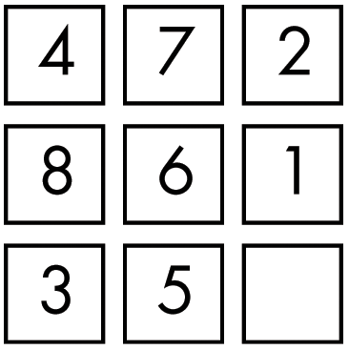
Problem Solving (cont.)
Sliding tile

Slide 18
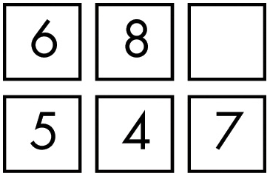
Problem Solving (cont.)
Sliding tile (cont.)
What is a good strategy to solve this?
Is it possible to see the entire solution from beginning to end?
Is this puzzle easier or harder to visualize?

Slide 19
Problem Solving (cont.)
Sliding tile (cont.)
To arrive at the complete solution, we can work on smaller problems first
Sometimes these small problems solve a part of the larger problem
Sometimes they just provide needed insights

Slide 20
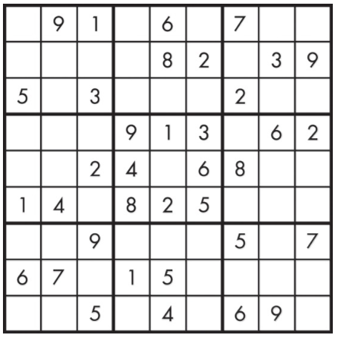
Problem Solving (cont.)
Sudoku
Where to start?

Slide 21
Problem Solving (cont.)
Sudoku (cont.)
Start solving at the most constrained (fewest possibilities) area
Also, start with the most obvious part

Slide 22
Problem Solving (cont.)
Quarrasi Lock
An alien race, the Quarrasi, has landed on Earth, and you’ve been captured. You’ve managed to overpower your large, tentacled guards, but to escape the spaceship, you have to open the massive door. The instructions for opening the door are, oddly enough, printed in English. To open the door, you have to slide the three bar-shaped Kratzz along tracks that lead from the right receptor to the left receptor, which lies at the end of the door, 10 feet away.
That’s easy enough, but you have to avoid setting off the alarms, which work as follows. On each Kratzz are one or more star-shaped crystal gems known as Quinicrys. Each receptor has four sensors that light up if the number of Quinicrys in the column above is even. An alarm goes off if the number of lit sensors is ever exactly one. Note that each receptor’s alarm is separate: You can’t ever have exactly one sensor lit for the left receptor or for the right receptor. The good news is that each alarm is equipped with a suppressor, which keeps the alarm from sounding as long as the button is pressed. If you could press both suppressors at once, the problem would be easy, but you can’t since you have short human arms rather than long Quarassi tentacles.
Given all of this, how do you slide the Kratzz to open the door without activating either alarm?

Slide 23
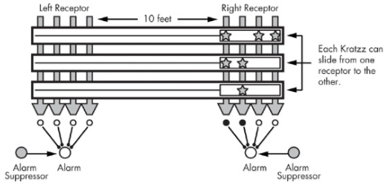
Problem Solving (cont.)
Quarrasi Lock (cont.)

Slide 24
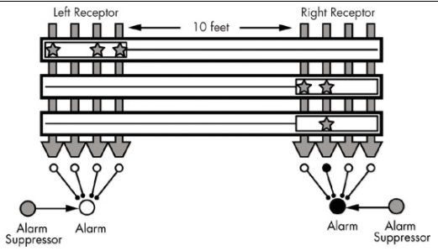
Problem Solving (cont.)
Quarrasi Lock (cont.)

Slide 25
Problem Solving (cont.)
Quarrasi Lock (cont.)
How should we go about solving this problem?
A few different, valid approaches

Slide 26
Problem Solving (cont.)
Quarrasi Lock (cont.)
How should we go about solving this problem?
A few different, valid approaches
Best way is to realize that we have solved it before
We can use fox, goose, and corn as an analogy
When encountering a new problem, it’s possible that we’ve already solved a part or the whole problem before

Slide 27
Problem Solving (cont.)
General Problem-Solving Techniques*
Always have a plan
Restate the problem
Divide the problem
Start with what you know
Reduce the problem
Look for analogies
Experiment
Don’t get frustrated
Code flows faster if we solve the problem first

Slide 28
MY FIRST PROGRAM

Slide 29
My First Program
What do computers understand?

Slide 30
My First Program
What do computers understand?
1’s and 0’s, nothing more
How does our code get turned into 1’s and 0’s?

Slide 31
My First Program
What do computers understand?
1’s and 0’s, nothing more
How does our code get turned into 1’s and 0’s?
The compile process translates our code for us
With C++, we do not have to micromanage the CPU
C++ is considered a high-level language
Assembly and machine code are low-level

Slide 32
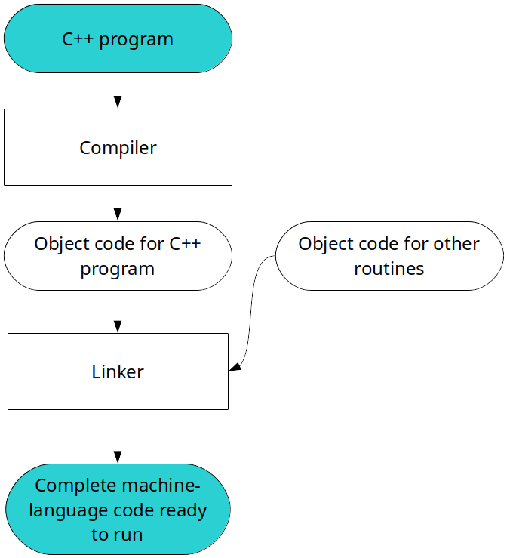
My First Program (cont.)

Slide 33
My First Program (cont.)
Demo time!

Slide 34
TESTING & DEBUGGING

Slide 35
Testing & Debugging
Types of errors
Syntax
Issue in the writing of code; compile process will either fail with errors, or show warnings
Run-time
Program compiles, but crashes with an error while executing
Logic
Program compiles and runs, but output is not correct

Slide 36
Testing & Debugging (cont.)
Debugging
For this course, proper debugging tools will not be taught
Programs are very simple; debugging tools are overkill
Linux, basic programming concepts, and C++ syntax are a lot to take in; avoid overloading
Debugging with gdb will be taught in 311/400 (by me)
Concepts translate to other tools
Easiest tool for this course will be printing to screen
Will be demonstrated later in semester

