Slide 1

Stock Market Prediction Using Deep Learning Techniques
By: Austin N. Thompson
Notes:
Image from Google Gemin via nanabanna.

Slide 2
Overview:
A deep learning model to predict SPY ETF weekly closing prices.
  Integrates historical prices (yfinance)
  Derives technical indicators (rolling average, RSI, MACD).
  Collects New via Finnhub API.
  Integrates news sentiment via FinBERT-Tone.
  Utilizes a Hybrid CNN-RNN architecture (targets log returns).
    1-D CNN for price information
    Sentiment embeddings and output of CNN fed into an RNN
    RNN for Time Series Data
  Achieved MSE of 0.00078 on test data (~2.80% average error in weekly returns).
  Monte Carlo simulation for probabilistic forecasts.

Slide 3
Problem:
Stock markets are volatile, nonlinear, and influenced by prices, news, geopolitics, and investor sentiment.
Challenges: Non-stationarity, sudden shifts, and high degree of “noise”.
Goal: Accurately forecast SPY ETF (S&P 500 tracker) weekly closes using pricing and sentiment data.

Slide 4
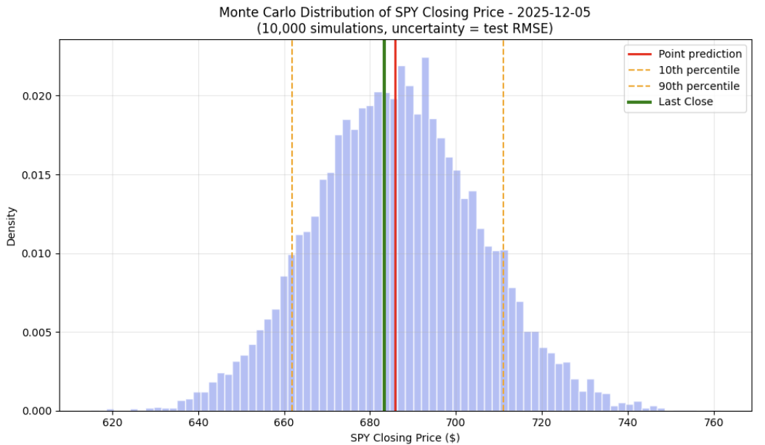
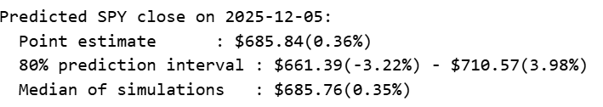
Results:
Actual Close SPY on 2025-12-05 was $685.69 (Δ $-0.15)

Slide 5
Data Collection:
Stock Data: 10 years of SPY weekly Friday closes/volumes via yfinance API.
News Data: General market news via Finnhub API. Aggregated weekly articles and limited to 100 articles.
Note: Free API limits historical depth (1- year). Paid version or alternative API can get 20+ years of historical data.

Slide 6
Feature Engineering / CNN-RNN Preprocessing
Technical Indicators from Prices:
  Rolling Averages (2w, 4w for closes/volumes).
  Momentum (1w, 2w, 4w changes).
  Relative Strength Index (RSI) (overbought/oversold: 1w, 2w, 4w).
  Moving Average Convergence Divergence (MACD) (trend strength).
News Sentiment: FinBERT-Tone embeddings (768D vectors from titles/summaries). [Last Hidden State]
Sequence Prep: Length 4 (prior weeks' features + embeddings); target = log return. [Required for GRU RNN]

Slide 7
Model Architecture
1D CNN
Kernal size = 3, Padding = 1
MaxPool1D
Dropout = 0.3
Hybrid Multimodal Neural Network:
  1D CNN: Extracts patterns from price sequences
  News Compressor: Reduces 768D embeddings to 64D.
  Gated Recurrent Unit (GRU) RNN: Improvement of Elman style network and for time-series data.
  Output: Fully connected layer predicts log return.
  Why GRU? Lighter than LSTM, effective for time-series.
  More info on GRU’s: https://www.geeksforgeeks.org/machine-learning/gated-recurrent-unit-networks/#
News Embedding Compressor
768D compressed into 64D
GRU
Input: 64D News and 1D CNN outputs
Dropout = 0.3
Final Fully-Connected Layer
Output of GRU to Predict Log Return for next week

Slide 8
Questions

Slide 9
More on Gated Recurrent Unit RNN
“The core idea behind GRUs is to use gating mechanisms to selectively update the hidden state at each time step allowing them to remember important information while discarding irrelevant details. GRUs aim to simplify the LSTM architecture by merging some of its components and focusing on just two main gates: the update gate and the reset gate.”
Advantages over LSTMS: No cell state, faster, lower computational intensity. Additionally, effective at processing time series data.
More info on GRU’s: https://www.geeksforgeeks.org/machine-learning/gated-recurrent-unit-networks/#

