Slide 1

Building an iPhone app with Rails and no Objective-C
Texas Association of Local Health Officials
Richard Boldway - rboldway@talho.org
Andrew Duhan - andrewduhan@gmail.com

Slide 2
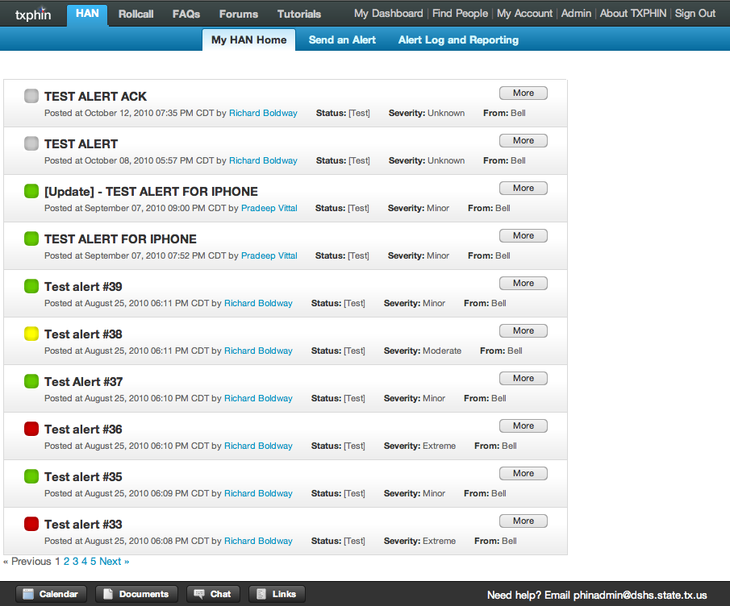

Slide 3
Intro to Problem
Build an iPhone interface to TxPhin application
  Rails RESTful create action uses POST
Restrict access by login
Show list of latest alerts
Search directory information
Mandatory: iTunes AppStore delivery
Client - github.com/talho/iPHIN/

Slide 4
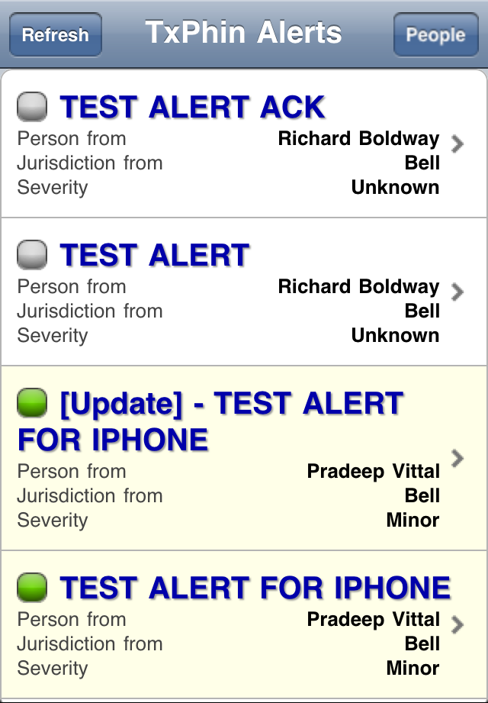
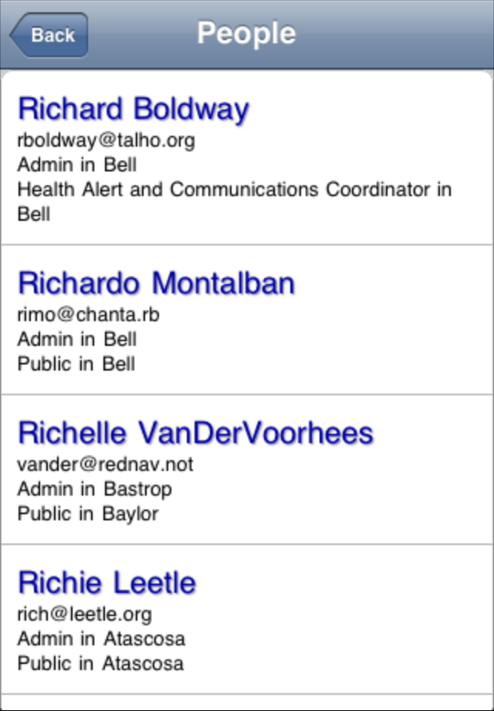
Objective:

Slide 5
Objective-C ?
Barriers to entry:
  Language learning curve
  Environment learning curve
  Memory Management: #1 killer of iPhone apps
Why write a client-app for an already web-enabled system?

Slide 6
Choice of Tools
Appcelerator (appcelerator.com)
Rhodes (rhomobile.com)
PhoneGap + HTML5/JS/CSS (phonegap.com)
  jQTouch
Roll-our-own

Slide 7
PhoneGap
Runs as a local web server
  Cross-origin security restrictions
Displays through full screen Safari
  Removes non-app elements
Supports local, session, sqlite storage
Access to iPhone resources via Javascript
  Accelerometer
  Contact manager and place calls
  GPS
  Easily extendable

Slide 8
AppStore Submission Tips
Graceful Network Error Handling
No High Data Volume/Request
No Desktop/Widget environment
No major UI/UX elements from the server
appreview.tumblr.com

Slide 9
RAILS Integration
Preferred to make controllers accept JSON via AJAX
  Search controller
  Alerts controller
Only fetching pieces of page data at a time

Slide 10
JSONP
JSONP works, but...
Concern about security
Concern about apple rejection (eval)
Built Rack hack for POST to support CRUD

Slide 11
Client side:
$.ajax({type: "GET",
url: “https://localhost:3000/session.json",
data: "session[login]=bill24&session[password]=password",
dataType: "jsonp", cache: false,
success: function(data){ alert(data.test); } //alerts 'me'
});
Rack App:
require(File.dirname(__FILE__) + "/../../config/environment") unless defined?(Rails)
class TestRack
def self.call(env)
if env["REQUEST_METHOD"] == "GET" &&
env["QUERY_STRING"] =~ /callback=jsonp/
env["REQUEST_METHOD"] = "POST"
end
[404, {"Content-Type" => "text/html"}, "Hello World."]
end
end
Rails controller action:
format.json {
render :json => "#{params[:callback]}({'test': 'me'})"
}

Slide 12
CORS - w3.org/TR/cors
Rails auto-token magic
  (don't try this without SSL)
Extra necessary headers
  Access-Control-Allow-Origin
  Access-Control-Allow-Methods
  Access-Control-Allow-Headers
  Access-Control-Max-Age
Option action / Pre-flighting JSON request
  Invisible in Webkit Inspector

Slide 13


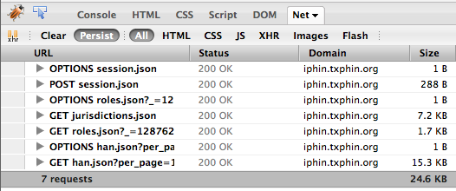
Preflighted Request AJAX (post)

Slide 14
client side, login:
$.ajax({
type: "POST",
data: $('#signin_form').serialize(),
dataType: "json",
timeout: 10000, // mobile connections are slow
url: DOMAIN + "/session.json",
cache: false,
success: function(data) {
setCookie(data);
// call the homescreen pane
},
error: function(xhr) {
if (xhr.readyState == 4){
switch (xhr.status) {
// handle most errors
}
} else {
// no connection was made at all
}
}
});

Slide 15
routes.rb
map.connect "/session.:format",
:controller => "application",
:action => "options",
:conditions => {:method => [:options]}
sessions_controller.rb
# iPhone app
format.json {
sign_in(@user)
remember(@user) if remember?
headers["Access-Control-Allow-Origin"] = "*"
render :json => {
:token => form_authenticity_token,
:cookie =>
"#{ActionController::Base.session_options[:key]}= \
#{ActiveSupport::MessageVerifier.new( \
ActionController::Base.session_options[:secret],
'SHA1').generate(session.to_hash)}"
}
}

Slide 16
application_controller.rb
def options
render :nothing => true, :status => 200
end
before_filter :add_cors_header, :only => :options
private
def add_cors_header
# Allows for Cross-Origin Resource Sharing
headers["Access-Control-Allow-Origin"] = "*"
headers["Access-Control-Allow-Methods"] = "OPTIONS"
headers["Access-Control-Allow-Headers"] = \
"X-Requested-With, Cookie"
headers["Access-Control-Max-Age"] = "1728000"
end

Slide 17
client side, search request:
$.ajax({
type: "POST",
data: $('#search_form').serializeObject(),
dataType: "json",
timeout: 10000, // mobile connections are slow
url: DOMAIN + OPTIONS,
cache: false,
beforeSend: function(xhr){
xhr.setRequestHeader("Cookie", getCookie());
},
success: function(data) {
// call the results pane
},
error: function(xhr) {
if (xhr.readyState == 4){
switch (xhr.status) {
// handle most errors
}
} else {
// no connection was made at all
}
}
});

Slide 18
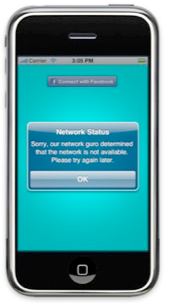
Error handling
Many errors are un-meaningful
JQTouch uses older jQuery; always returns XHR success :-/
Server dead? Or lost Network?
  Reachability API in PhoneGap

Slide 19
iPhone UI Concerns
jQTouch is dead.
iPhone tap delay
  Double click
  History issues
Jquery behavior
  window['localStorage']._cookie
  $('body').data(obj)
Large <select> lists are painful

Slide 20
What would we do today?
Rails – Generally very happy
  Alias .iphone to text/json, avoiding base JSON handler confusion
Alternatives to jQTouch
  SenchaTouch (ext.js): very iPhoney but Android-compatible
  jQuery Mobile: still in alpha, lots of devices, more generic
  Jo App:
Skip the app store?

