Slide 1
Artificial Neural Networks
Lecture 13

Slide 2
Human Learning vs. Machine Learning
Machine Learning
Good at problems can be described formally, e.g., chess and Go.
Difficult to deal with problems that can not be formally described, e.g., face recognition and speech recognition
Human
Completely opposite story
Creative thinking
General intelligence
What is behind the differences?

Slide 3
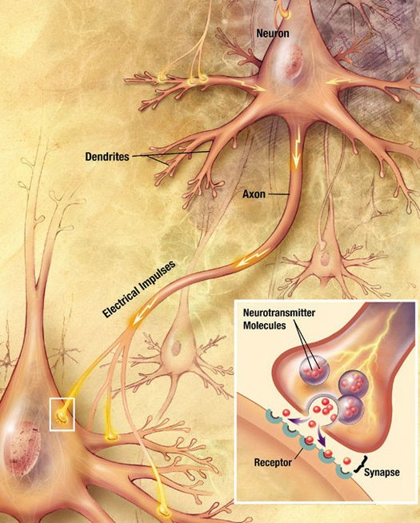
Biologic Neural Networks
US National Institutes of Health, National Institute on Aging created original

Slide 4
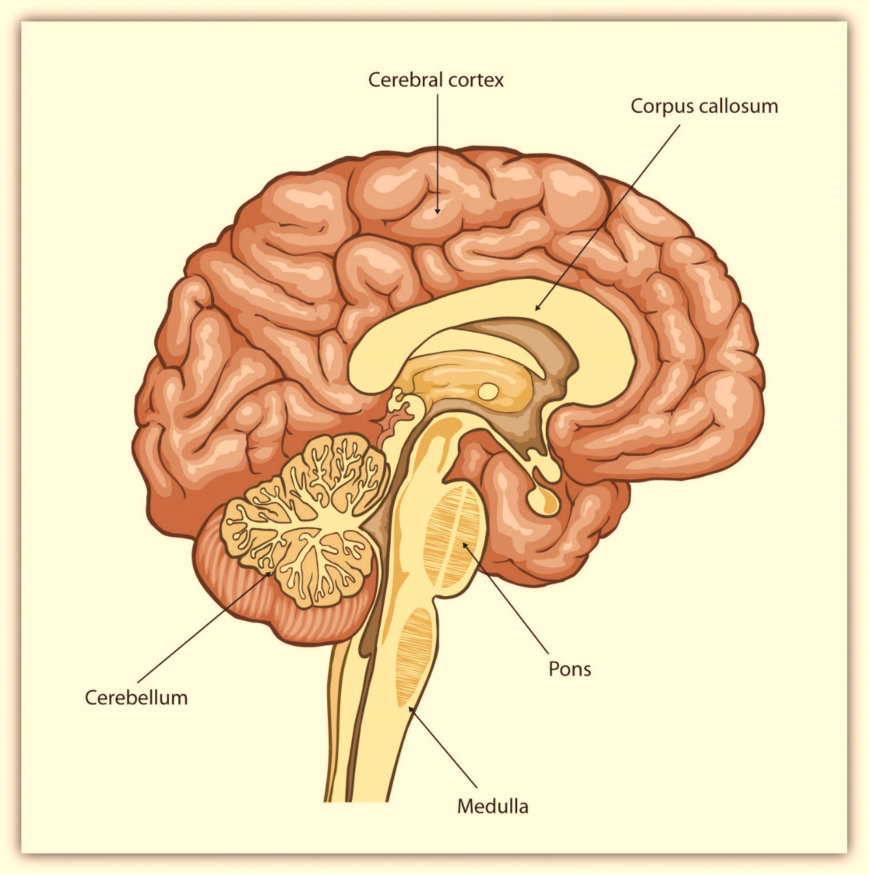
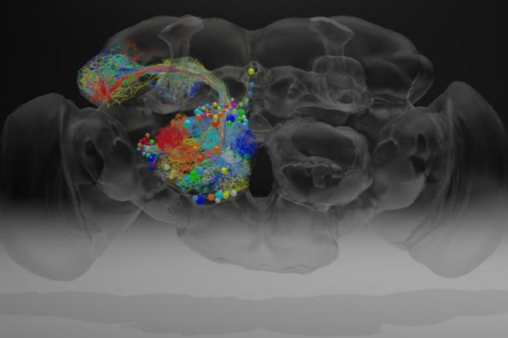
Biologic Neural Networks
Human brains
Cerebral cortex: 16.3 billion neurons
Memory, attention, language, …
Cerebellum: 85-86 billion neurons
Movements, balance, …
Fruit fly
100,000 neurons
https://www.discovermagazine.com/mind/every-neuron-of-a-fruit-fly-brain-in-nanoscopic-detail

Slide 5
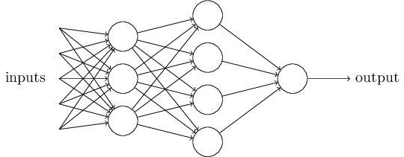
Artificial Neural Networks
Deep learning is about Neural Networks
Connectionism (Biologically-inspired)
An Artificial Neural Network
US National Institutes of Health, National Institute on Aging created original

Slide 6
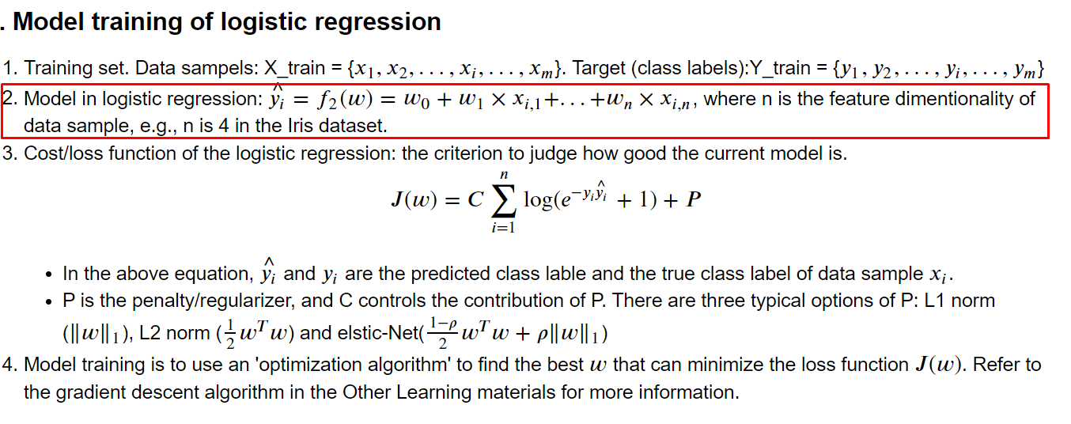
Models in Machine Learning
Predefine models in machine learning algorithm
From Lecture 11

Slide 7
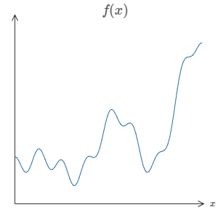
The Universality theorem
f(x)
Neural networks with a single hidden layer can be used to approximate any continuous function to any desired precision
(Informal) No matter what the function, there is guaranteed to be a neural network that can fit the function (y_pre = f(x) = y), even if the NN has one hidden layer.
x
y

Slide 8
Limitation
In theory, the Universality theorem is true if we have enough number of hidden neurons
But, we may don’t have the techniques for constructing or even recognizing such a network
f(x)
x
y

Slide 9

Feedforward NNs
Input
Hidden
Output
class 1
class 2

Slide 10
Feedforward NNs
Input
Hidden
Output
Height
sick
Weight
Temperature
healthy

Slide 11
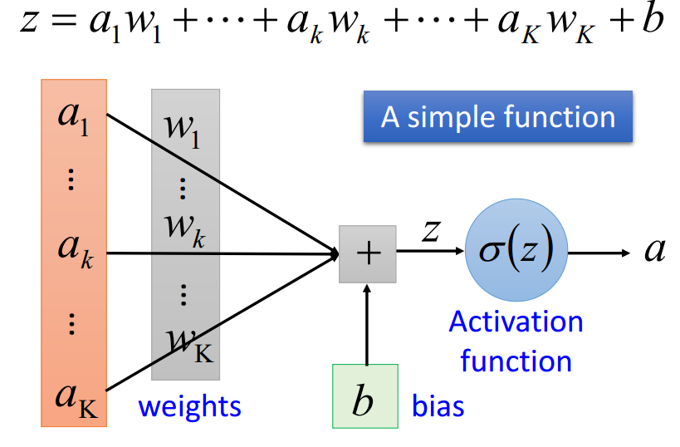
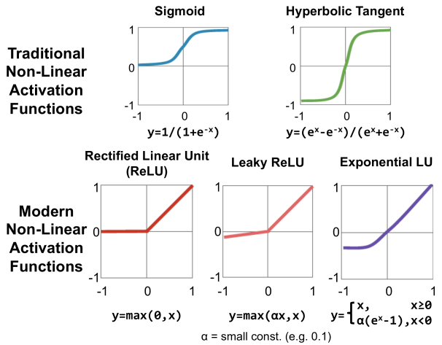
Building Blocks
Hidden
Input
Output
class 1
Unites and activate functions
class 2

Slide 12
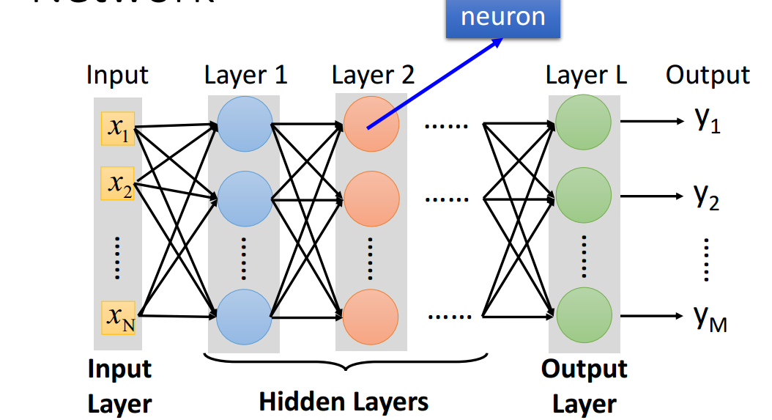
Building Blocks
Layers: fully connected, convolutional + pooling layer, recurrent layer

Slide 13
Example
Tensorflow + Keras
Installation and setup (the anaconda website)

Slide 14
Parameters and Hyperparameters
Input
Hidden
Output
Parameters → training set
Weights
Biases
Hyperparameters → validation set
learning rate,
iterations
the # of hidden unites
# of hidden layer
minibatch size…
class 1
class 2

