Slide 1

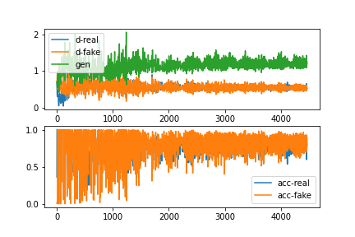
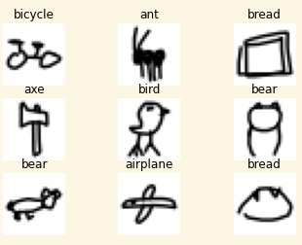





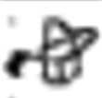

Computer Science Department
Final Project: DoodleGAN
Course: Introduction to AI (CS156)
Course Instructor: Yulia Newton, Ph.D.
Austin Rivard
Introduction/Background
Methodology
Analysis and Results
These charts show the losses (top) and accuracies (bottom) of the models while training during the first ten epochs. You can see the models strike a stable but noisy balance.
This project was created with the goal of generating new images of doodles from seven different classes: airplane, ant, axe, bear, bicycle, bird, and bread.
Doodles are a very interesting domain of images to work with in computer vision because they are the human brain's attempt to represent an actual object (airplane, bicycle, bread) to other humans using very few features. When tasked with quickly drawing a doodle of an object from memory, a person is forced to think about the most efficient way to convey meaning that another person would likely understand. For this reason, doodles typically include the most distinguishing features of an object and could be a sort of window into how the human brain represents real-life objects internally.
Intrigued by this idea, I wanted to investigate how a machine learning model could learn to doodle. I chose these categories because they are so different from one another that the model would need to learn to draw a wide variety of objects as opposed to if I were to, say, choose just cats and dogs, although that could be an interesting dataset to use to see the distinguishing features that it learns from each.
Algorithm
Generative adversarial networks, or GANs, train a fake image generator and a fake image discriminator against each other in a zero-sum game with the idea that as the generator gets better at creating plausible images, the discriminator will get better at determining between fake and real images, which in turn forces the generator to improve, creating a feedback loop. Conditional GANs implement an additional input vector in both the generator and discriminator to allow for controlling the category of image that the generator produces.
Application to the project
The model I used is a conditional deep convolutional GAN, or cDCGAN, with some additional modifications like spectral normalization added to help convergence of the model and improve the final quality of generated images. It took me many iterations to find hyperparameters that wouldn't result in the network falling into a failure mode during training. The most common failure mode was characterized by discriminator loss going to zero and generator loss climbing to around ten shortly after training began. I performed many experiments by tweaking the learning rate, ADAM momentum, latent space dimensionality, batch size, and also added spectral normalization to both the generator and discriminator and added dropout to just the generator. The hyperparameters used in this model are what I found success with through experimentation, but there are likely many changes that could be made to speed up training, improve image quality, or both.
To implement the conditionality component of the generator and discriminator, I used a categorical embedding layer which was given the label as input. The output was scaled up to the size of the input image dimensions and was then concatenated with the input image as an additional channel.
After setting up the basic network architecture, I began training the model with commonly used hyperparameters like a learning rate of 0.0002, latent space dimensionality of 100, and batch size of 64. This immediately failed and resulted in a generator which produced noisy, almost-blank white images. Following that, I experimented with slower learning rates which helped model convergence but failed to produce acceptable results. I also tried lowering the latent space dimensionality from 100 to 32 which stabilized the model with lowered learning rates but, once again, failed to impress with the final quality of images generated. I raised the dimensionality back up but this time to 128 to attempt to improve training time by using a power of 2. I also returned the learning rate to 0.0002 and, drawing inspiration from the BigGAN paper, tried increasing the batch size from 64 to 2048. This change proved to be the most effective by dramatically reducing training time and improving the quality of the images, perhaps due to the increased coverage of the dataset’s modes in each batch.
The images produced by the model trained with these parameters were much more impressive but still lacked consistency, with a large portion of generated images being unrecognizable minus some general characteristics like bicycles having two circles somewhere in the image and airplanes typically being drawn with a “+” shape. In particular, the model really seemed to struggle with drawing axes and bread.
Shown below is a hand-picked sample of the generator’s output when seeded with each of the seven categories.
Summary/Conclusions
Overall, I am pleased with the results of the project. Some of the drawings really stood out to me as believably coming from a human, which is what I was hoping to achieve starting out.
Going forward, there are several possible approaches I could take to further improve the model’s performance such as using batch normalization or changing the architecture to use either relativistic or diffusion-based networks.
Dataset description
Google’s Quick Draw dataset is a collection of 50 million drawings across 345 categories. For this project, I took images from 7 of these categories which amounted to 915,788 images. Each sample is stored as a 28x28 NumPy bitmap which was then assigned a numerical label. I then normalized each pixel to be between -1 and 1 and shuffled the samples. Below I’ve included a random collection of drawings from the dataset for reference.
GAN.MNIST.ipynb by Dr. Yulia Newton
https://machinelearningmastery.com
https://github.com/soumith/ganhacks
https://arxiv.org/abs/1611.07004
https://arxiv.org/abs/1809.11096
https://arxiv.org/abs/1807.04720
https://arxiv.org/abs/1802.05957
Key References
Generated images
Acknowledgements
airplane
ant
axe
This project was so much fun to work on! I definitely got my fill of reading ML papers. Not all of it went over my head, so I consider that testament to the authors. I also want to thank Jason Brownlee from MachineLearningMastery, the authors from the ganhacks repository, and my professor Dr. Yulia Newton.
bear
bicycle
bird
bread

