Slide 1

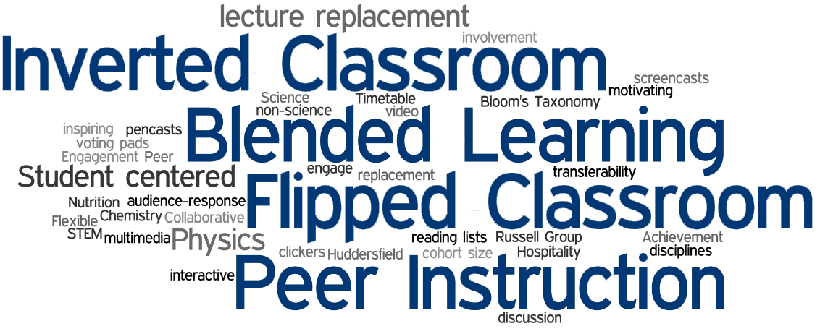
Flipping Your Classroom
Brandy Close, M. Ed.
OSU-CHS
Office of Educational Development

Slide 2
Objectives
Define the “Flipped Classroom”
Identify the goal(s) of flipping the classroom
Differentiate between teaching methods that do and do not foster higher level learning
Identify steps/components needed to successfully create a flipped classroom

Slide 3
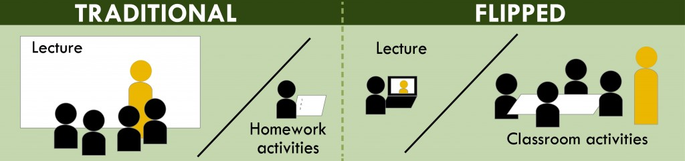
Flipping the Classroom: What is it?
The Flipped classroom inverts traditional teaching methods. In-class time is re-purposed for inquiry, application, and assessment in order to foster higher learning in students
http://www.washington.edu/teaching/teaching-resources/flipping-the-classroom/

Slide 4
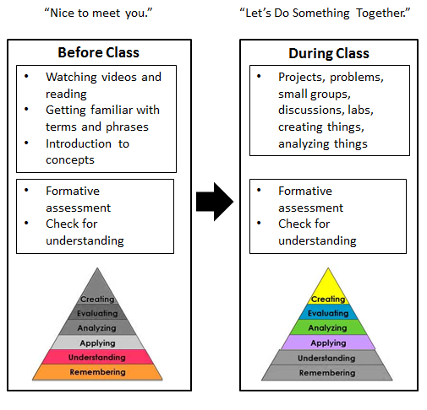

Flipping Your Classroom
Students become invested in the learning process through studying course material outside of class prior to class time:
readings
Pre-recorded lectures (using Tegrity)
research assignments
Instructors become facilitators
http://etale.org/main/2013/02/21/a-flipped-classroom-primer/

Slide 5
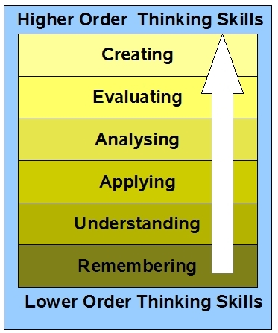
The Goal(s) of a Flipped Classroom
The primary goal in flipping your classroom is to foster deeper, richer learning experiences that result in student learning on a higher level.
maximize the limited face-to-face time between students and the instructor
http://educationaljargonschs.wikispaces.com/Bloom's+Taxonomy+(revised)

Slide 6
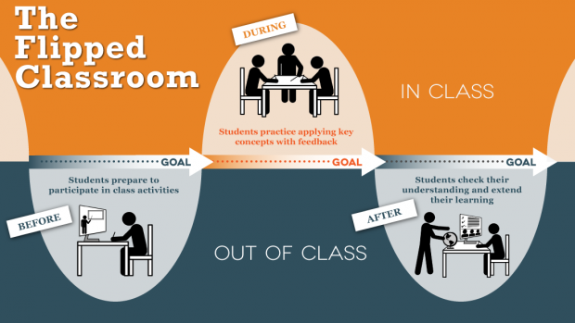
The Flipped Classroom Teaching Methods
Lecture: pre-recorded for students to view outside/before class (integration of technology using Tegrity)
Collaborative Learning: fosters student engagement during class time (Integrating technology using Group Twitter, Join.me, Google+ Hangout)
http://ctl.utexas.edu/teaching/flipping_a_class/what_is_flipped
Case-based Learning: alternative, authentic assessment

Slide 7
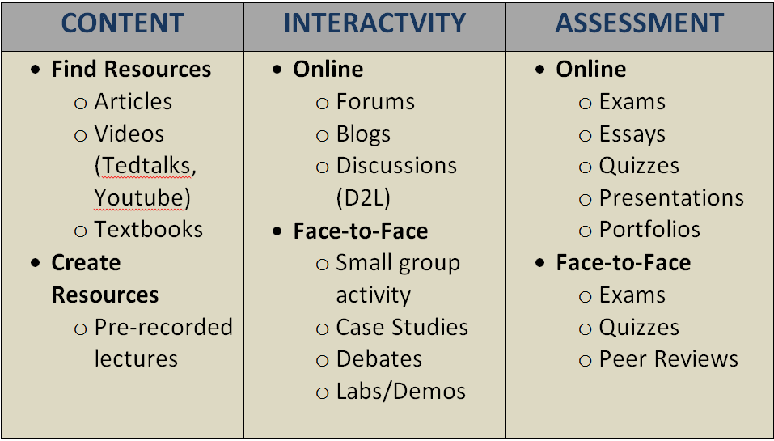
Flipping Your Classroom
Wiley Learning Institute

Slide 8
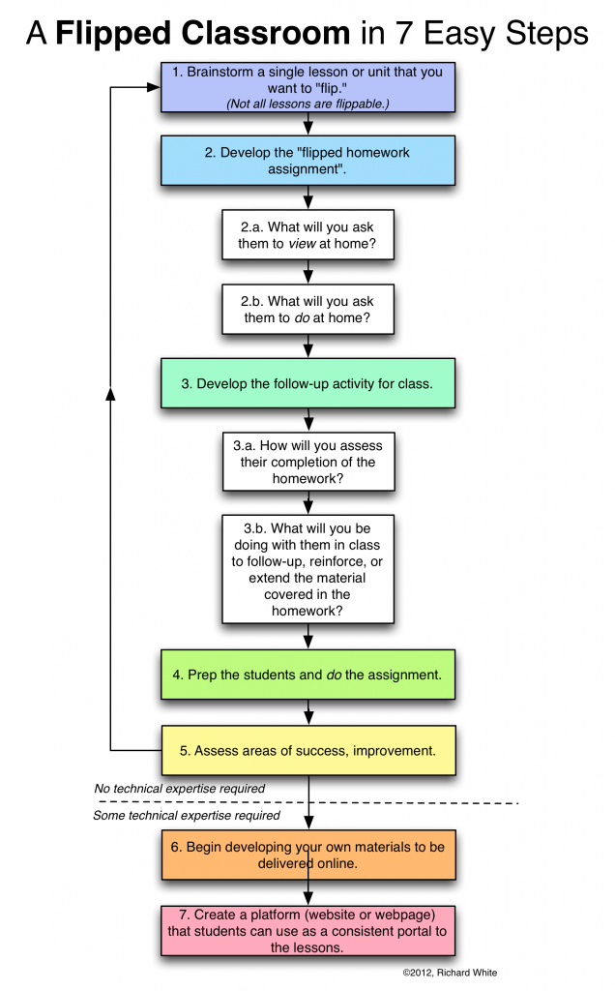

Slide 9
Flipping the Classroom : Resources
Mind/Shift: The Flipped Classroom Defined (infographic)
Flipped Classroom ePortfolio
Learning4Mastery
Salman Khan: Let’s use video to reinvent education (TED Talk)
The Flipped Class Network
7 Things You Should Know… (PDF)
The Flipped Class: What does a good one look like? (Article)
Wiley Learning Institute

Slide 10
Questions???

