Slide 1
MIPS Multi-Cycle Processor
Austin Brown
Daniel Mills

Slide 2
Executive Summary
Goal is to implement a MIPS microcontroller
Executes instructions in multiple cycles
Entirely implemented in VHDL
Used Quartus to synthesize
The project was implemented on a DE10-lite board

Slide 3
Introduction
MIPS Overview
MIPS Architecture - reduced instruction set
Load/Store architecture - all instructions read and write to registers except for load and store instructions
3 instruction formats
J format
I format
R format

Slide 4
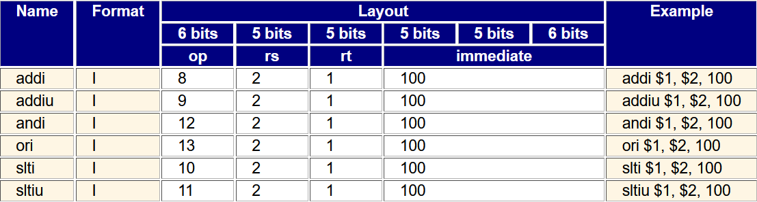
Introduction
I Type Instructions

Slide 5
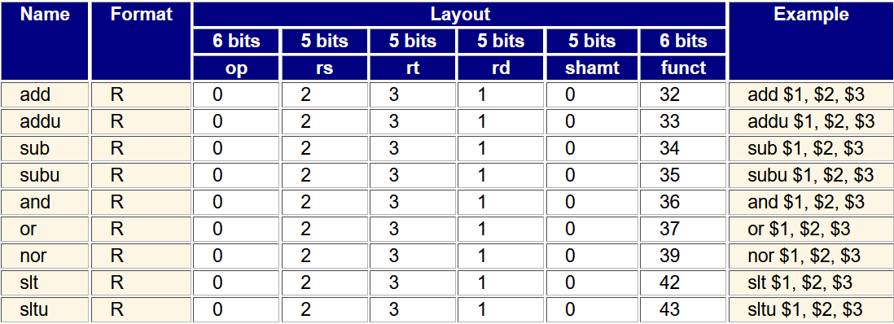
Introduction
R Type Instructions

Slide 6
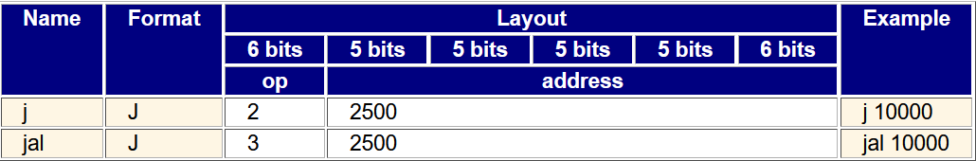
Introduction
J Type Instructions

Slide 7
Introduction
Why Multi-Cycle
Single cycle implementations are held back by load and store instructions
Slower instructions use more cycles while faster instructions use fewer cycles
Use five total stages
IF - get instruction to be executed and increment program counter
ID - Read sources registers and generate control signals
EX - Execute ALU instructions
MEM - Read or write from memory
WB - Store data back to register file

Slide 8
Design

Slide 9
Limitations of Our Design
Did not implement J instructions
All instructions are hardcoded into memory
Cannot be dynamically loaded
Notes:
Daniel

Slide 10
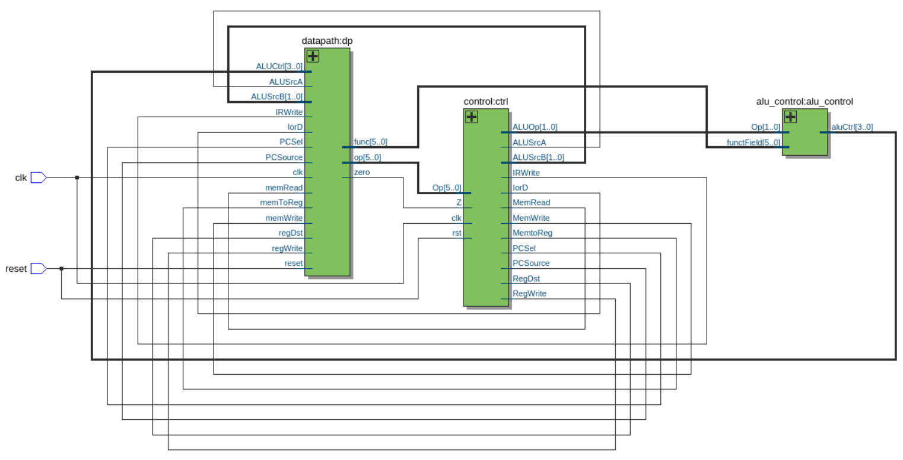
Top-Level Module
Defines all signals used in top-level of design
Instantiates Control, Datapath, and ALU Control
Reconciles clock and reset on-board with our models
Notes:
Daniel
datapath has modules inside it - alu, memory, pc
Talk about how this was generated in quartus netlist viewer -> rtl viewer

Slide 11
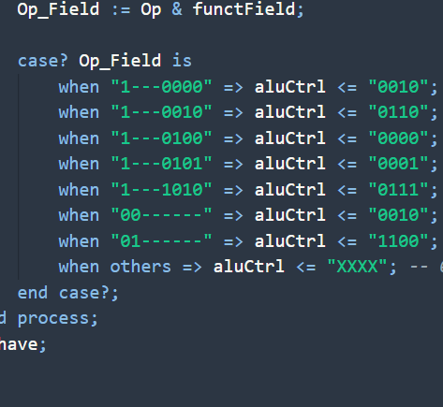
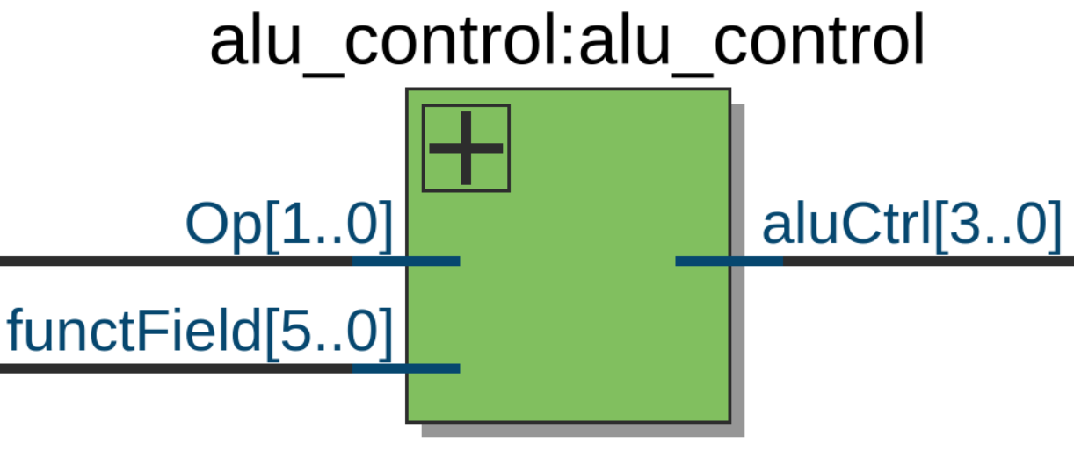
ALU Control
Determines what operation the ALU will perform
Reconciles signal from control and signal from datapath
Factoring it into its own module was a design choice
Notes:
Daniel
Remember where op and functfield come from exactly when explaining

Slide 12
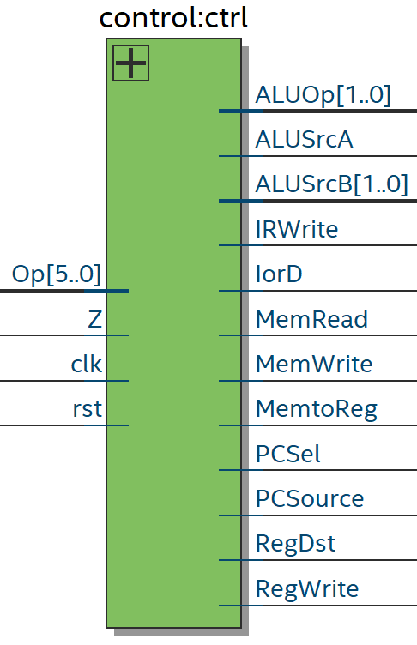
Control
Responsible for determining what control signals are sent to the datapath
Implemented at a state machine
Beq uses 3 cycles
ALU instructions use 4 cycles
Sw uses 4 cycles
Lw uses 5 cycles
Notes:
Daniel
IorD => read instruction (pc) or data (alu read data for load word)
Mention that single cycle implementation of control is combinational
Where magic happens lol

Slide 13
Control (Continued)
The multicycle implementation works because different instructions take a different amount of cycles
BEQ | IF | ID | EX
SW | IF | ID | EX | MEM
ALU | IF | ID | EX | WB
LW | IF | ID | EX | MEM | WB
Notes:
Daniel

Slide 14
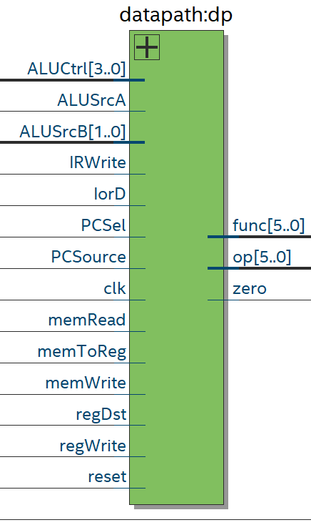
Datapath
Takes signals from control module
Contains smaller modules
Memory
Registers
ALU
Program Counter
Notes:
Daniel
datapath has modules inside it - alu, memory, pc
Also intermediate registers
Russian doll

Slide 15
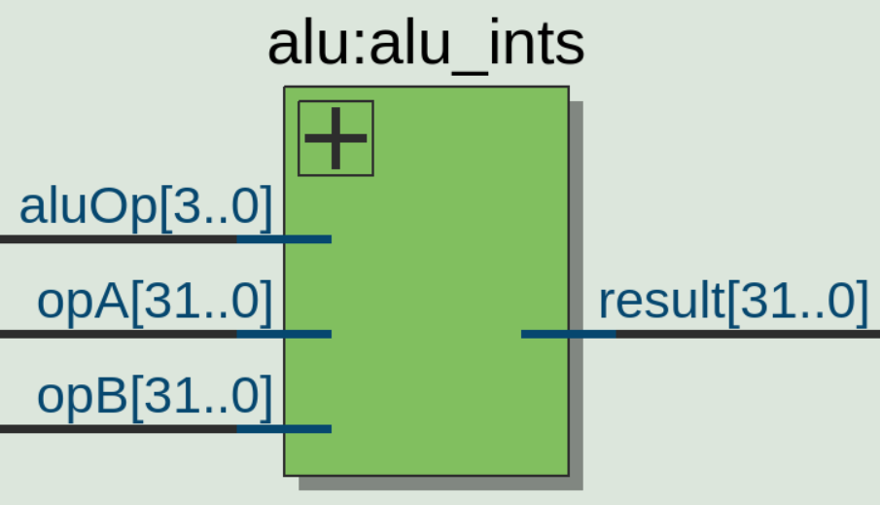
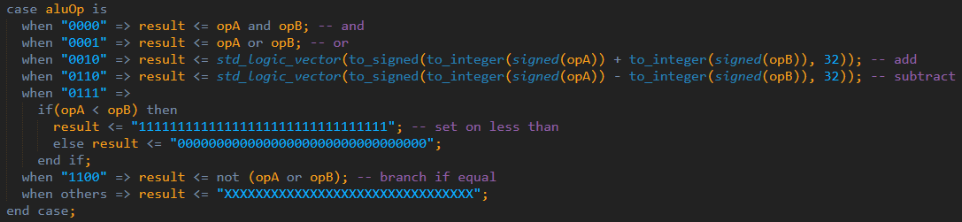
ALU
2 input operands
Input from ALU Control
Output result
Performs the following:
Logical AND
Logical OR
Addition
Subtraction
Set on Less Than
Branch if Equal
Notes:
Daniel

Slide 16
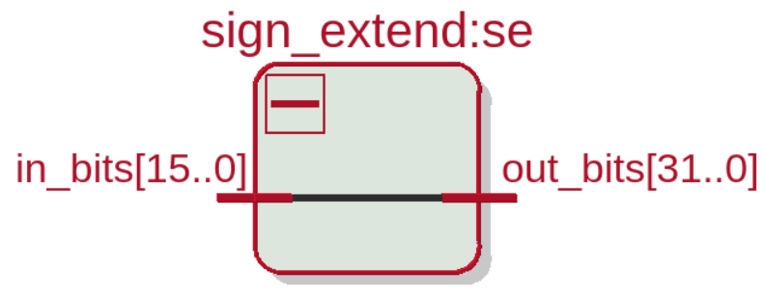
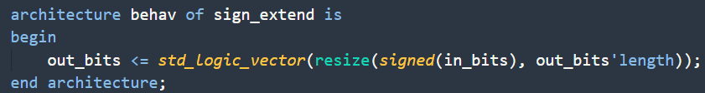
Sign Extend
Performs sign extension from 16 bits to 32 bits
Can be performed with a single line of VHDL
Used for I-type instructions
Notes:
Daniel

Slide 17
Registers
Register_block - user defined type
Reg - instantiation of that user defined type.
Notes:
Austin

Slide 18
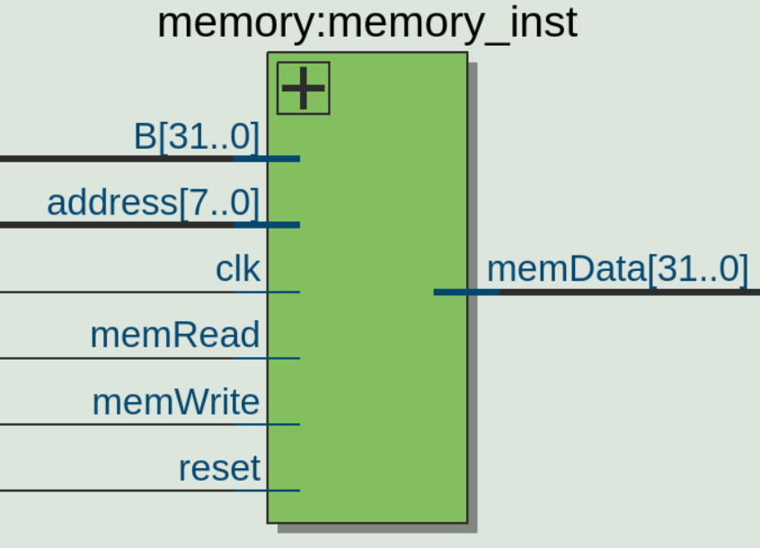
Memory
Princeton architecture
Data memory starts at address 0
Instruction memory starts at address 128
Makes use of various signals to control reads and writes
Notes:
Austin
Remember princeton architecture

Slide 19
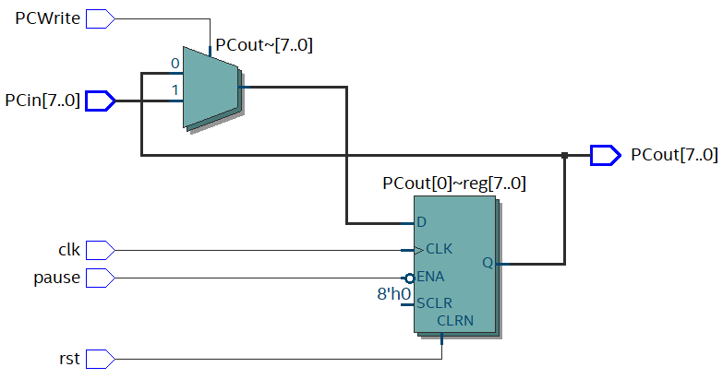
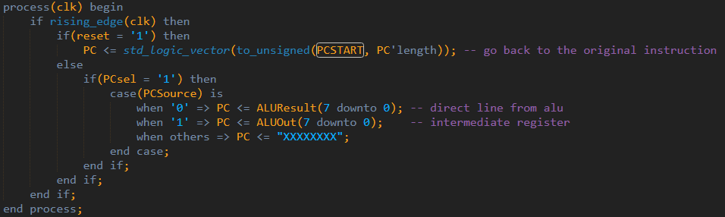
Program Counter
Keeps track of current instruction
Reset sets PCout to default
Pause sets PCout to itself
PCWrite sets PCout to PCin
Notes:
Austin

Slide 20
Intermediate Registers
Intermediate registers are used when we need an output in a later clock cycle then when the instruction was executed
A and B - store data read from the general purpose registers
ALUOut - stores data from the ALU
Instruction register - holds data read from memory in stage 2
Memory Data Register - holds data read from memory
Notes:
Austin

Slide 21
Verification

Slide 22
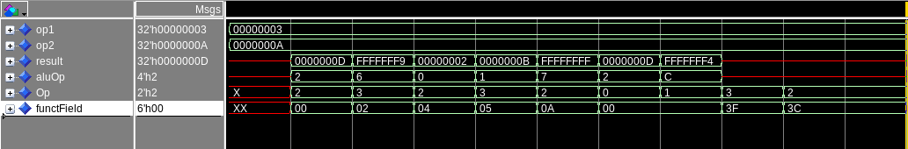
ALU and ALU Control TestBench Result
Hold operands constant
Change Op and functField in ALUControl
aluOp will change
ALU computes correct result.
Last two tests verified correct undefined behavior
Notes:
Daniel

Slide 23
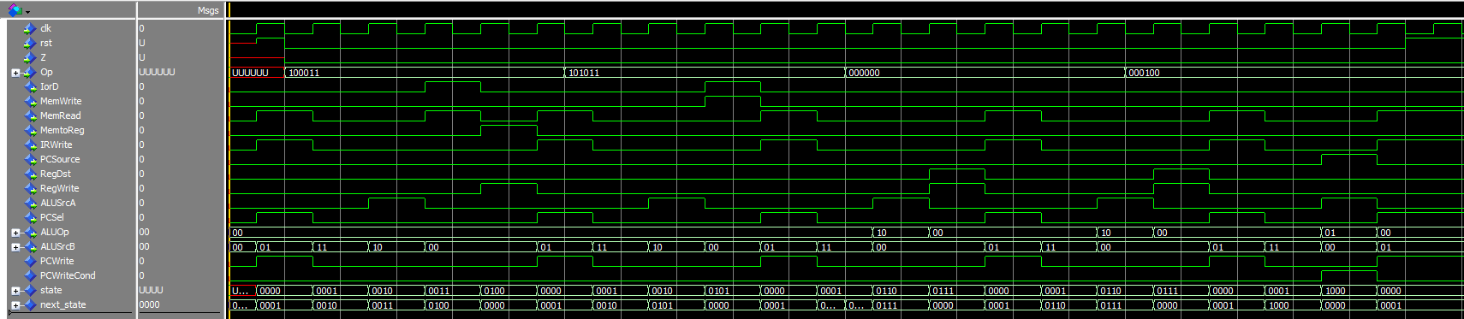
Control TestBench
State and next state progress as expected based on Op
Fetch, Decode, Memory Address Computation, Memory Load, End Memory Read
All outputs change as expected based on state
Notes:
Daniel
First 5 states

Slide 24
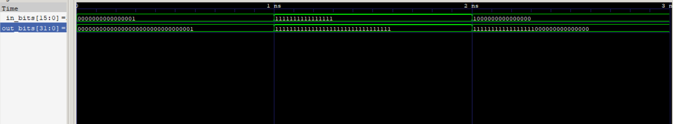
Sign Extend Testbench Result
The input is a signed 16 bit number
The output is a signed 32 bit number
Notes:
Daniel

Slide 25
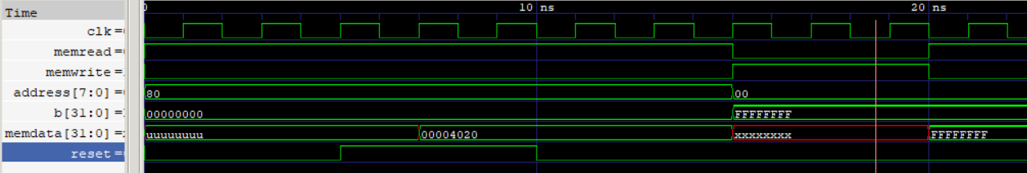
Memory Testbench Result
Instructions are initialized when there is a reset (Power on reset)
At this point an instruction is read
memWrite is set to High and 0xFFFFFFFF is written to address 0
This value is then read from memory
Notes:
Austin

Slide 26
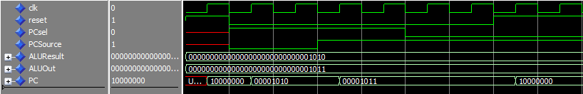
Program Counter TestBench
PC starts with initial value
Correct output as result of reset
Correct output as result of control signals
Notes:
Daniel

Slide 27
Synthesis

Slide 28
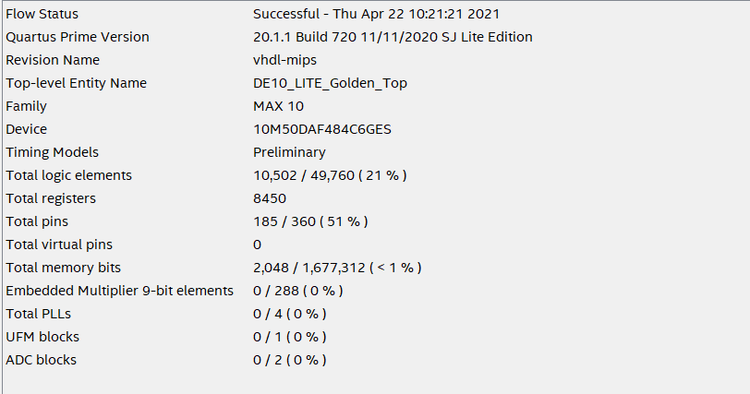
Compilation Report
Notes:
Daniel

Slide 29
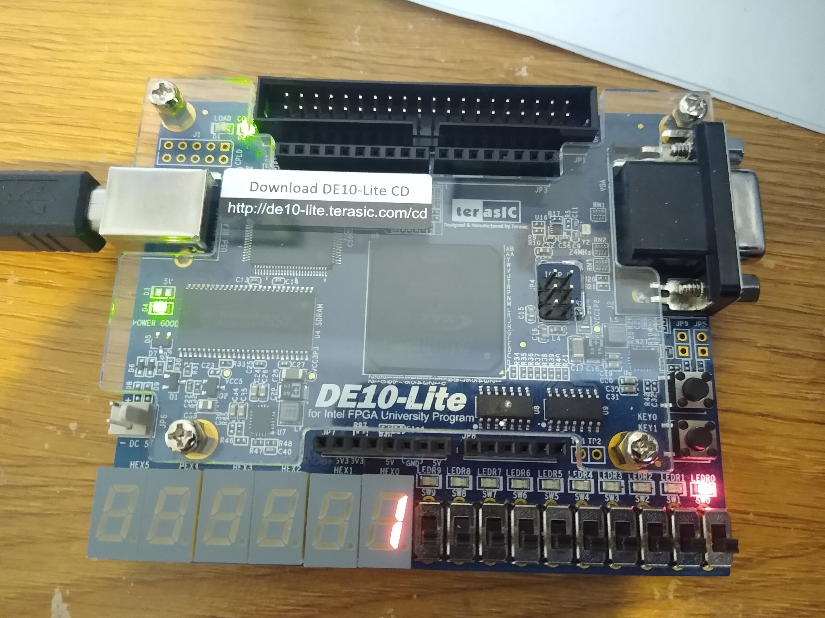
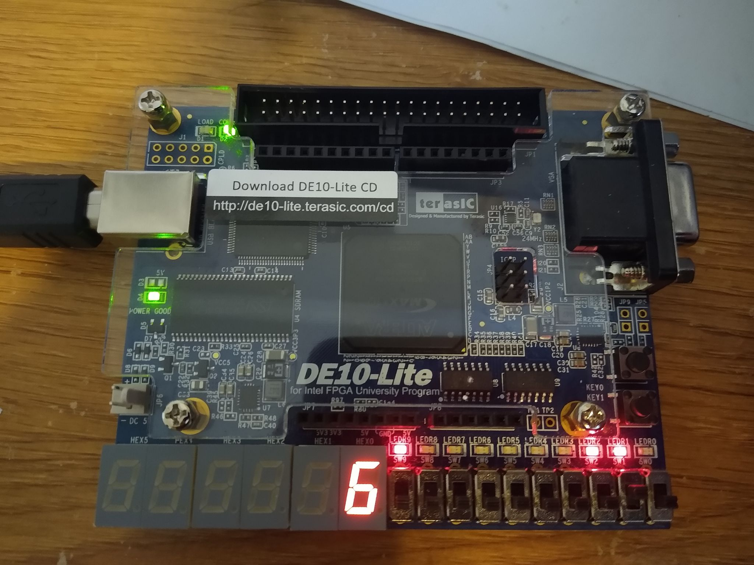
Output on the Board
Notes:
Daniel - it is simply displaying the current state (fetch, decode, etc.)

Slide 30
Issues
Quartus did not allow for the memory module to have instructions hard coded in
A power on reset had to be implemented
Power on Reset - reset signal is generated when power is supplied
Initially had no output, our design synthesized into one logic unit
Output Z flag and AluOp to LEDs
Had to learn how to use quartus with a VHDL project
Change VHDL version
Generate top level file in VHDL
Notes:
Daniel

Slide 31
Conclusion and Lessons Learned
Logical errors in our largest modules
Datapath (still broken)
Control
Should have researched our first project idea better
Spent a lot of time working on it before scrapping it
Less time to research and understand MIPS
Paying attention to lectures helped us when it came time to write our models
Notes:
Daniel
- assigned 1 instead of 0
- incorrect case that fell through to default accidentally

Slide 32
References
http://fourier.eng.hmc.edu/e85_old/lectures/processor/node7.html
Help understanding and naming control signals
https://max.cs.kzoo.edu/cs230/Resources/MIPS/MachineXL/InstructionFormats.html
For understanding instruction formats

