Slide 1
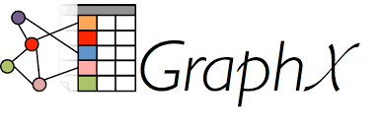
Prashant Shetty
Phunware Inc.

Slide 2
Agenda
Graphs
Definition
Key concepts & algorithms
GraphX
Basic operations - joins, neighborhood aggregations
Integration with Neo4J
GraphFrames
Hands-on tutorial

Slide 3
Graphs
Ordered pair, G = (V,E) of
V “vertices” (aka nodes) &
E “edges” (aka relations) between V
Main types of Graph Models:
Property Graphs,
Hypergraphs
RDF Triples
Popular graph algorithms
Shortest Path
PageRank
Connected Components
Triangle Counting
Notes:
A hypergraph is a generalized graph model in which a relationship (called a hyper- edge) can connect any number of nodes. Whereas the property graph model permits a relationship to have only one start node and one end node, the hypergraph model allows any number of nodes at either end of a relationship. Hypergraphs can be useful where the domain consists mainly of many-to-many relationships.
A triple is a subject-predicate-object data structure. Using triples, we can capture facts, such as “Ginger dances with Fred” and “Fred likes ice cream.” Individually, single triples are semantically rather poor, but en-masse they provide a rich dataset from
which to harvest knowledge and infer connections. Triple stores typically provide SPARQL capabilities to reason about and stored RDF (Resource Description Framework) data.

Slide 4
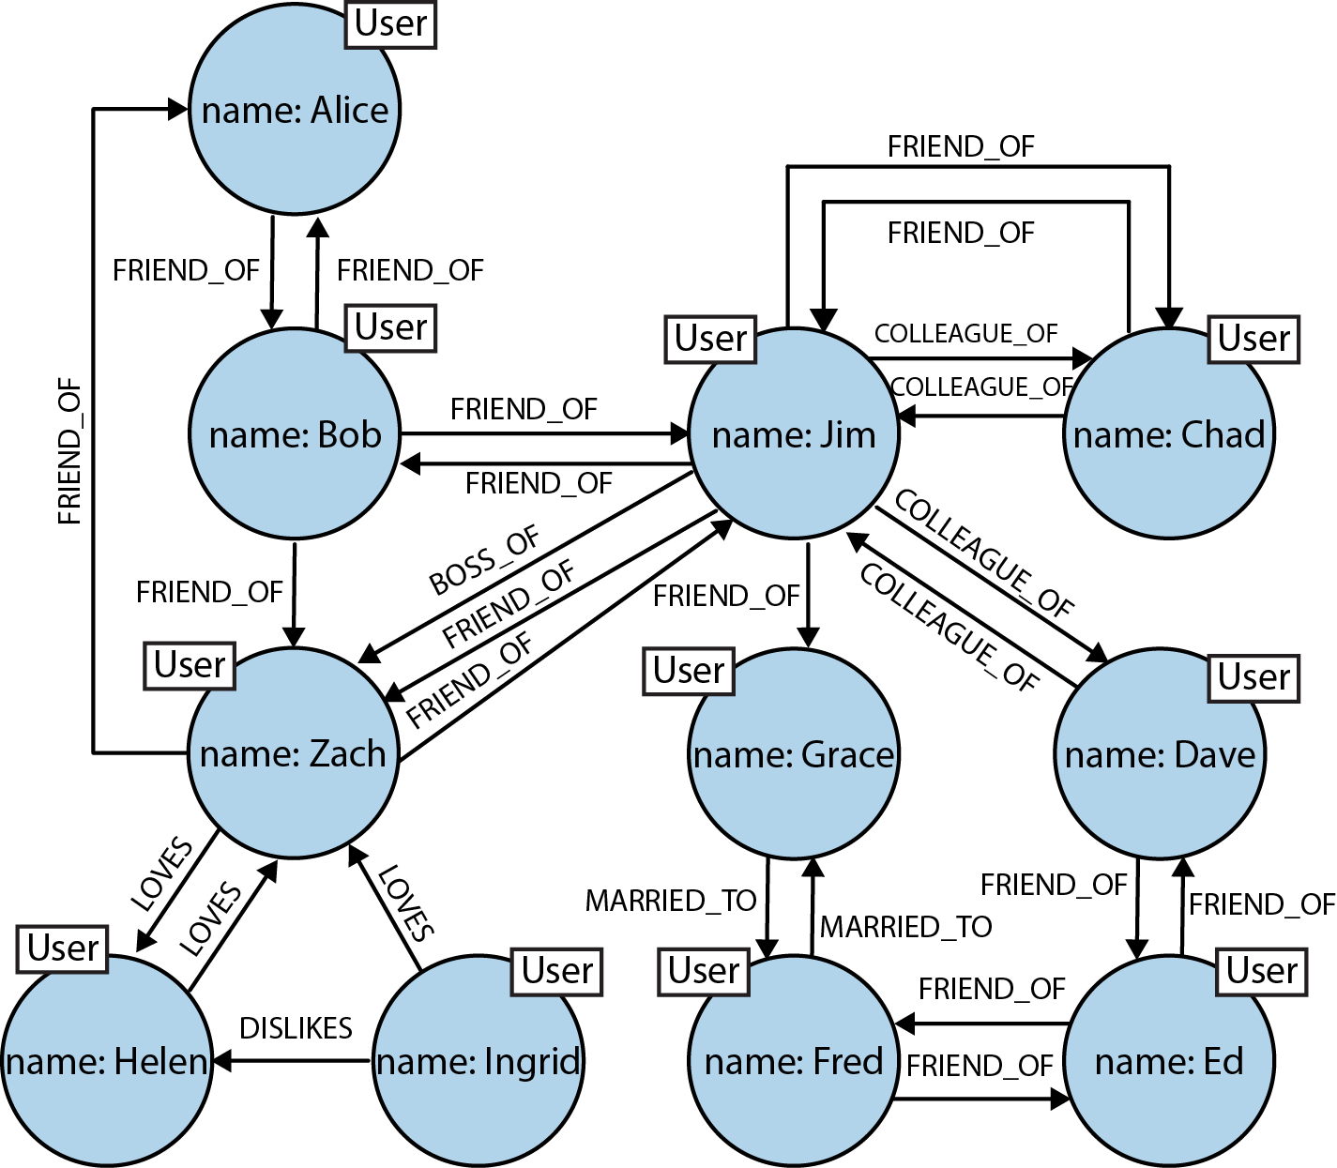
Property Graph
Consists of nodes and relationships
Nodes contain “properties” (represented as key-value pairs)
Nodes can be assigned one or more “labels”
Relationships
named and “directed”
also contain “properties”
have a “start” and an “end” node

Slide 5
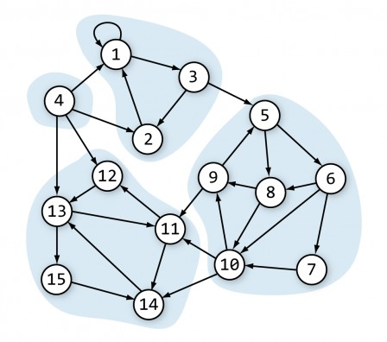
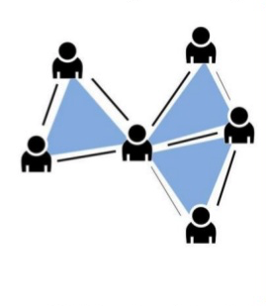
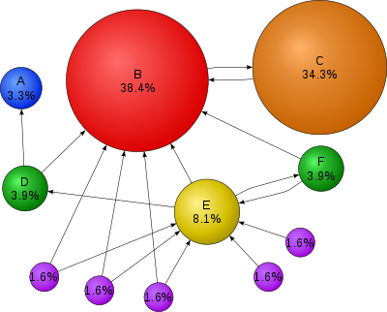
Graph Algorithms
Notes:
PageRank measures the importance of each vertex in a graph, assuming an edge from u to v represents an endorsement of v’s importance by u.
Connected components identifies clusters in a graph

Slide 6
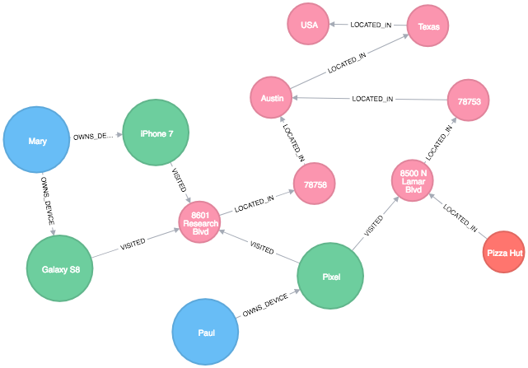
Location Graph

Slide 7
GraphX
Graph compute engine in Spark
Extends Spark RDD
class Graph[VD, ED] { val vertices: VertexRDD[VD] val edges: EdgeRDD[ED] }
Directed multigraph
Properties attached to vertices & edges
Partitioned along vertices

Slide 8
GraphX - Basic operations
mapVertices(), mapEdges(), joinVertices()
inDegrees(), outDegrees(), degrees()
persist (newLevel: StorageLevel = StorageLevel.MEMORY_ONLY)
cache(), partitionBy()
aggregateMessages()
pregel()
pageRank(), connectedComponents(), triangleCount(), stronglyConnectedComponents()

Slide 9
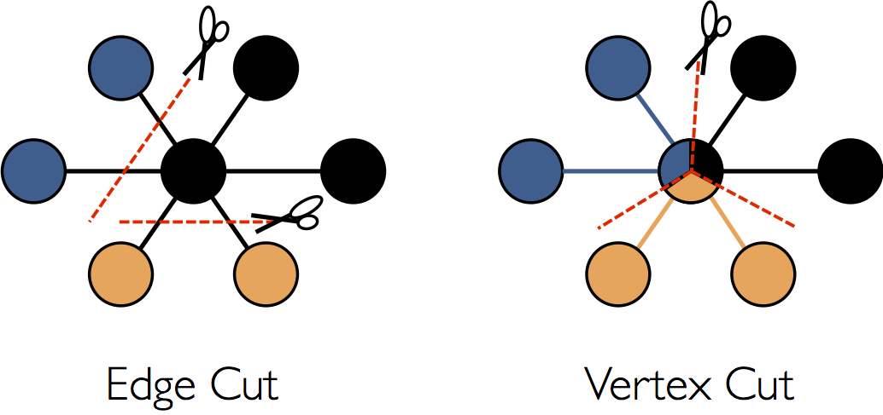
GraphX -Partitioning
Partitioned along vertices
Assign edges to machines
Span vertices across multiple machines
PartitioningStrategy using partition()
EdgePartition1D
EdgePartition2D
RandomVertexCut

Slide 10
Aggregate Messages
Core aggregation operation in GraphX
Comprised of
sendMsg() - sends message to each triplet.
mergeMsg() - merges all the messages at each vertex
class Graph[VD, ED] { def aggregateMessages[Msg: ClassTag]( sendMsg: EdgeContext[VD, ED, Msg] => Unit, mergeMsg: (Msg, Msg) => Msg, tripletFields: TripletFields = TripletFields.All) : VertexRDD[Msg] }

Slide 11
GraphX - Integration with neo4J
neo4J - Graph database
transactional (ACID compliant)
Native storage and processing
Proprietary Query Language - Cypher
neo4J Spark connector
Binary Bolt protocol
Export data to and from neo4j cluster
neo4J-MazeRunner
Export data from neo4J to Spark
Notes:
Neo4j itself is capable of running graph processing on medium to large graphs quickly. For instance the graph-processing project demonstrates that we can run PageRank (5 iterations) on the dbpedia dataset (10M nodes, 125M relationships) in 20 seconds as a Neo4j server extension or user defined procedure. Spark might be better suited for larger datasets or more intensive compute operations.

Slide 12
GraphFrames
API for DataFrame-based graphs
val v = sqlContext.createDataFrame(List( ("a", "Alice", 34), ("b", "Bob", 36)).toDF("id", "name", "age")
val e = sqlContext.createDataFrame(List( ("a", "b", "friend"), ("b", "a", "follow")).toDF("src", "dst", "relationship")
val g = GraphFrame(v, e)

Slide 13
GraphFrames (contd.)
Python, Scala and Java API
Motif finding - structural patterns in Graph
graph.find("(a)-[e]->(b); (b)-[e2]->(a)")
similar to MATCH in Cypher
Partitioning not available yet
Command to run GraphFrames:
spark-shell --master yarn --packages graphframes:graphframes:0.5.0-spark2.1-s_2.11
spark-submit --master yarn --packages graphframes:graphframes:0.5.0-spark2.1-s_2.11

Slide 14
Appendix
GraphX - https://spark.apache.org/docs/latest/graphx-programming-guide.html
GraphFrames - https://graphframes.github.io/user-guide.html
Pregel - https://www.cs.cmu.edu/~pavlo/courses/fall2013/static/papers/p135-malewicz.pdf
Purchase Intent using GraphX - https://youtu.be/lFBPdL9XpA4

