Slide 1
Enhanced Entity-Relationship Modeling
Transparencies
© Pearson Education Limited 1995, 2005

Slide 2
Specialization / Generalization
Superclass
  An entity type that includes one or more distinct subgroupings of its occurrences.
Subclass
  A distinct subgrouping of occurrences of an entity type.
© Pearson Education Limited 1995, 2005

Slide 3
Specialization / Generalization
Superclass/subclass relationship is one-to-one (1:1).
Superclass may contain overlapping or distinct subclasses.
Not all members of a superclass need be a member of a subclass.
© Pearson Education Limited 1995, 2005

Slide 4
Specialization / Generalization
Attribute Inheritance
  An entity in a subclass represents same ‘real world’ object as in superclass, and may possess subclass-specific attributes, as well as those associated with the superclass.
© Pearson Education Limited 1995, 2005

Slide 5
Specialization / Generalization
Specialization
  Process of maximizing differences between members of an entity by identifying their distinguishing characteristics.
Generalization
  Process of minimizing differences between entities by identifying their common characteristics.
© Pearson Education Limited 1995, 2005

Slide 6
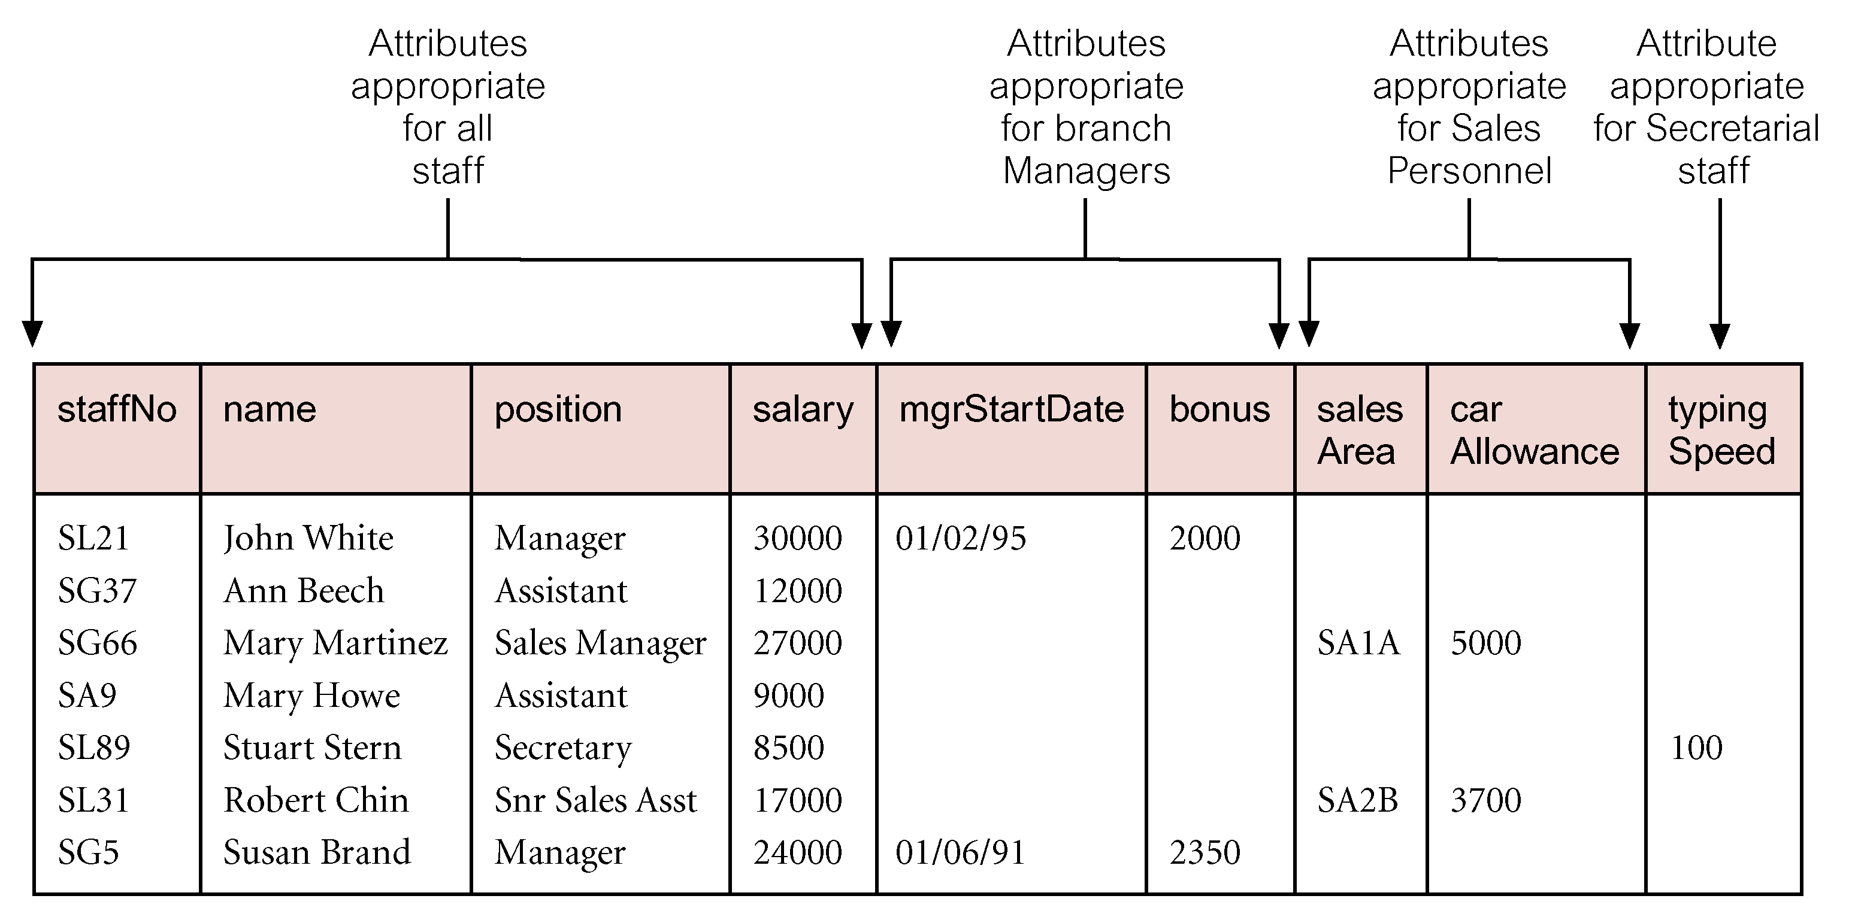
AllStaff relation holding details of all staff
© Pearson Education Limited 1995, 2005

Slide 7
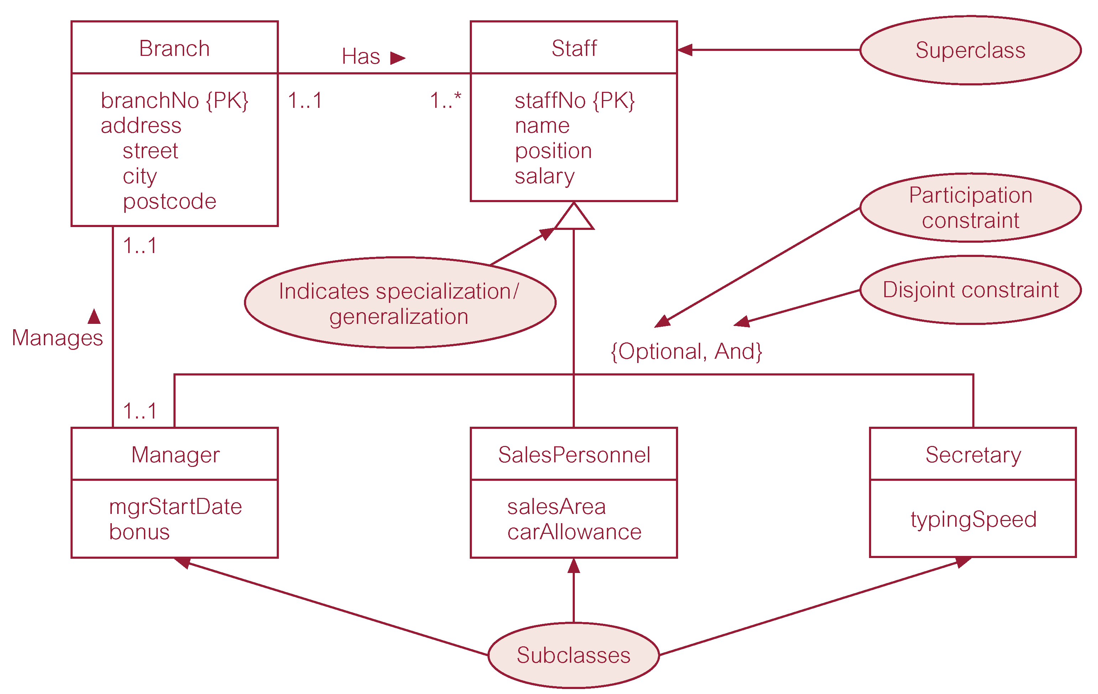
Specialization/generalization of Staff entity into subclasses representing job roles
© Pearson Education Limited 1995, 2005

Slide 8
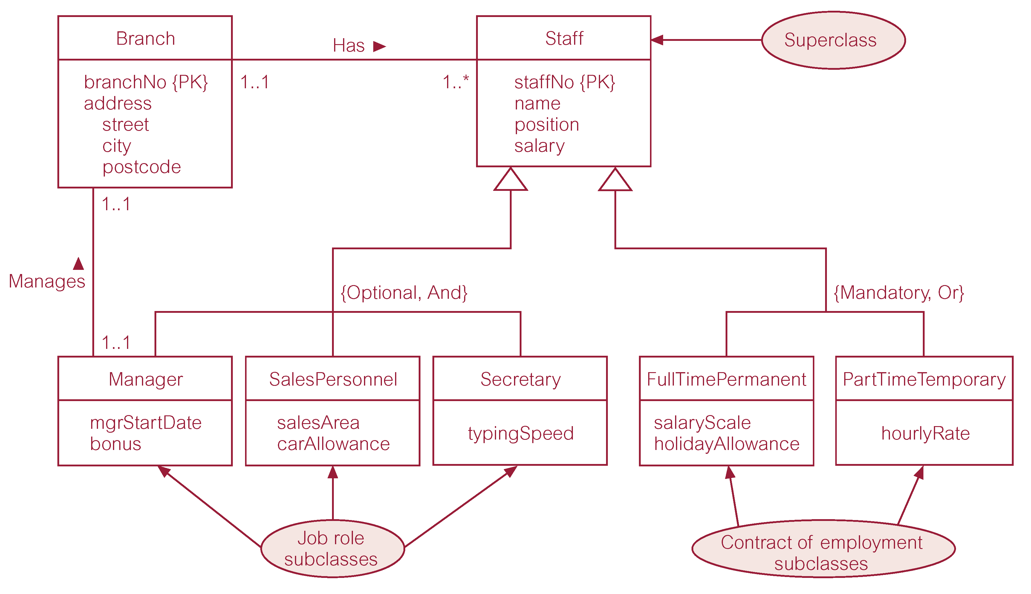
Specialization/generalization of Staff entity into job roles and contracts of employment
© Pearson Education Limited 1995, 2005

Slide 9
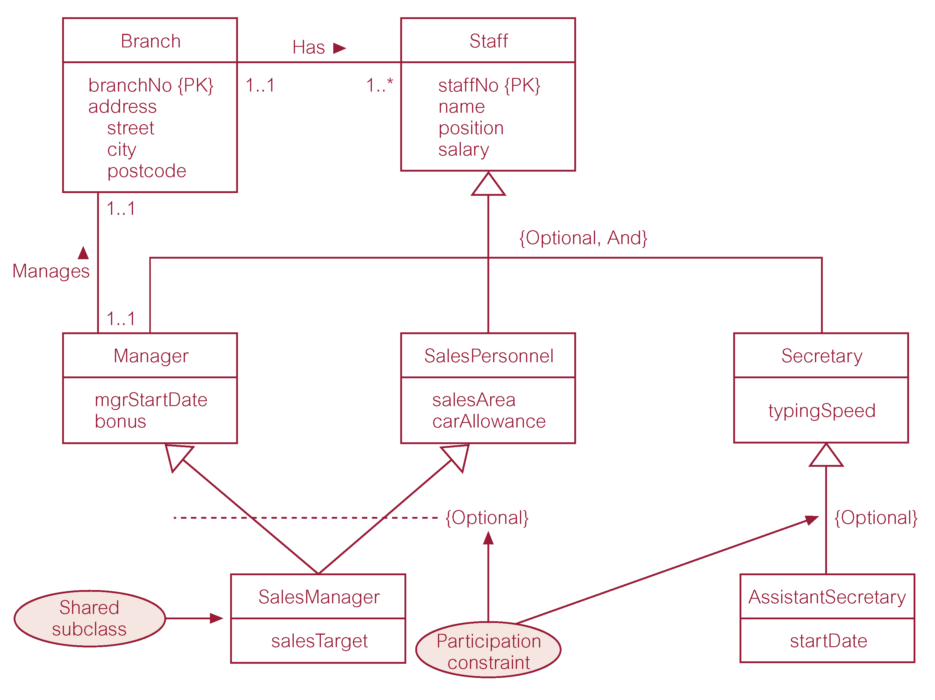
EER diagram with shared subclass and subclass with its own subclass
© Pearson Education Limited 1995, 2005

Slide 10
Constraints on Specialization / Generalization
Two constraints that may apply to a specialization/generalization:
  participation constraints
  disjoint constraints.
Participation constraint
  Determines whether every member in superclass must participate as a member of a subclass.
  May be mandatory or optional.
© Pearson Education Limited 1995, 2005

Slide 11
Constraints on Specialization / Generalization
Disjoint constraint
  Describes relationship between members of the subclasses and indicates whether member of a superclass can be a member of one, or more than one, subclass.
  May be disjoint or nondisjoint.
© Pearson Education Limited 1995, 2005

Slide 12
Constraints on Specialization / Generalization
There are four categories of constraints of specialization and generalization:
  mandatory and disjoint
  optional and disjoint
  mandatory and nondisjoint
  optional and nondisjoint.
© Pearson Education Limited 1995, 2005

Slide 13
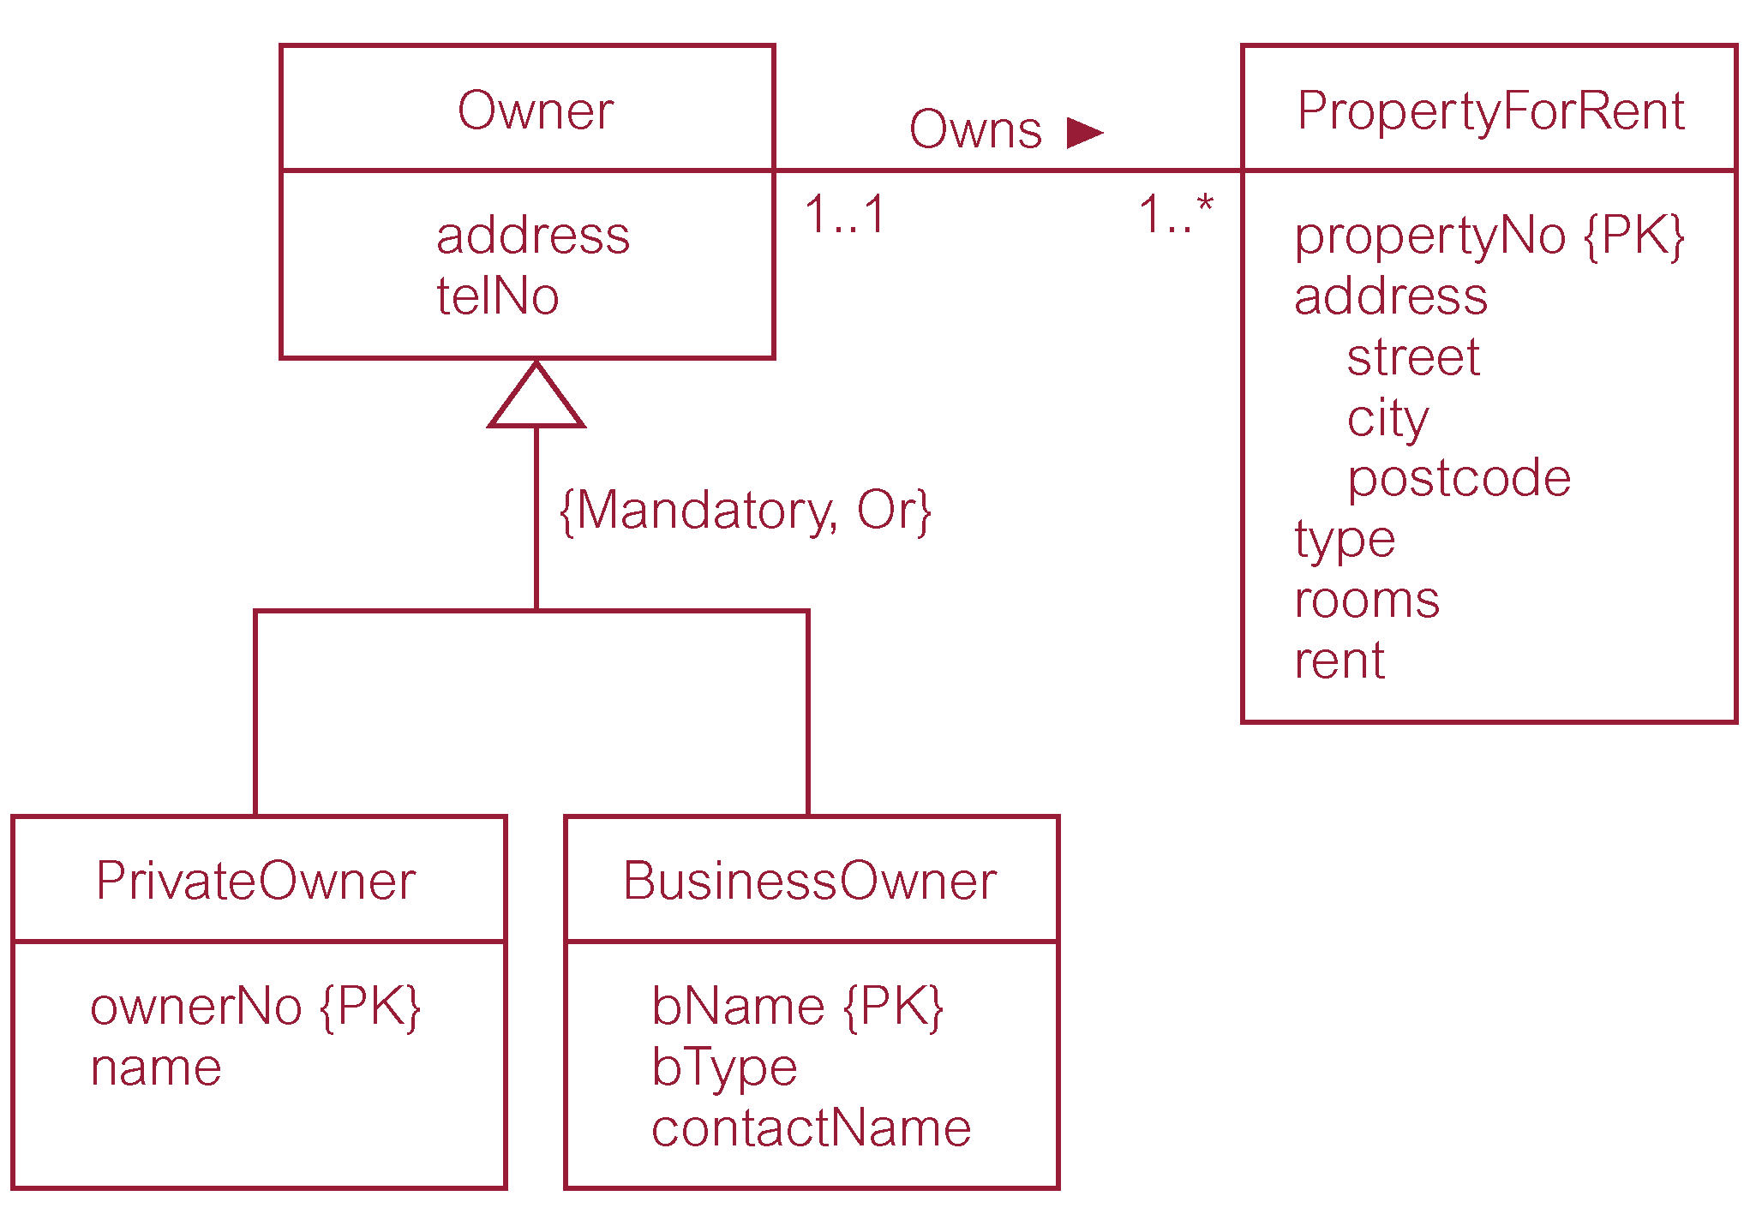
DreamHome worked example - Owner Superclass with PrivateOwner and BusinessOwner subclasses
© Pearson Education Limited 1995, 2005

Slide 14
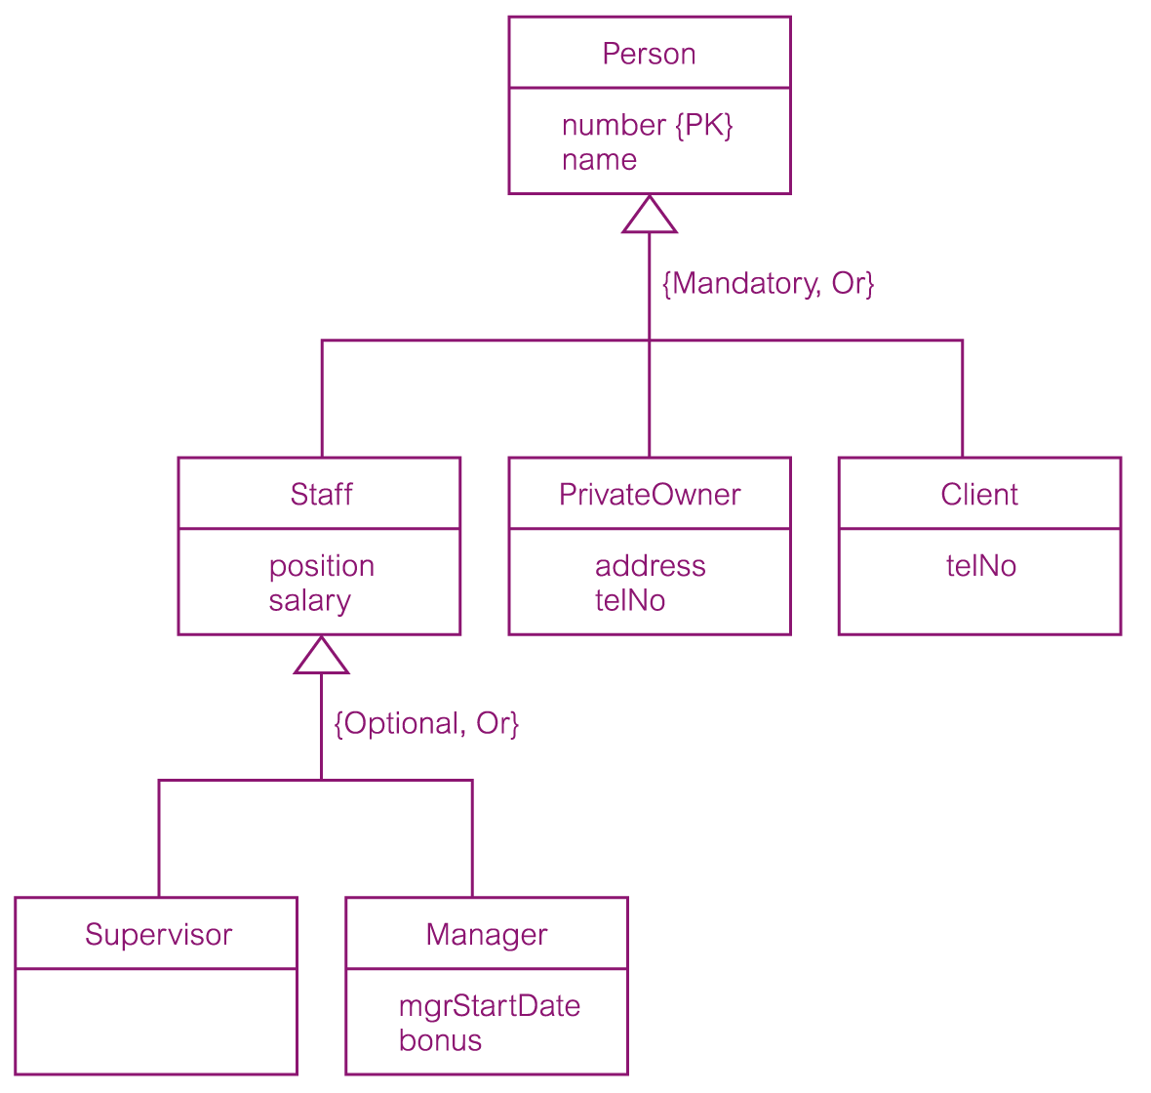
DreamHome worked example - Person superclass with Staff, PrivateOwner, and Client subclasses
© Pearson Education Limited 1995, 2005

