Slide 1
Consider the following example of a database for a produce store:
SUPPLIER SNAME ADDRESS ITEM PRICE
John 10 Main oranges .59
John 10 Main apples .59
Jane 20 Maple grapes 1.29
Jane 20 Maple mangos 2.49
Frank 30 State grapes 1.19

Slide 2
If the SUPPLIER relation above is decomposed into the following two relations, the problems mentioned above will disappear.
SA SNAME ADDRESS
John 10 Main
Jane 20 Maple
Frank 30 State
SIP SNAME ITEM PRICE
John oranges .59
John apples .59
Jane grapes 1.29
Jane mangos 2.49
Frank grapes 1.19

Slide 3
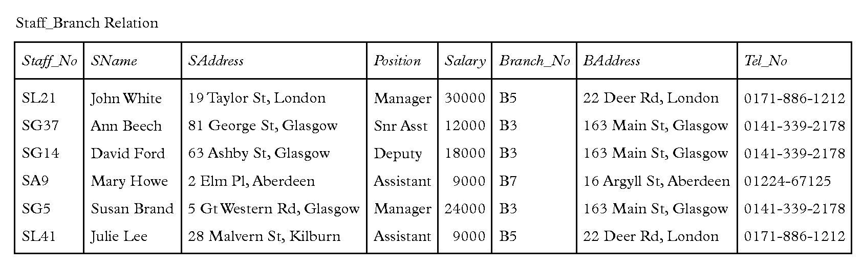

Slide 4
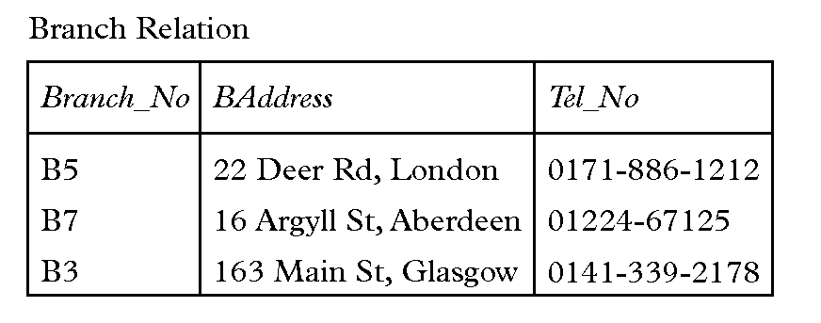
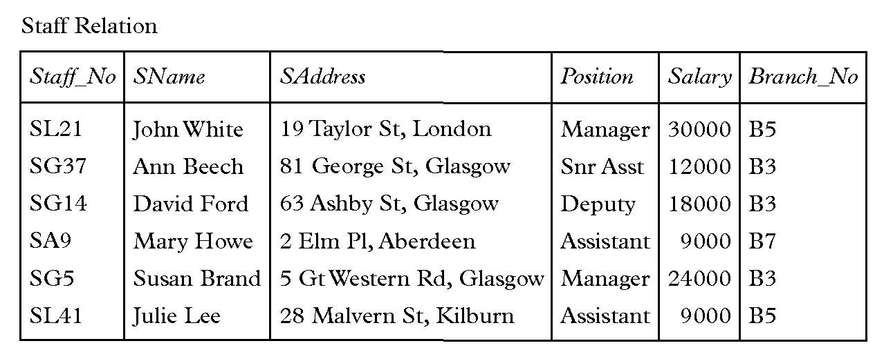

Slide 5
KEYS AND CANDIDATE KEYS
Now that we have a definition of functional dependency we can define what we mean by the key of a relational database

Slide 6
Def. A superkey of a relation R is a set of attributes that functionally determines all the attributes in the relation.
Def. A candidate key of a relation R is a minimal superkey, that is, it is a superkey that does not properly contain another superkey.

Slide 7
Candidate Key
  An attribute or set of attributes that uniquely identifies individual occurrences of an entity type.

Slide 8
Primary Key
  An entity type may have one or more possible candidate keys, one of which is selected to be the primary key.

Slide 9
Composite Key
  A candidate key that consists of two or more attributes.

Slide 10
In other words, a candidate key is a set of attributes that determines all the attributes in the relation, such that if you remove an attribute, the remaining attributes no longer functionally determine the whole relation.
If there is more than one candidate key, the database designer then chooses one of the candidate keys to be the actual database key after thinking about how people will access the database.

Slide 11
SA SNAME ADDRESS
John 10 Main
Jane 20 Maple
Frank 30 State
SIP SNAME ITEM PRICE
John oranges .59
John apples .59
Jane grapes 1.29
Jane mangos 2.49
Frank grapes 1.19

Slide 12
In the SUPPLIER database, the only candidate key is {SUPPLIER,ITEM}, so this pair of attributes must be chosen as the database key.
The key of a relation is commonly indicated by underlining the attributes, so we can write:
  SUPPLIER(SNAME, ADDRESS, ITEM, PRICE)
  SA(SNAME, ADDRESS)
  SIP(SNAME, ITEM, PRICE)

Slide 13
On my computer at home I have a relation CIS 317, with attributes NETID, LAST (your last names), FIRST (your first names), TELNO (your telephone numbers), and EMAIL (your email addresses).

Slide 14
The set of all attributes is a superkey, so is the set {NETID,EMAIL}.
{NETID} is a candidate key. So is {LAST,FIRST}.
The set {NETID,EMAIL} is not a candidate key because it is not minimal - it properly contains {NETID}.

Slide 15
The set {LAST} is not a candidate key. There are two different people in this class with the last name “Smith” so LAST does not determine all the other attributes. It is considered perfectly correct in database circles to talk about {LAST} and LAST as if they were the same even though one is a set and the other is not.

Slide 16
KEYS AND ER DIAGRAMS
Suppose entity E1 has attributes A1, A2, ..., An} and X is the key, then X --> Y for all subsets Y of the attribute set {A1, A2, ..., An}.
Suppose X is the key of E1 with attributes {A1, A2, ..., An} and Y is the key of E2 with attributes {B1, B2, ..., Bn} and there is a 1:1 (one-to-one) relationship between E1 and E2, then X --> Y and Y --> X.

Slide 17
Suppose X is the key of E1 with attributes {A1, A2, ..., An} and Y is the key of E2 with attributes {B1, B2, ..., Bn} and there is a m:1 (many-to-one) relationship between E1 and E2, then X --> Y.

Slide 18
LOGICAL IMPLICATIONS OF FD'S
Given a set F of FD's, other FD's can be derived from it.
Theorem (Transitivity). Let R be a relation and F be a set of FD's for R such that F contains A --> B and B --> C. Then A --> C also holds in R.

Slide 19
Proof: Let A --> B and B --> C hold in R
and let there be two tuples t and u in R that agree on A. We have to show that t and u also agree on C.
Since t and u agree on A, they must agree on B, since A --> B holds in R.
Since t and u agree on B, they must agree on C, since B --> C holds in R. QED.

Slide 20
Def. The closure of F, denoted F+, is the set of all FD's that are logically implied by F (logically derived from F).
Inference rules for FD's tell us how to derive other FD's from a given set.
Def. A set of inference rules is complete, if they allow us to deduce from F every FD that is in F+.
Def. A set of inference rules is sound, if they do not allow us to deduce from F any FD that is not in F+.

Slide 21
ARMSTRONG'S AXIOMS
A1. Reflexivity. If Y is a subset of X and X is a
subset of U then X --> Y is in F+.
This axiom gives us the trivial dependencies like
{SNAME, ITEM} --> ITEM

Slide 22
A2. Augmentation. If X --> Y and Z is a subset of U then XZ --> YZ is in F+.
If SNAME --> ADDRESS
then {SNAME, ITEM} --> {ADDRESS, ITEM}.

Slide 23
A3. Transitivity. If F contains X --> Y and Y --> Z,
then X --> Z is in F+.
Note. We can obtain F+ by applying these axioms repeatedly.
In other words, these axioms are sound and complete.
The two axioms below (A4 and A5) follow from axioms A1 to A3.

Slide 24
A4. Union or Additivity If F contains X --> Y and X --> Z, then X --> YZ is in F+.
Proof:
1. X --> Y given
2. X --> XY augmentation
3. X --> Z given
4. XY --> YZ augmentation
5. X --> YZ by transitivity from (2) and (4)

Slide 25
A5. Pseudotransitivity. If F contains X --> Y and YW --> Z, then XW --> Z is in F+.
Proof: 1. X --> Y given
2. XW --> YW augmentation
3. YW --> Z given
4. XW --> Z by transitivity

