Slide 1
Client Server Development

Slide 2
Outline
1 – Introduction
2 - Application Architectures
3 - World Wide Web
4 - Electronic Mail

Slide 3
1 Introduction
Clients
Servers
Communication Networks
Server
Client

Slide 4
1 Introduction
Applications
(e.g., email, web,
word processing)
Application Layer
Transport Layer
Network Layer
Application architecture
The way in which the functions of the application layer software are spread among the clients and servers on the network
Functions of Application Layer
Data storage - Storing of data generated by programs (e.g., files, records)
Data access logic - Processing required to access stored data (e.g., SQL)
Application logic - Business logic such as word processors, spreadsheets
Presentation logic - Presentation of info to user & acceptance of user commands

Slide 5
2 Application Architectures
Determined by how functions of application programs are spread among clients and servers
Host-based Architectures
Server performs almost all functions
Client-based architectures
Client performs most functions
Client-server architectures
Functions shared between client and server

Slide 6
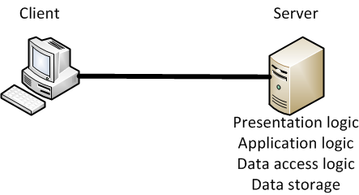
Host-Based Architectures
Client captures key strokes then sends them to the mainframe
Client displays information according to the server’s instructions

Slide 7
Host-based Architecture Problems
Host becoming a bottleneck
All processing done by the host, which can severely limit network performance
Host upgrades typically expensive
Available upgrades require large scale and often costly jumps in processing and memory

Slide 8
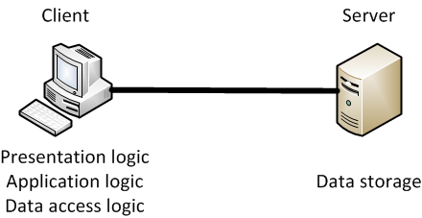
Client-Based Architectures
Example: Using a word processing package on a PC and storing data files on a server

Slide 9
Client-Based Architecture Problems
Data traffic must travel back and forth between server and client
Example: when the client program is making a database query, the ENTIRE database must travel to the client before the query can be processed
Often the large file sizes moving across the LAN can yield a poor result in network performance

Slide 10
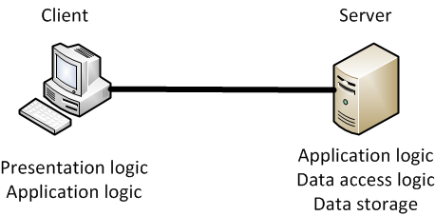
Client-Server Architectures
Example: Using a Web browser to obtain web pages uses logic balanced between the client and server
Application logic can be on client and/or server

Slide 11
Client-Server Architectures
Advantages
More efficient because of distributed processing
Allow hardware and software from different vendors to be used together
Enables cloud computing
Disadvantages
Difficulty in getting software from different vendors to work together smoothly
May require Middleware, a third category of software

Slide 12
Middleware
client application programs
a standard way of translating between software from different vendors
Manages message transfers
Insulates network changes from the clients (e.g., adding a new server)
Middleware
server application programs
Example of standard for Middleware:
Open Database Connectivity (ODBC)

Slide 13
Types of Client/Server Architectures
Involve more than two computers in distributing application program logic
2-tier architecture
Uses clients and servers in a balance, very popular approach in simple LANs
3-tier architecture
3 sets of computers involved
N-tier architecture
More than three sets of computers used, more typical across complex organizations
Allows load balancing across servers

Slide 14
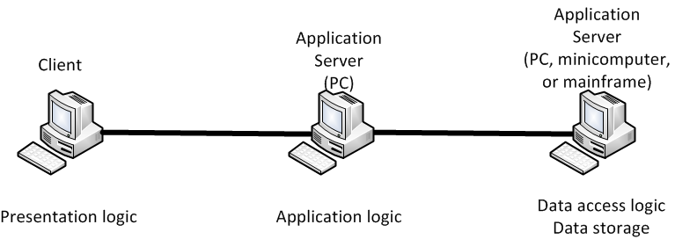
3-tier Architecture

Slide 15
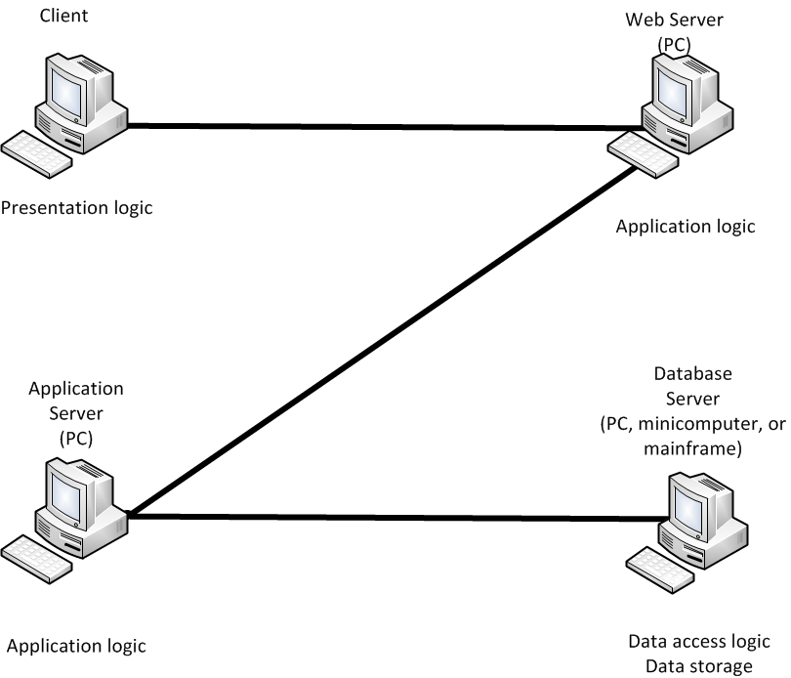
N-tier Architecture

Slide 16
Multi-tier Architectures
Advantages
Better load balancing:
More evenly distributed processing. (e.g., application logic distributed between several servers.)
More scalable
Disadvantages
Heavily loaded network:
More distributed processing necessitates more data exchanges
Difficult to program and test due to increased complexity

Slide 17
Thin and Thick Clients
Classification depends on how much of the application logic resides on the client or server
Thin client:
Little or no application logic on client
Becoming popular because easier to manage, (only the server application logic generally needs to be updated)
The best example: World Wide Web architecture (uses a two-tier, thin client architecture)
Thick client:
All or most of the application logic resides on the client

Slide 18
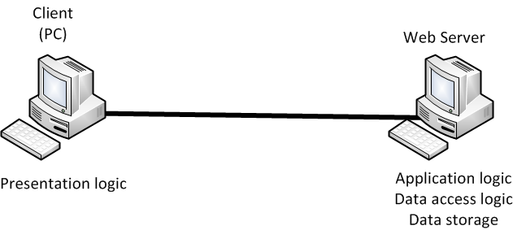
Thin-Client Example: Web Architecture

Slide 19
Peer to Peer Architecture
All computers can serve as a client and a server
Increased popularity in the last decade due to the rise of P2P services such as Napster
Advantages:
Data can be stored anywhere on the network
Very resilient to failure
Disadvantages:
Finding data
Security

Slide 20
Criteria for Choosing Architecture
Infrastructure Cost
Cost of servers, clients, and circuits
Mainframes: very expensive; terminals, PCs: inexpensive
Development Cost
Mainly cost of software development
Software: expensive to develop; off-the-shelf software: inexpensive
Scalability
Ability to increase (or decrease) in computing capacity as network demand changes
Mainframes: not scalable; PCs: highly scalable

Slide 21
Choosing an Architecture
Host-Based
Client-Based
Client-Server
Cost of Infrastructure
High
Medium
Low
Cost of Development
Low
Medium
Medium
Scalability
Low
Medium
High

Slide 22
Applications Layer Examples
World Wide Web
E-mail
File Transfer
Videoconferencing
Instant Messaging

Slide 23
3 World Wide Web
Web began with two innovative ideas:
Hypertext
A document containing links to other documents
Uniform Resource Locators (URLs)
A formal way of identifying links to other documents

Slide 24
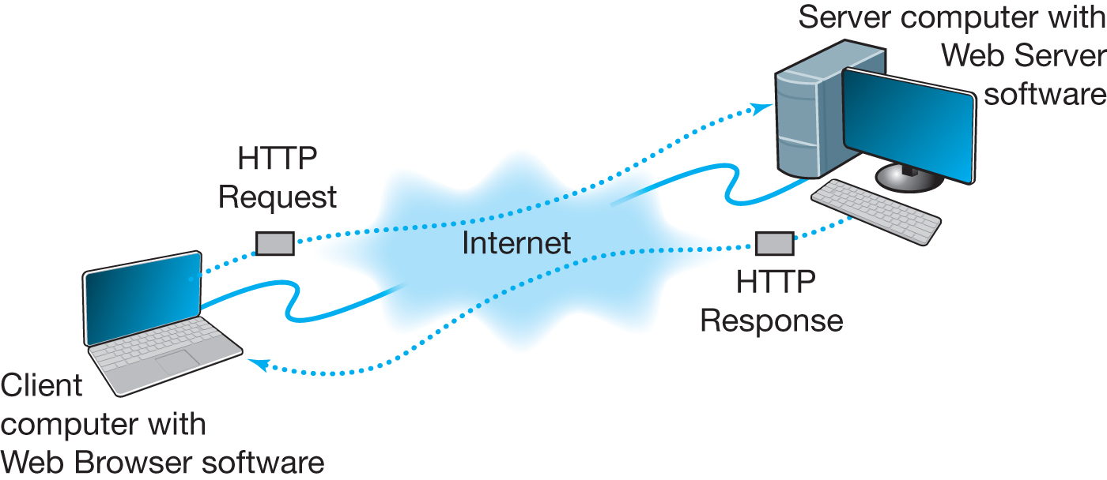
How the Web Works

Slide 25
HTML - Hypertext Markup Language
A language used to create Web pages
Tags are embedded in HTML documents
include information on how to format the file
Extensions to HTML needed to format multimedia files
XML - Extensible Markup Language
A new markup language becoming popular

Slide 26
4- Two-Tier E-mail Architecture
User agent is another word for an e-mail client application
Run on client computers
Send e-mail to e-mail servers
Download e-mail from mailboxes on those servers
Examples: Eudora, Outlook, Netscape Messenger
Mail transfer agent is another word for the mail server application
Used by e-mail servers
Send e-mail between e-mail servers
Maintain individual mailboxes.

Slide 27
Web Development Tools
HTML , XHTML, XML
VB Script
PHP Script
ASP.Net
Java Programming (Java Script)
Web Servers:
Apache Apache,
IIS Microsoft,
GWS Google.

