Slide 1
Global Security
SharePoint
2018 – Oct - 16

Slide 2
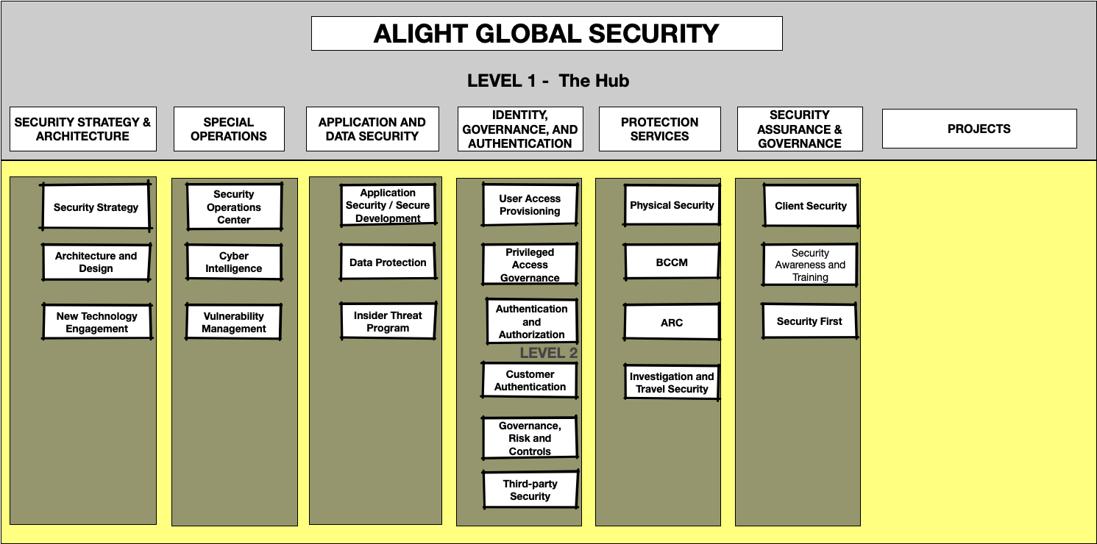
The Landing Page
Divisions

