Slide 1

Medical Readmission Project
Austin Stewart, MSDS

Slide 2
Hospital readmissions can be expensive.
Understanding why patients return can help identify areas for improvement.
Reducing readmissions can improve patient outcomes while lowering costs.

Slide 3
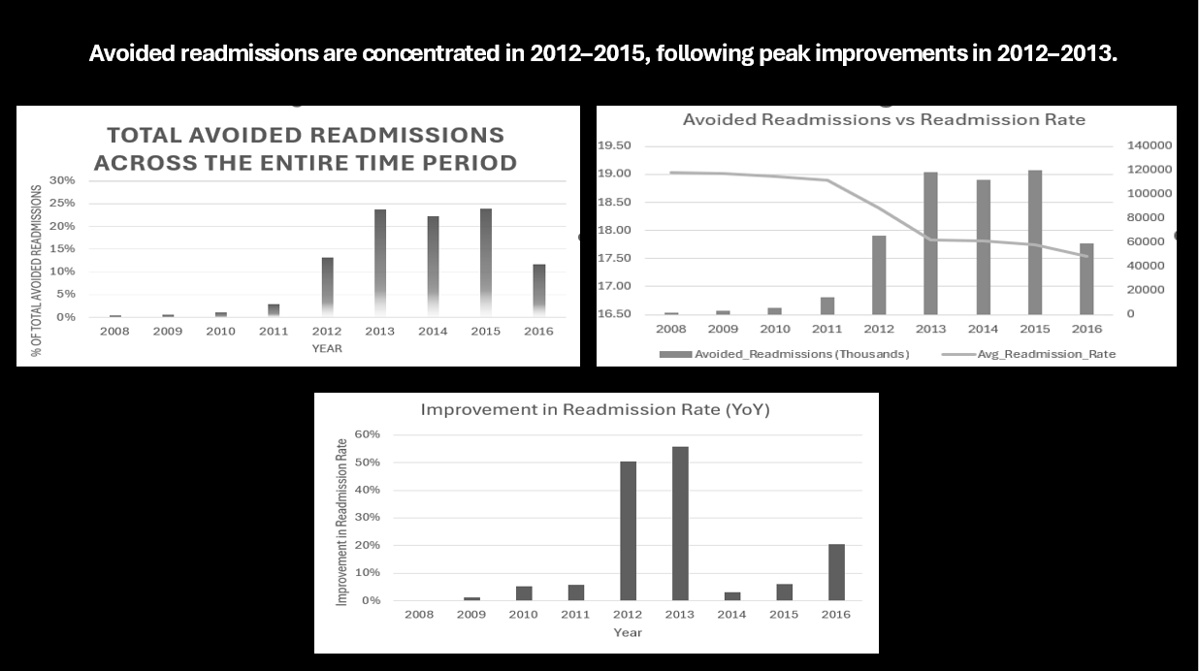
Finding: Readmission rates improved throughout the study period, with the largest improvements occurring between 2012 and 2015.

Slide 4
Recommendation 1
Recommendation: Continue supporting the programs and practices that contributed to the improvements observed between 2012 and 2015.

Slide 5
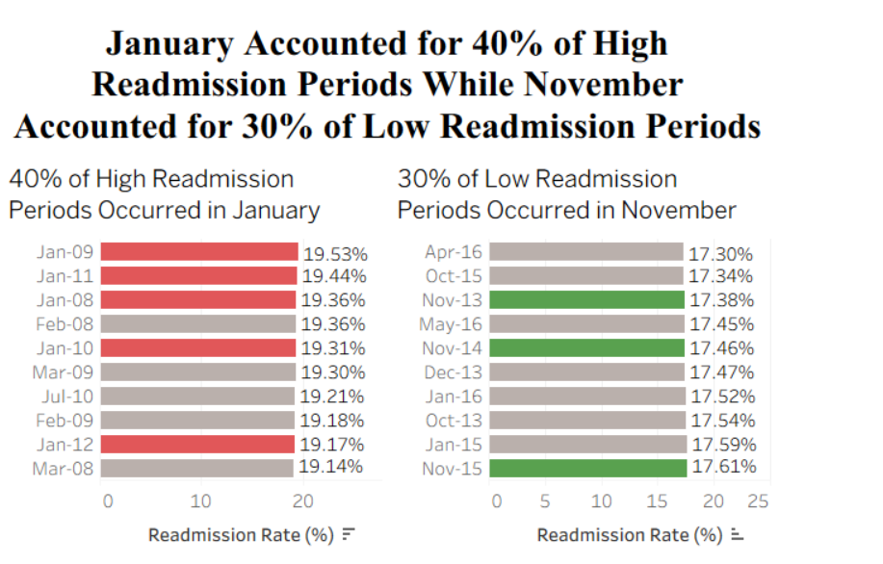
Finding: The highest readmission rate occurred in January 2009 (19.53%), while the lowest occurred in April 2016 (17.30%).

Slide 6
Recommendation 2
Review the differences between these periods to identify factors that may have contributed to lower readmission rates.

Slide 7
Key Findings
Readmission rates improved throughout the study period.
The largest improvements occurred between 2012 and 2015.
The highest readmission rate occurred in January 2009.
The lowest readmission rate occurred in April 2016.
Recommendations
Continue supporting the practices associated with improvements between 2012 and 2015.
Review differences between high and low readmission periods to identify opportunities for further improvement.

