Slide 1
GenealoTree
GenealoTree
Austin Tauer, Emily Budke, Taylor Ruhoff
Austin Tauer, Emily Budke, Taylor Ruhoff

Slide 2
Project Description
A desktop application for tracking family history/genealogy

Slide 3
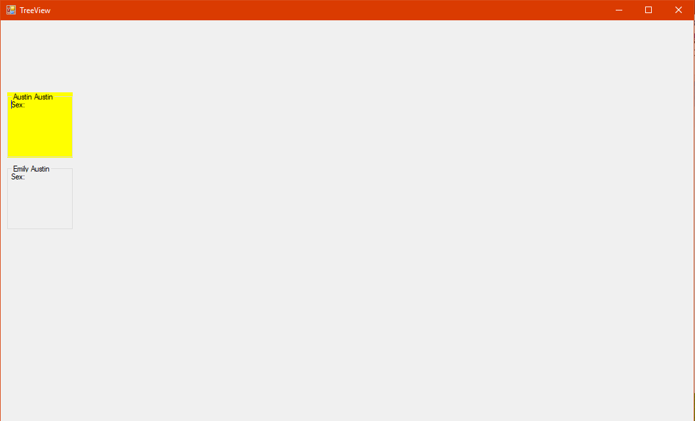
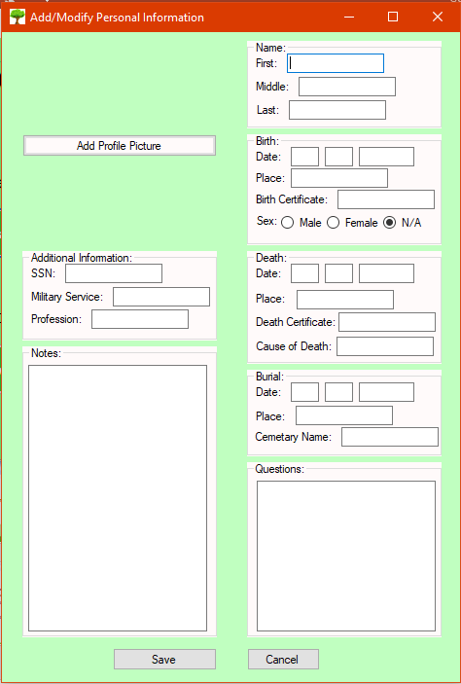
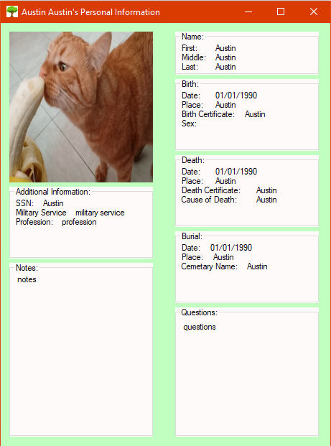
Interface Design
Tree View
Add/Modify View
Individual View

Slide 4
High-Fidelity Prototype

Slide 5
Implementation Plan
Current Functions/Features
Future Functions/Features
Add Person
Modify Person
View Relationships
Data Validation
Easy Reversibility
Attachments
Database Support
Visual Appeal

