Slide 1
GenealoTree
GenealoTree
Austin Tauer, Emily Budke, Taylor Ruhoff
Austin Tauer, Emily Budke, Taylor Ruhoff

Slide 2
Project Description
A desktop application for tracking family history/genealogy

Slide 3
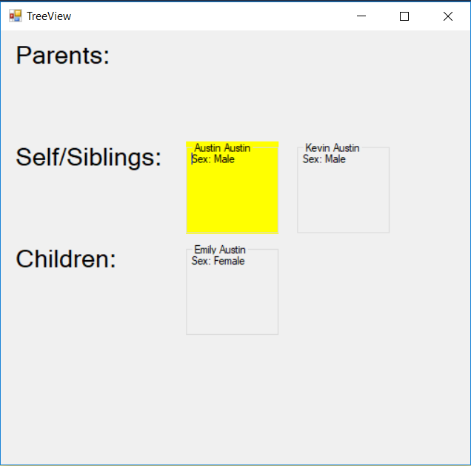
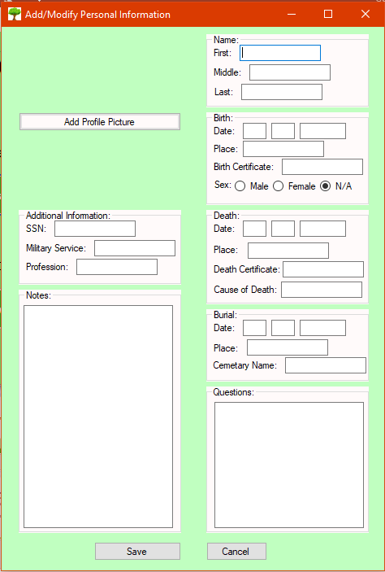
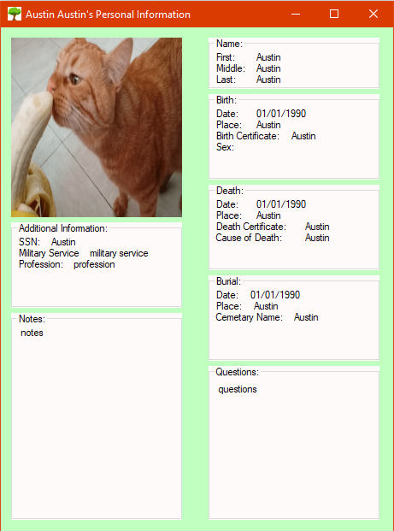
Old Interface Design
Relationship View
Add/Modify View
Personal Information View

Slide 4
New Interface Design
Relationship View
Add/Modify View
Personal Information View

Slide 5
Functions & Features
Previous
New
Add Person
Modify Person
View Person
View Relationships
Relationship Management
Data Validation
Reversibility
Save Functionality (File system)
Navigation and Interconnectivity
Visual Appeal

Slide 6
High-Fidelity Prototype

