Slide 1
Capstone_Final_Report
Cybersecurity Survey by Pew Research Center for the People & the Press conducted March 30 – May 3, 2016
Summary by C. Halsell for Springboard Data Science Basic Course

Slide 2
Explanation
Pew Research Center conducted the survey in 2016, calling 2,254 people. There are 1,040 observations with 105 variables included in their data set.
Selected this data to learn about survey data focusing on a current issue – Cybersecurity.
Many non-responses, N/A and Don’t Know’s are included.
Categorical, Ordinal, Interval and Numeric data types make the statistical analysis ”interesting”.
Perspective assumed to identify target audience for marketing a new consumer cyber security application.

Slide 3
Data Issues
Many Non-Response, NA and Don’t Know responses in the majority of the 105 variables.
105 Variables and 1,040 observations made initial investigation bulky.
Survey data is very interesting, but the limited quantity of numerical and time-related variables reduced types of analytical methods that I wanted to learn.
After several attempts to set up a model, I decided to use the age (agegroup) as the base variable since it was answered by almost everyone surveyed.

Slide 4
Data Wrangling
Data file was initially imported to Excel to check and update variable names for easier use in R analysis.
Added a variable ‘agegroup’ that grouped ages into subsets to improve graphics.
Imported data file into R.
Investigated several survey websites regarding the high numbers of non-responses and learned that it is possible to learn from them rather than using the mean to fill them.
Large number of variables drove me to do a quick lm to identify a much smaller number of significant variables.
> # The best combination of variables are marital, par, emplnw3, hh1, qc1, intfreq, acct2, habits2, habits3, habits7, habits9, habits10, wifi2a, wifi2b, policy2a, policy3, policy4 and policy6e compared to recage. I saved this data in cybersec1m1.

Slide 5
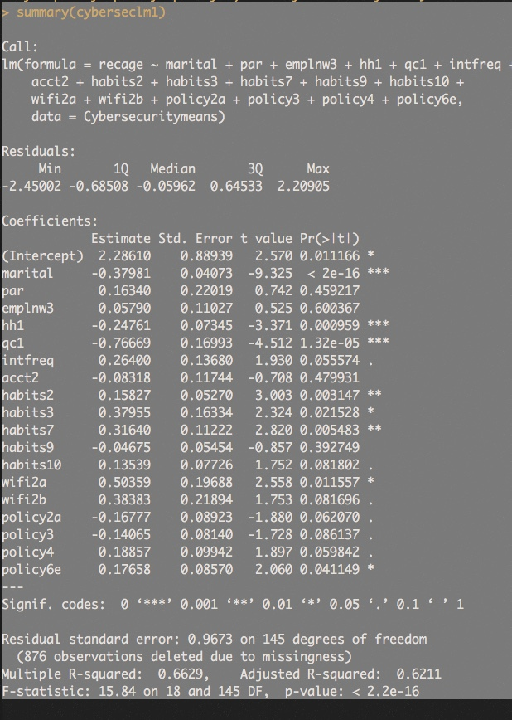
Data Wrangling Narrowing the More Significant Variables
876 Observations Missing. Highest R^2 Value Scenario

Slide 6
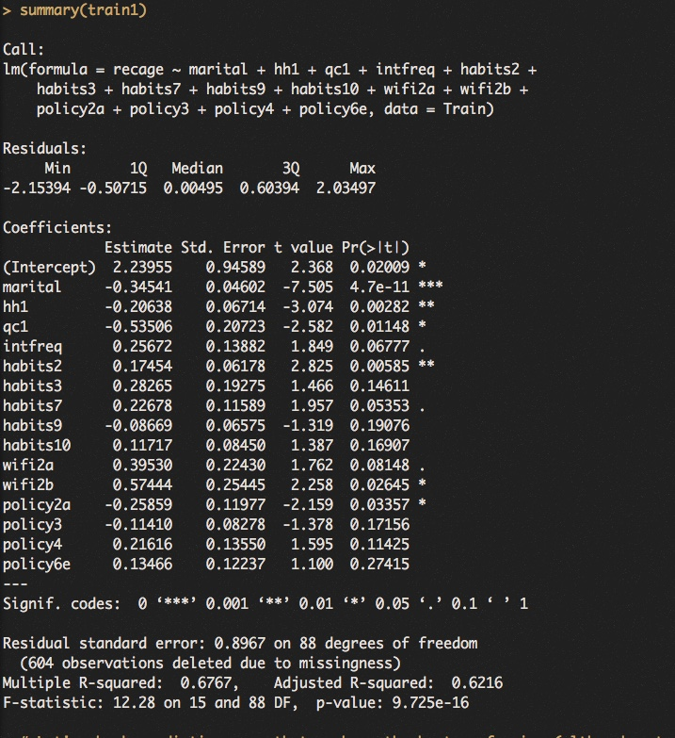
Interesting Findings Creating the Train and Test Data Sets
Data was split into a Train data set with 708 observations (70%) and a Test data set with 332 observations (30%)
Summary of Train is on the right. Notice the changes in variables that gave us the highest R^2 values 0.6767 and 0.6216.

Slide 7
Interesting Findings Predictions
 | Min | 1st Qu. | Median | Mean | 3rd Qu | Max | NA’s
Train | -0.07253 | 1.84435 | 2.96549 | 2.82692 | 3.81794 | 5.50285 | 0
Test | 0.1182 | 2.4306 | 3.3750 | 3.2034 | 3.9318 | 5.9376 | 271
Difference | 0.1907 262.9% | 0.5863 31.8% | 0.4095 13.8% | 0.3765 13.3% | 0.1139 0.3% | 0.4348 7.9% | 271
Notice the number of NA’s in the Test Prediction (271) that were not a part of the Train Prediction.
The increase in the Min and 1st Quartile was much greater than the 3rd Quartile and Max measurements.

Slide 8
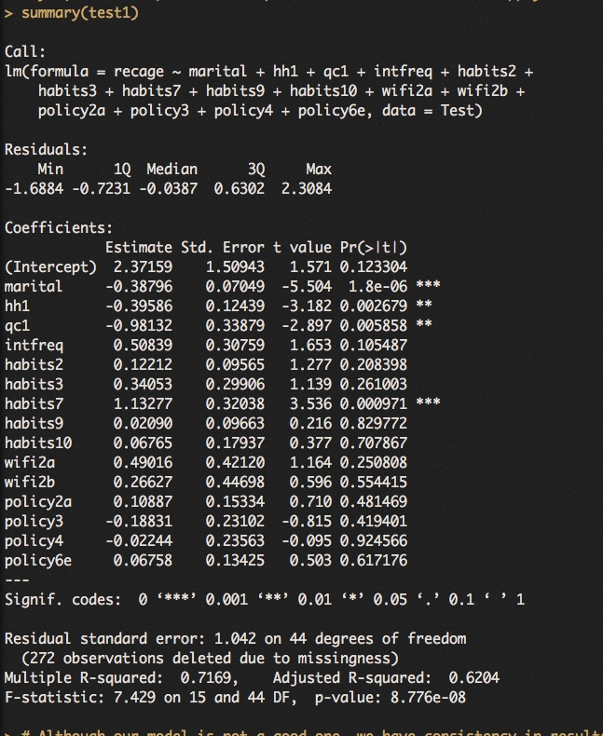
Interesting Findings Summary of the Test Data
Summary of Test is on the right. Notice the changes in variables that gave us the highest R^2 values 0.7169 (improvement) and 0.6204(slightly lower).
Notice the significance of variables changed from the Train data.
Remember that 272 observations of 332 in the Test data are missing / not included.

Slide 9
Interesting Findings Additional Comparisons between Train and Test Data Sets
RMSE (Root Mean Squared Error)
Train Data = 0.8248378
Test Data = 0.8925444 (~8.2% Increase)
MAE (Mean Absolute Error)
Train Data = 0.6663744
Test Data = 0.7099496 (~6.5% Increase)
OutlierTest
Train Data #610 w/ rstudent = -2.729616 and Bonferonni p = 0.79802
Test Data #253 w/ rstudent = 2.878609 and Bonferonni p = 0.37197
NCVTest (Non-constant Variance Score Test)
Train Data Chisquare = 4.20791 (96%), DF = 1, p = 0.04023589
Test Data Chisquare = 5.691413(98.22%), DF = 1, p = 0.01704813

Slide 10
Interesting Findings Summary Statistics
Dataset | Min | 1Q | Median | 3Q | Max | RSE | Obs Deleted | RSQ | Adj RSQ | F-Statistic | P-Value
Complete | -2.45002 | -0.68508 | -0.05962 | 0.64533 | 2.20905 | 0.9673 on 145DF | 876 | 0.6629 | 0.6211 | 15.84 on 18 and 145DF | 2.2e-16
Train | -2.15394 | -0.50715 | 0.00495 | 0.60394 | 2.03497 | 0.8967 on 88DF | 604 | 0.6767 | 0.6216 | 12.28 on 15 and 88DF | 9.725e-16
Test | -1.6884 | -0.7231 | -0.0387 | 0.6302 | 2.3084 | 1.042 on 44DF | 272 | 0.7169 | 0.6204 | 7.429 on 15 and 44DF | 8.77e-08
Please note the number of observations missing from the datasets.
The range decreased from 4.6591 to 3.9968.
Complete n=1,040, Train n=708, Test = 332

Slide 11
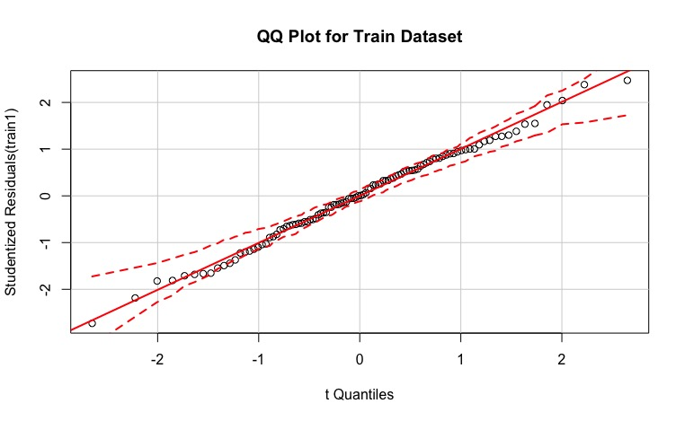
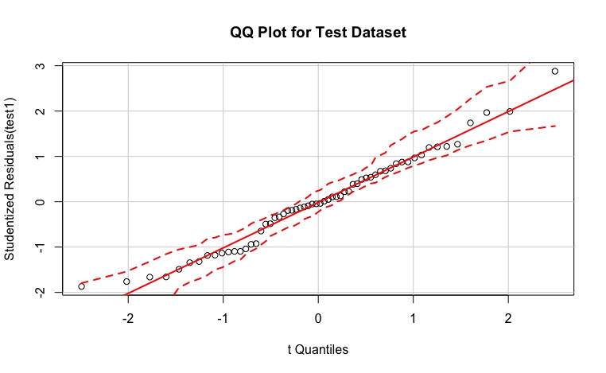
Interesting Findings QQ Plots for Train and Test Datasets
QQ Plot for Train Dataset
QQ Plot for Test Dataset
Notice the scale difference as well as the effects of the missing data

Slide 12
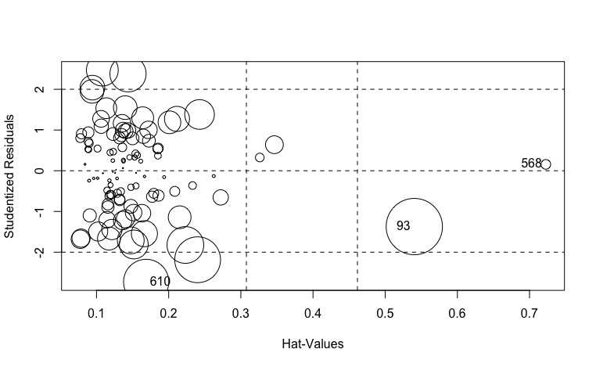
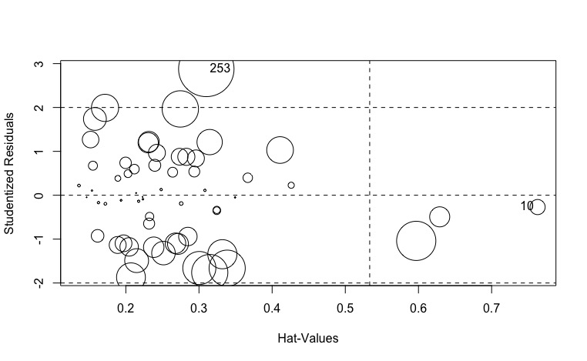
Interesting Findings Influence Plots for Train and Test Datasets
Influence Plot for Train Dataset
Influence Plot for Test Dataset
Notice the scale variation

Slide 13
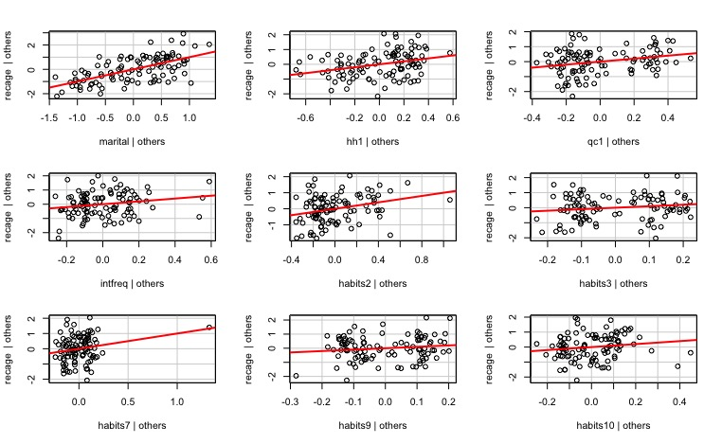
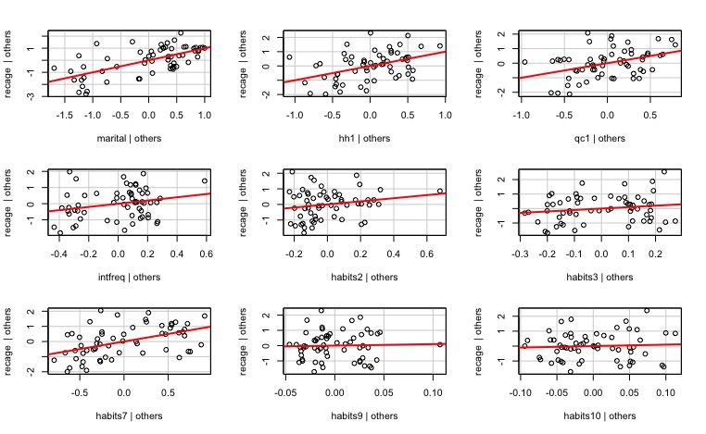
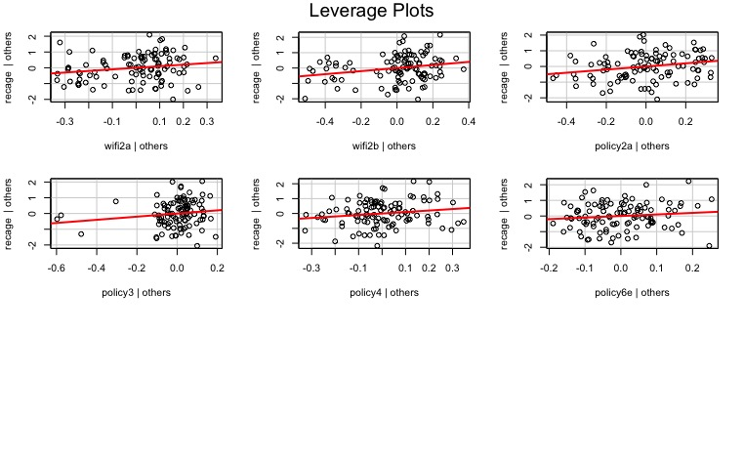
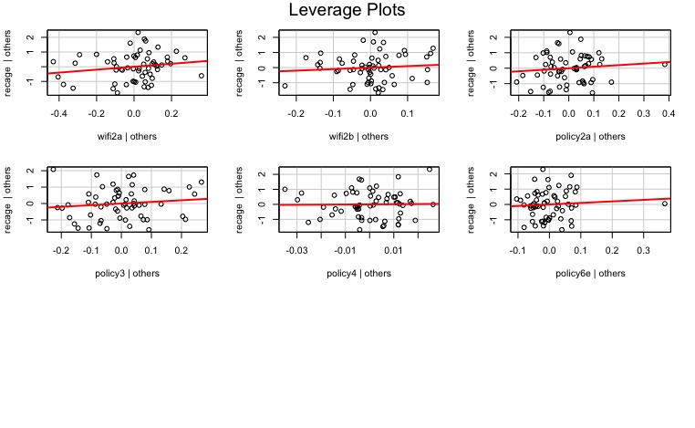
Interesting Findings Leverage Plots for Train and Test Datasets
Train Leverage Plots
Test Leverage Plots
Notice the scale variance.

Slide 14
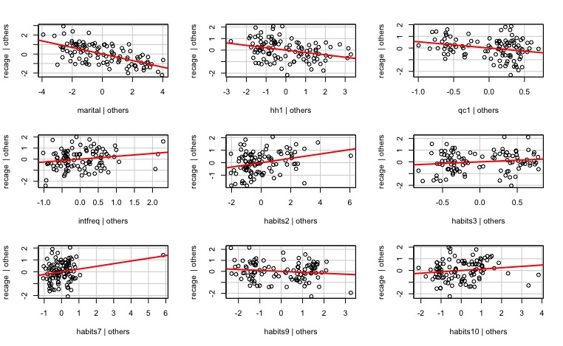
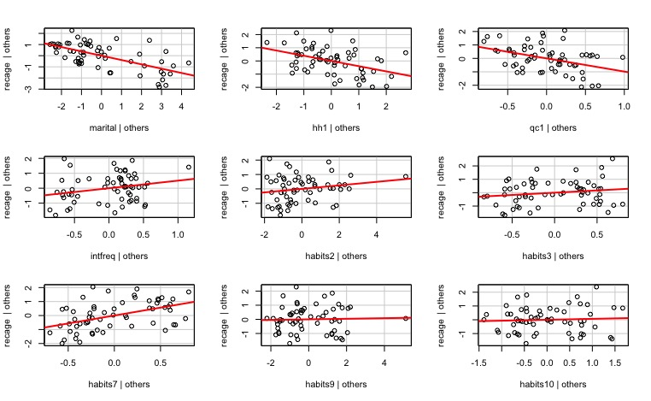
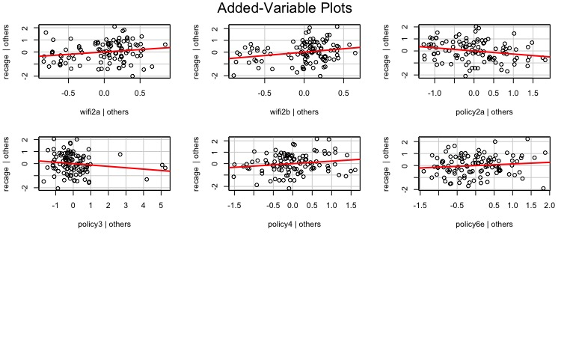
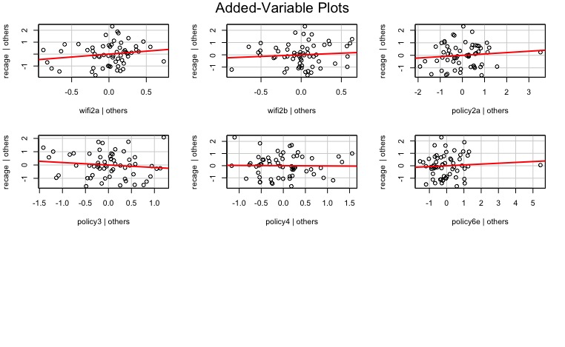
Interesting Findings Added Variables Plots for Train and Test Datasets
Added Variables for Train Dataset
Added Variables for Test Dataset

Slide 15
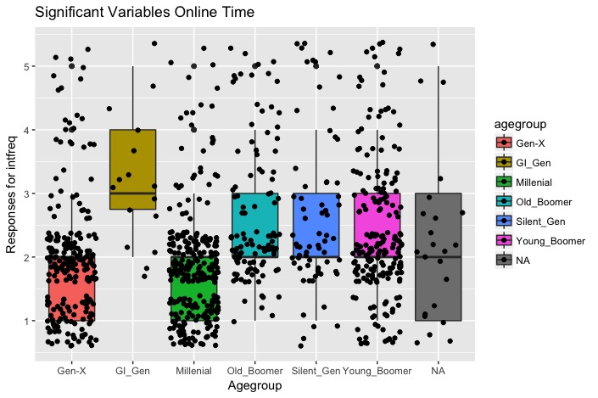
Interesting Findings Box and Scatter Plots for Variable – How often do you use the internet? Grouped by Age Group Millenial – 273 Gen-X – 242 Young Boomer – 231 Old Boomer – 135 Silent Generation – 92 GI Generation – 39 No Response - 28 Total – 1,040
How often do you use the internet?
Almost constantly
Several times per day
Once a day
Several times per week
Less often
Millenial and Gen-X are the most frequent internet users.
Mean = 2.19 / Median = 2 / SD = 1.05 /
MAD = 0 / n = 921 / Skew = 1.11
Note: (8) Don’t Know (9) Refused to Answer

Slide 16
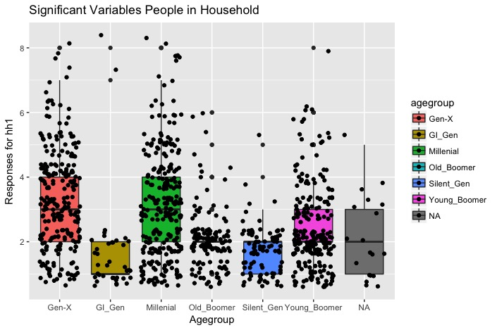
Interesting Findings Box and Scatter Plots for Variable – Number of People in Household Grouped by Age Group Millenial – 273 Gen-X – 242 Young Boomer – 231 Old Boomer – 135 Silent Generation – 92 GI Generation – 39 No Response - 28 Total – 1,040
Box Plot for Variable – Number of People in Household
Responses were exact numbers
Majority of households are 1-4 people. Mean = 2.68 / Median = 2 / n = 1,018 /
SD = 1.5 / MAD = 1.48 / Skew = 1.08
Note: (98) Don’t Know (99) Refused to Answer

Slide 17
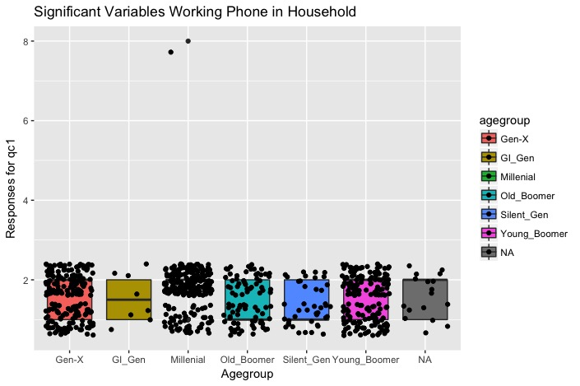
Interesting Findings Box and Scatter Plots for Variable – One Working Phone that is not a cell? Grouped by Age Group Millenial – 273 Gen-X – 242 Young Boomer – 231 Old Boomer – 135 Silent Generation – 92 GI Generation – 39 No Response - 28 Total – 1,040
Box Plot for Variable – Is there at lease one working phone that is not a cell phone in your home?
Yes
No
Notice the Millenial responses are primarily “No”. Mean = 1.62 / Median = 2 /
n = 773 / SD = 0.54 / MAD = 0 / Skew = 1.77
Note: (8) Don’t Know (9) Refused to Answer

Slide 18
Interesting Findings Box and Scatter Plots for Variable – How frequently are you on the internet? Grouped by Age Group Millenial – 273 Gen-X – 242 Young Boomer – 231 Old Boomer – 135 Silent Generation – 92 GI Generation – 39 No Response - 28 Total – 1,040
Box Plot for Variable – How frequently do you use the internet?
Almost constantly
Several times per day
About once per day
Several times per week
Less often
Mean = 2.19 / Median = 2 /
n = 921 / SD = 1.05 / MAD = 0 / Skew = 1.11
Note: (8) Don’t Know (9) Refused to Answer

Slide 19
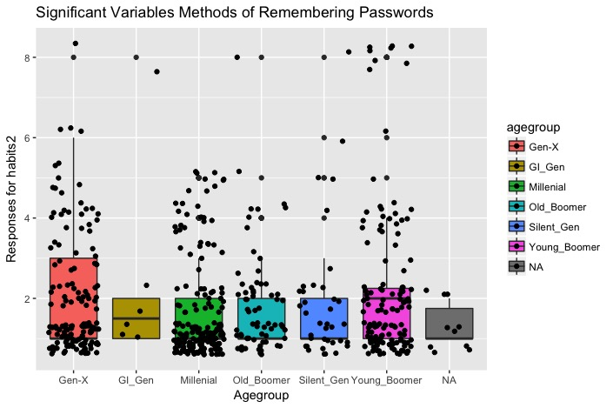
Interesting Findings Box and Scatter Plots for Variable – How do you manage your passwords? Grouped by Age Group Millenial – 273 Gen-X – 242 Young Boomer – 231 Old Boomer – 135 Silent Generation – 92 GI Generation – 39 No Response - 28 Total – 1,040
Box Plot for Variable – How do you manage passwords most?
Memorize them in your head
Write them down on paper
Password Management Program
Save in a note or document on your pc or mobile device
Save them in your browser
Another way
Mean = 1.92 / Median = 1 /
n = 574 / SD = 1.49 / MAD = 0 / Skew = 2.05
Note: (8) Don’t Know (9) Refused to Answer

Slide 20
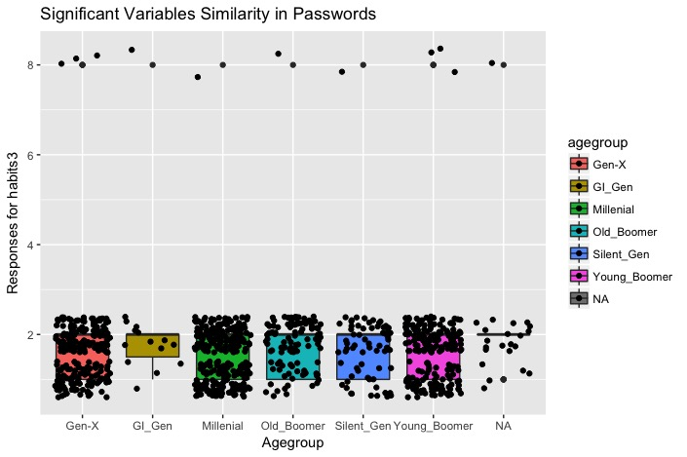
Interesting Findings Box and Scatter Plots for Variable – How similar are your passwords? Grouped by Age Group Millenial – 273 Gen-X – 242 Young Boomer – 231 Old Boomer – 135 Silent Generation – 92 GI Generation – 39 No Response - 28 Total – 1,040
Box Plot for Variable – How similar are your passwords for various accounts?
Most are very similar
Most are very different
Millenial and Gen-X have a good number of similar passwords, more than other age groups. Mean = 1.69 / Median = 2 /
n = 903 / SD = 0.85 / MAD = 0 / Skew = 4.77
Note: (8) Don’t Know (9) Refused to Answer

Slide 21
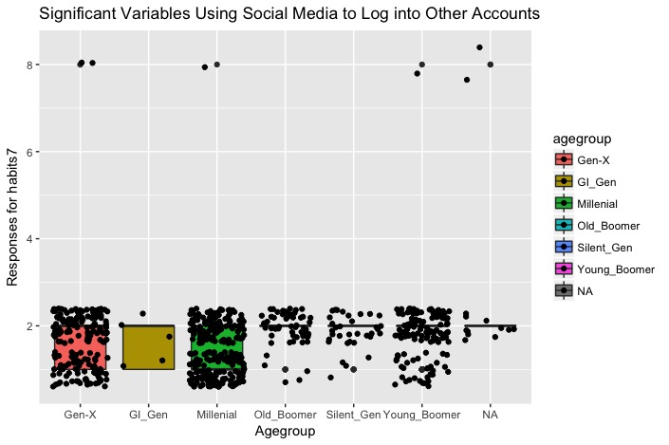
Interesting Findings Box and Scatter Plots for Variable – Have you used your social media account to log into another website? Grouped by Age Group Millenial – 273 Gen-X – 242 Young Boomer – 231 Old Boomer – 135 Silent Generation – 92 GI Generation – 39 No Response - 28 Total – 1,040
Box Plot for Variable – Have you used your social media password to log into another account?
Yes
No
Millenials incorporate social media more than other age groups.
Mean = 1.7 / Median = 2 /
n = 663 / SD = 0.77 / MAD = 0 / Skew = 4.75
Note: (8) Don’t Know (9) Refused to Answer

Slide 22
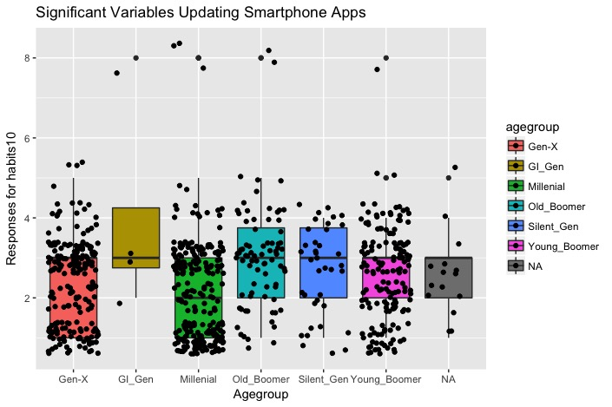
Interesting Findings Box and Scatter Plots for Variable – How frequently do you update apps? Grouped by Age Group Millenial – 273 Gen-X – 242 Young Boomer – 231 Old Boomer – 135 Silent Generation – 92 GI Generation – 39 No Response - 28 Total – 1,040
Box Plot for Variable – How frequently do you update apps on your smart phone?
Set them to automatically update
Update them yourself as soon as a new version is available
Update when convenient
Never install updates
Different settings for different apps
Millenials set up automatic updates more than other age groups.
Mean = 2.44 / Median = 3 /
n = 738 / SD = 1.2 / MAD = 1.48 / Skew = 0.9
Note: (8) Don’t Know (9) Refused to Answer

Slide 23
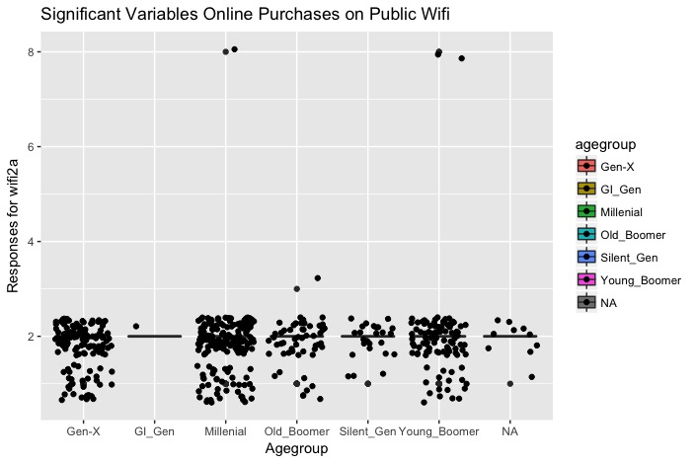
Interesting Findings Box and Scatter Plots for Variable – Do you make online purchases while connected to public WiFi? Grouped by Age Group Millenial – 273 Gen-X – 242 Young Boomer – 231 Old Boomer – 135 Silent Generation – 92 GI Generation – 39 No Response - 28 Total – 1,040
Box Plot for Variable – Do you make online purchases while connected to public WiFi?
Yes
No
Not applicable
Mean = 1.84 / Median = 2 /
n = 500 / SD = 0.63 / MAD = 0 / Skew = 5.26
Note: (8) Don’t Know (9) Refused to Answer

Slide 24
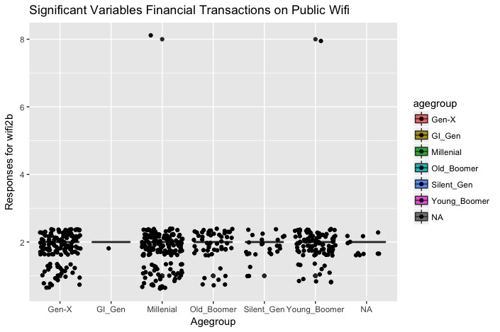
Interesting Findings Box and Scatter Plots for Variable – Do you bank or make financial transactions while connected to public WiFi? Grouped by Age Group Millenial – 273 Gen-X – 242 Young Boomer – 231 Old Boomer – 135 Silent Generation – 92 GI Generation – 39 No Response - 28 Total – 1,040
Box Plot for Variable –Do you bank or make financial transactions while connected to public WiFi?
Yes
No
Not applicable
Millenial and Gen-X responded ‘Yes’ more than other age groups.
Mean = 1.84 / Median = 2 /
n = 500 / SD = 0.55 / MAD = 0 / Skew = 5
Note: (8) Don’t Know (9) Refused to Answer

Slide 25
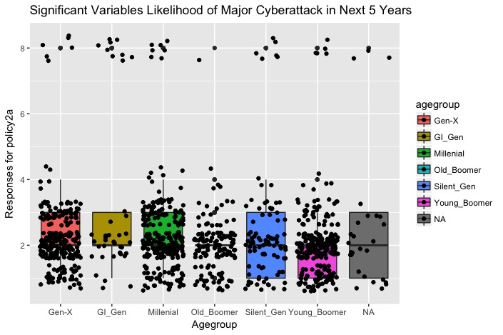
Interesting Findings Box and Scatter Plots for Variable – How likely do you think our infrastructure like power grid will have a significant cyber attack in next 5 years? Grouped by Age Group Millenial – 273 Gen-X – 242 Young Boomer – 231 Old Boomer – 135 Silent Generation – 92 GI Generation – 39 No Response - 28 Total – 1,040
Box Plot for Variable –How likely do you think our infrastructure like power grid will have a significant cyber attack in next 5 years?
Definitely
Probably happen
Probably not happen
Definitely not
Mean = 2.27 / Median = 2 /
n = 1,037 / SD = 1.31 / MAD = 0 /
Skew = 2.86
Note: (8) Don’t Know (9) Refused to Answer

Slide 26
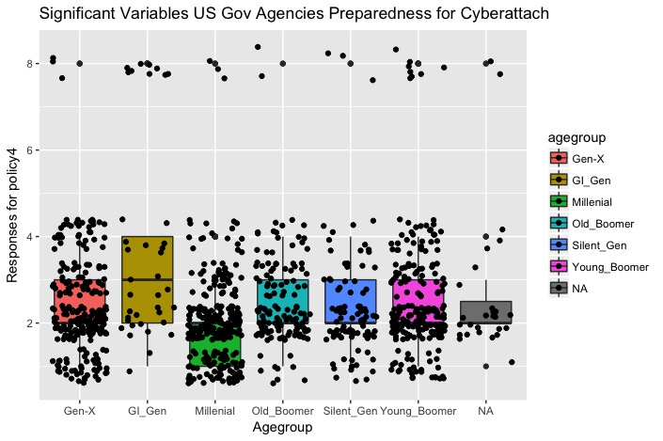
Interesting Findings Box and Scatter Plots for Variable – How prepared is the US to prevent cyber attack on government agencies? Grouped by Age Group Millenial – 273 Gen-X – 242 Young Boomer – 231 Old Boomer – 135 Silent Generation – 92 GI Generation – 39 No Response - 28 Total – 1,040
Box Plot for Variable – How prepared is the US to prevent cyber attack on government agencies? (1) Very prepared
(2) Somewhat prepared
(3) Not too prepared
(4) Not at all prepared
Mean = 2.42 / Median = 2 /
n = 1,034 / SD = 1.29 / MAD = 0 /
Skew = 2.34
Note: (8) Don’t Know (9) Refused to Answer

Slide 27
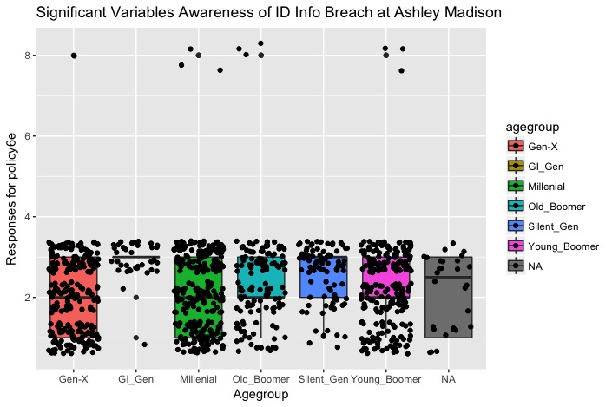
Interesting Findings Box and Scatter Plots for Variable – Have you heard about publishing of identities of AshleyMadison.com customers? Grouped by Age Group Millenial – 273 Gen-X – 242 Young Boomer – 231 Old Boomer – 135 Silent Generation – 92 GI Generation – 39 No Response - 28 Total – 1,040
Box Plot for Variable –Have you heard about publishing of identities of AshleyMadison.com customers? (1) Yes a lot
(2) Yes a little
(3) No
Millenials and Gen-X’ers heard more than other age groups.
Mean = 2.38 / Median = 3 /
n = 1,037 / SD = 0.92 / MAD = 0 /
Skew = 0.75
Note: (8) Don’t Know (9) Refused to Answer

Slide 28
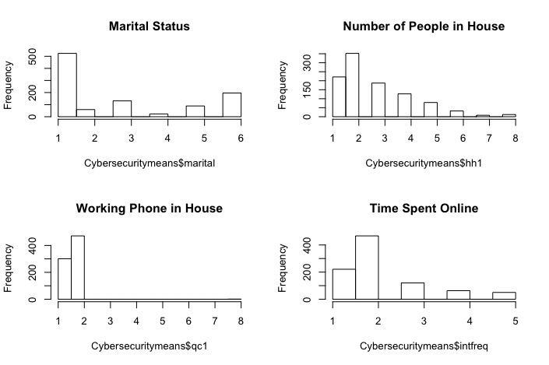
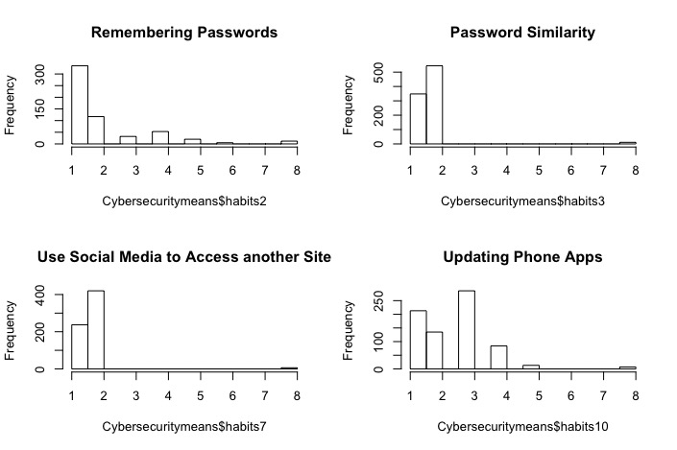
Interesting Findings Histograms for Significant Variables applied on Complete Dataset
Histograms for Significant Variables (Page 1)

Slide 29
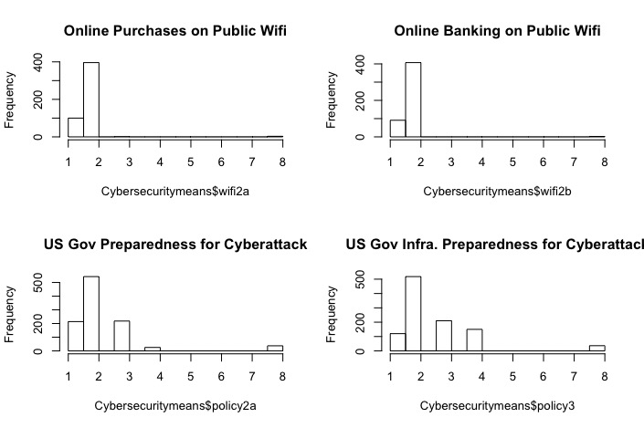
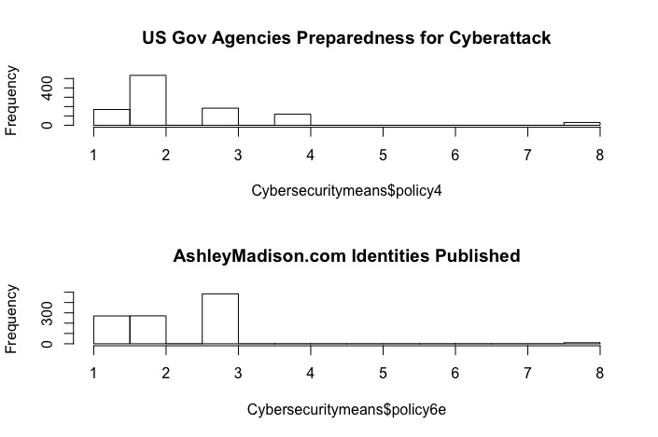
Interesting Findings Histograms for Significant Variables applied on Complete Dataset
Histograms for Significant Variables (Page 2)

Slide 30
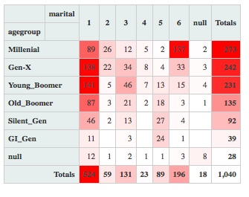
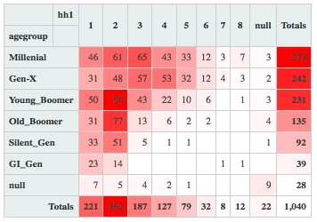
Interesting Findings Heat Tables for Variables Maritial Status & Number of People in Household
26% - Millenials
23% - Gen-X’ers
22% - Young Boomers
13% - Old Boomers
9% - Silent Generation
4% - GI Generation
50.4% of the responders are married.
13.2% of the responders are Millenials that have never been married.
33.85% have 2 people in their household.
~2% did not respond to either question.

Slide 31
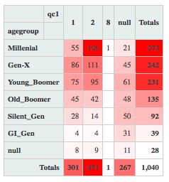
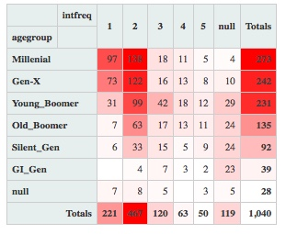
Interesting Findings Heat Tables for Variables Land Line Working in Household & Internet Usage Frequency
45.3% do not have a working land line in their home, with the Millenials leading the way.
25.7% did not respond to the land line question.
44.9% use the internet several times per day.
51% of Millenials, 50% Gen-X, 43% Young Boomers, 47% Old Boomers, 36% Silent Gen and 10% GI Gen check several times per day.
11.4% did not respond to the internet frequency question.

Slide 32
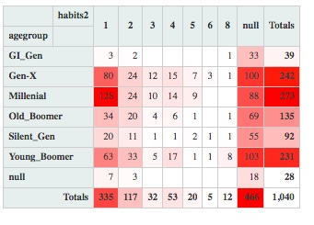
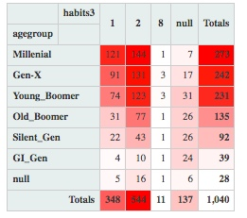
Interesting Findings Heat Tables for Variables Password Management & Similarity of Passwords
44.8% did not respond to how they manage their passwords (#1 Response)
32.2% memorize their passwords.
11.3% write their passwords on a piece of paper.
3.1% use a password management program
52.3% use very different passwords for various accounts
33.5% use very similar passwords
13.2% did not respond to the question

Slide 33
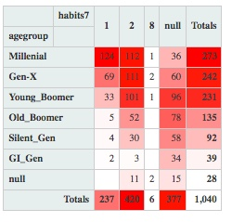
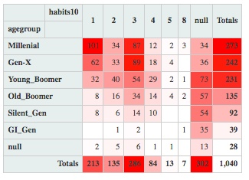
Interesting Findings Heat Tables for Variables Using Social Media to log into another Website & How do You Update Your Phone Apps
40.4% have not used their social media account to log into another account.
36.3% did not respond to the question (#2 Response). Higher percentages of the older generations drove the results.
36.7% chose to not respond to question of how they update their phone apps (#1)
27.5% update their apps when convenient.
20.5% (#3) set up their devices to automatically update their apps.

Slide 34
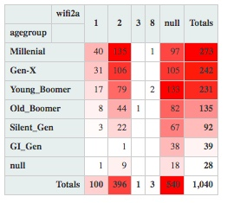
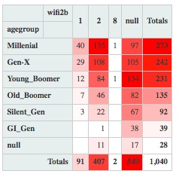
Interesting Findings Heat Tables for Variables Making Online Purchases on Public WiFi & Making Financial Transactions while on Public WiFi
51.9% (#1) did not respond to this question.
38.1% (#2) do not make purchases while on Public WiFi
9.6% do make purchases while on Public WiFi
Missing observations cause concern in predictions.
51.9% (#1) did not respond to this question.
39.1% (#2) do not do financial transactions on Public WiFi
8.8% make financial transactions on Public WiFi.
Missing observations cause concern in predictions.

Slide 35
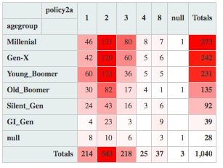
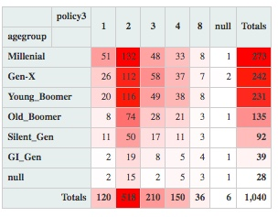
Interesting Findings Heat Tables for Variables Do you think a significant cyber attack on public infrastructure is likely in next 5 years? & How prepared do you think US Government is to prevent cyber attacks on public infrastructure?
52.2% think a significant cyber attack on our infrastructure will PROBABLY happen in next 5 years.
21% think it probably will not happen.
20.6% think it definitely will happen.
49.8% think we are somewhat prepared to defend an attack on US infrastructure.
20.2% think we are not too prepared.
22.5% feel confident that we are prepared.

Slide 36
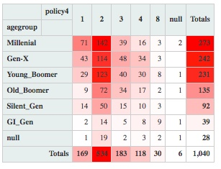
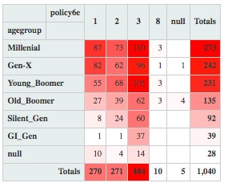
Interesting Findings Heat Tables for Variables How well prepared do you think US is to prevent cyber attack on US agencies? & Have you heard about publishing AshleyMadison.com customer identities?
51.3% think US is somewhat prepared to prevent cyber attack on agencies.
17.6% think we are not too prepared.
16.3% think we are very prepared.
46.5% did not hear about AshleyMadison.com customer info published.
26% heard a lot about it.
26% heard a little about it.

Slide 37
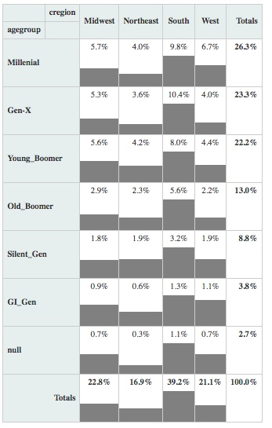
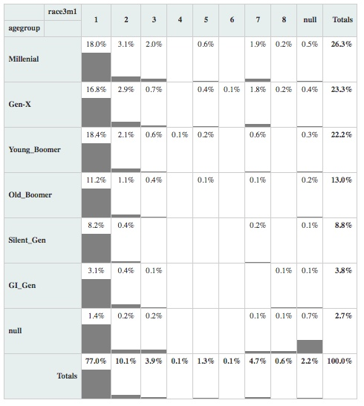
Concerns Two Variables Race and Region do not directly match the US population.
South is 39.2% of n.
Race – White makes up 77% of n.

Slide 38
Recommendations and Improvement Ideas Finding target audience for cyber attack-proof password management program in the US.
Target Millenials and Gen-X’ers and add Young Boomers if possible.
Approximately 3% of those surveyed currently use a password management program, so there is significant growth potential.
Although not a significant variable, the survey included a good proportion of income and education levels in the target age groups.
Conduct a follow up survey building upon these results, focusing on target age groups based upon responses for this survey.
Multiple trials subsetting various observations did not drastically improve our model.
Opportunities
More quantitative data would be helpful for more detailed analysis.
Address the demographic concerns of race and region.
Design survey to avoid non-responses and improve the ability to create an improved model.
Include questions covering options that responders/ customers want, which was not included in this survey.
Include operating system questions to help with the app design.

