Slide 1
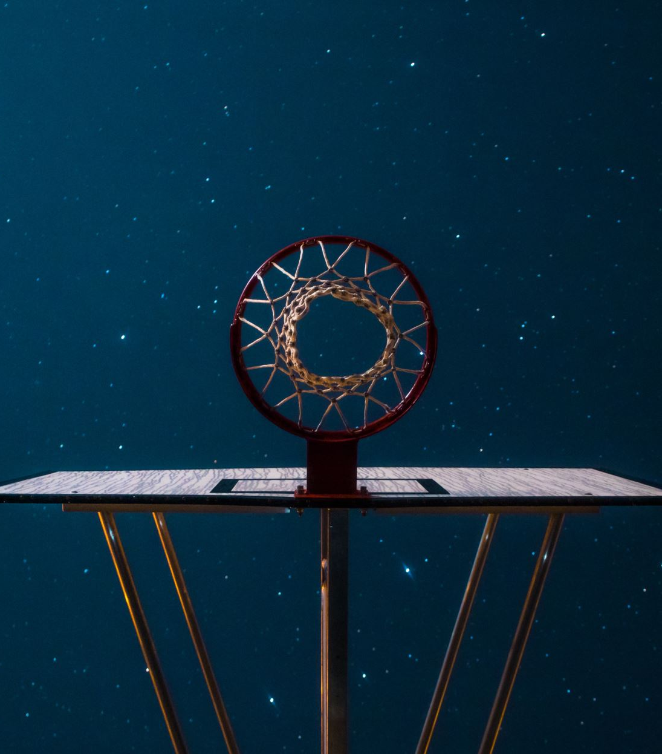
Optimizing an NBA Roster
An ISE 3230 Project
By Ryan Marshall, Nate Rezell,
and Austin Trout
December 2, 2021

Slide 2

Introduction

Slide 3
Variables and Objective

Slide 4
“RAPTOR” Score

Slide 5
Constraints

Slide 6
Optimal Solution

Slide 7
