Slide 1
Project: Fire
Andrew Maddox & Austin Van Bockern
(D N’ A)

Slide 2
What is Project: Fire?
How hard is it to make a programming language? (Hint: Very Hard…)
Resources
Compiled vs interpreted
Client-side vs Server-side
Making a language with another language
We decided to find out…

Slide 3
Iced Latte (Our Language)
Interpreted
Client-side
HTML & JavaScript
Loosely-typed → strongly-typed
“.iced” files

Slide 4
Code Demo

Slide 5
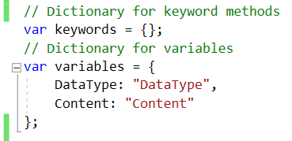
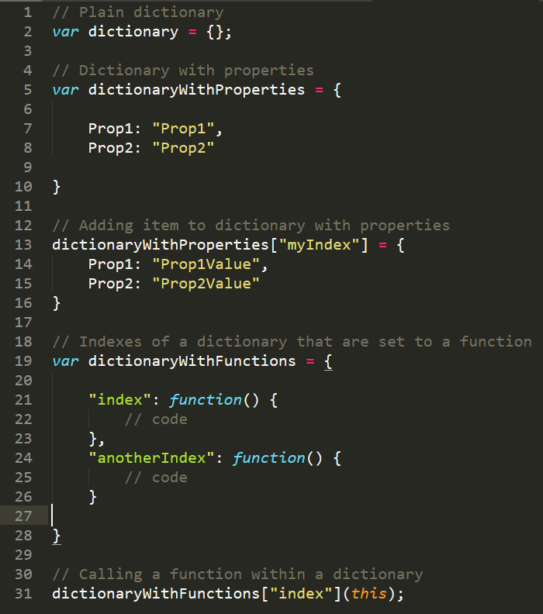
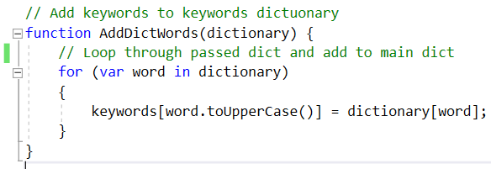
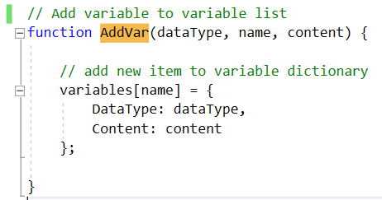
Dictionaries Our Dictionary Uses: Examples:

Slide 6
Handling “Keywords” (Logic)
Get string of input
Split string by semicolons to get statements
Loop through statements
Inside the loop, split each statement into words
Check the keywords dictionary for the first word in the statement
If word exists, handle that statement

Slide 7

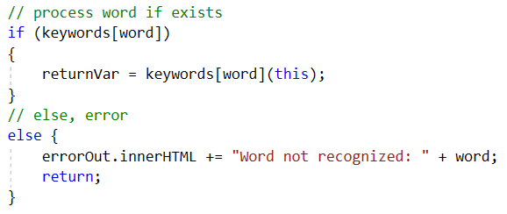
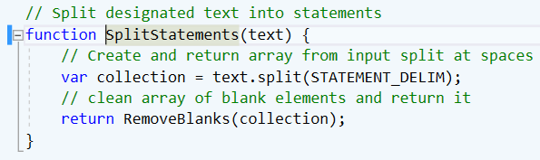

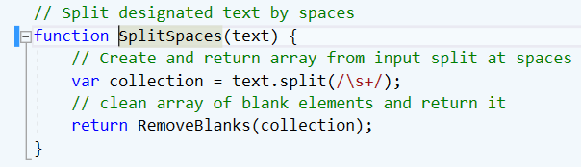
Handling “Keywords” (Code)
Splitting text into statements
Checking if word exists
Splitting statement into words

Slide 8
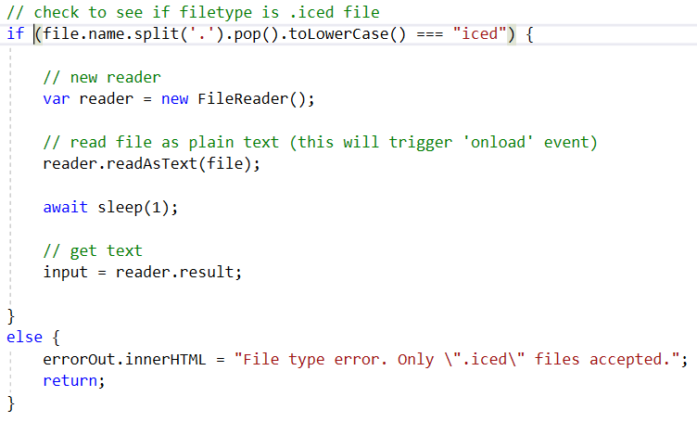
Text & File Input
Getting file input

