Slide 1

Git 分享
（Austin）
104 HA．EHRMS2
Jun. 27, 2019

Slide 2
內容
Git的特性 (svn -> git)
Git tools (gitlab, bash, vscode, tortoiseGit, sourceTree)
commit (work-tree/staged, commit with amend)
commit-operator (reset, revert, cherry-pick)
branch (tracking, merge, rebase, pull, push)
Gitlab (issue tracking, branch by issue(?), pull request)
Further (config, ignore, attribute, hook)
Reference

Slide 3
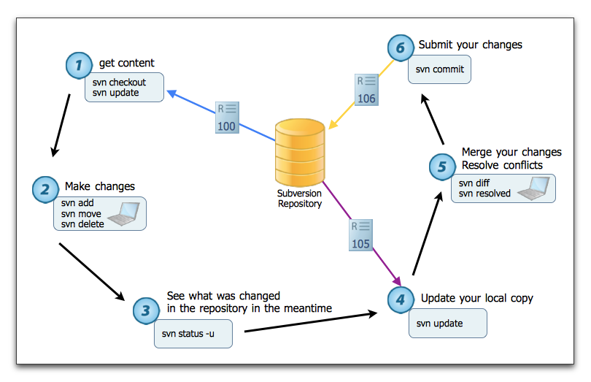
SVN 操作流程

Slide 4
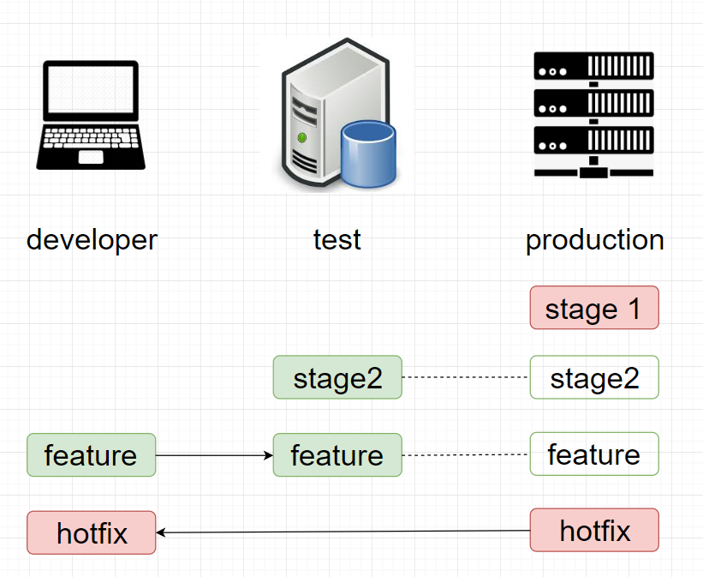
SVN 工作模式
*分支切換等同資料夾切換
*程式比對, beyond compare

Slide 5
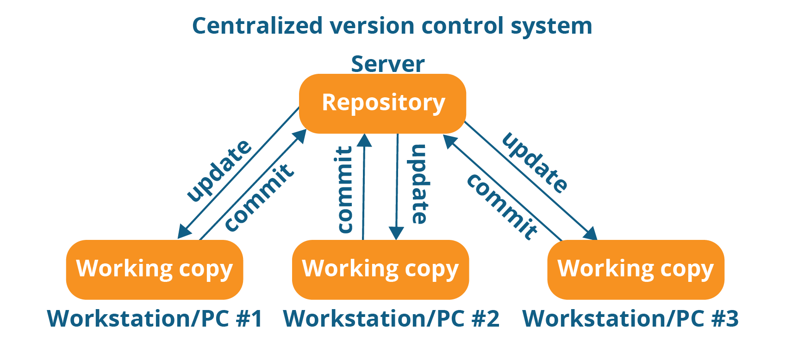
SVN 集中管理
*兩個程式庫(公司/用戶)
*離開SVN後無法作業(無法加班)
*程式碼錯誤影響作業(個別排除)

Slide 6
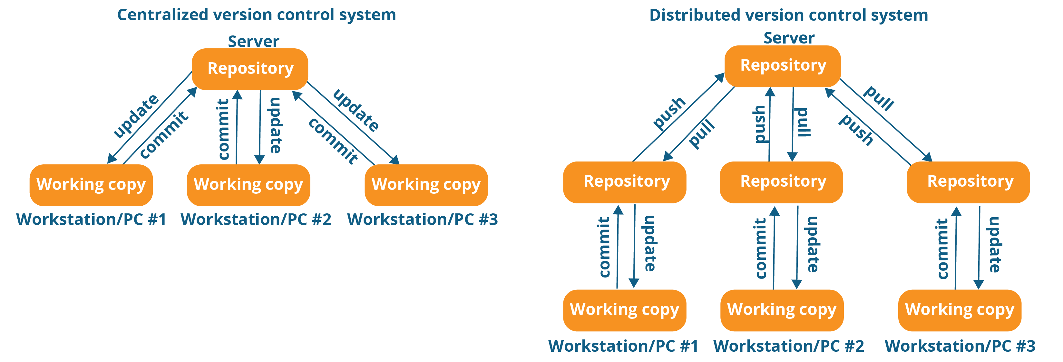
Git 分散式管理

Slide 7
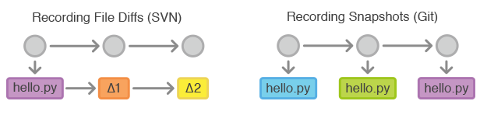
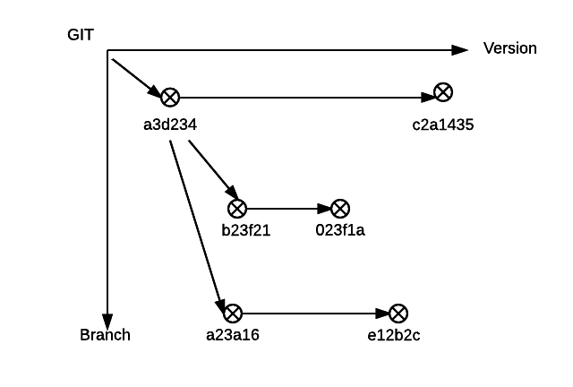
Git Branch

Slide 8
Git clone
git clone <path>
git init
git remote add origin <path>
git checkout –b master
git branch –u origin master
git pull

Slide 9
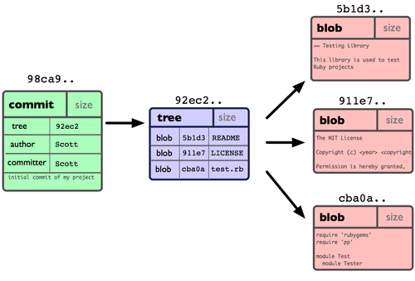
commit

Slide 10
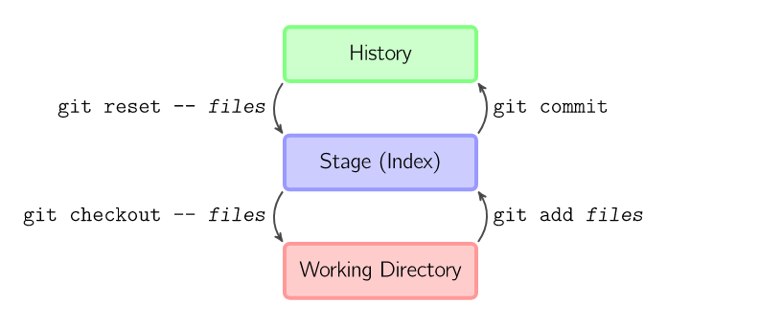
commit

Slide 11
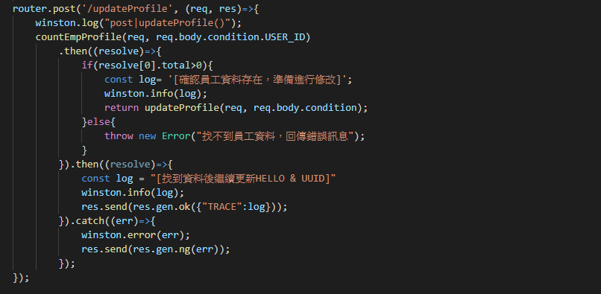
Promise concat
/Ehrms2portal_SC/api-auth-acUser.js LINE 927

Slide 12
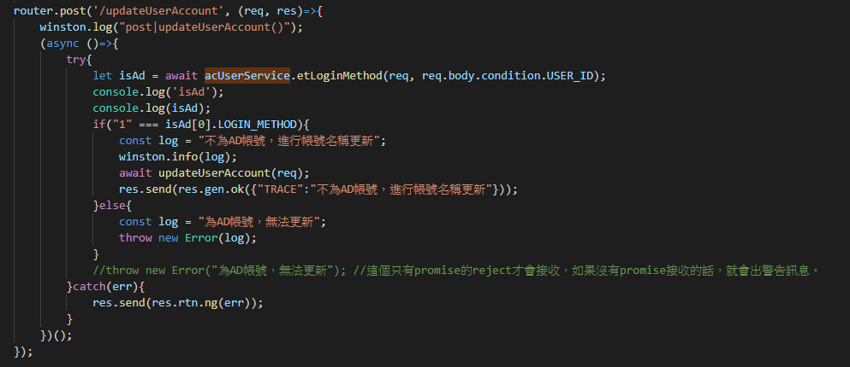
Async try-catch-finally
/Ehrms2portal_SC/api-auth-acUser.js LINE 954

Slide 13
Async.Waterfall
/Ehrms2portal_SC/api-auth-acPwdRule.js LINE 531

Slide 14
ASYNC整理
CallBack 是js在處理non-blockin的設計方式(async)
解決CallBack Hell
ES6 ➔ promise
Async ➔ waterfall, each …
ES7 ➔ async await
nodejs ➔ promisify

Slide 15
Reference
[連猴子都能懂得Git入門指南] (https://backlog.com/git-tutorial/tw/intro/intro2_4.html)
[ihower的Git教室] (https://ihower.tw/git/index.html)
[git-document] (https://git-scm.com/book/en/v2)

Slide 16

關心人資．共創價值 Define人才標準｜Discover人才遴選｜Develop人才發展｜Deploy人才佈署

