Slide 1

Git 分享
（Austin）
104 HA．EHRMS2
Jun. 27, 2019

Slide 2
內容
Git specialty (svn -> git)
Git tools (gitlab, bash, vscode, tortoiseGit, sourceTree)
commit (work-tree/staged, commit with amend)
commit-operator (reset, revert, cherry-pick)
branch (tracking, merge, rebase, pull, push)
Githab (issue tracking, branch by issue(?), pull request)
Further (config, ignore, attribute, hook)
Reference

Slide 3
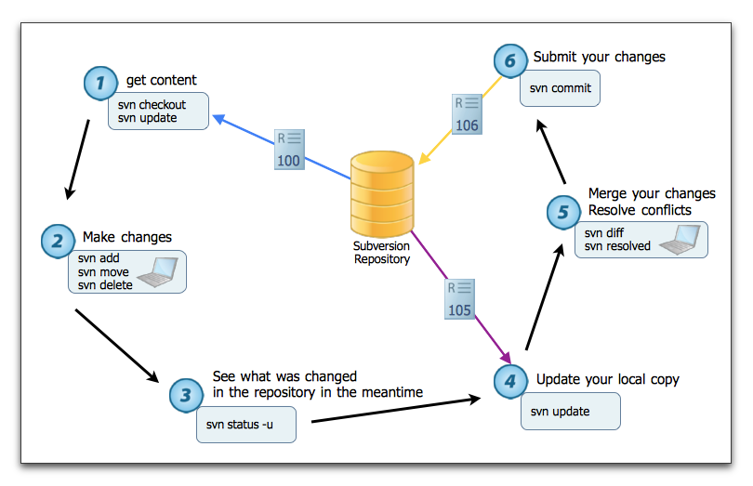
SVN 操作流程

Slide 4
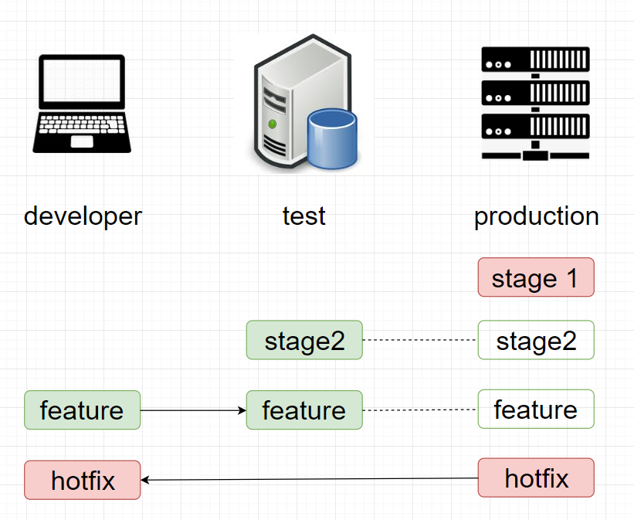
SVN 工作模式
*分支切換等同資料夾切換
*程式比對, beyond compare

Slide 5
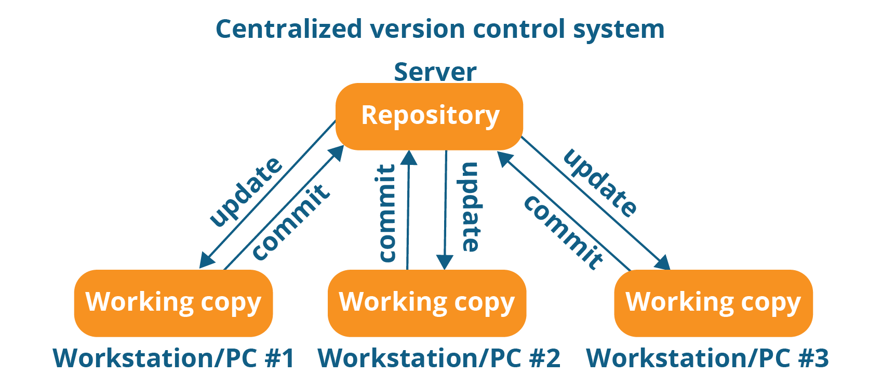
SVN 集中管理
*兩個程式庫(公司/用戶)
*離開SVN後無法作業(無法加班)
*程式碼錯誤影響作業(個別排除)

Slide 6
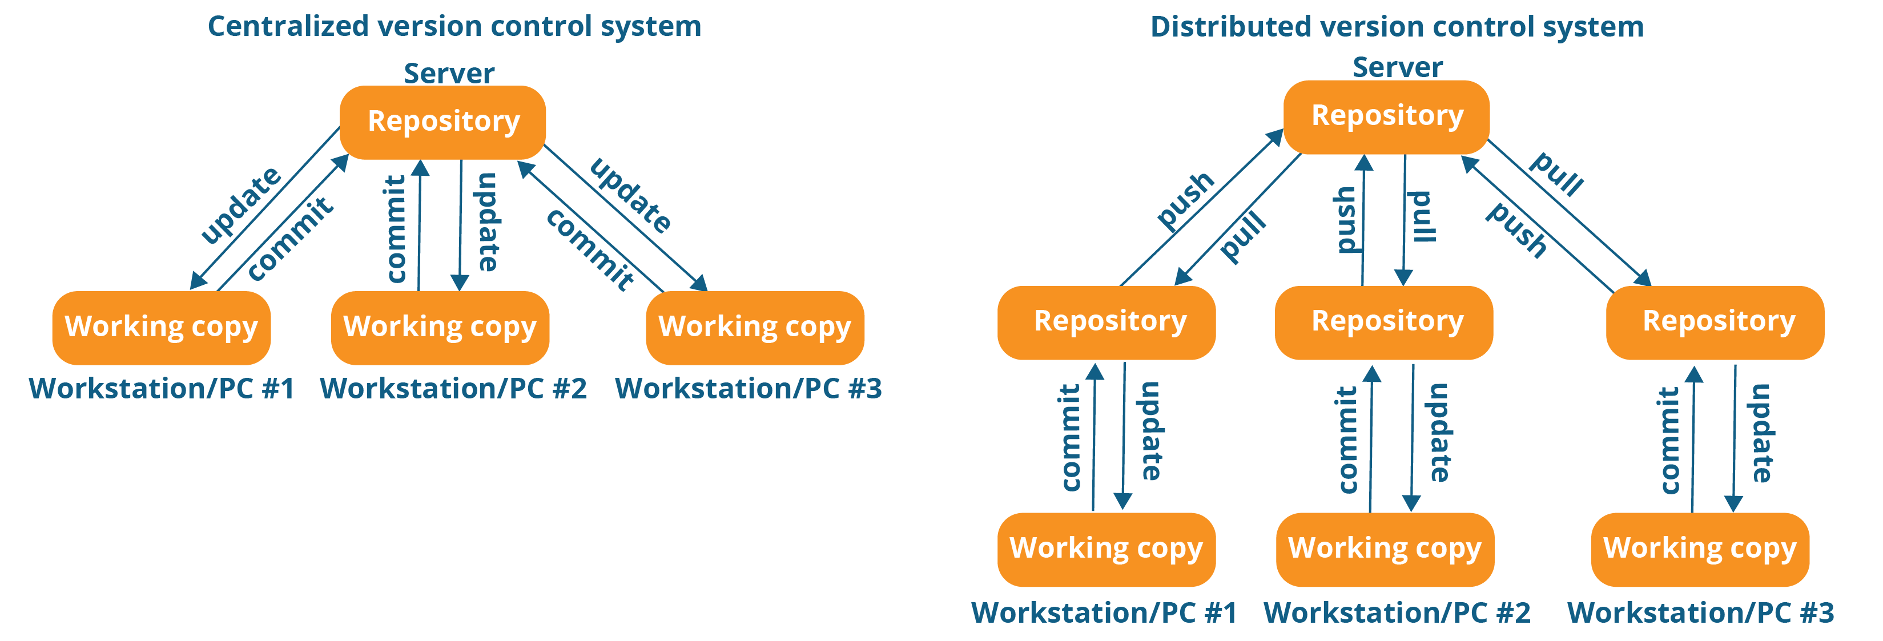
Git 分散式管理

Slide 7
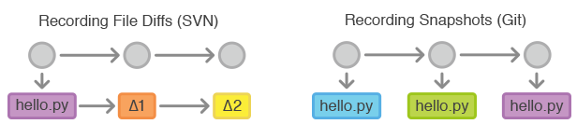
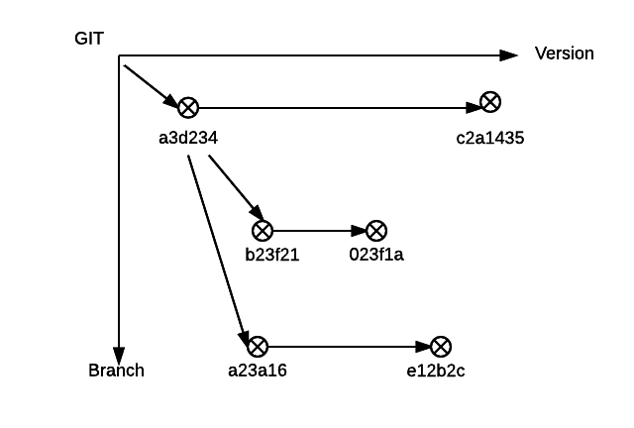
Git Branch

Slide 8
Git clone
git clone <path>
git init
git remote add origin <path>
git checkout –b master
git branch –u origin master
git pull

Slide 9
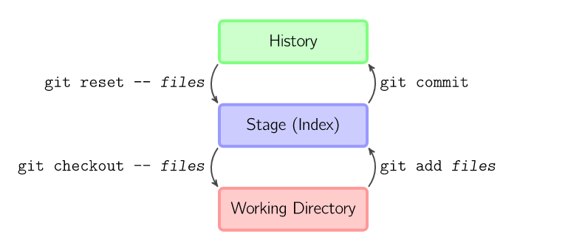
Commit work-tree
git add <file> / git reset -- <file>
git commit / git reset HEAD^

Slide 10
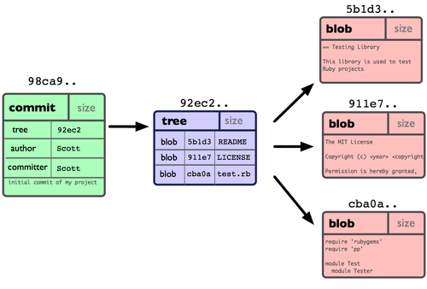
Commit 的結構

Slide 11
Git移除追蹤的檔案
assume-unchanged 練習

Slide 12
Commit operator
git log
git reflog
git reset
git revert
git cherry-pick

Slide 13
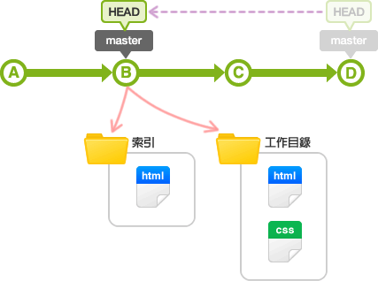
git reset

Slide 14
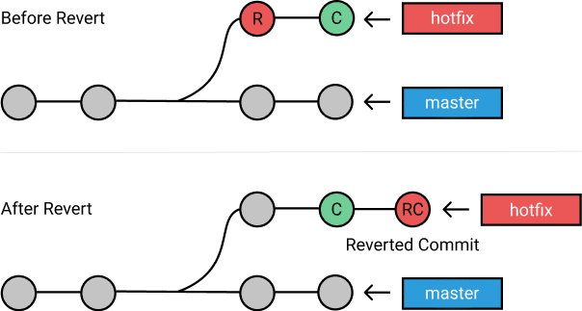
git revert

Slide 15
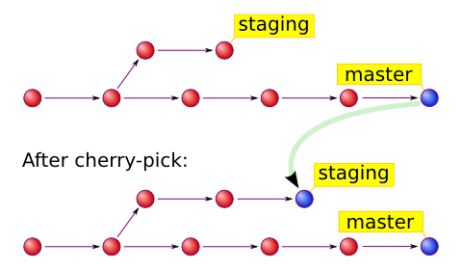
git cherry-pick

Slide 16
git branch 的相關操作
git fetch (git pull = git fetch + git merge)
git tracking
git merge
git rebase
git pull
git push

Slide 17
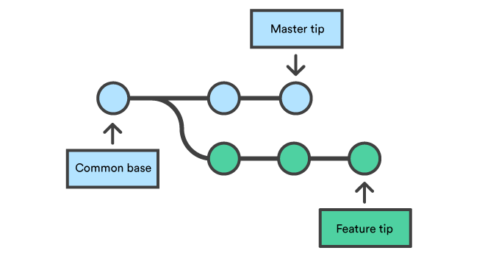
git branch

Slide 18
git branch 練習
git branch –b >> new branch
git branch –d >> delete branch
git branch –D >> force delete branch
git branch -u origin/dev

Slide 19
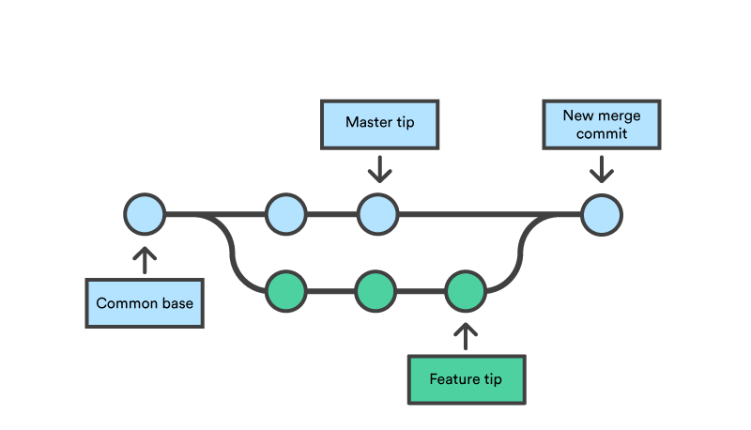
git merge
*(V)git merge feature / git merge master?

Slide 20
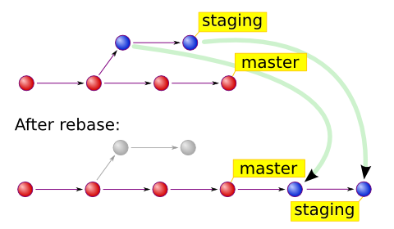
git rebase
*git rebase staging / (V)git rebase master?

Slide 21
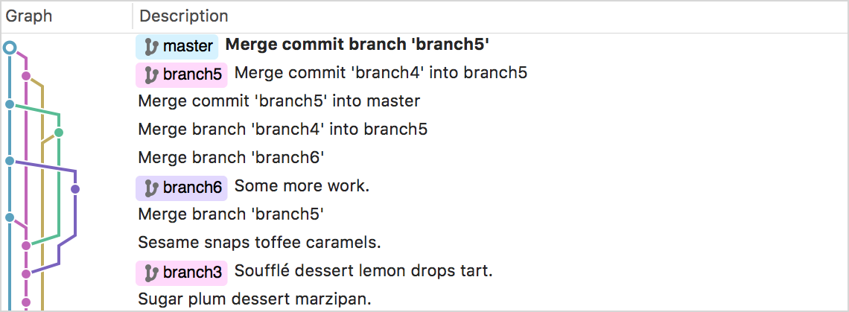
git rebase
為什麼需要rebase?

Slide 22

git rebase
為什麼需要rebase?

Slide 23
git pull / git push 練習
git pull
git pull -u origin dev
git pull --rebase 建議加入此動作即可
git push
git push -u origin dev
git push –f `force push without protect`

Slide 24
Gitlab 練習
Issue tracking
Branch by issue
Pull request

Slide 25
補充
git config `alias`
git ignore `~$`, `node_modules/`
git attributes `* -text`
git hook `pre-commit`
git rev-parse `sha1`
git rev-lise --count --all dev `208`

Slide 26
Git relation
Service
BerliOS
Beanstalk
Bitbucket
CodePlex
GitHub
Gitorious
GUN Savannah
Google Code
JavaForge
Pikacode
SourceForge
Gitee[碼雲]
CSDN CODE
Coding
gitlab
GIT GUI
GitHub Desktop
Git for Windows
TortoiseGit
SourceTree
GitEye

Slide 27
QA
Thanks for your time.

Slide 28
Reference
[連猴子都能懂得Git入門指南] (https://backlog.com/git-tutorial/tw/intro/intro2_4.html)
[ihower的Git教室] (https://ihower.tw/git/index.html)
[git-document] (https://git-scm.com/book/en/v2)
[ATLASSIAN](https://www.atlassian.com/cs/git/tutorials/learn-git-with-bitbucket-cloud)

Slide 29

關心人資．共創價值 Define人才標準｜Discover人才遴選｜Develop人才發展｜Deploy人才佈署

