Slide 1
MACHINE-LEARNING PORTFOLIO · 深度學習課程作品集
深度學習研究實驗室
Deep-Learning Research Lab
QuantLab · Epic H
framework-free 參考模型 → 真實 PyTorch 訓練 → 互動研究 UI
framework-free reference model → real PyTorch training → interactive research UI
方法論誠實 ＞ alpha · methodology honesty over alpha · no_alpha_claim
YC Chang · ycchang.pmp@gmail.com · 2026

Slide 2



01 · 專案概覽 OVERVIEW
一個對自己結果誠實的量化研究實驗室
A quant research lab that never lies about its own results
QuantLab 是個人、純紙上 (paper-only) 量化研究平台。成功 = 方法論誠實 + 實驗能力，而非 alpha。
專案規模 · At a glance
A personal, paper-only quant lab. Success = methodology honesty + experimentation capability, not alpha — every model slice declares no_alpha_claim.
10
Epics 已實作 / implemented (A0→H)
OOS-net 為唯一權威
OOS-net is the only ranking authority — baseline always visible
435
PIT-safe 資料
Python 測試通過 / tests pass (2 skipped)
PIT-safe: available_date ≤ asof; approximate data strict-excluded
0
Fail-closed 誠實
alpha 宣稱 / alpha claims — no_alpha_claim
Fail-closed by default — never emits a misleading computed
QuantLab · Epic H · 深度學習研究實驗室 / Deep-Learning Research Lab
02 / 13

Slide 3



02 · 系統架構 ARCHITECTURE
框架隔離：核心引擎永不依賴任何 ML 框架
Framework isolation — the core engine never imports an ML framework
FrameworkAdapterRegistry 惰性解析 torch/jax/tf，缺席時誠實降級為 reference；import-linter 兩條契約 KEPT 強制邊界。
engine / data 核心 · core
可插拔 backends · pluggable
向量化回測引擎、PIT loader — 不 import torch/jax/tf
reference
framework-free，永不 raise / never raises
策略 adapter 邊界 · boundary
DeepForecastAllocationStrategy 將模型接入 A0 引擎
pytorch
真實 autograd 訓練 / real training (H-2)
DL backend registry
惰性解析 + 誠實 fallback / lazy resolve + honest fallback
jax / tensorflow
已註冊，缺席時 fallback / registered
import-linter 禁止 / forbids: engine / data ⊁ torch · jax · tf · DL backend
QuantLab · Epic H · 深度學習研究實驗室 / Deep-Learning Research Lab
03 / 13

Slide 4




03 · 切片 SLICE H-1
H-1 — 深度學習研究 lab
Deep-learning research lab
framework-free 確定性參考模型 + 完整實驗 CLI 與 MLOps lineage。
A framework-free deterministic reference model + full experiment CLI and MLOps lineage.
Reference MLP forecaster
統計效能報告 · Performance report
純 NumPy、PIT-safe、per-epoch learning trace · pure-NumPy, PIT-safe
distribution / rolling-Sharpe / drawdown / learning-curve；退化輸入 fail-closed
參數化實驗 CLI · Experiment CLI
ExperimentRegistry lineage
run_dl_experiment.py：模型 + dumb baseline 跑過 A0 引擎
確定性 idempotent experiment_id + self-contained SVG/HTML viz
QuantLab · Epic H · 深度學習研究實驗室 / Deep-Learning Research Lab
04 / 13

Slide 5



04 · 切片 SLICE H-2
H-2 — 真實 PyTorch 訓練
Real PyTorch training
讓 pytorch backend 真的用 torch autograd 訓練 reference MLP — 而非 mock。
Makes the pytorch backend actually train the reference MLP via torch autograd — not a mock.
真實 torch 訓練 · Real training
Seed-init parity ≤ 1e-3
torch autograd、float64 高精度，位於 lazy backend 邊界之後
與 reference 種子初始化一致、deterministic、可重現 · reproducible
Optional torch lane
框架隔離 KEPT · Isolation
預設跳過 (pytest.importorskip)；torch 缺席時誠實回退 reference
torch 不進 default lock；import-linter「DL backend boundary」守住
QuantLab · Epic H · 深度學習研究實驗室 / Deep-Learning Research Lab
05 / 13

Slide 6



05 · 切片 SLICE H-3
H-3 — 互動研究 UI
Interactive research UI
把 Epic H 成果搬上 dashboard：調參數、讀 model-vs-baseline 排行榜。
Brings Epic H onto the dashboard: tune parameters, read a model-vs-baseline leaderboard.
參數工作流 · Parameter workflow
OOS-net 排行榜 · Leaderboard
backend / hiddenUnits / lookback / epochs / seed / rebalance 控制項
確定性 static_replay，baseline 永遠可見 · baseline always visible
Fail-closed 行為
真實 Chromium VRT
不支援參數或 checksum 不符 → status=fail_closed，不渲染假結果
npm run e2e:interactive：computed→fail_closed，0-pixel 視覺回歸
QuantLab · Epic H · 深度學習研究實驗室 / Deep-Learning Research Lab
06 / 13

Slide 7
06 · 誠實工程 HONESTY ENGINEERING
與眾不同之處：對自己結果說真話的工程
What sets it apart — engineering that tells the truth about its results
no_alpha_claim
PIT-safe · 無 lookahead
每個切片明確宣告不主張獲利；OOS-net 唯一權威，baseline 永遠可見 · OOS-net is the only authority, baseline always shown
available_date ≤ asof；歷史回填標 is_approximate=true 並被 strict 模式排除 · strict mode excludes approximate data
近似資料警告 · Warnings
Fail-closed by default
research_mode_approximate_availability 全程顯示，不假裝是 true-PIT · never pretends to be true-PIT
資料不足、過取樣、checksum 不符一律 fail-closed，絕不輸出誤導的 computed · never a misleading computed
QuantLab · Epic H · 深度學習研究實驗室 / Deep-Learning Research Lab
07 / 13

Slide 8
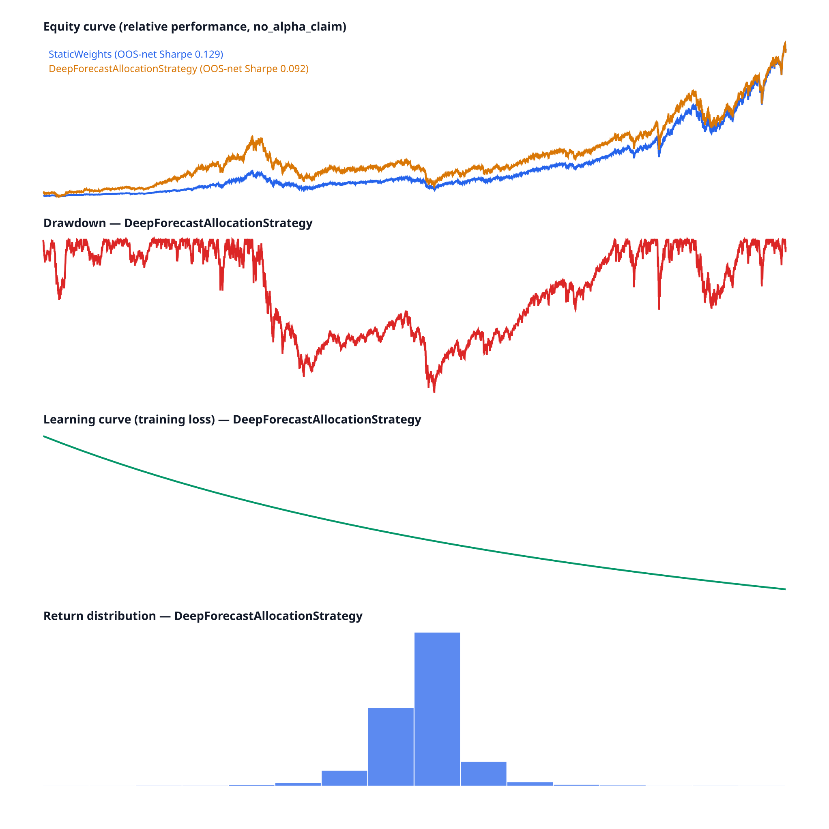
07 · 真實實驗輸出 REAL EXPERIMENT OUTPUT
模型誠實地輸給 buy-and-hold — 這正是重點
The model honestly loses to buy-and-hold — that is the point
StaticWeights (baseline) OOS-net Sharpe 0.129
DeepForecast (model)
OOS-net Sharpe 0.092
訓練後的模型在樣本外淨值上輸給 buy-and-hold：機制證據，非策略勝負，no_alpha_claim。
Mechanism evidence on real data — not a strategy verdict, not an alpha claim.
資料正確性驗證 · Data-correctness validation 1990→2026
dot-com 崩盤 / crash
−49% / −78%
金融海嘯 / GFC
−57%
COVID 崩盤 / crash
−34%
2022 升息熊市 / bear
−25%
真實 PyTorch 實驗報告 · real run_dl_experiment.py output
QuantLab · Epic H · 深度學習研究實驗室 / Deep-Learning Research Lab
08 / 13

Slide 9
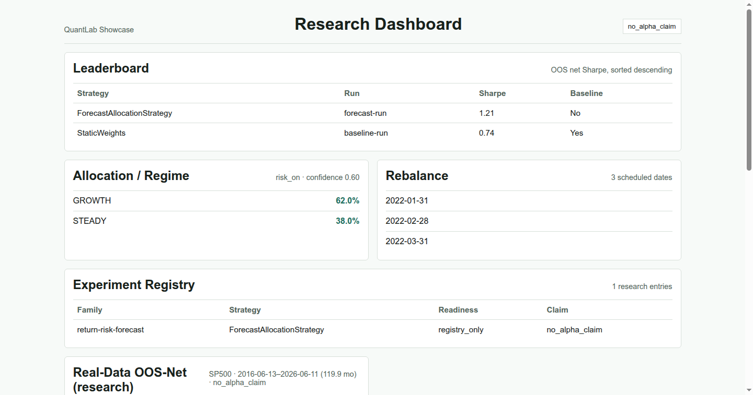
08 · SHOWCASE 儀表板 RESEARCH DASHBOARD
把研究成果變成可讀的儀表板
Turning research output into a readable dashboard
Leaderboard
OOS-net Sharpe 排序，baseline 標記 · sorted by OOS-net, baseline flagged
Allocation / Regime
risk_on、GROWTH/STEADY 配置 · regime-aware allocation
Experiment Registry
research entries、readiness、claim 邊界 · MLOps lineage on screen
no_alpha_claim badge
local_demo_only；靜態 artifact self-claim not_proven · honest by contract
Next.js 靜態匯出，由本地 result-store 生成 · Next.js static export from a canonical local result-store
QuantLab · Epic H · 深度學習研究實驗室 / Deep-Learning Research Lab
09 / 13

Slide 10
09 · 品質與證據 QUALITY & EVIDENCE
可驗證的工程：每個宣稱都有 gate 撐著
Verifiable engineering — every claim is backed by a gate
435
118/118
29/29
Python 測試通過 / tests pass
Python mutation killed
frontend mutation killed
2 skipped
突變測試 / mutation
含 H-3 守門 / incl. H-3
84.12%
88 / 242
proven
frontend 覆蓋率 / coverage
import-linter 檔/依賴 files/deps
公開部署證明 / public hosting
52 tests · 0 漏洞 / vulns
2 契約 KEPT / contracts
GitHub Pages · 0-pixel VRT
QuantLab · Epic H · 深度學習研究實驗室 / Deep-Learning Research Lab
10 / 13

Slide 11
10 · 技術棧 TECH STACK
端到端：研究核心 → 模型 → 前端 → 治理
End to end — research core → model → frontend → governance
研究與模型 · Research & model
Python 3.13
PyTorch
NumPy
A0 回測引擎
ExperimentRegistry
前端展示 · Frontend
Next.js
React
TypeScript
靜態匯出 / Pages
品質與治理 · Quality & governance
mypy
import-linter
mutation testing
Chromium VRT
PBT (Hypothesis)
QuantLab · Epic H · 深度學習研究實驗室 / Deep-Learning Research Lab
11 / 13

Slide 12

11 · 展示的能力 SKILLS DEMONSTRATED
這個作品集證明了什麼
What this portfolio demonstrates
ML 工程 · ML engineering
軟體架構 · Architecture
framework-free → 真實 PyTorch，理解而非堆疊框架 · understanding over stacking
import-linter 強制邊界，核心與框架解耦 · enforced boundaries
測試嚴謹度 · Test rigor
MLOps lineage
PBT、mutation、VRT、smoke — 把「CI 會抓到」當成自己的責任
ExperimentRegistry 確定性追蹤 + 可重現 artifact · reproducible
全端整合 · Full-stack
研究誠實 · Research honesty
後端研究核心一路接到 Next.js 互動 dashboard
no_alpha_claim、OOS-net、fail-closed — 對結果說真話
QuantLab · Epic H · 深度學習研究實驗室 / Deep-Learning Research Lab
12 / 13

Slide 13

THANK YOU · 深度學習課程作品集 / COURSE PORTFOLIO
把模型做出來不難，難的是對自己的結果誠實。
Building a model is easy — being honest about its results is the hard part.
framework-free 參考模型 → 真實 PyTorch 訓練 → 互動研究 UI，全程 no_alpha_claim · OOS-net · fail-closed.
YC Chang · ycchang.pmp@gmail.com

