Slide 1
Interactive Patient Similarity Networks
Patient Health Development Analysis and Prediction for Precision Health

Slide 2
Agenda
Project Overview and Motivation
Methodology and Base Results
Interactive Application
Notes:
I am going to start with providing you all the motivation and key pieces of the project
After which, I can dive into the methodology and the process that I undertook
Which will then lead into an overview of the application
And finally, I will play a 3 minute demo of the application in action

Slide 3
How can we identify the target subpopulations that would benefit most from already developed therapeutics?
An interactive visualization approach that lets researchers easily explore patient subpopulations and evaluate against downstream outcomes such as key predictors of short-term mortality and probability of survival over time
I leverage visualization methodology based on Patient Similarity Networks to:
Reduce wasted time in identifying important subpopulations
More quickly understand key patient populations within the data
Provide accessibility to a non-technical audience

Slide 4
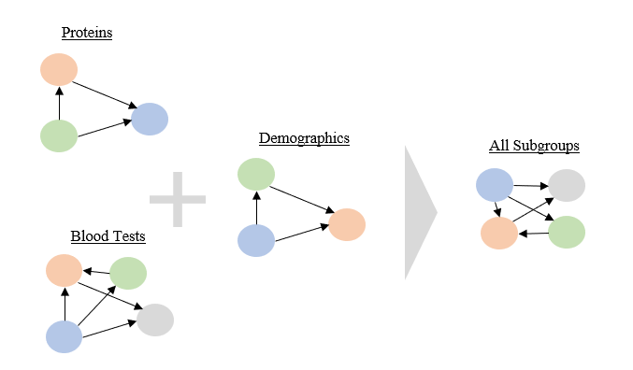
Patient Similarity Networks - An Interpretable Network Approach to Visualizing Data
What are Patient Similarity Networks?
A network of patients where each node represents a patient and each edge represents the similarity between the two
The closer two patients are, the more similar they are on the evaluated measures
Multiple networks across multiple measures / heterogeneous data sources are combined to form an overall patient similarity network
Graph algorithms can then be applied to traverse relationships or identify communities

Slide 5
Agenda
Project Overview and Motivation
Methodology and Base Results
Interactive Application
Notes:
I am going to start with providing you all the motivation and key pieces of the project
After which, I can dive into the methodology and the process that I undertook
Which will then lead into an overview of the application
And finally, I will play a 3 minute demo of the application in action

Slide 6
Leverages an Extensive Data Pre-processing and Analytical Pipeline
Identify clinically meaningful variables
Identify patients with liver disease
Run HEOR analyses on individual patient subgroups
For each variable, compute the similarity for each patient-patient combination
Generate the patient-patient network
Identify the patient subpopulations
Interactive visualization of the network and results
Measure intra-group similarities and inter-group differences

Slide 7

Analyzed Chronic Liver Disease Patients from MIMIC-III
A database made up of de-identified health information for over forty-thousand patients between 2001 and 2012
Utilized the precise medical definition for broad liver disease incorporating patients diagnosed with Cirrhosis and Hepatitis
Resulted in 2,884 patients for further analysis

Slide 8
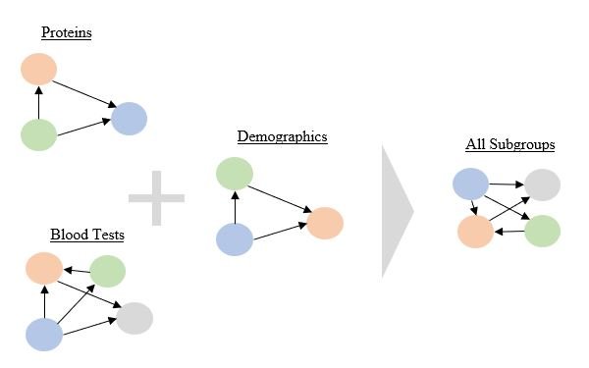
Utilized Data Subgroups for More Detailed Interpretations
Incorporating prior knowledge and research on diagnosis procedures, risks, symptoms, and procedures related to patients with Liver disease, I extracted a clinically meaningful subgroups which make-up individual networks. A few examples are below:
Breakdown products outcomes: results on Creatine, Creatinine, Albumin, and Bilirubin
Blood related outcomes: Fibrinogen, platelet count, INR, PT, PTT, Iron, Transferritin, and Ferritin
Diet: Braden Nutrition measurement, special diet restrictions, appetite level, and diet type
Medical History including comorbidities, mental status, and recreational drug use

Slide 9
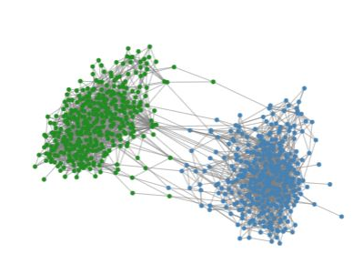
Identified Two Key Patient Subpopulations within Our Data
Cluster 0
Cluster 1
Applied Spectral Clustering to Graph’s Adjacency matrix to identify two key populations
Cluster 0 characterized by higher rates of serious comorbidities including anemia, congestive heart failure, diabetes, and renal failure
Cluster 1 characterized by shorter survival times and lower protein and enzyme levels

Slide 10
Incorporated Models Predicting 30-day Mortality
Cluster | Mortality within 30 Days Ratio | Avg. Number of Days to Death | F1 Score
0 | 0.31 | 317.74 | 0.82
1 | 0.24 | 108.84 | 0.85
Total | 0.28 | 233.81 | 0.83
A LightGBM model is applied to the entire set of patients to predict mortality within 30 days
The final model included the top 50 most important features as identified via Shapley values

Slide 11
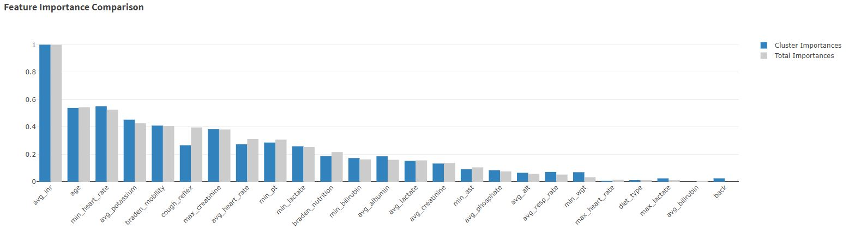
Identified Key Predictors of Short-term Mortality
Key biological predictors include INR, Heart Rate, Potassium, Creatinine, and PT
Key non-biological predictors include age, mobility, cough reflex, and nutrition

Slide 12
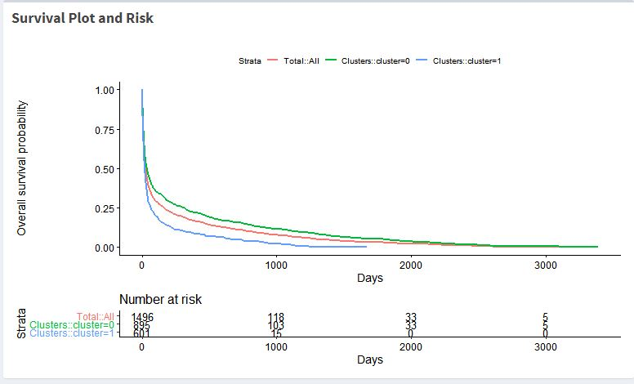
Evaluated Patients’ Likelihood of Survival for any Given Point in Time
Cluster 0 experienced significantly longer survival times than Cluster 1

Slide 13
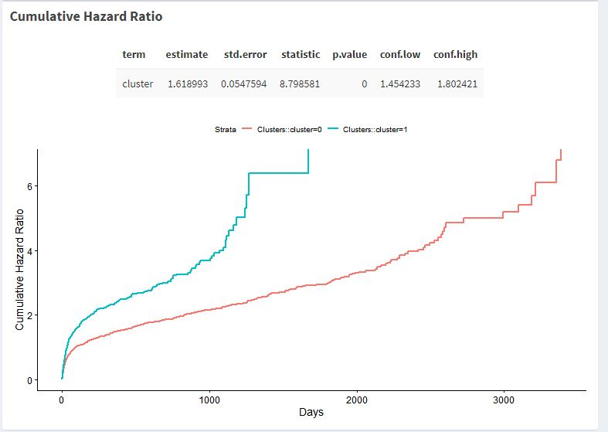
Correspondingly, Cluster 1 Patients had much Higher Risks of Death
On average, cluster 1 was 1.62 times more likely to die than their Cluster 0 counterparts

Slide 14
Agenda
Project Overview and Motivation
Methodology and Base Results
Interactive Application
Notes:
I am going to start with providing you all the motivation and key pieces of the project
After which, I can dive into the methodology and the process that I undertook
Which will then lead into an overview of the application
And finally, I will play a 3 minute demo of the application in action

Slide 15
Contents of Application
The application consists of four tabs
Project Introduction
Patient Similarity Networks
30-Day Mortality
Survival Analysis
Notes:
I will explore the high-level overview of the application, followed by an example of interactively exploring the application, and finished off with a demo.

Slide 16
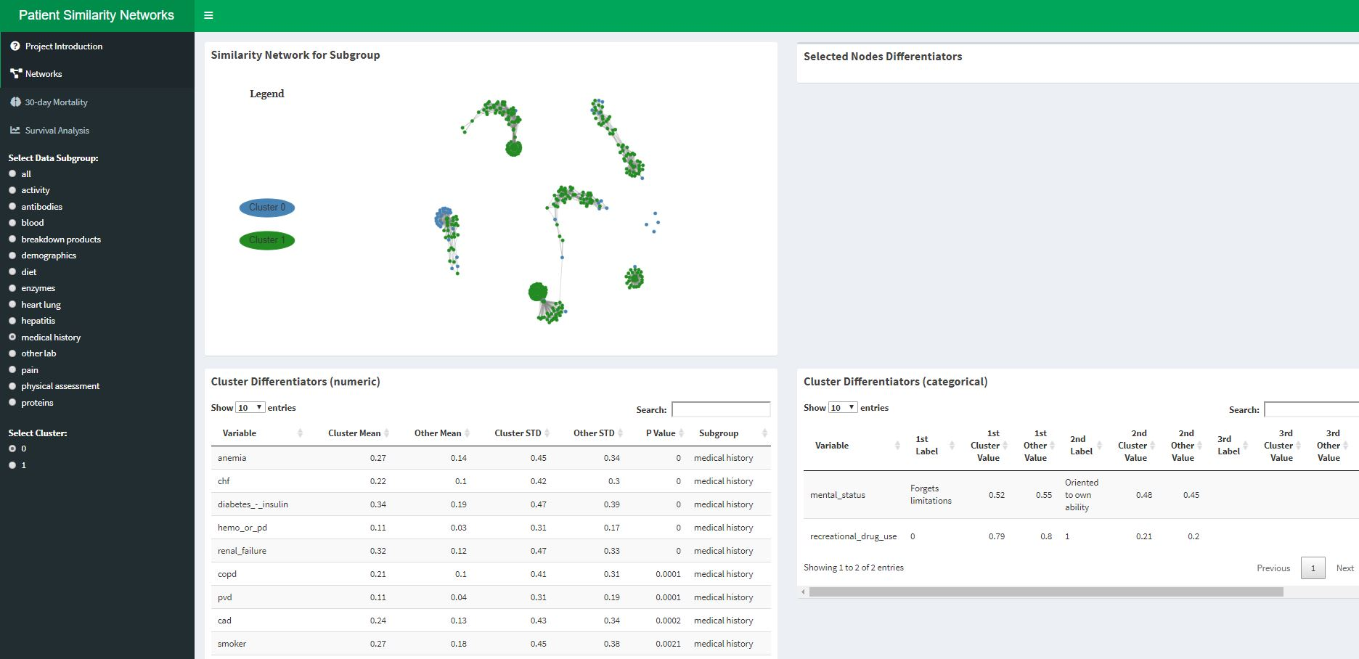
Networks Tab: an Overview of the Patient Similarity Networks
Screenshot of the interactive application’s ‘Networks’ tab currently viewing the “medical history” data subgroup.
The top left box displays the selected PSN.
The two bottom boxes display the statistical test results for numeric (left) and categorical (variables).
Ordered by level of statistical significance.

Slide 17
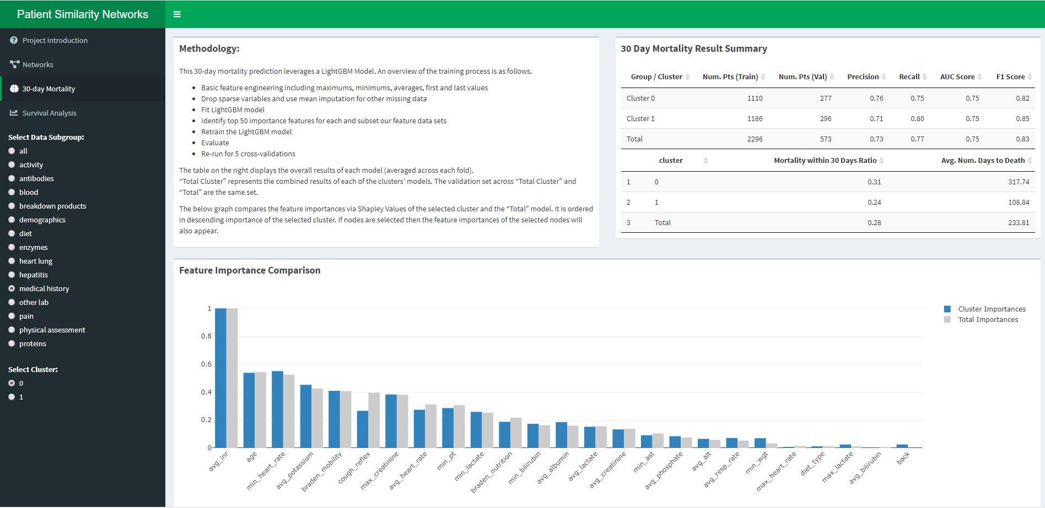
30-day Mortality Tab: Feature Importance in Predicting Mortality
Screenshot of the interactive application’s “30-day Mortality” tab
The top left box displays methodology information.
The top right box displays the efficacy results of our prediction model and summary statistics of the percent of patients who die within 30 days and the average time to death for patient
The bottom box displays the mean Shapley values (feature importance scores) for the selected cluster and the total population

Slide 18
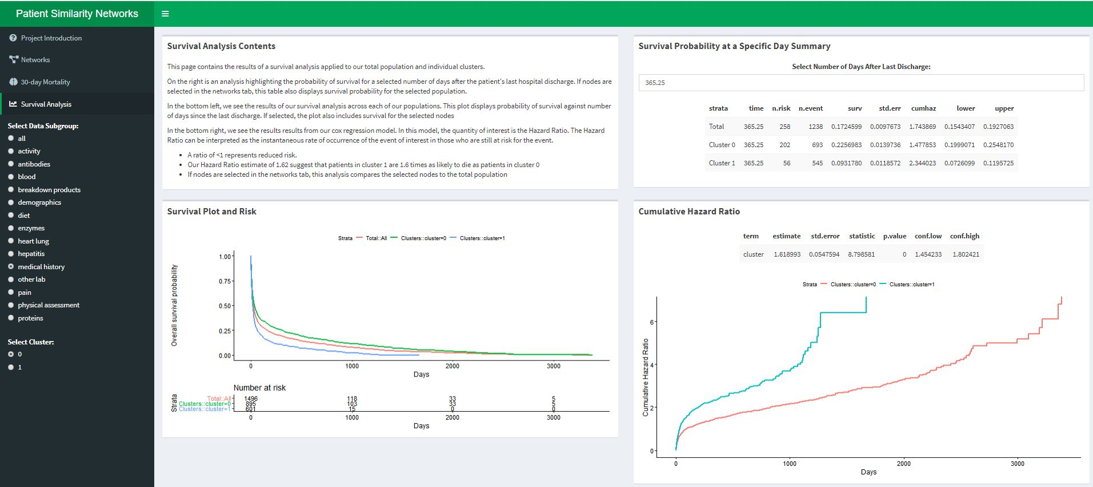
Survival Tab: Interactively Explore Survival Probabilities and Risks
Screenshot of the interactive application’s “Survival” tab
The top left box displays the methodology and summary
The top right box displays detailed survival information for a user-selected day
The bottom right box displays the cumulative hazard ratio plot (risk of death over time)
The bottom left box displays the survival plot (survival probability over time)

Slide 19
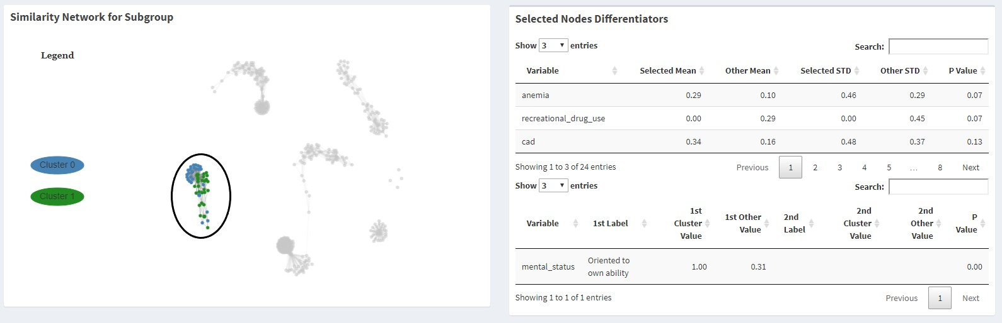
Identify, Select, and Explore within Individual Subpopulations
Select to view the “Medical History” Patient Similarity Network - notice that there are 6 main clusters within our data
Select one of the clusters - the application will update identifying the differences between the selected cluster and the rest of the population
We can see that our selected patient subpopulation is characterized by higher rates of anemia and coronary artery disease (cad), but lower rates of recreational drug use than the general chronic liver disease population

Slide 20
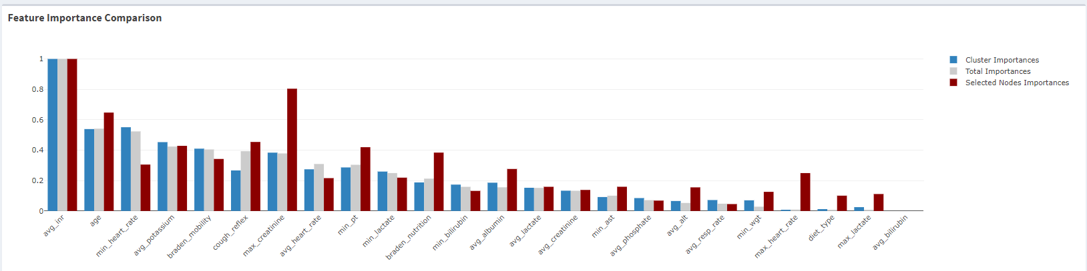
Evaluate Key Predictors to Short-term Mortality for Selected Population
The selected nodes are analyzed via the 30-day mortality machine learning pipeline.
There are different key predictors of 30-day mortality for this patient subpopulation than the general population or clusters
We see that age, creatinine, nutrition, and cough reflex values are more predictive
But, heart rate and mobility are less predictive

Slide 21
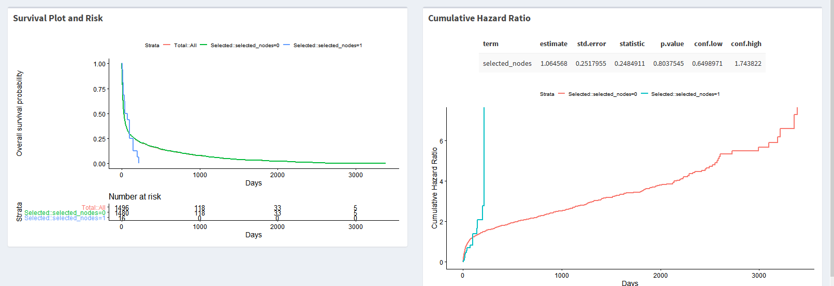
The Selected Subpopulation Experiences much Higher Risks of Death and Shorter Survival Times

Slide 22
Application Demo
Notes:
Link to Youtube
Demo to provide an overview and go into how we can compare outcomes across different populations

