Slide 1
Lecture 1: Introduction

Slide 2
Course logistics in brief
Instructor: A. Nickabadi
TAs:
…
Time: Saturday Monday 10:45-12:15
TA Classes: Saturday 12:15 – 12:45
Class webpage: http://ceit.aut.ac.ir/courses/
Office hours: Saturday 13:30 – 15:00
Email: nickabadi@aut.ac.ir
Phone: +98-21-6454-2743

Slide 3
Work for the class
Required work:
4-6 problem sets (2/20)
3 programming assignments (4/20)
Final exam: (9/20)
Midterm (5/20)
Bonus points:
Class participation
Research works

Slide 4
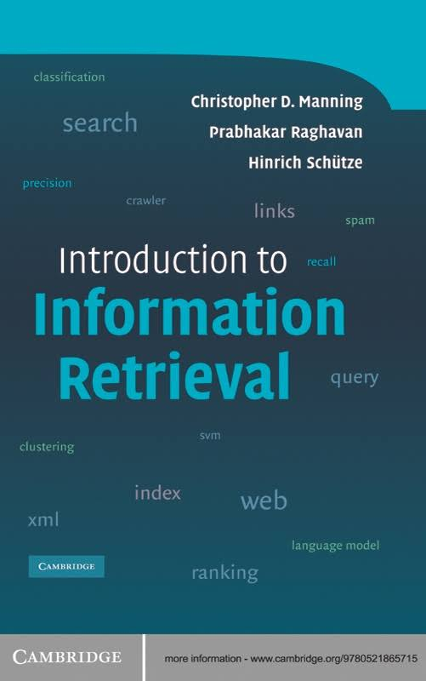
References
[IIR]: Introduction to Information Retrieval, by C. Manning, P. Raghavan, and H. Schütze (Cambridge University Press, 2008).

Slide 5
References
Other useful references:
(MG) Managing Gigabytes, by I. Witten, A. Moffat, and T. Bell.
(IRAH) Information Retrieval: Algorithms and Heuristics, by D. Grossman and O. Frieder.
(MIR) Modern Information Retrieval, by R. Baeza-Yates and B. Ribeiro-Neto.
(FSNLP) Foundations of Statistical Natural Language Processing, by C. Manning and H. Schütze.
(SE) Search Engines: Information Retrieval in Practice, by B. Croft, D. Metzler, and T. Strohman.
(IRIE) Information Retrieval: Implementing and Evaluating Search Engines, by S. Büttcher, C. Clarke, and G. Cormack.

Slide 6
What do we hope to teach?
How to do efficient (fast, compact) text indexing
Retrieval models: Boolean, vector-space, probabilistic, and machine learning models
Evaluation and IR interface issues
Document clustering and classification
Search on the web, including crawling, link-based algorithms, indirect feedback, metadata, and personalization

