Slide 1
CS276 Information Retrieval and Web Search
Chris Manning and Pandu Nayak
Link analysis

Slide 2
Today’s lecture – hypertext and links
We look beyond the content of documents
We begin to look at the hyperlinks between them
Address questions like
Do the links represent a conferral of authority to some pages? Is this useful for ranking?
How likely is it that a page pointed to by the CERN home page is about high energy physics
Big application areas
The Web
Email
Social networks

Slide 3
Links are everywhere
Powerful sources of authenticity and authority
Mail spam – which email accounts are spammers?
Host quality – which hosts are “bad”?
Phone call logs
The Good, The Bad and The Unknown
?
Good
?
?
Bad
?

Slide 4
Example 1: Good/Bad/Unknown
The Good, The Bad and The Unknown
Good nodes won’t point to Bad nodes
All other combinations plausible
?
Good
?
?
Bad
?

Slide 5
Simple iterative logic
Good nodes won’t point to Bad nodes
If you point to a Bad node, you’re Bad
If a Good node points to you, you’re Good
?
Good
?
?
Bad
?

Slide 6
Simple iterative logic
Good nodes won’t point to Bad nodes
If you point to a Bad node, you’re Bad
If a Good node points to you, you’re Good
Good
?
Bad
?

Slide 7
Simple iterative logic
Good nodes won’t point to Bad nodes
If you point to a Bad node, you’re Bad
If a Good node points to you, you’re Good
Good
Bad
Sometimes need probabilistic analogs – e.g., mail spam
Notes:
There’s now virus software explicitly targeting this stuff – putting spam links into WordPress sites.

Slide 8
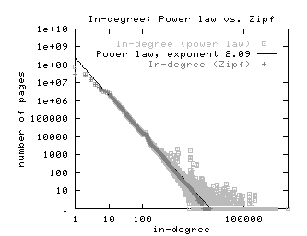
Example 2: In-links to pages – unusual patterns ☺
Spammers violating power laws!

Slide 9
Many other examples of link analysis
Social networks are a rich source of grouping behavior
E.g., Shoppers’ affinity – Goel+Goldstein 2010
Consumers whose friends spend a lot, spend a lot themselves
http://www.cs.cornell.edu/home/kleinber/networks-book/
See cs224w

Slide 10
Our primary interest in this course
Link analysis additions to IR functionality thus far based purely on text
Scoring and ranking
Link-based clustering – topical structure from links
Links as features in classification – documents that link to one another are likely to be on the same subject
Crawling
Based on the links seen, where do we crawl next?

Slide 11
The Web as a Directed Graph
Sec. 21.1
Page A
Page B
hyperlink
Anchor
Hypothesis 1: A hyperlink between pages denotes a conferral of authority (quality signal)
Hypothesis 2: The text in the anchor of a hyperlink on page A describes the target page B

Slide 12
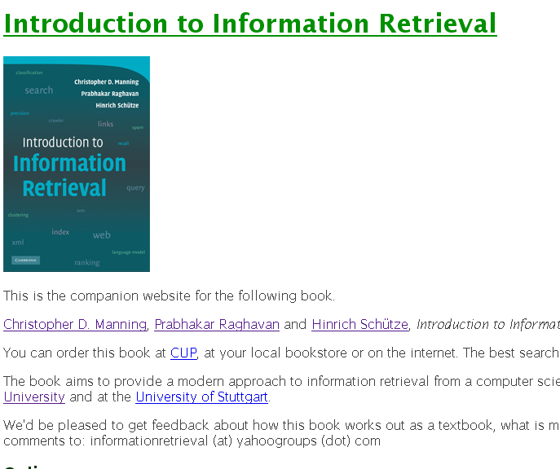
Assumption 1: reputed sites

Slide 13


Assumption 2: annotation of target

Slide 14
Anchor Text WWW Worm - McBryan [Mcbr94]
Sec. 21.1.1
For ibm how to distinguish between:
IBM’s home page (mostly graphical)
IBM’s copyright page (high term freq. for ‘ibm’)
Rival’s spam page (arbitrarily high term freq.)
“ibm.com”
“IBM home page”
“ibm”
A million pieces of anchor text with “ibm” send a strong signal
www.ibm.com

Slide 15
Indexing anchor text
Sec. 21.1.1
When indexing a document D, include (with some weight) anchor text (and perhaps nearby surrounding text) from links pointing to D.
Armonk, NY-based computer
giant IBM announced today
More information about IBM products can be found here
www.ibm.com
Joe’s computer hardware links
Sun
HP
IBM
Big Blue today announced
record profits for the quarter

Slide 16
Indexing anchor text
Sec. 21.1.1
Can sometimes have unexpected effects, e.g., spam, miserable failure
Can score anchor text with weight depending on the authority of the anchor page’s website
E.g., if we were to assume that content from cnn.com or yahoo.com is authoritative, then trust (more) the anchor text from them
Increase the weight of off-site anchors (non-nepotistic scoring)

Slide 17
Getting at all that link information inexpensively
Connectivity servers

Slide 18
Connectivity Server
Sec. 20.4
Support for fast queries on the web graph
Which URLs point to a given URL?
Which URLs does a given URL point to?
Stores mappings in memory from
URL to outlinks, URL to inlinks
Applications
Link analysis
Web graph analysis
Connectivity, crawl optimization
Crawl control

Slide 19
Boldi and Vigna 2004
Sec. 20.4
http://www2004.org/proceedings/docs/1p595.pdf
Webgraph – set of algorithms and a java implementation
Fundamental goal – maintain node adjacency lists in memory
For this, compressing the adjacency lists is the critical component

Slide 20
Adjacency lists
Sec. 20.4
The set of neighbors of a node
Assume each URL represented by an integer
E.g., for a 4 billion page web, need 32 bits per node … and now there are definitely > 4B pages
Naively, this demands 64 bits to represent each hyperlink
Boldi/Vigna get down to an average of ~3 bits/link
Further work achieves 2 bits/link

Slide 21
Adjacency list compression
Sec. 20.4
Properties exploited in compression:
Similarity (between lists)
Locality (many links from a page go to “nearby” pages)
Use gap encoding in sorted lists
Distribution of gap values

Slide 22
Main ideas of Boldi/Vigna
Sec. 20.4
Consider lexicographically ordered list of all URLs, e.g.,
www.stanford.edu/alchemy
www.stanford.edu/biology
www.stanford.edu/biology/plant
www.stanford.edu/biology/plant/copyright
www.stanford.edu/biology/plant/people
www.stanford.edu/chemistry

Slide 23
Boldi/Vigna
Sec. 20.4
Each of these URLs has an adjacency list
Main idea: due to templates, the adjacency list of a node is similar to one of the 7 preceding URLs in the lexicographic ordering … or else encoded anew
Express adjacency list in terms of one of these
E.g., consider these adjacency lists
1, 2, 4, 8, 16, 32, 64
1, 4, 9, 16, 25, 36, 49, 64
1, 2, 3, 5, 8, 13, 21, 34, 55, 89, 144
1, 4, 8, 16, 25, 36, 49, 64
Why 7?
Encode as (–2), remove 9, add 8
Notes:
Why 7?

Slide 24
Gap encodings
Sec. 20.4
Given a sorted list of integers x, y, z, …, represent by x, y-x, z-y, …
Compress each integer using a code
γ code - Number of bits = 1 + 2 ⎣lg x⎦
δ code: …
Information theoretic bound: 1 + ⎣lg x⎦ bits
ζ code: Works well for integers from a power law [Boldi, Vigna: Data Compression Conf. 2004]

Slide 25
Main advantages of BV
Sec. 20.4
Depends only on locality in a canonical ordering
Lexicographic ordering works well for the web
Adjacency queries can be answered very efficiently
To fetch out-neighbors, trace back the chain of prototypes
This chain is typically short in practice (since similarity is mostly intra-host)
Can also explicitly limit the length of the chain during encoding
Easy to implement one-pass algorithm

Slide 26
Link analysis: Pagerank

Slide 27
Citation Analysis
Citation frequency
Bibliographic coupling frequency
Articles that co-cite the same articles are related
Citation indexing
Who is this author cited by? (Garfield 1972)
Pagerank preview: Pinsker and Narin ’60s
Asked: which journals are authoritative?

Slide 28
The web isn’t scholarly citation
Millions of participants, each with self interests
Spamming is widespread
Once search engines began to use links for ranking (roughly 1998), link spam grew
You can join a link farm – a group of websites that heavily link to one another

Slide 29
Pagerank scoring
Sec. 21.2
Imagine a user doing a random walk on web pages:
Start at a random page
At each step, go out of the current page along one of the links on that page, equiprobably
“In the long run” each page has a long-term visit rate – use this as the page’s score
Variant: rather than equiprobable, use text and link information to have probability of following a link: intelligent surfer [Richardson and Domingos 2001]
1/3
1/3
1/3

Slide 30
Not quite enough
Sec. 21.2
The web is full of dead-ends.
Random walk can get stuck in dead-ends.
Makes no sense to talk about long-term visit rates.
??

Slide 31
Teleporting
Sec. 21.2
At a dead end, jump to a random web page.
At any non-dead end, with probability 10%, jump to a random web page.
With remaining probability (90%), go out on a random link.
10% - a parameter.
“Teleportation” probability
Simulates a web users going somewhere else
Solves linear algebra problems….

Slide 32
Result of teleporting
Sec. 21.2
Now cannot get stuck locally.
There is a long-term rate at which any page is visited (not obvious, will show this).
How do we compute this visit rate?

Slide 33
Markov chains
Sec. 21.2.1
A Markov chain consists of n states, plus an n×n transition probability matrix P.
At each step, we are in one of the states.
For 1 ≤ i,j ≤ n, the matrix entry P_{ij} tells us the probability of j being the next state, given we are currently in state i.
P_{ii}>0
is OK.
i
j
P_{ij}

Slide 34
Markov chains
Sec. 21.2.1
Clearly, for all i,
Markov chains are abstractions of random walks.
Exercise: represent the teleporting random walk from 3 slides ago as a Markov chain, for this case:

Slide 35
Ergodic Markov chains
Sec. 21.2.1
For any ergodic Markov chain, there is a unique long-term visit rate for each state.
Steady-state probability distribution.
Over a long time-period, we visit each state in proportion to this rate.
It doesn’t matter where we start.
Ergodic: no periodic patterns
Teleportation ensures ergodicity
Not ergodic

Slide 36
Probability vectors
Sec. 21.2.1
A probability (row) vector x = (x₁, … x_{n}) tells us where the walk is at any point.
E.g., (000…1…000) means we’re in state i.
1
i
n
More generally, the vector x = (x₁, … x_{n}) means the walk is in state i with probability x_{i}.

Slide 37
Change in probability vector
Sec. 21.2.1
If the probability vector is x = (x₁, … x_{n}) at this step, what is it at the next step?
Recall that row i of the transition prob. matrix P tells us where we go next from state i.
So from x, our next state is distributed as xP
The one after that is xP², then xP³, etc.
(Where) Does this converge?
Running this and finding out is “the power method”
It’s actually the method of choice, done with sparse P

Slide 38
How do we compute this vector?
Sec. 21.2.2
Let a = (a₁, … a_{n}) denote the row vector of steady-state probabilities.
If our current position is described by a, then the next step is distributed as aP.
But a is the steady state, so a=aP.
Solving this matrix equation gives us a.
So a is the (left) eigenvector for P.
Corresponds to the “principal” eigenvector of P with the largest eigenvalue. (See: Perron-Frobenius theorem.)
Transition probability matrices always have largest eigenvalue 1.

Slide 39
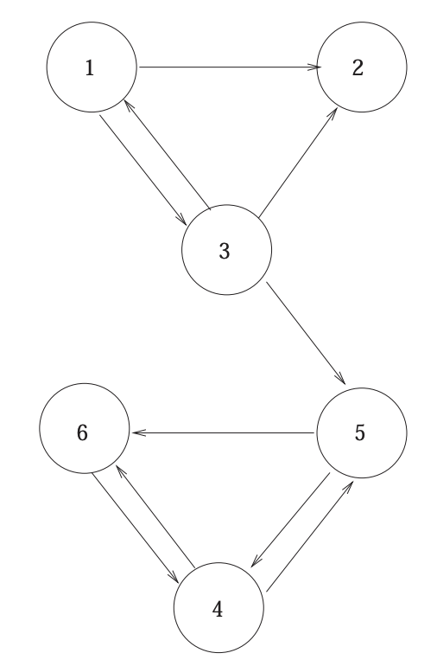
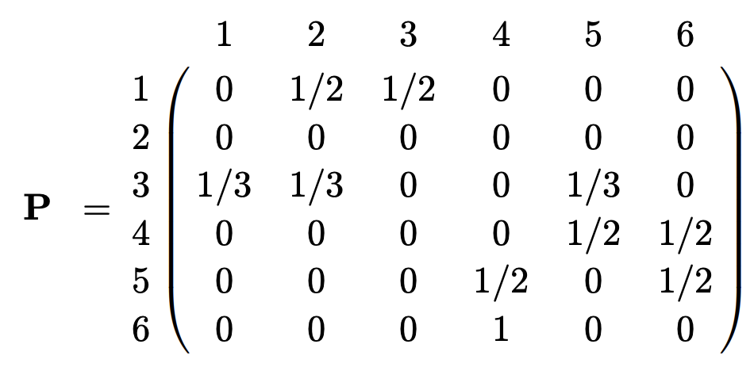
Example: Mini web graph

Slide 40
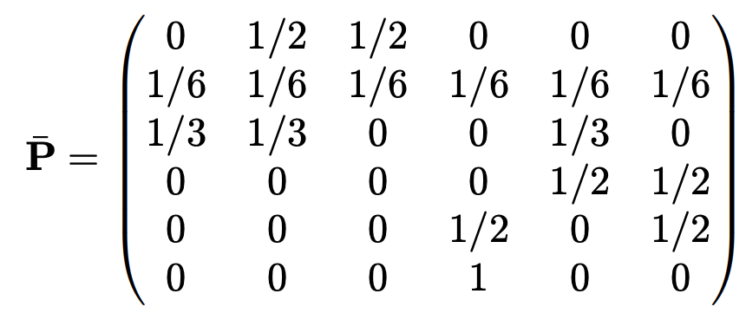
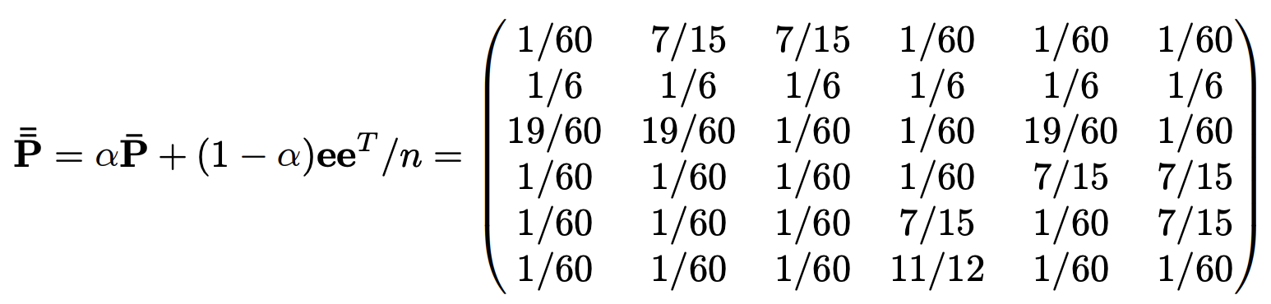
Example: Fixing sinks and teleporting

Slide 41
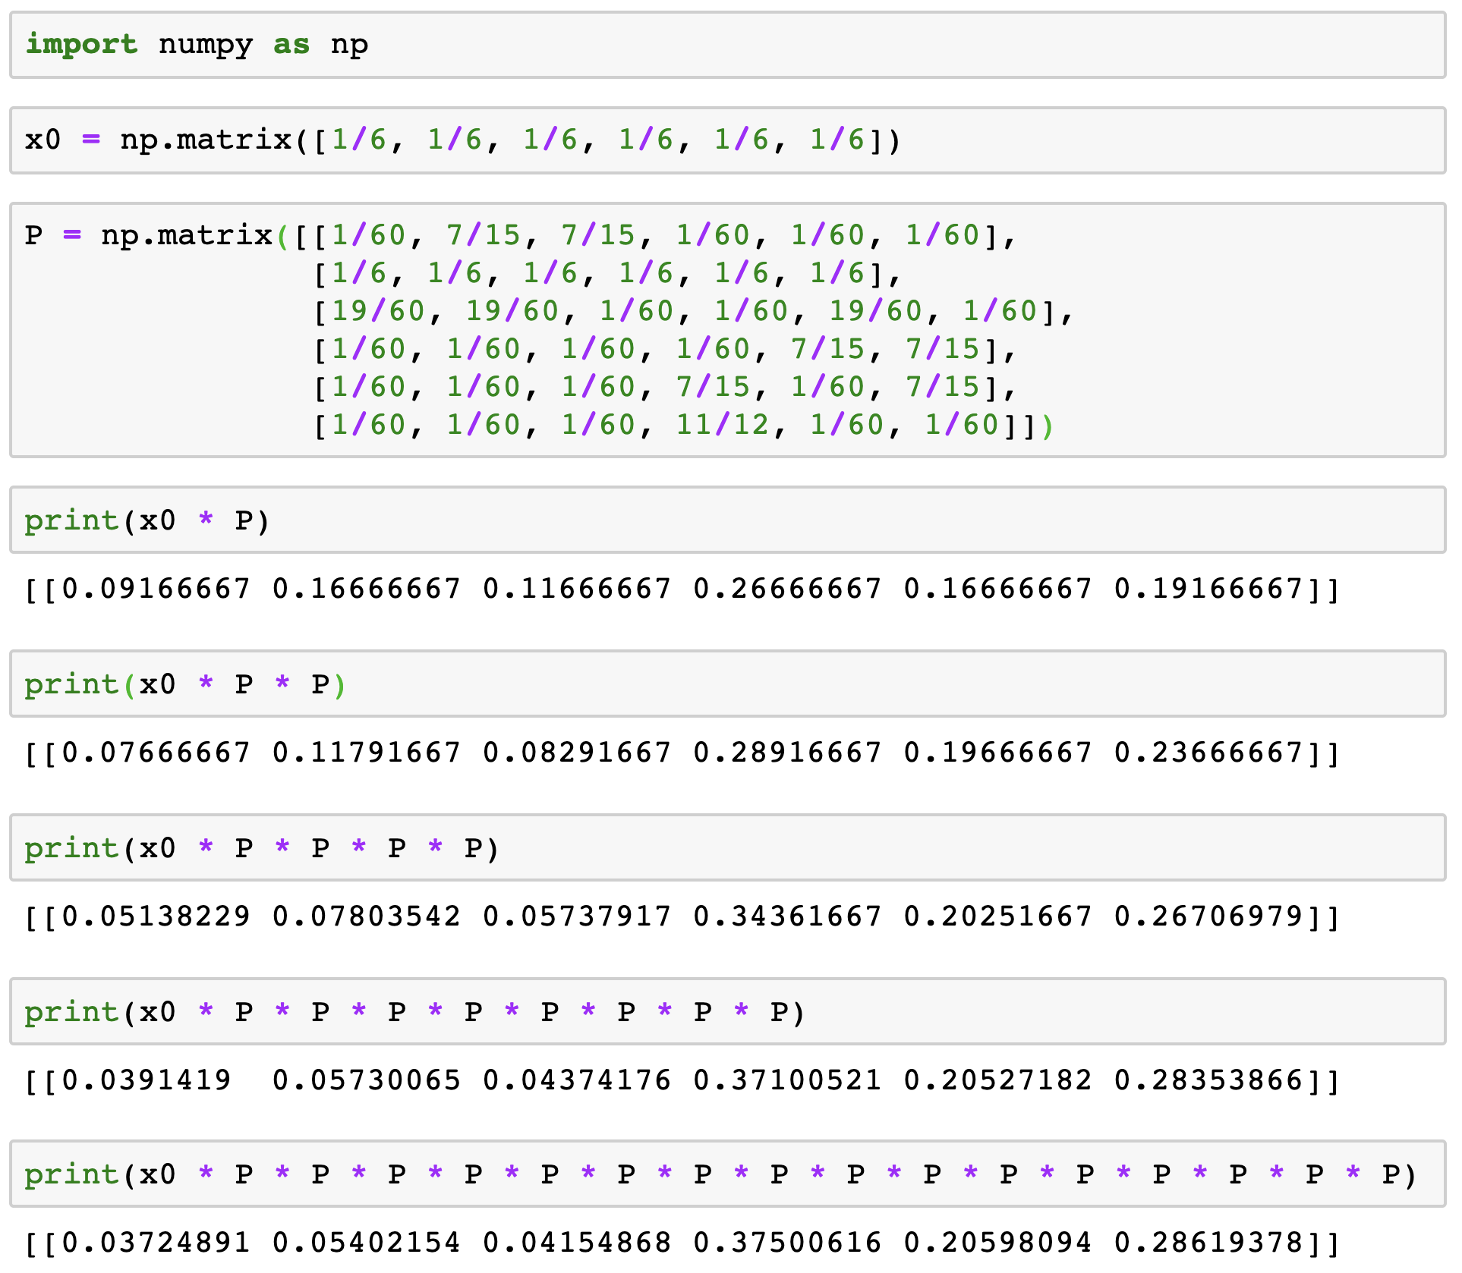
Example: Doing power iteration

Slide 42
Kleinberg (1999)
Link analysis: HITS

Slide 43
Hyperlink-Induced Topic Search (HITS)
Sec. 21.3
In response to a query, instead of an ordered list of pages each meeting the query, find two sets of inter-related pages:
Hub pages are good lists of links on a subject
e.g., “Bob’s list of cancer-related links.”
Authority pages occur recurrently on good hubs for the subject
Best suited for “broad topic” queries rather than for page-finding queries
Gets at a broader slice of common opinion

Slide 44
Hubs and Authorities
Sec. 21.3
Thus, a good hub page for a topic points to many authoritative pages for that topic.
A good authority page for a topic is pointed to by many good hubs for that topic.
Circular definition – will turn this into an iterative computation.

Slide 45
The hope
Sec. 21.3
Authorities
Hubs
Mobile telecom companies

Slide 46
High-level scheme
Sec. 21.3
Extract from the web a base set of pages that could be good hubs or authorities.
From these, identify a small set of top hub and authority pages;
iterative algorithm.

Slide 47
Base set
Sec. 21.3
Given text query (say browser), use a text index to get all pages containing browser.
Call this the root set of pages.
Add in any page that either
points to a page in the root set, or
is pointed to by a page in the root set.
Call this the base set.

Slide 48
Visualization
Sec. 21.3
Root
set
Base set
Get in-links (and out-links) from a connectivity server

Slide 49
Distilling hubs and authorities
Sec. 21.3
Compute, for each page x in the base set, a hub score h(x) and an authority score a(x).
Initialize: for all x, h(x)←1; a(x) ←1;
Iteratively update all h(x), a(x);
After iterations
output pages with highest h() scores as top hubs
highest a() scores as top authorities.
Key

Slide 50
Iterative update
Sec. 21.3
Repeat the following updates, for all x:
x
x

Slide 51
Scaling
Sec. 21.3
To prevent the h() and a() values from getting too big, can scale down after each iteration.
Scaling factor doesn’t really matter:
we only care about the relative values of the scores.

Slide 52
How many iterations?
Sec. 21.3
Claim: relative values of scores will converge after a few iterations:
in fact, suitably scaled, h() and a() scores settle into a steady state!
proof of this comes later.
In practice, ~5 iterations get you close to stability.

Slide 53
Proof of convergence
Sec. 21.3
n×n adjacency matrix A:
each of the n pages in the base set has a row and column in the matrix.
Entry A_{ij} = 1 if page i links to page j, else = 0.
1 2 3
1
2
1
2
3
0 1 0
1 1 1
3
1 0 0

Slide 54
Hub/authority vectors
Sec. 21.3
View the hub scores h() and the authority scores a() as vectors with n components.
Recall the iterative updates

Slide 55
Rewrite in matrix form
Sec. 21.3
h=Aa.
a=A^{T}h.
Recall A^{T} is the transpose of A.
Substituting, h=AA^{T}h and a=A^{T}Aa.
Thus, h is an eigenvector of AA^{T} and a is an eigenvector of A^{T}A.
Further, our algorithm is a particular, known algorithm for computing eigenvectors: again, the power iteration method.
Guaranteed to converge.

Slide 56
Example authorities found … in 1999
(java) Authorities
.328 http://www.gamelan.com/ Gamelan
.251 http://java.sun.com/ JavaSoft Home Page
.190 http://www.digitalfocus.com/... The Java Developer: How Do I ...
.190 http://lightyear.ncsa.uiuc.edu/;srp/java/ javabooks.html
.183 http://sunsite.unc.edu/javafaq/javafaq.html comp.lang.java FAQ
(censorship) Authorities
.378 http://www.eff.org/ EFFweb—The Electronic Frontier Foundation
.344 http://www.eff.org/blueribbon.html The Blue Ribbon Campaign for Online Free Speech
.238 http://www.cdt.org/ The Center for Democracy and Technology
.235 http://www.vtw.org/ Voters Telecommunications Watch
.218 http://www.aclu.org/ ACLU: American Civil Liberties Union

Slide 57
Issues
Sec. 21.3
Topic Drift
Off-topic pages can cause off-topic “authorities” to be returned
E.g., the neighborhood graph can be about a “super topic”
Mutually Reinforcing Affiliates
Affiliated pages/sites can boost each others’ scores
Linkage between affiliated pages is not a useful signal

Slide 58
Resources
IIR Chap 21
Kleinberg, Jon (1999). Authoritative sources in a hyperlinked environment. Journal of the ACM. 46 (5): 604–632.
http://www2004.org/proceedings/docs/1p309.pdf
http://www2004.org/proceedings/docs/1p595.pdf
http://www2003.org/cdrom/papers/refereed/p270/kamvar-270-xhtml/index.html
http://www2003.org/cdrom/papers/refereed/p641/xhtml/p641-mccurley.html
The WebGraph framework I: Compression techniques (Boldi et al. 2004)

