Slide 1
CS276: Information Retrieval and Web Search
Christopher Manning and Pandu Nayak
Lecture 4: Index Compression
Notes:
Remind people about bitwise operators.

Slide 2
Last lecture – index construction
Sort-based indexing
Naïve in-memory inversion
Blocked Sort-Based Indexing (BSBI)
Merge sort is effective for hard disk–based sorting (avoid seeks!)
Single-Pass In-Memory Indexing (SPIMI)
No global dictionary
Generate separate dictionary for each block
Don’t sort postings
Accumulate postings in postings lists as they occur
Distributed indexing using MapReduce
Dynamic indexing: Multiple indices, logarithmic merge

Slide 3
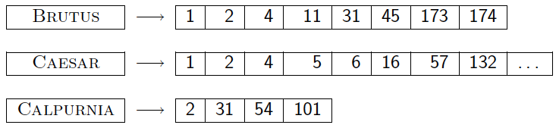
Today
Ch. 5
Collection statistics in more detail (with RCV1)
How big will the dictionary and postings be?
Dictionary compression
Postings compression

Slide 4
Why compression (in general)?
Ch. 5
Use less disk space
Save a little money; give users more space
Keep more stuff in memory
Increases speed
Increase speed of data transfer from disk to memory
[read compressed data | decompress] is faster than [read uncompressed data]
Premise: Decompression algorithms are fast
True of the decompression algorithms we use

Slide 5
Why compression for inverted indexes?
Ch. 5
Dictionary
Make it small enough to keep in main memory
Make it so small that you can keep some postings lists in main memory too
Postings file(s)
Reduce disk space needed
Decrease time needed to read postings lists from disk
Large search engines keep a significant part of the postings in memory.
Compression lets you keep more in memory
We will devise various IR-specific compression schemes

Slide 6
Recall Reuters RCV1
Sec. 5.1
symbol statistic value
N documents 800,000
L avg. # tokens per doc 200
M terms (= word types) ~400,000
avg. # bytes per token 6
(incl. spaces/punct.)
avg. # bytes per token 4.5
(without spaces/punct.)
avg. # bytes per term 7.5
non-positional postings 100,000,000

Slide 7
Index parameters vs. what we index (details IIR Table 5.1, p.80)
Sec. 5.1
size of | word types (terms) |  |  | non-positional postings |  |  | positional postings
 | dictionary |  |  | non-positional index |  |  | positional index
 | Size (K) | ∆% | cumul % | Size (K) | ∆ % | cumul % | Size (K) | ∆ % | cumul %
Unfiltered | 484 |  |  | 109,971 |  |  | 197,879
No numbers | 474 | -2 | -2 | 100,680 | -8 | -8 | 179,158 | -9 | -9
Case folding | 392 | -17 | -19 | 96,969 | -3 | -12 | 179,158 | 0 | -9
30 stopwords | 391 | -0 | -19 | 83,390 | -14 | -24 | 121,858 | -31 | -38
150 stopwords | 391 | -0 | -19 | 67,002 | -30 | -39 | 94,517 | -47 | -52
stemming | 322 | -17 | -33 | 63,812 | -4 | -42 | 94,517 | 0 | -52
Exercise: give intuitions for all the ‘0’ entries. Why do some zero entries correspond to big deltas in other columns?

Slide 8
Lossless vs. lossy compression
Sec. 5.1
Lossless compression: All information is preserved.
What we mostly do in IR.
Lossy compression: Discard some information
Several of the preprocessing steps can be viewed as lossy compression: case folding, stop words, stemming, number elimination.
Chapter 7: Prune postings entries that are unlikely to turn up in the top k list for any query.
Almost no loss of quality in top k list.

Slide 9
Vocabulary size vs. collection size
Sec. 5.1
How big is the term vocabulary?
That is, how many distinct words are there?
Can we assume an upper bound?
Not really: At least 70²⁰ = 10³⁷ different words of length 20
In practice, the vocabulary will keep growing with the collection size
Especially with Unicode ☺
Notes:
Also - the calculation "At least 7020 = 1037 different words of length 20" seems like a bit of a gross overestimate (and in any case, might be more useful to say it's 2 raised to some power rather than 10 raised to the power 37)

Slide 10
Vocabulary size vs. collection size
Sec. 5.1
Heaps’ law: M = kT^{b}
M is the size of the vocabulary, T is the number of tokens in the collection
Typical values: 30 ≤ k ≤ 100 and b ≈ 0.5
In a log-log plot of vocabulary size M vs. T, Heaps’ law predicts a line with slope about ½
It is the simplest possible (linear) relationship between the two in log-log space
log M = log k + b log T
An empirical finding (“empirical law”)

Slide 11
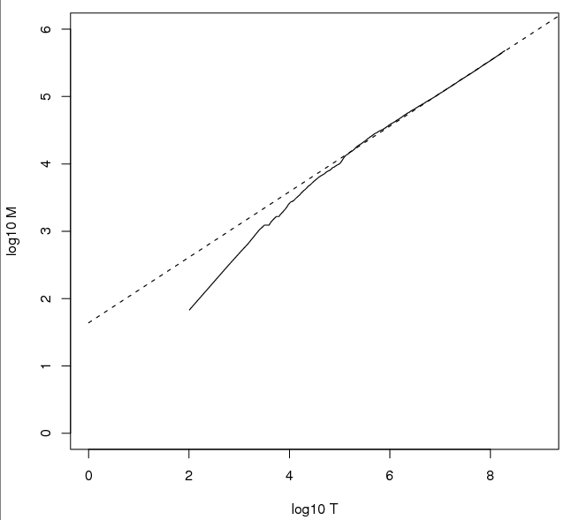
Heaps’ Law
Sec. 5.1
Fig 5.1 p81
For RCV1, the dashed line
log₁₀M = 0.49 log₁₀T + 1.64 is the best least squares fit.
Thus, M = 10^{1.64}T^{0.49} so k = 10^{1.64} ≈ 44 and b = 0.49.
Good empirical fit for Reuters RCV1 !
For first 1,000,020 tokens,
law predicts 38,323 terms;
actually, 38,365 terms
Notes:
Example: for the first 1,000,020 tokens Heaps’ law predicts
38,323 terms:
44 Å~ 1,000,0200.49 ≈ 38,323
The actual number is 38,365 terms, very close to the
prediction.
Empirical observation: fit is good in general.

Slide 12
Exercises
Sec. 5.1
What is the effect of including spelling errors, vs. automatically correcting spelling errors on Heaps’ law?
Compute the vocabulary size M for this scenario:
Looking at a collection of web pages, you find that there are 3000 different terms in the first 10,000 tokens and 30,000 different terms in the first 1,000,000 tokens.
Assume a search engine indexes a total of 20,000,000,000 (2 × 10¹⁰) pages, containing 200 tokens on average
What is the size of the vocabulary of the indexed collection as predicted by Heaps’ law?

Slide 13
Zipf’s law
Sec. 5.1
Heaps’ law gives the vocabulary size in collections.
We also study the relative frequencies of terms.
In natural language, there are a few very frequent terms and very many very rare terms.
Zipf’s law: The i^{th} most frequent term has frequency proportional to 1/i .
cf_{i} ∝ 1/i = K/i where K is a normalizing constant
cf_{i} is collection frequency: the number of occurrences of the term t_{i} in the collection.

Slide 14
Zipf consequences
Sec. 5.1
If the most frequent term (the) occurs cf₁ times
then the second most frequent term (of) occurs cf₁/2 times
the third most frequent term (and) occurs cf₁/3 times …
Equivalent: cf_{i} = K/i where K is a normalizing factor, so
log cf_{i} = log K - log i
Linear relationship between log cf_{i} and log i
Another power law relationship

Slide 15
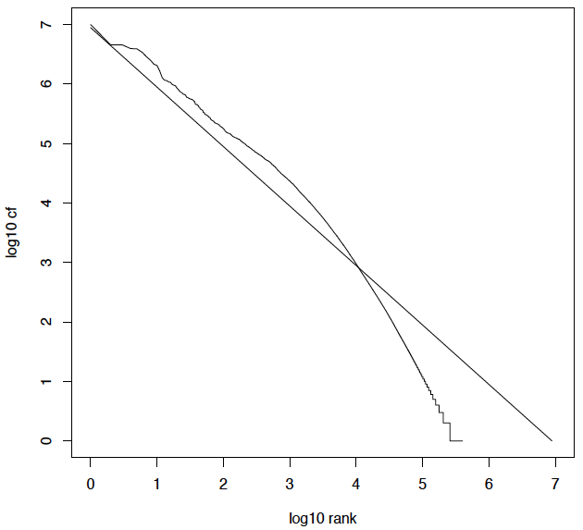
Zipf’s law for Reuters RCV1
Sec. 5.1

Slide 16
Compression
Ch. 5
Now, we will consider compressing the space for the dictionary and postings. We’ll do:
Basic Boolean index only
No study of positional indexes, etc.
But these ideas can be extended
We will consider compression schemes

Slide 17
DICTIONARY COMPRESSION
Sec. 5.2

Slide 18
Why compress the dictionary?
Sec. 5.2
Search begins with the dictionary
We want to keep it in memory
Memory footprint competition with other applications
Embedded/mobile devices may have very little memory
Even if the dictionary isn’t in memory, we want it to be small for a fast search startup time
So, compressing the dictionary is important

Slide 19
Dictionary storage – naïve version
Sec. 5.2
Array of fixed-width entries
~400,000 terms; 28 bytes/term = 11.2 MB.
Dictionary search
structure
20 bytes
4 bytes each
Notes:
400,000 number is from Reuters corpus

Slide 20
Fixed-width terms are wasteful
Sec. 5.2
Most of the bytes in the Term column are wasted – we allot 20 bytes for 1 letter terms.
And we still can’t handle supercalifragilisticexpialidocious or hydrochlorofluorocarbons.
Written English averages ~4.5 characters/word.
Exercise: Why is/isn’t this the number to use for estimating the dictionary size?
Ave. dictionary word in English: ~8 characters
How do we use ~8 characters per dictionary term?
Short words dominate token counts but not type average.

Slide 21
Compressing the term list: Dictionary-as-a-String
Sec. 5.2
Store dictionary as a (long) string of characters:
Pointer to next word shows end of current word
Hope to save up to 60% of dictionary space
….systilesyzygeticsyzygialsyzygyszaibelyiteszczecinszomo….
Total string length =
400K x 8B = 3.2MB
Pointers resolve 3.2M
positions: log₂3.2M =
22bits = 3bytes

Slide 22
Space for dictionary as a string
Sec. 5.2
4 bytes per term for Freq.
4 bytes per term for pointer to Postings.
3 bytes per term pointer
Avg. 8 bytes per term in term string
400K terms x 19 ⇒ 7.6 MB (against 11.2MB for fixed width)
⎫ Now avg. 11
⎬ bytes/term,
⎭ not 20.

Slide 23
Blocking
Sec. 5.2
Store pointers to every kth term string.
Example below: k=4.
Need to store term lengths (1 extra byte)
….7systile9syzygetic8syzygial6syzygy11szaibelyite8szczecin9szomo….
⎫ Save 9 bytes
⎬ on 3
⎭ pointers.
Lose 4 bytes on
term lengths.

Slide 24
Blocking Net Gains
Sec. 5.2
Example for block size k = 4
Where we used 3 bytes/pointer without blocking
3 x 4 = 12 bytes,
now we use 3 + 4 = 7 bytes.
Question: Why not go with larger k?
Shaved another ~0.5MB. This reduces the size of the dictionary from 7.6 MB to 7.1 MB.
We can save more with larger k.

Slide 25
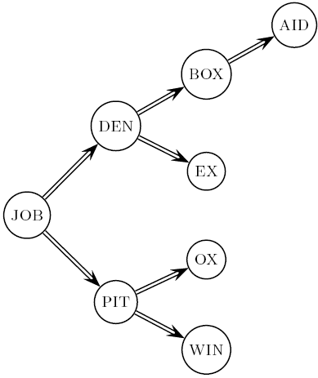
Dictionary search without blocking
Sec. 5.2
Assuming each dictionary term equally likely in query (not really so in practice!), average number of comparisons = (1+2∙2+4∙3+4)/8 ~2.6
Exercise: what if the frequencies of query terms were non-uniform but known, how would you structure the dictionary search tree?

Slide 26
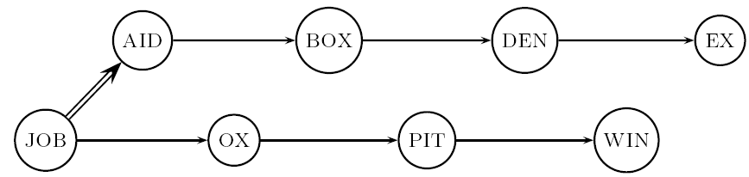
Dictionary search with blocking
Sec. 5.2
Binary search down to 4-term block;
Then linear search through terms in block.
Blocks of 4 (binary tree), avg. = (1+2∙2+2∙3+2∙4+5)/8 = 3 compares

Slide 27
Exercises
Sec. 5.2
Estimate the space usage (and savings compared to 7.6 MB) with blocking, for block sizes of k = 4, 8 and 16.
Estimate the impact on search performance (and slowdown compared to k=1) with blocking, for block sizes of k = 4, 8 and 16.

Slide 28
Front coding
Sec. 5.2
Front-coding:
Sorted words commonly have long common prefix – store differences only
(for last k-1 in a block of k)
8automata8automate9automatic10automation
→8automat*a1◊e2◊ic3◊ion
Encodes prefix automat
Extra length
beyond automat.
Begins to resemble general string compression.

Slide 29
RCV1 dictionary compression summary
Sec. 5.2
Technique | Size in MB
Fixed width | 11.2
Dictionary-as-String with pointers to every term | 7.6
+ blocking, k = 4 | 7.1
+ blocking + front coding | 5.9

Slide 30
POSTINGS COMPRESSION
Sec. 5.3

Slide 31
Postings compression
Sec. 5.3
The postings file is much larger than the dictionary, factor of at least 10, often over 100 times larger
Key desideratum: store each posting compactly.
A posting for our purposes is a docID.
For Reuters (800,000 documents), we would use 32 bits per docID when using 4-byte integers.
Alternatively, we can use log₂ 800,000 ≈ 20 bits per docID.
Our goal: use far fewer than 20 bits per docID.

Slide 32
Postings: two conflicting forces
Sec. 5.3
A term like arachnocentric occurs in maybe one doc out of a million – we would like to store this posting using log₂ 1M ≈ 20 bits.
A term like the occurs in virtually every doc, so 20 bits/posting ≈ 2MB is too expensive.
Prefer 0/1 bitmap vector in this case (≈100K)

Slide 33
Gap encoding of postings file entries
Sec. 5.3
We store the list of docs containing a term in increasing order of docID.
computer: 33,47,154,159,202 …
Consequence: it suffices to store gaps.
33,14,107,5,43 …
Hope: most gaps can be encoded/stored with far fewer than 20 bits.
Especially for common words

Slide 34
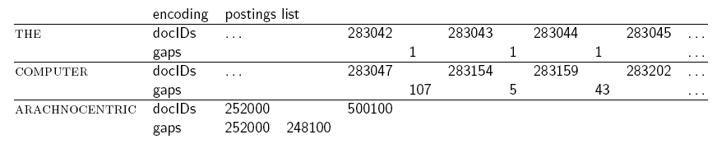
Three postings entries
Sec. 5.3

Slide 35
Variable length encoding
Sec. 5.3
Aim:
For arachnocentric, we will use ~20 bits/gap entry.
For the, we will use ~1 bit/gap entry.
If the average gap for a term is G, we want to use ~log₂G bits/gap entry.
Key challenge: encode every integer (gap) with about as few bits as needed for that integer.
This requires a variable length encoding
Variable length codes achieve this by using short codes for small numbers

Slide 36
Unary code
Represent n as n 1s with a final 0.
Unary code for 3 is 1110.
Unary code for 40 is
11111111111111111111111111111111111111110 .
Unary code for 80 is:
111111111111111111111111111111111111111111111111111111111111111111111111111111110
This doesn’t look promising, but….
Optimal if P(n) = 2^{–n}
We can use it as part of our solution

Slide 37
Gamma codes
Sec. 5.3
We can compress better with bit-level codes
The Gamma code is the best known of these.
Represent a gap G as a pair length and offset
offset is G in binary, with the leading bit cut off
For example 13 → 1101 → 101
length is the length of offset
For 13 (offset 101), this is 3.
We encode length with unary code: 1110.
Gamma code of 13 is the concatenation of length and offset: 1110101

Slide 38
Gamma code examples
Sec. 5.3
number | length | offset | γ-code
0 |  |  | none
1 | 0 |  | 0
2 | 10 | 0 | 10,0
3 | 10 | 1 | 10,1
4 | 110 | 00 | 110,00
9 | 1110 | 001 | 1110,001
13 | 1110 | 101 | 1110,101
24 | 11110 | 1000 | 11110,1000
511 | 111111110 | 11111111 | 111111110,11111111
1025 | 11111111110 | 0000000001 | 11111111110,0000000001

Slide 39

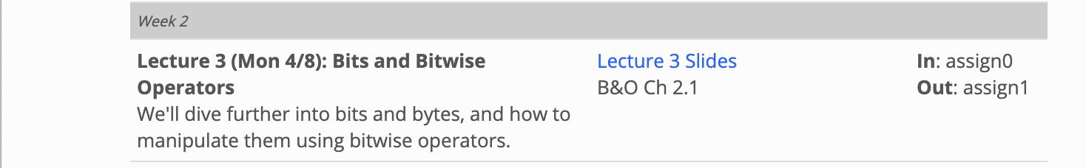
Reminder: bitwise operations
For compression, you need to use bitwise operators
Python (and most everything else):
& bitwise and; | bitwise or; ^ bitwise xor; ~ ones complement
<< left shift bits, >> right shift; LACKS >>> zero fill right shift
Recipes:
Extract 7 bits: a & 0x7f00 >> 8 ; if take high-order bit add: & 0x7f
Combine 3 5-bit numbers: a | (b << 5) | (c << 10)
Lookup tables rather than decoding can be faster, yet still small

Slide 40
Gamma code properties
Sec. 5.3
G is encoded using 2 ⎣log G⎦ + 1 bits
Length of offset is ⎣log G⎦ bits
Length of length is ⎣log G⎦ + 1 bits
All gamma codes have an odd number of bits
Almost within a factor of 2 of best possible, log₂ G
Gamma code is uniquely prefix-decodable, like VB
Gamma code can be used for any distribution
Optimal for P(n) ≈ 1/(2n²)
Gamma code is parameter-free

Slide 41
Gamma seldom used in practice
Sec. 5.3
Machines have word boundaries – 8, 16, 32, 64 bits
Operations that cross word boundaries are slower
Compressing and manipulating at the granularity of bits can be too slow
All modern practice is to use byte or word aligned codes
Variable byte encoding is a faster, conceptually simpler compression scheme, with decent compression
Notes:
Huffman, Golomb, Rice, delta, …

Slide 42
Variable Byte (VB) codes
Sec. 5.3
For a gap value G, we want to use close to the fewest bytes needed to hold log₂ G bits
Begin with one byte to store G and dedicate 1 bit in it to be a continuation bit c
If G ≤127, binary-encode it in the 7 available bits and set c =1
Else encode G’s lower-order 7 bits and then use additional bytes to encode the higher order bits using the same algorithm
At the end set the continuation bit of the last byte to 1 (c =1) – and for the other bytes c = 0.

Slide 43
Example
Sec. 5.3
docIDs | 824 | 829 | 215406
gaps |  | 5 | 214577
VB code | 00000110 10111000 | 10000101 | 00001101 00001100 10110001
Postings stored as the byte concatenation
000001101011100010000101000011010000110010110001
Key property: VB-encoded postings are
uniquely prefix-decodable.
For a small gap (5), VB
uses a whole byte.
Notes:
This still seems a bit inefficient. You might have seen more bitwise coding

Slide 44
RCV1 compression
Sec. 5.3
Data structure | Size in MB
dictionary, fixed-width | 11.2
dictionary, term pointers into string | 7.6
with blocking, k = 4 | 7.1
with blocking & front coding | 5.9
collection (text, xml markup etc) | 3,600.0
collection (text) | 960.0
Term-doc incidence matrix | 40,000.0
postings, uncompressed (32-bit words) | 400.0
postings, uncompressed (20 bits) | 250.0
postings, variable byte encoded | 116.0
postings, γ−encoded | 101.0

Slide 45
Other variable unit codes
Sec. 5.3
Variable byte codes are used by many real systems
Good low-tech blend of variable-length coding and sensitivity to computer memory alignment matches
Byte alignment wastes space if you have many small gaps – as gap encoding often makes
More modern work mainly uses the ideas:
Be word aligned (32 or 64 bits; even faster)
Encode several gaps at the same time
Often assume a maximum gap size, perhaps with an escape

Slide 46
Group Variable Integer code
Used by Google around turn of millennium….
Jeff Dean, keynote at WSDM 2009 and presentations at CS276
Encodes 4 integers in blocks of size 5–17 bytes
First byte: four 2-bit binary length fields
, L_{j}∈{1,2,3,4}
Then, L1+L2+L3+L4 bytes (between 4–16) hold 4 numbers
Each number can use 8/16/24/32 bits. Max gap length ~4 billion
It was suggested that this was about twice as fast as VB encoding
Decoding gaps is much simpler – no bit masking
First byte can be decoded with lookup table or switch
L₁
L₂
L₃
L₄

Slide 47
Simple-9 [Anh & Moffat, 2004]
A word-aligned, multiple number encoding scheme
How can we store several numbers in 32 bits with a format selector?
28 1-bit numbers
14 2-bit numbers
9 3-bit numbers
7 4-bit numbers
“selectors”
(9 total ways)

Slide 48
Simple9 Encoding Scheme [Anh & Moffat, 2004]
Encoding block: 4 bytes (32 bits)
Most significant nibble (4 bits) describe the layout of the 28 other bits as follows:
0: a single 28-bit number
1: two 14-bit numbers
2: three 9-bit numbers (and one spare bit)
3: four 7-bit numbers
4: five 5-bit numbers (and three spare bits)
5: seven 4-bit numbers
6: nine 3-bit numbers (and one spare bit)
7: fourteen two-bit numbers
8: twenty-eight one-bit numbers
Simple16 is a variant with 5 additional (uneven) configurations
Efficiently decoded with hand-coded decoder, using bit masks
Extended Simple Family – idea applies to 64-bit words, etc.
Layout
(4 bits)
n numbers of b bits each
n * b ≤ 28

Slide 49
Index compression summary
Sec. 5.3
We can now create an index for highly efficient Boolean retrieval that is very space efficient
Only 4% of the total size of the collection
Only 10-15% of the total size of the text in the collection
We’ve ignored positional information
Hence, space savings are less for indexes used in practice
But techniques substantially the same

Slide 50
Resources for today’s lecture
Ch. 5
IIR 5
MG 3.3, 3.4.
F. Scholer, H.E. Williams and J. Zobel. 2002. Compression of Inverted Indexes For Fast Query Evaluation. Proc. ACM-SIGIR 2002.
Variable byte codes
V. N. Anh and A. Moffat. 2005. Inverted Index Compression Using Word-Aligned Binary Codes. Information Retrieval 8: 151–166.
Word aligned codes

