Slide 1
CS276: Information Retrieval and Web Search
Christopher Manning and Pandu Nayak
Wildcard queries and Spelling Correction

Slide 2
WILD-CARD QUERIES

Slide 3
Wild-card queries: *
Sec. 3.2
mon*: find all docs containing any word beginning with “mon”.
Easy with binary tree (or B-tree) dictionary: retrieve all words in range: mon ≤ w < moo
*mon: find words ending in “mon”: harder
  Maintain an additional B-tree for terms backwards.
  Can retrieve all words in range: nom ≤ w < non.
From this, how can we enumerate all terms
meeting the wild-card query pro*cent ?

Slide 4
Query processing
Sec. 3.2
At this point, we have an enumeration of all terms in the dictionary that match the wild-card query.
We still have to look up the postings for each enumerated term.
E.g., consider the query:
se*ate AND fil*er
This may result in the execution of many Boolean AND queries.

Slide 5
B-trees handle *’s at the end of a query term
Sec. 3.2
How can we handle *’s in the middle of query term?
  co*tion
We could look up co* AND *tion in a B-tree and intersect the two term sets
  Expensive
The solution: transform wild-card queries so that the *’s occur at the end
This gives rise to the Permuterm Index.

Slide 6
Permuterm index
Sec. 3.2.1
Add a $ to the end of each term
Rotate the resulting term and index them in a B-tree
For term hello, index under:
  hello$, ello$h, llo$he, lo$hel, o$hell, $hello
  where $ is a special symbol.
hello$
ello$h
llo$he
Empirically, dictionary
quadruples in size
hello
lo$hel
o$hell
$hello

Slide 7
Permuterm query processing
Sec. 3.2.1
(Add $), rotate * to end, lookup in permuterm index
Queries:
  X
  X*
  *X
  *X*
  X*Y
  X*Y*Z
  lookup on X$ hello$ for hello
  lookup on $X* $hel* for hel*
  lookup on X$* llo$* for *llo
  lookup on X* ell* for *ell*
  lookup on Y$X* lo$h for h*lo
  treat as a search for X*Z and post-filter
  For h*a*o, search for h*o by looking up o$h*
  and post-filter hello and retain halo

Slide 8
Bigram (k-gram) indexes
Sec. 3.2.2
Enumerate all k-grams (sequence of k chars) occurring in any term
e.g., from text “April is the cruelest month” we get the 2-grams (bigrams)
  $ is a special word boundary symbol
Maintain a second inverted index from bigrams to dictionary terms that match each bigram.
$a,ap,pr,ri,il,l$,$i,is,s$,$t,th,he,e$,$c,cr,ru,
ue,el,le,es,st,t$, $m,mo,on,nt,h$

Slide 9
Bigram index example
Sec. 3.2.2
The k-gram index finds terms based on a query consisting of k-grams (here k=2).
$m
mace
madden
mo
among
amortize
on
along
among

Slide 10
Processing wild-cards
Sec. 3.2.2
Query mon* can now be run as
  $m AND mo AND on
Gets terms that match AND version of our wildcard query.
But we’d enumerate moon.
Must post-filter these terms against query.
Surviving enumerated terms are then looked up in the term-document inverted index.
Fast, space efficient (compared to permuterm).

Slide 11
Processing wild-card queries
Sec. 3.2.2
As before, we must execute a Boolean query for each enumerated, filtered term.
Wild-cards can result in expensive query execution (very large disjunctions…)
  pyth* AND prog*
If you encourage “laziness” people will respond!
Search
Type your search terms, use ‘*’ if you need to.
E.g., Alex* will match Alexander.

Slide 12
SPELLING CORRECTION

Slide 13
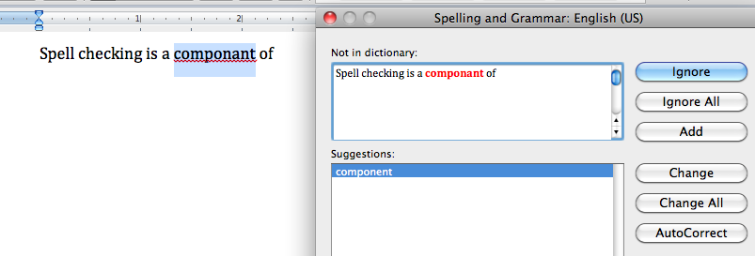
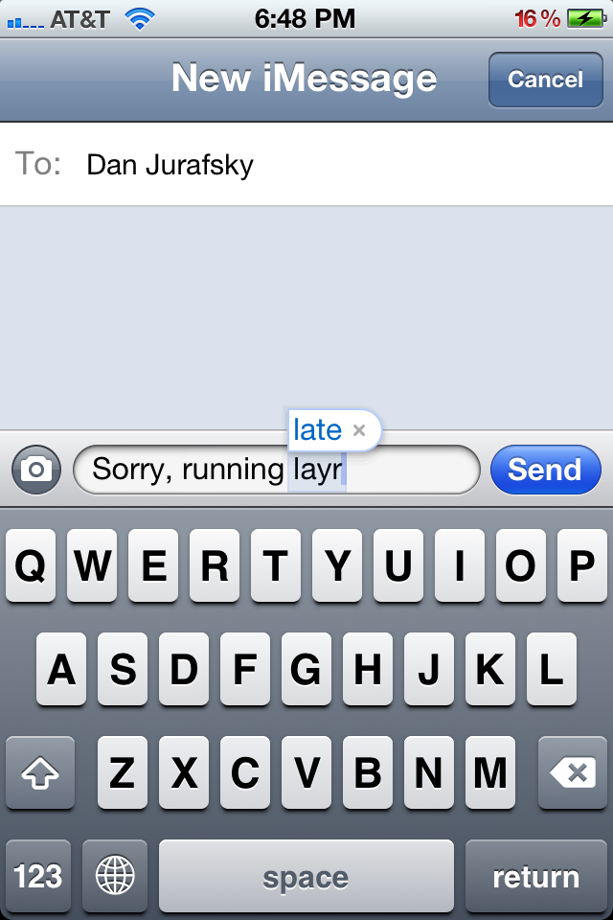
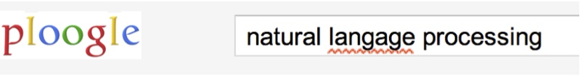

Applications for spelling correction
Word processing
Phones
Web search

Slide 14
Rates of spelling errors
Depending on the application, ~1–20% error rates
  26%: Web queries Wang et al. 2003
  13%: Retyping, no backspace: Whitelaw et al. English&German
  7%: Words corrected retyping on phone-sized organizer
  2%: Words uncorrected on organizer Soukoreff &MacKenzie 2003
1-2%: Retyping: Kane and Wobbrock 2007, Gruden et al. 1983
Notes:
Wang et al 2003l: Mining longitudinal web queries: Trends and patterns
Retyping: subjects were asked to retype a Wikipedia article without using backspace/delete
Soukoreff&MacKenzie: Metrics for text entry research

Slide 15
Spelling Tasks
Spelling Error Detection
Spelling Error Correction:
  Autocorrect
    hte→the
  Suggest a correction
  Suggestion lists
Notes:
HCI issues and confidence determine.

Slide 16
Types of spelling errors
Non-word Errors
  graffe →giraffe
Real-word Errors
  Typographical errors
    three →there
  Cognitive Errors (homophones)
    piece→peace,
    too → two
    your →you’re
Non-word correction was historically mainly context insensitive
Real-word correction almost needs to be context sensitive

Slide 17
Non-word spelling errors
Non-word spelling error detection:
  Any word not in a dictionary is an error
  The larger the dictionary the better … up to a point
  (The Web is full of mis-spellings, so the Web isn’t necessarily a great dictionary …)
Non-word spelling error correction:
  Generate candidates: real words that are similar to error
  Choose the one which is best:
    Shortest weighted edit distance
    Highest noisy channel probability
Notes:
Old school spelling correction

Slide 18
Real word & non-word spelling errors
For each word w, generate candidate set:
  Find candidate words with similar pronunciations
  Find candidate words with similar spellings
  Include w in candidate set
Choose best candidate
  Noisy Channel view of spell errors
  Context-sensitive – so have to consider whether the surrounding words “make sense”
  Flying form Heathrow to LAX → Flying from Heathrow to LAX

Slide 19
Terminology
We just discussed character bigrams and k-grams:
  st, pr, an …
We can also have word bigrams and n-grams:
  palo alto, flying from, road repairs

Slide 20
INDEPENDENT WORD SPELLING CORRECTION
The Noisy Channel Model of Spelling

Slide 21
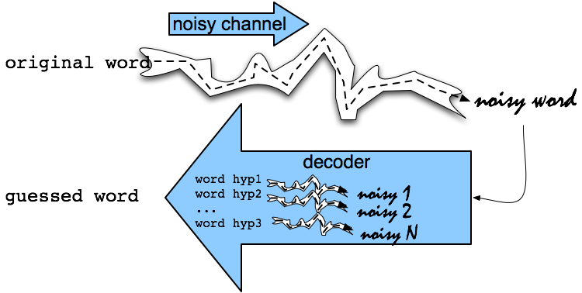
Noisy Channel Intuition

Slide 22
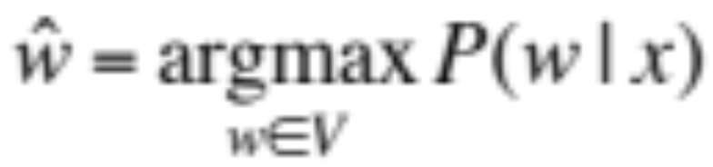
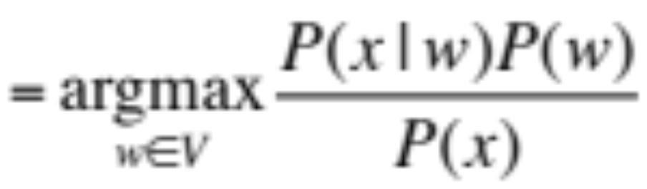
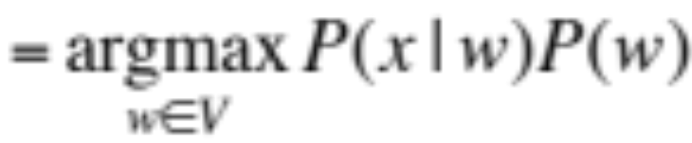
Noisy Channel = Bayes’ Rule
We see an observation x of a misspelled word
Find the correct word ŵ
Bayes
Prior
Noisy channel model
Notes:
Bayes Rule

Slide 23
History: Noisy channel for spelling proposed around 1990
IBM
  Mays, Eric, Fred J. Damerau and Robert L. Mercer. 1991. Context based spelling correction. Information Processing and Management, 23(5), 517–522
AT&T Bell Labs
  Kernighan, Mark D., Kenneth W. Church, and William A. Gale. 1990. A spelling correction program based on a noisy channel model. Proceedings of COLING 1990, 205-210

Slide 24
Non-word spelling error example
acress

Slide 25
Candidate generation
Words with similar spelling
  Small edit distance to error
Words with similar pronunciation
  Small distance of pronunciation to error

Slide 26
Candidate Testing:
Damerau-Levenshtein edit distance
Minimal edit distance between two strings, where edits are:
  Insertion
  Deletion
  Substitution
  Transposition of two adjacent letters
See IIR sec 3.3.3 for edit distance

Slide 27
Words within 1 of acress
Error | Candidate Correction | Correct Letter | Error Letter | Type
acress | actress | t | - | deletion
acress | cress | - | a | insertion
acress | caress | ca | ac | transposition
acress | access | c | r | substitution
acress | across | o | e | substitution
acress | acres | - | s | insertion

Slide 28
Candidate generation
80% of errors are within edit distance 1
Almost all errors within edit distance 2
Also allow insertion of space or hyphen
  thisidea → this idea
  inlaw → in-law
Can also allow merging words
  data base → database
  For short texts like a query, can just regard whole string as one item from which to produce edits

Slide 29
How do you generate the candidates?
Run through dictionary, check edit distance with each word
Generate all words within edit distance ≤ k (e.g., k = 1 or 2) and then intersect them with dictionary
Use a character k-gram index and find dictionary words that share “most” k-grams with word (e.g., by Jaccard coefficient)
  see IIR sec 3.3.4
Compute them fast with a Levenshtein finite state transducer
Have a precomputed map of words to possible corrections

Slide 30
A paradigm …
We want the best spell corrections
Instead of finding the very best, we
  Find a subset of pretty good corrections
    (say, edit distance at most 2)
  Find the best amongst them
These may not be the actual best
This is a recurring paradigm in IR including finding the best docs for a query, best answers, best ads …
  Find a good candidate set
  Find the top K amongst them and return them as the best

Slide 31
Let’s say we’ve generated candidates: Now back to Bayes’ Rule
We see an observation x of a misspelled word
Find the correct word ŵ
What’s P(w)?
Notes:
Bayes Rule

Slide 32
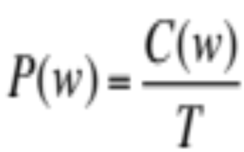
Language Model
Take a big supply of words (your document collection with T tokens); let C(w) = # occurrences of w
In other applications – you can take the supply to be typed queries (suitably filtered) – when a static dictionary is inadequate

Slide 33
Unigram Prior probability
Counts from 404,253,213 words in Corpus of Contemporary English (COCA)
word | Frequency of word | P(w)
actress | 9,321 | .0000230573
cress | 220 | .0000005442
caress | 686 | .0000016969
access | 37,038 | .0000916207
across | 120,844 | .0002989314
acres | 12,874 | .0000318463

Slide 34
Channel model probability
Error model probability, Edit probability
Kernighan, Church, Gale 1990
Misspelled word x = x₁, x₂, x₃… x_{m}
Correct word w = w₁, w₂, w₃,…, w_{n}
P(x|w) = probability of the edit
  (deletion/insertion/substitution/transposition)

Slide 35
Computing error probability: confusion “matrix”
del[x,y]: count(xy typed as x)
ins[x,y]: count(x typed as xy)
sub[x,y]: count(y typed as x)
trans[x,y]: count(xy typed as yx)
Insertion and deletion conditioned on previous character

Slide 36
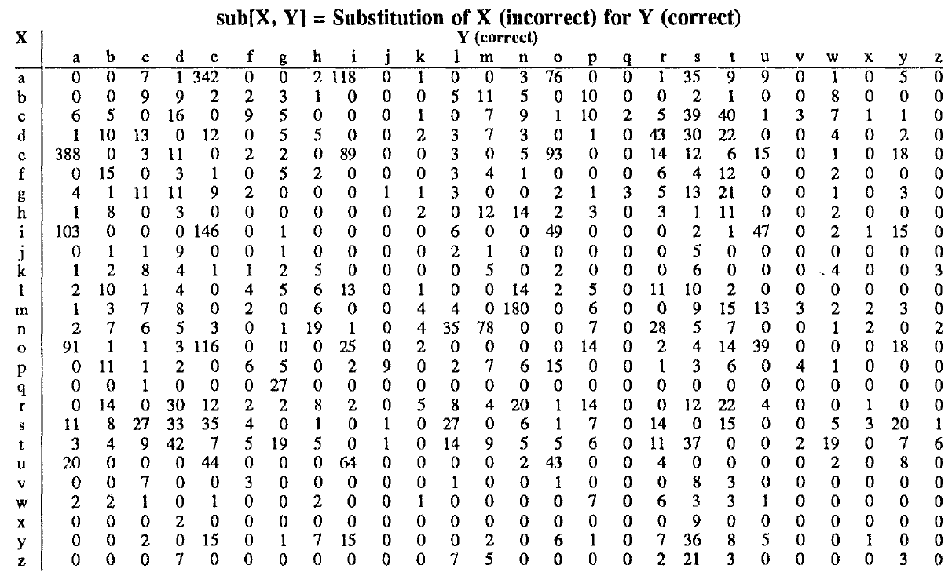
Confusion matrix for substitution

Slide 37
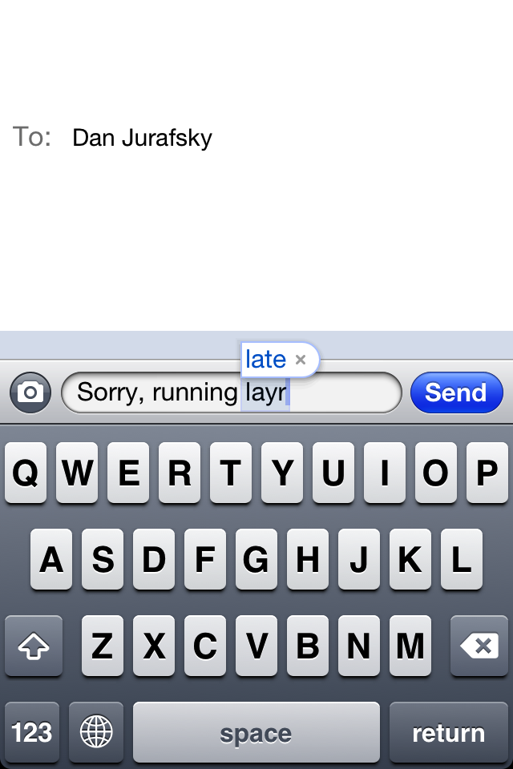
Nearby keys

Slide 38
Generating the confusion matrix
Peter Norvig’s list of errors
Peter Norvig’s list of counts of single-edit errors
    All Peter Norvig’s ngrams data links: http://norvig.com/ngrams/

Slide 39
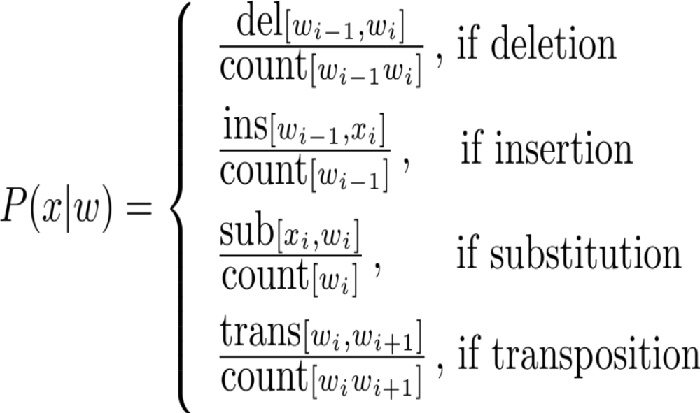
Channel model
Kernighan, Church, Gale 1990

Slide 40
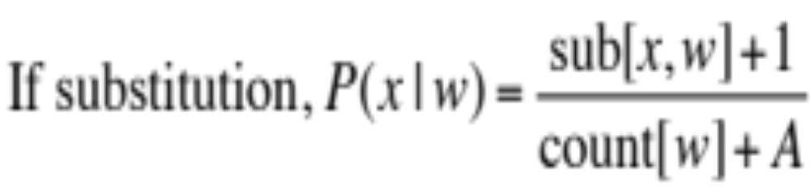
Smoothing probabilities: Add-1 smoothing
But if we use the confusion matrix example, unseen errors are impossible!
They’ll make the overall probability 0. That seems too harsh
  e.g., in Kernighan’s chart q➔a and a➔q are both 0, even though they’re adjacent on the keyboard!
A simple solution is to add 1 to all counts and then if there is a |A| character alphabet, to normalize appropriately:

Slide 41
Channel model for acress
Candidate Correction | Correct Letter | Error Letter | x|w | P(x|w)
actress | t | - | c|ct | .000117
cress | - | a | a|# | .00000144
caress | ca | ac | ac|ca | .00000164
access | c | r | r|c | .000000209
across | o | e | e|o | .0000093
acres | - | s | es|e | .0000321
acres | - | s | ss|s | .0000342

Slide 42
Noisy channel probability for acress
Candidate Correction | Correct Letter | Error Letter | x|w | P(x|w) | P(w) | 10^{9 *} P(x|w)* P(w)
actress | t | - | c|ct | .000117 | .0000231 | 2.7
cress | - | a | a|# | .00000144 | .000000544 | .00078
caress | ca | ac | ac|ca | .00000164 | .00000170 | .0028
access | c | r | r|c | .000000209 | .0000916 | .019
across | o | e | e|o | .0000093 | .000299 | 2.8
acres | - | s | es|e | .0000321 | .0000318 | 1.0
acres | - | s | ss|s | .0000342 | .0000318 | 1.0

Slide 43
Noisy channel probability for acress
Candidate Correction | Correct Letter | Error Letter | x|w | P(x|w) | P(w) | 10^{9 *}P(x|w)P(w)
actress | t | - | c|ct | .000117 | .0000231 | 2.7
cress | - | a | a|# | .00000144 | .000000544 | .00078
caress | ca | ac | ac|ca | .00000164 | .00000170 | .0028
access | c | r | r|c | .000000209 | .0000916 | .019
across | o | e | e|o | .0000093 | .000299 | 2.8
acres | - | s | es|e | .0000321 | .0000318 | 1.0
acres | - | s | ss|s | .0000342 | .0000318 | 1.0

Slide 44
Evaluation
Some spelling error test sets
  Wikipedia’s list of common English misspelling
  Aspell filtered version of that list
  Birkbeck spelling error corpus
  Peter Norvig’s list of errors (includes Wikipedia and Birkbeck, for training or testing)

Slide 45
SPELLING CORRECTION WITH THE NOISY CHANNEL
Context-Sensitive Spelling Correction

Slide 46
Real-word spelling errors
…leaving in about fifteen minuets to go to her house.
The design an construction of the system…
Can they lave him my messages?
The study was conducted mainly be John Black.
25-40% of spelling errors are real words Kukich 1992

Slide 47
Context-sensitive spelling error fixing
For each word in sentence (phrase, query …)
  Generate candidate set
    the word itself
    all single-letter edits that are English words
    words that are homophones
    (all of this can be pre-computed!)
Choose best candidates
    Noisy channel model

Slide 48
Noisy channel for real-word spell correction
Given a sentence x₁,x₂,x₃,…,x_{n}
Generate a set of candidates for each word x_{i}
  Candidate(x₁) = {x₁, w₁ , w’₁ , w’’₁ ,…}
  Candidate(x₂) = {x₂, w₂ , w’₂ , w’’₂ ,…}
  Candidate(x_{n}) = {x_{n}, w_{n} , w’_{n} , w’’_{n} ,…}
Choose the sequence W that maximizes P(W|x₁,…,x_{n})

Slide 49
Incorporating context words:
Context-sensitive spelling correction
Determining whether actress or across is appropriate will require looking at the context of use
We can do this with a better language model
  You learned/can learn a lot about language models in CS124 or CS224N
  Here we present just enough to be dangerous/do the assignment
A bigram language model conditions the probability of a word on (just) the previous word
    P(w₁…w_{n}) = P(w₁)P(w₂|w₁)…P(w_{n}|w_{n−1})

Slide 50
Incorporating context words
For unigram counts, P(w) is always non-zero
  if our dictionary is derived from the document collection
This won’t be true of P(w_{k}|w_{k−1}). We need to smooth
We could use add-1 smoothing on this conditional distribution
But here’s a better way – interpolate a unigram and a bigram:
    P_{li}(w_{k}|w_{k−1}) = λP_{uni}(w_{k}) + (1−λ)P_{bi}(w_{k}|w_{k−1})
      P_{bi}(w_{k}|w_{k−1}) = C(w_{k−1}, w_{k}) / C(w_{k−1})

Slide 51
All the important fine points
Note that we have several probability distributions for words
  Keep them straight!
    You might want/need to work with log probabilities:
      log P(w₁…w_{n}) = log P(w₁) + log P(w₂|w₁) + … + log P(w_{n}|w_{n−1})
  Otherwise, be very careful about floating point underflow
Our query may be words anywhere in a document
  We’ll start the bigram estimate of a sequence with a unigram estimate
  Often, people instead condition on a start-of-sequence symbol, but not good here
  Because of this, the unigram and bigram counts have different totals – not a problem

Slide 52
Using a bigram language model
“a stellar and versatile acress whose combination of sass and glamour…”
Counts from the Corpus of Contemporary American English with add-1 smoothing
P(actress|versatile)=.000021 P(whose|actress) = .0010
P(across|versatile) =.000021 P(whose|across) = .000006
P(“versatile actress whose”) = .000021*.0010 = 210 x10⁻¹⁰
P(“versatile across whose”) = .000021*.000006 = 1 x10⁻¹⁰

Slide 53
Using a bigram language model
“a stellar and versatile acress whose combination of sass and glamour…”
Counts from the Corpus of Contemporary American English with add-1 smoothing
P(actress|versatile)=.000021 P(whose|actress) = .0010
P(across|versatile) =.000021 P(whose|across) = .000006
P(“versatile actress whose”) = .000021*.0010 = 210 x10⁻¹⁰
P(“versatile across whose”) = .000021*.000006 = 1 x10⁻¹⁰

Slide 54
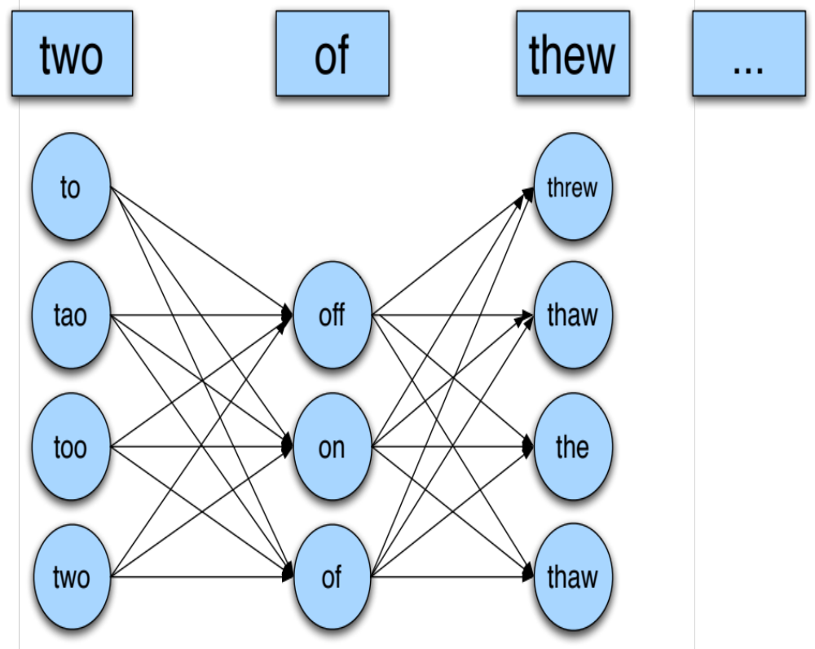
Noisy channel for real-word spell correction

Slide 55
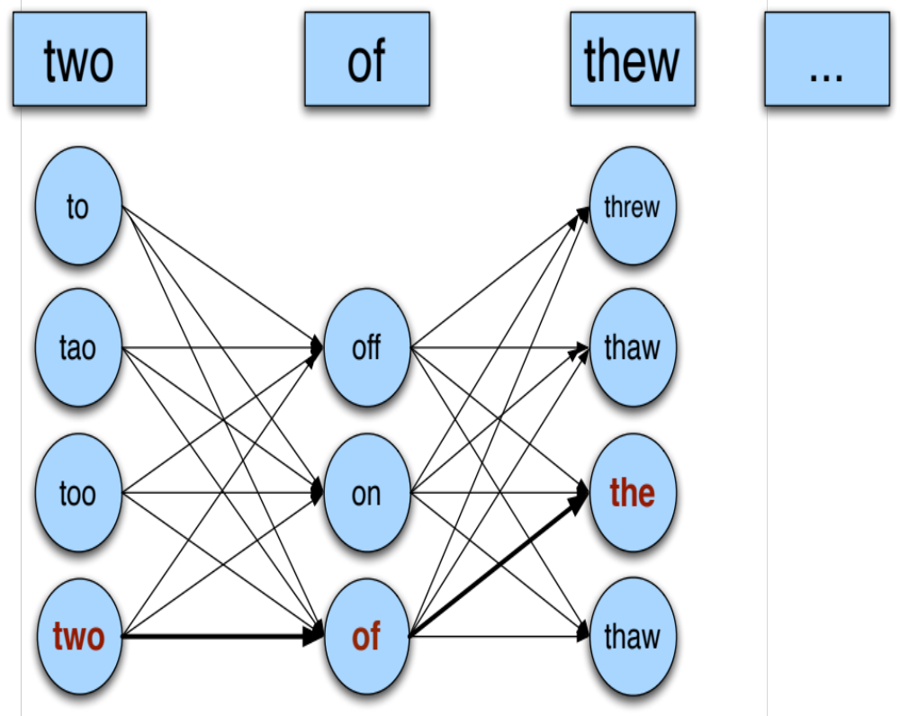
Noisy channel for real-word spell correction

Slide 56
Simplification: One error per sentence
Out of all possible sentences with one word replaced
  w₁, w’’₂,w₃,w₄ two off thew
  w₁,w₂,w’₃,w₄ two of the
  w’’’₁,w₂,w₃,w₄ too of thew
  …
Choose the sequence W that maximizes P(W)
Notes:
Simplification: Only allow one error.

Slide 57
Where to get the probabilities
Language model
  Unigram
  Bigram
  etc.
Channel model
  Same as for non-word spelling correction
  Plus need probability for no error, P(w|w)

Slide 58
Probability of no error
What is the channel probability for a correctly typed word?
P(“the”|“the”)
  If you have a big corpus, you can estimate this percent correct
But this value depends strongly on the application
  .90 (1 error in 10 words)
  .95 (1 error in 20 words)
  .99 (1 error in 100 words)

Slide 59
Peter Norvig’s “thew” example
x | w | x|w | P(x|w) | P(w) | 10⁹ P(x|w)P(w)
thew | the | ew|e | 0.000007 | 0.02 | 144
thew | thew |  | 0.95 | 0.00000009 | 90
thew | thaw | e|a | 0.001 | 0.0000007 | 0.7
thew | threw | h|hr | 0.000008 | 0.000004 | 0.03
thew | thwe | ew|we | 0.000003 | 0.00000004 | 0.0001

Slide 60
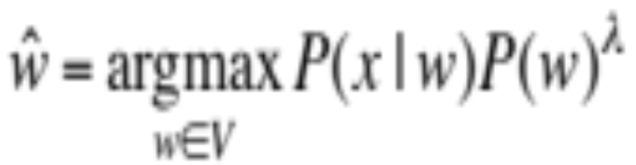
State of the art noisy channel
We never just multiply the prior and the error model
Independence assumptions→probabilities not commensurate
Instead: Weight them
Learn λ from a development test set

Slide 61
Improvements to channel model
Allow richer edits (Brill and Moore 2000)
  ent→ant
  ph→f
  le→al
Incorporate pronunciation into channel (Toutanova and Moore 2002)
Incorporate device into channel
  Not all Android phones need have the same error model
  But spell correction may be done at the system level

