Slide 1
CS276
Information Retrieval and Web Search
Chris Manning and Pandu Nayak
Personalization
Notes:
----- Meeting Notes (5/26/16 17:54) -----

Slide 2
Ambiguity
Unlikely that a short query can unambiguously describe a user’s information need
For example, the query [chi] can mean
  Calamos Convertible Opportunities & Income Fund quote
  The city of Chicago
  Balancing one’s natural energy (or ch’i)
  Computer-human interactions

Slide 3
Personalization
Ambiguity means that a single ranking is unlikely to be optimal for all users
Personalized ranking is the only way to bridge the gap
Personalization can use
  Long term behavior to identify user interests,
  e.g., a long term interest in user interface research
  Short term session to identify current task,
  e.g., checking on a series of stock tickers
  User location, e.g., MTA in New York vs Baltimore
  Social network
  …

Slide 4
Potential for Personalization
[Teevan, Dumais, Horvitz 2010]
How much can personalization improve ranking? How can we measure this?
Ask raters to explicitly rate a set of queries
  But rather than asking them to guess what a user’s information need might be …
  ... ask which results they would personally consider relevant
  Use self-generated and pre-generated queries
Notes:
Self generated queries might not get multiple ratings

Slide 5
Computing potential for personalization
For each query q
  Compute average rating for each result
  Let R_{q} be the optimal ranking according to the average rating
  Compute the NDCG value of ranking R_{q} for the ratings of each rater i
  Let Avg_{q} be the average of the NDCG values for each rater
Let Avg be the average Avg_{q} over all queries
Potential for personalization is (1 – Avg)

Slide 6
Example: NDCG values for a query
Result | Rater A | Rater B | Average rating
D1 | 1 | 0 | 0.5
D2 | 1 | 1 | 1
D3 | 0 | 1 | 0.5
D4 | 0 | 0 | 0
D5 | 0 | 0 | 0
D6 | 1 | 0 | 0.5
D7 | 1 | 2 | 1.5
D8 | 0 | 0 | 0
D9 | 0 | 0 | 0
D10 | 0 | 0 | 0
NDCG | 0.88 | 0.65
Average NDCG for raters: 0.77

Slide 7
Example: NDCG values for optimal ranking for average ratings
Result | Rater A | Rater B | Average rating
D7 | 1 | 2 | 1.5
D2 | 1 | 1 | 1
D1 | 1 | 0 | 0.5
D3 | 0 | 1 | 0.5
D6 | 1 | 0 | 0.5
D4 | 0 | 0 | 0
D5 | 0 | 0 | 0
D8 | 0 | 0 | 0
D9 | 0 | 0 | 0
D10 | 0 | 0 | 0
NDCG | 0.98 | 0.96
Average NDCG for raters: 0.97

Slide 8
Example: Potential for personalization
Result | Rater A | Rater B | Average rating
D7 | 1 | 2 | 1.5
D2 | 1 | 1 | 1
D1 | 1 | 0 | 0.5
D3 | 0 | 1 | 0.5
D6 | 1 | 0 | 0.5
D4 | 0 | 0 | 0
D5 | 0 | 0 | 0
D8 | 0 | 0 | 0
D9 | 0 | 0 | 0
D10 | 0 | 0 | 0
NDCG | 0.98 | 0.96
Potential for personalization: 0.03
Notes:
What is the potential for personalization if there’s just one rater?
What happens to the potential for personalization as we add more raters?

Slide 9
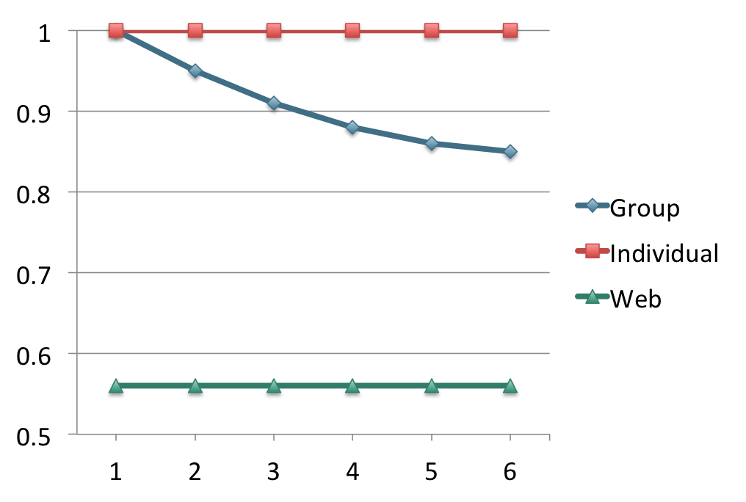
Potential for personalization graph
Potential for
personalization
NDCG
Number of raters
Notes:
Not all queries have a high potential for personalization
What are examples of queries with low/high potential for personalization

Slide 10
Personalizing search

Slide 11
Personalizing search
[Pitkow et al. 2002]
Two general ways of personalizing search
  Query expansion
    Modify or augment user query
    E.g., query term “IR” can be augmented with either “information retrieval” or “Ingersoll-Rand” depending on user interest
    Ensures that there are enough personalized results
  Reranking
    Issue the same query and fetch the same results …
    … but rerank the results based on a user profile
    Allows both personalized and globally relevant results
Notes:
Common to do both together

Slide 12
User interests
Explicitly provided by the user
  Sometimes useful, particularly for new users
  … but generally doesn’t work well
Inferred from user behavior and content
  Previously issued search queries
  Previously visited Web pages
  Personal documents
  Emails
Ensuring privacy and user control is very important

Slide 13

Relevance feedback perspective
[Teevan, Dumais, Horvitz 2005]
Search
Engine
Query
Personalized
reranking
Results
Personalized
Results
User model
(source of relevant
documents)

Slide 14
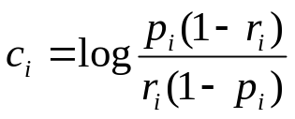
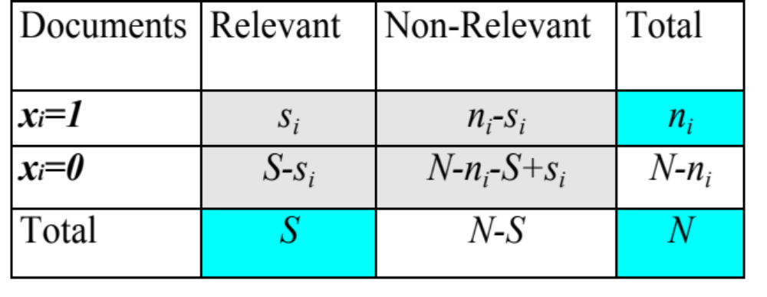
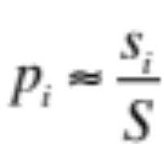
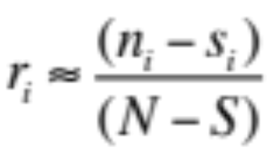
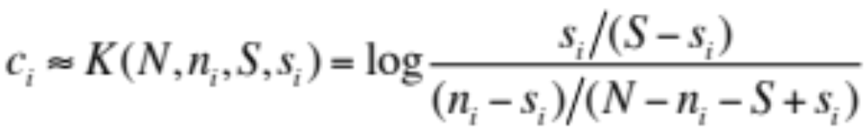
Binary Independence Model
Estimating RSV coefficients in theory
For each term i look at this table of document counts:
Estimates:
For now,
assume no
zero terms.
See later
lecture.
Notes:
Prabhakar wanted the add 0.5 explained. Here or elsewhere?
Log odds ratio. Add 0.5 to every expression

Slide 15
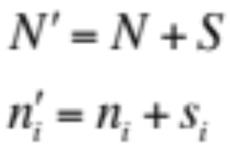
Personalization as relevance feedback
S
N
N
s_{i}
n_{i}
s_{i}
n_{i}
User
content
S
Documents
containing
term i
All
documents
Relevant
documents

Slide 16
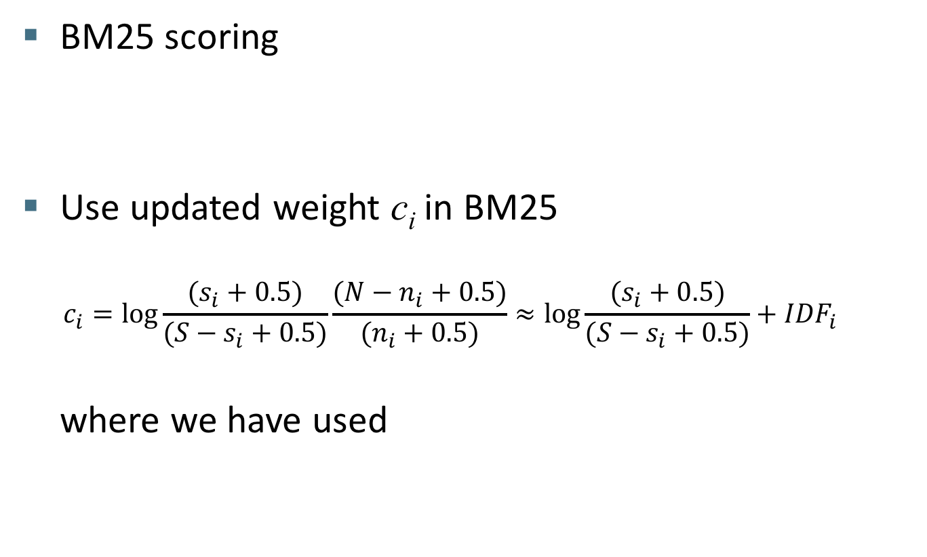
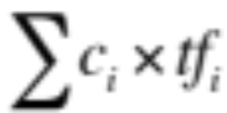
Reranking

Slide 17
Corpus representation
Estimating N and n_{i}
Many possibilities
  N: All documents, query relevant documents, result set
  n_{i}: Full text, only titles and snippets
Practical strategy
  Approximate corpus statistics from result set
  … and just the title and snippets
  Empirically seems to work the best!

Slide 18
User representation
Estimating S and s_{i}
Estimated from a local search index containing
  Web pages the user has viewed
  Email messages that were viewed or sent
  Calendar items
  Documents stored on the client machine
Best performance when
  S is the number of local documents matching the query
  s_{i} is the number that also contains term i

Slide 19
Document and query representation
Document represented by the title and snippets
Query is expanded to contain words near query terms (in titles and snippets)
  For the query [cancer] add underlined terms
    The American Cancer Society is dedicated to eliminating cancer as a major health problem by preventing cancer, saving lives, and diminishing suffering through …
This combination of corpus, user, document, and query representations seem to work well
Notes:
This is a form of pseudo-relevance feedback

Slide 20
Location

Slide 21
User location
User location is one of the most important features for personalization
  Country
    Query [football] in the US vs the UK
  State/Metro/City
    Queries like [zoo], [craigslist], [giants]
  Fine-grained location
    Queries like [pizza], [restaurants], [coffee shops]

Slide 22
Challenges
Not all queries are location sensitive
  [facebook] is not asking for the closest Facebook office
  [seaworld] is not necessarily asking for the closest SeaWorld
Different parts of a site may be more or less location sensitive
  NYTimes home page vs NYTimes Local section
Addresses on a page don’t always tell us how location sensitive the page is
  Stanford home page has address, but not location sensitive

Slide 23
Key idea
[Bennett et al. 2011]
Usage statistics, rather than locations mentioned in a document, best represent where it is relevant
  I.e., if users in a location tend to click on that document, then it is relevant in that location
User location data is acquired from anonymized logs (with user consent, e.g., from a widely distributed browser extension)
  User IP addresses are resolved into geographic location information

Slide 24

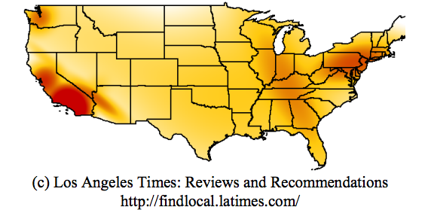
Location interest model
Use the logs data to estimate the probability of the location of the user given they viewed this URL

Slide 25
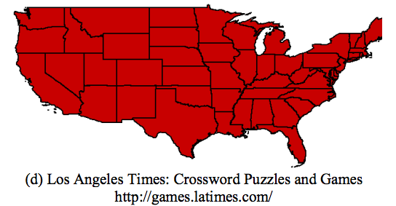
Location interest model
Use the logs data to estimate the probability of the location of the user given they viewed this URL

Slide 26
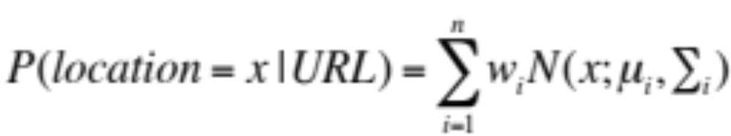
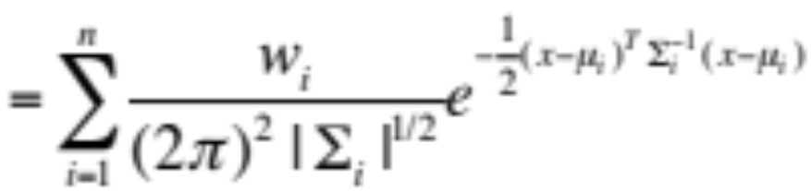
Learning the location interest model
For compactness, represent location interest model as a mixture of 5-25 2-d Gaussians (x is [lat, long])
Learn Gaussian mixture model using EM
  Expectation step: Estimate probability that each point belongs to each Gaussian
  Maximization step: Estimate most likely mean, covariance, weight

Slide 27
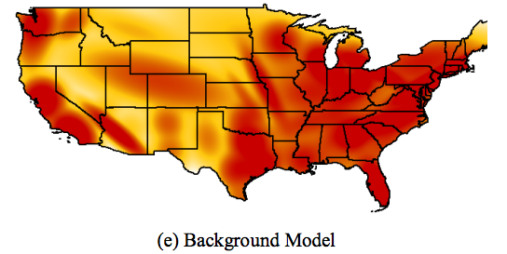
More location interest models
Learn a location-interest model for queries
  Using location of users who issued the query
Learn a background model showing the overall density of users

Slide 28
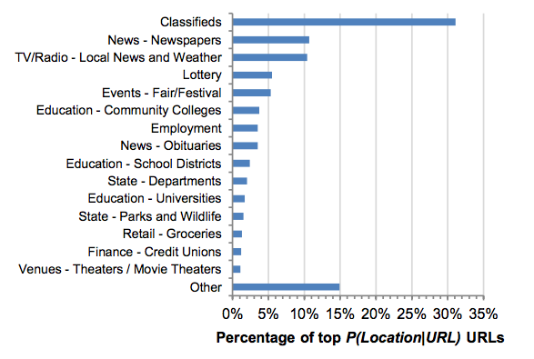
Topics in URLs with high
P(user location | URL)

Slide 29
Location sensitive features
Non-contextual features (user-independent)
  Is the query location sensitive? What about the URLs?
  Feature: Entropy of the location distribution
    Low entropy means distribution is peaked and location is important
  Feature: KL-divergence between location model and background model
    High KL-divergence suggests that it is location sensitive
  Feature: KL-divergence between query and URL models
    Low KL-divergence suggests URL is more likely to be relevant to users issuing the query

Slide 30
More location sensitive features
Contextual features (user-dependent)
  Feature: User’s location (naturally!)
  Feature: Probability of the user’s location given the URL
    Computed by evaluating URL’s location model at user location
    Feature is high when user is at a location where URL is popular
    Downside: large population centers tend to higher probabilities for all URLs
  Feature: Use Bayes rule to compute P(URL | user location)
  Feature: Also create a normalized version of the above feature by normalizing with the background model
  Features: Versions of the above with query instead of URL

Slide 31
Learning to rank
Add location features (in addition to standard features) for machine learned ranking
  Training data derived from logs
  P(URL | user location) turns out to be an important feature
  KL divergence of the URL model from the background model also plays an important role

Slide 32
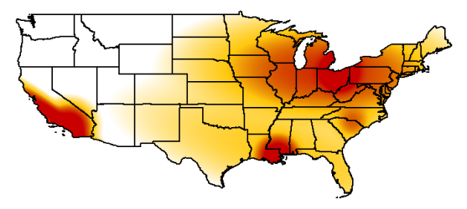
Query model for [rta bus schedule]
User in New Orleans

Slide 33
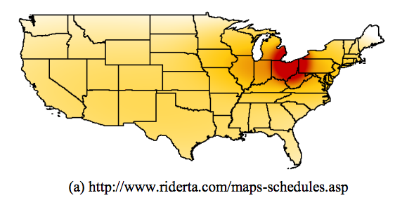
URL model for top original result
User in New Orleans

Slide 34
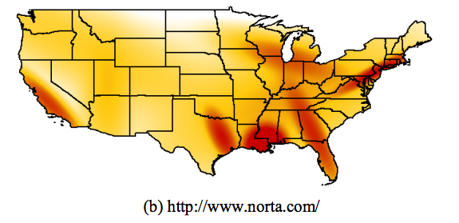
URL model for promoted URL
User in New Orleans

Slide 35
Personalized pagerank

Slide 36

Pagerank review
Let A be the stochastic matrix corresponding to the Web graph G over n nodes
  No teleportation links (but assume no deadends in G)
  If node i has o_{i} outlinks, and there is an edge from node i to node j, then A_{ij} = 1/o_{i}
Let p be the teleportation probabilities
  (n x 1) column vector with each entry being 1/n
Pagerank vector r is defined by the following

Slide 37
Personalized pagerank
[Haveliwala 2003] [Jeh and Widom 2003]
In the basic pagerank computation, teleportation probability vector p is uniform over all pages
But if the user has preferences on which pages to teleport to, that preference can be represented in p
  p could be uniform over user’s bookmarks
  Or it could be non-zero on just pages on topics of interest to the user
Pagerank would be personalized to user’s interests
But computing personalized pagerank is expensive

Slide 38

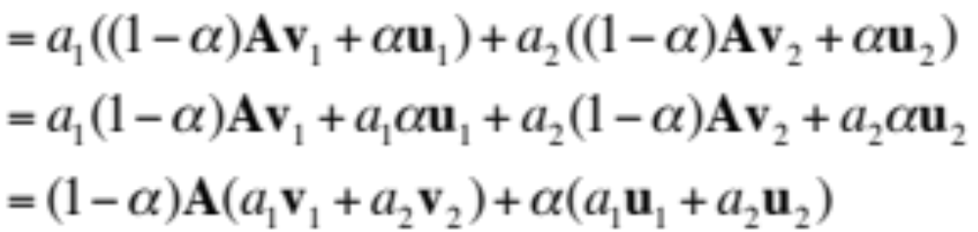
Linearity theorem
For any preference vectors u₁ and u₂, if v₁ and v₂ are the corresponding personalized pagerank vectors, then for any non-negative constants a₁ and a₂ such that a₁+ a₂ = 1, we have
Proof

Slide 39
Topic-sensitive pagerank
Compute personalized pagerank vector per topic
  16 top-level topics from the Open Directory Project
  Each ODP topic has a set of pages (hand-)classified into that topic
  Preference vector for the topic is uniform over pages in that topic, and 0 elsewhere
Note: [Jeh and Widom 2003] provide a more general treatment

Slide 40
Query-time processing
Construct a distribution over topics for the query
  User profile can provide a distribution over topics
  Query can be classified into the different topics
  Any other context information can be used to inform topic distributions
Use the topic preferences to compute a weighted linear combination of topic pagerank vectors to use in place of pagerank

Slide 41
Social networks

Slide 42
Unicorn
[Curtiss et al 2013]
Primary backend for Facebook Graph Search
Facebook social graph
  Nodes represent people and things (entities)
  Each entity has a unique 64-bit id
  Edges represent relationships between nodes
  There are many thousands of edge-types
    Examples: friend, likes, likers, …

Slide 43
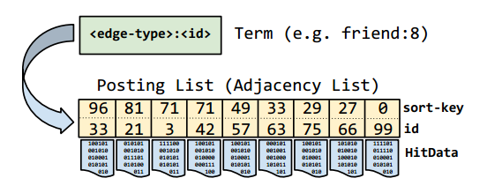
Data model
Billions of nodes, but graph is sparse
  Represent graph using adjacency list
  Postings sorted by sort-key (importance) and then id
  Index sharded by result-id
Notes:
Result sharding advantages:
If a shard is down, they can still return some friends
Many operations can be done at the leaf

Slide 44
Basic set operations
Query language includes basic set operations
  and, or, difference
  Friends of either Jon Jones (id 5) and Lea Lin (id 6)
  (or(friend:5 friend:6))
  Female friends of Jon Jones who are not friend of Lea Lin
  (difference (and friend:5 gender:1)
  friend:6)

Slide 45
Typeahead
Find users by typing first few characters of their name
Index servers contain postings lists for every name prefix up to a predefined character limit
  Simple typeahead implementation would simply return ids in the corresponding postings lists
Simple solution doesn’t ensure social relevance
Alternate solution: Use a conjunctive query
(and mel* friend:3)
  Misses people who are not friends
  Issuing two queries is expensive

Slide 46
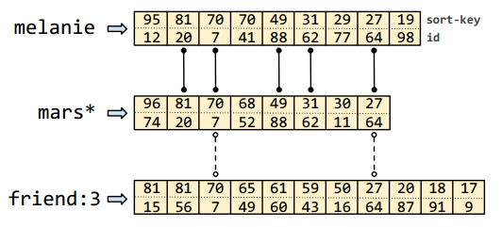
WeakAnd operator
Provides a mechanism for some fraction of results to possess a trait without requiring trait for all results
WeakAnd allows missing terms from some results
  These optional terms can have an optional count or weight
  Once the optional count is met, the term is required
(weak-and (term friend:3 :optional-hits 2) (term melanie) (term mars*))
Notes:
User looking for Melanie Marshall
Ids returned would be 20, 7, 88, 64. 62 would not be returned.

Slide 47
Graph Search
Graph Search results are often more than one edge away from source nodes
  Example: Pages liked by friends of Melanie who like Emacs
Unicorn provides additional operators to support Graph Search
  Apply
  (apply likes: (and friend:7 likers:42))
  Extract
    Extract and return (denormalized) ids stored in HitData

Slide 48
References
J. Teevan, S. Dumais, E. Horvitz. Potential for personalization. 2010
J. Pitkow et al. Personalized search. 2002
J. Teevan, S. Dumais, E. Horvitz. Personalizing search via automated analysis of interests and activities. 2005
P. Bennett et al. Inferring and using location metadata to personalize Web search. 2011
T. Haveliwala. Topic-sensitive pagerank. 2002.
G. Jeh and J. Widom. Scaling personalized Web search. 2003
M. Curtiss et al. Unicorn: A system for searching the social graph. 2013

