Slide 1
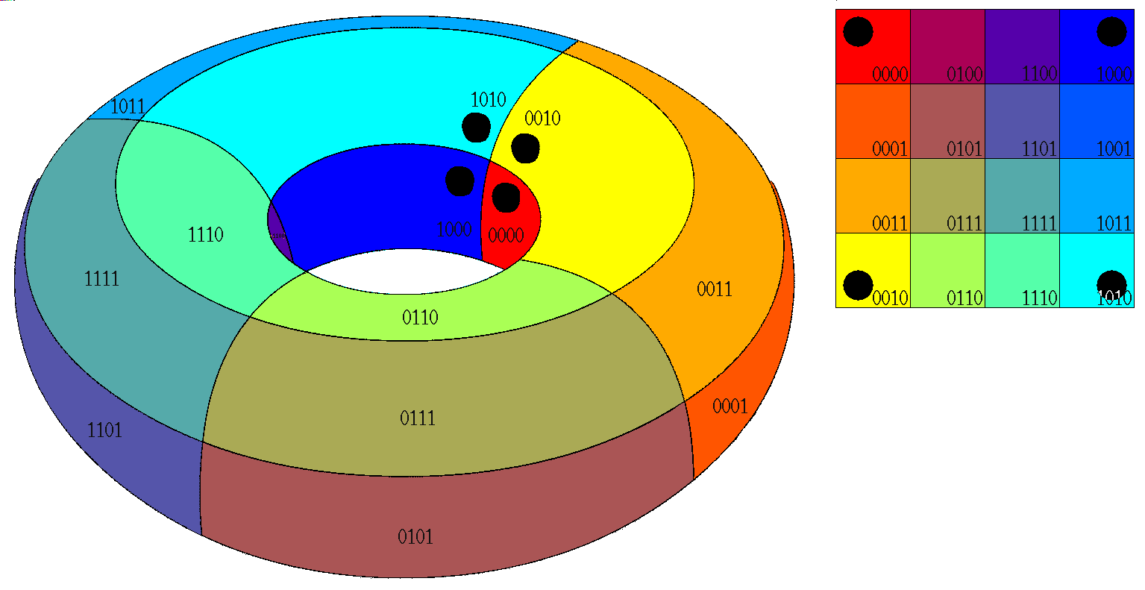
Logic Design
Karnaugh Map, EPI

Slide 2
EPI
F(A,B,C,D,E)= ∑ m(0,4,6,11,15,20,22,24,26,27,31)

Slide 3
F(A,B,C,D,E)= ∑ m(0,4,6,11,15,20,22,24,26,27,31)
ABC\DE | 00 | 01 | 11 | 10
000 | 0 1 | 1 | 3 | 2
001 | 4 1 | 5 | 7 | 6 1
011 | 12 | 13 | 15 1 | 14
010 | 8 | 9 | 11 1 | 10
ABC\DE | 00 | 01 | 11 | 10
100 | 16 | 17 | 19 | 18
101 | 20 1 | 21 | 23 | 22 1
111 | 28 | 29 | 31 1 | 30
110 | 24 1 | 25 | 27 1 | 26 1

Slide 4
F(A,B,C,D,E)= ∑ m(0,4,6,11,15,20,22,24,26,27,31)
ABC\DE | 00 | 01 | 11 | 10
000 | 0 1 | 1 | 3 | 2
001 | 4 1 | 5 | 7 | 6 1
011 | 12 | 13 | 15 1 | 14
010 | 8 | 9 | 11 1 | 10
ABC\DE | 00 | 01 | 11 | 10
100 | 16 | 17 | 19 | 18
101 | 20 1 | 21 | 23 | 22 1
111 | 28 | 29 | 31 1 | 30
110 | 24 1 | 25 | 27 1 | 26 1
PI

Slide 5
F(A,B,C,D,E)= ∑ m(0,4,6,11,15,20,22,24,26,27,31)
ABC\DE | 00 | 01 | 11 | 10
000 | 0 1 | 1 | 3 | 2
001 | 4 1 | 5 | 7 | 6 1
011 | 12 | 13 | 15 1 | 14
010 | 8 | 9 | 11 1 | 10
ABC\DE | 00 | 01 | 11 | 10
100 | 16 | 17 | 19 | 18
101 | 20 1 | 21 | 23 | 22 1
111 | 28 | 29 | 31 1 | 30
110 | 24 1 | 25 | 27 1 | 26 1
EPI = $\overline{A}\overline{B}\overline{D}\overline{E}, BCD, \overline{B}C\overline{E}, AB\overline{C}\overline{E}$
F = $\overline{A}\overline{B}\overline{D}\overline{E}+ BCD+ \overline{B}C\overline{E}+ AB\overline{C}\overline{E}$

Slide 6
EPI
F(A,B,C,D,E)= ∑ m(0,2,5,7,8,10,13,15)

Slide 7
F(A,B,C,D,E)= ∑ m(0,2,5,7,8,10,13,15)
ABC\DE | 00 | 01 | 11 | 10
000 | 0 1 | 1 | 3 | 2 1
001 | 4 | 5 1 | 7 1 | 6
011 | 12 | 13 1 | 15 1 | 14
010 | 8 1 | 9 | 11 | 10 1
ABC\DE | 00 | 01 | 11 | 10
100 | 16 | 17 | 19 | 18
101 | 20 | 21 | 23 | 22
111 | 28 | 29 | 31 | 30
110 | 24 | 25 | 27 | 26

Slide 8
F(A,B,C,D,E)= ∑ m(0,2,5,7,8,10,13,15)
ABC\DE | 00 | 01 | 11 | 10
000 | 0 1 | 1 | 3 | 2 1
001 | 4 | 5 1 | 7 1 | 6
011 | 12 | 13 1 | 15 1 | 14
010 | 8 1 | 9 | 11 | 10 1
ABC\DE | 00 | 01 | 11 | 10
100 | 16 | 17 | 19 | 18
101 | 20 | 21 | 23 | 22
111 | 28 | 29 | 31 | 30
110 | 24 | 25 | 27 | 26
PI

Slide 9
F(A,B,C,D,E)= ∑ m(0,2,5,7,8,10,13,15)
ABC\DE | 00 | 01 | 11 | 10
000 | 0 1 | 1 | 3 | 2 1
001 | 4 | 5 1 | 7 1 | 6
011 | 12 | 13 1 | 15 1 | 14
010 | 8 1 | 9 | 11 | 10 1
ABC\DE | 00 | 01 | 11 | 10
100 | 16 | 17 | 19 | 18
101 | 20 | 21 | 23 | 22
111 | 28 | 29 | 31 | 30
110 | 24 | 25 | 27 | 26
EPI = $\overline{A}CE, A\overline{C}\overline{E}$
F = $\overline{A}CE+ A\overline{C}\overline{E}$

Slide 10

EPI
F(A,B,C,D,E)= $\prod{M (}$0,2,10,11,13,15,16,18,29,31)

Slide 11

F(A,B,C,D,E)= $\prod{M (}$0,2,10,11,13,15,16,18,29,31)
ABC\DE | 00 | 01 | 11 | 10
000 | 0 0 | 1 | 3 | 2 0
001 | 4 | 5 | 7 | 6
011 | 12 | 13 0 | 15 0 | 14
010 | 8 | 9 | 11 0 | 10 0
ABC\DE | 00 | 01 | 11 | 10
100 | 16 0 | 17 | 19 | 18 0
101 | 20 | 21 | 23 | 22
111 | 28 | 29 0 | 31 0 | 30
110 | 24 | 25 | 27 | 26

Slide 12
F(A,B,C,D,E)= $\prod{M (}$0,2,10,11,13,15,16,18,29,31)
ABC\DE | 00 | 01 | 11 | 10
000 | 0 0 | 1 | 3 | 2 0
001 | 4 | 5 | 7 | 6
011 | 12 | 13 0 | 15 0 | 14
010 | 8 | 9 | 11 0 | 10 0
ABC\DE | 00 | 01 | 11 | 10
100 | 16 0 | 17 | 19 | 18 0
101 | 20 | 21 | 23 | 22
111 | 28 | 29 0 | 31 0 | 30
110 | 24 | 25 | 27 | 26
PI

Slide 13
F(A,B,C,D,E)= $\prod{M (}$0,2,10,11,13,15,16,18,29,31)
ABC\DE | 00 | 01 | 11 | 10
000 | 0 0 | 1 | 3 | 2 0
001 | 4 | 5 | 7 | 6
011 | 12 | 13 0 | 15 0 | 14
010 | 8 | 9 | 11 0 | 10 0
ABC\DE | 00 | 01 | 11 | 10
100 | 16 0 | 17 | 19 | 18 0
101 | 20 | 21 | 23 | 22
111 | 28 | 29 0 | 31 0 | 30
110 | 24 | 25 | 27 | 26
EPI = ($\overline{B}+\overline{C}+\overline{E}$),($B+C+E$)
F = ($\overline{B}+\overline{C}+\overline{E}$).($B+C+E$).($A+\overline{B}+C+\overline{D}$)

Slide 14

EPI
F(A,B,C,D)= $\prod{M (}$4,5,6,7,8,9,10,11,13,15)

Slide 15

F(A,B,C,D)= $\prod{M (}$4,5,6,7,8,9,10,11,13,15)
ABC\DE | 00 | 01 | 11 | 10
000 | 0 | 1 | 3 | 2
001 | 4 0 | 5 0 | 7 0 | 6 0
011 | 12 | 13 0 | 15 0 | 14
010 | 8 0 | 9 0 | 11 0 | 10 0

Slide 16
F(A,B,C,D)= $\prod{M (}$4,5,6,7,8,9,10,11,13,15)
AB\CD | 00 | 01 | 11 | 10
00 | 0 | 1 | 3 | 2
01 | 4 0 | 5 0 | 7 0 | 6 0
11 | 12 | 13 0 | 15 0 | 14
10 | 8 0 | 9 0 | 11 0 | 10 0
PI

Slide 17
F(A,B,C,D)= $\prod{M (}$4,5,6,7,8,9,10,11,13,15)
AB\CD | 00 | 01 | 11 | 10
00 | 0 | 1 | 3 | 2
01 | 4 0 | 5 0 | 7 0 | 6 0
11 | 12 | 13 0 | 15 0 | 14
10 | 8 0 | 9 0 | 11 0 | 10 0
EPI = ($A+ \overline{B}$),($\overline{A}+B$)
F = ($A+ \overline{B}$).($\overline{A}+B$).($\overline{A}$ + $\overline{D}$)

Slide 18
EPI
F(A,B,C,D,E)= ∑ m(7,9,12,13,19,22) + d(0,3,20,25,27,28,29)

Slide 19
F(A,B,C,D,E)= ∑ m(7,9,12,13,19,22) + d(0,3,20,25,27,28,29)
ABC\DE | 00 | 01 | 11 | 10
000 | 0 X | 1 | 3 X | 2
001 | 4 | 5 | 7 1 | 6
011 | 12 1 | 13 1 | 15 | 14
010 | 8 | 9 1 | 11 | 10
ABC\DE | 00 | 01 | 11 | 10
100 | 16 | 17 | 19 1 | 18
101 | 20 X | 21 | 23 | 22 1
111 | 28 X | 29 X | 31 | 30
110 | 24 | 25 X | 27 X | 26

Slide 20
F(A,B,C,D,E)= ∑ m(7,9,12,13,19,22) + d(0,3,20,25,27,28,29)
ABC\DE | 00 | 01 | 11 | 10
000 | 0 X | 1 | 3 X | 2
001 | 4 | 5 | 7 1 | 6
011 | 12 1 | 13 1 | 15 | 14
010 | 8 | 9 1 | 11 | 10
ABC\DE | 00 | 01 | 11 | 10
100 | 16 | 17 | 19 1 | 18
101 | 20 X | 21 | 23 | 22 1
111 | 28 X | 29 X | 31 | 30
110 | 24 | 25 X | 27 X | 26
PI

Slide 21
F(A,B,C,D,E)= ∑ m(7,9,12,13,19,22) + d(0,3,20,25,27,28,29)
ABC\DE | 00 | 01 | 11 | 10
000 | 0 X | 1 | 3 X | 2
001 | 4 | 5 | 7 1 | 6
011 | 12 1 | 13 1 | 15 | 14
010 | 8 | 9 1 | 11 | 10
ABC\DE | 00 | 01 | 11 | 10
100 | 16 | 17 | 19 1 | 18
101 | 20 X | 21 | 23 | 22 1
111 | 28 X | 29 X | 31 | 30
110 | 24 | 25 X | 27 X | 26
EPI = $B\overline{D}E, BC\overline{D}, A\overline{C}DE, \overline{A}\overline{B}DE, A\overline{B}C\overline{E}$
F = $B\overline{D}E+BC\overline{D}+ A\overline{C}DE+ \overline{A}\overline{B}DE+ A\overline{B}C\overline{E}$

Slide 22
EPI
F(A,B,C,D,E)= ∑ m(1,3,6,12,13) + d(4,15)

Slide 23
F(A,B,C,D)= ∑ m(1,3,6,12,13) + d(4,15)
AB\CD | 00 | 01 | 11 | 10
00 | 0 | 1 1 | 3 1 | 2
01 | 4 X | 5 | 7 | 6 1
11 | 12 1 | 13 1 | 15 X | 14
10 | 8 | 9 | 11 | 10

Slide 24
F(A,B,C,D)= ∑ m(1,3,6,12,13) + d(4,15)
AB\CD | 00 | 01 | 11 | 10
00 | 0 | 1 1 | 3 1 | 2
01 | 4 X | 5 | 7 | 6 1
11 | 12 1 | 13 1 | 15 X | 14
10 | 8 | 9 | 11 | 10
PI

Slide 25
F(A,B,C,D)= ∑ m(1,3,6,12,13) + d(4,15)
AB\CD | 00 | 01 | 11 | 10
00 | 0 | 1 1 | 3 1 | 2
01 | 4 X | 5 | 7 | 6 1
11 | 12 1 | 13 1 | 15 X | 14
10 | 8 | 9 | 11 | 10
EPI = $\overline{A}\overline{B}D,\overline{A}B\overline{D}$
F = $\overline{A}\overline{B}D+ \overline{A}B\overline{D}+AB\overline{C}$

