Slide 1
Parity

Slide 2
Parity Generation and Checking
Parity:
  The number of 1’s in a bit stream
Application:
  Error detection
Parity generator:
  The circuit that generates the parity bit before or during transmission
  Two kinds: even and odd
Parity checker:
  The circuit that checks the parity at the receiver side

Slide 3
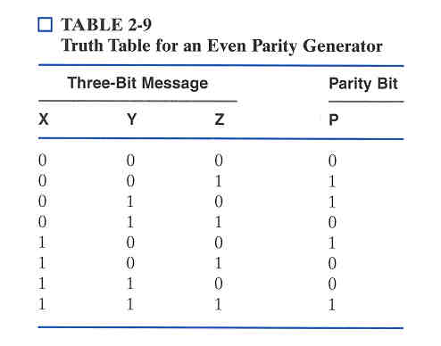
Example: Even Parity Generator
  P(X,Y,Z) must produce a 1 for all the input combinations that contain an odd number of 1’s
  Thus, it is a 3-input odd function P = X⊕Y⊕Z

Slide 4
Example (Cont’d): Parity Checker
  How would you implement a parity
  checker for the previous example?
Use a 4-input XOR circuit (another odd function)
C = X⊕Y⊕Z⊕P
C = 0 indicates that data has been received correctly
C = 1 indicates an error in the received data
  Note that this only works when there is a single bit error!

Slide 5
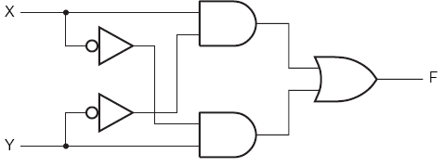
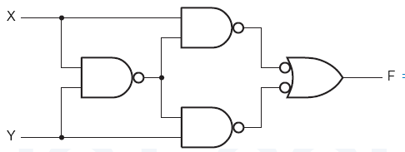
XOR in Parity Circuits
XOR gates are widely used for parity generation and checking
How to implement multiple-input XOR functions?

Slide 6
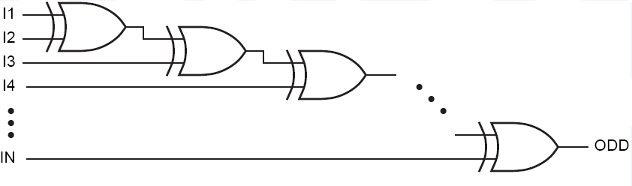
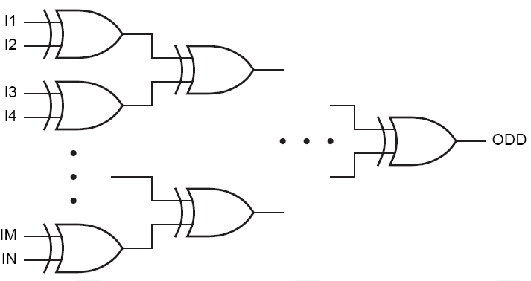
Parity Circuits: 2 Implementations
Daisy Chain
Tree

