Slide 1
Load Generator Akka/Play & MongoDB
Patrick Robinson
Alex Laitenberger

Slide 2
Inhaltsverzeichnis
Architektur
Überblick
WebSocket, Play
Aktorsystem
DB-Schema & Java Datenstruktur
UI
Allgemein
Graph
Reflexion/Bewertung

Slide 3
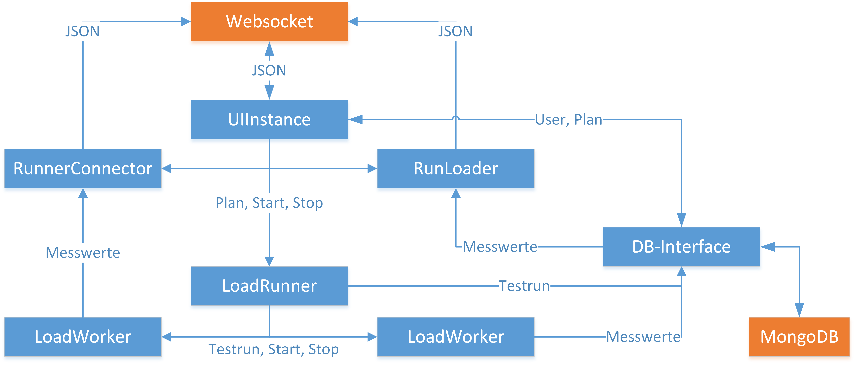
Aktorsystem

Slide 4
DB-Schema
User: {_id, name, password}
Testplan: {_id, user, path, connectionType, wait, parallelity, numRuns}
Testrun: {_id, testplan, [raws]}
raw: {start, end}

Slide 5
Futures & Promises

