Slide 1
https://github.com/jpt4/proflog IU Logic Seminar – 2026MAY27
Proflog, its implementation and rationale
1
James P. Torre, IV jpt4@proton.me

Slide 2
Contents
I: Proflog per se
II: Prior art and the current implementation
III: Extensions and connections
2

Slide 3
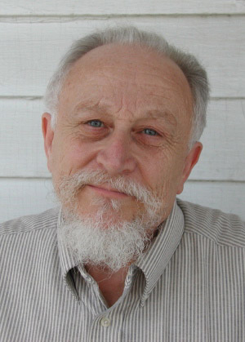
Fitting’s Proflog
“Life would be almost perfect if we had a logic programming language that was efficient, treated
negation naturally, and had a semantics that exactly fit its computational mechanism.”
– Tableaus for Logic Programming (1993)
3

Slide 4

Fitting’s Proflog
Khitan General: Wrong! Conan, what is best in life?
Conan: To crush your enemies, see them driven before you, and to hear the lamentations of their women!
-Conan the Barbarian (1982)
3

Slide 5

Fitting’s Proflog
Proflog:
- First-order logic with equality
- Tableau proof procedure
vs
Prolog:
- Horn Clauses
- Resolution
4

Slide 6
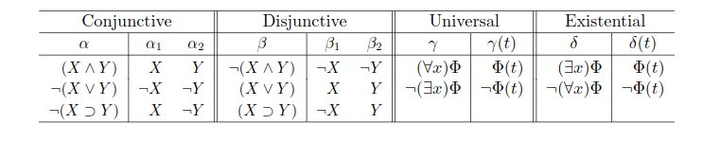
Tableaus
- To prove P, construct ~P
- ~P → contradiction, ergo P holds
- Cut-free
5

Slide 7
Prior Art
alphaleanTAP – Near, Byrd, Friedman, Amin
6

Slide 8
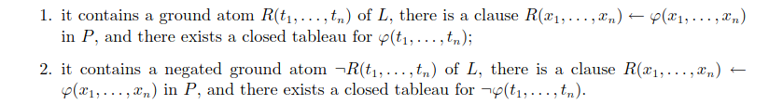
Procedure Call Rule
7

Slide 9

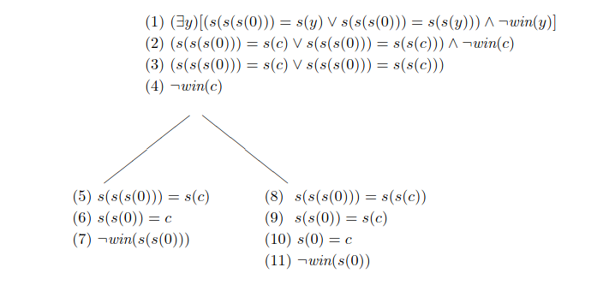
Procedure Call Rule
8

Slide 10
Proflog Implementation
;; - `fml` / `unexpanded`: the current formula and the remaining branch work,
;; - `lits`: saved positive / negative atoms already on the branch,
;; - `env`: lexical substitution for bound variables introduced by tableau
;; quantifier rules,
;; - `proof-vars`: the noms introduced by gamma so we can distinguish proof-time
;; instantiations from user-visible answer variables,
;; - `sigma`: the explicit free-constructor equality substitution,
;; - `neqs`: delayed disequalities that remain open for now,
;; - `prog`: the compiled Proflog program used by the Procedure Call Rule,
;; - `fuel`: bounded micro-step control for non-closing branch progress,
;; - `proof`: the proof term witnessing the branch closure.
9

Slide 11
Proflog Implementation
(defn p1-program
"Fitting P1 with the original forall-based odd clause."
[]
(ast/nom x y
(language/compile-program
peano-language
[(ast/clause 'even [x]
(or*
[(ast/eq-lit (ast/var-term x) (app 'zero))
(exists*
[y]
(and*
[(ast/eq-lit (ast/var-term x)
(app 's (ast/var-term y)))
(ast/pos-lit
(app 'odd (ast/var-term y)))]))]))
9

Slide 12
Proflog Implementation
(ast/clause 'odd [x]
(ast/forall-form
y
(ast/implies-form
(ast/pos-lit (app 'even (ast/var-term y)))
(ast/neq-lit (ast/var-term x)
(ast/var-term y)))))])))
9

Slide 13
Autarkic Formal Systems
To what extent are the aspects of a formal system determined by its own powers?
- Consistency
- Definability
- Decidability
- Interpretation
Brown and Palsberg, self-interpretation in System F
- Replication
Von Neumann automata
11

Slide 14
Autarkic Formal Systems
To what extent are the aspects of a formal system determined by its own powers?
- Consistency
- Definability <= Lawvere’s Fixed Point Theorm
- Decidability (per Yanofsky)
Further motivation for intensional exploration.
12

Slide 15
Selected References
[0] https://id144254.securedata.net/melvinfitting/bookspapers/pdf/papers/LPTableaus.pdf
[1] https://github.com/namin/leanTAP
[2] https://jpt401.substack.com/p/self-justifying-axiom-systems-and
13

