Slide 1
Cooperative Hunting Simulation
Yao-Jen Chang, Phoebe Chang, Meng Li, Tai-Yi Wu

Slide 2
Outline
Introduction
Related Work
Current Design
Model Design
Learning Methods
Progress
Tools
Models

Slide 3
Introduction
Goal: Develop better strategy for cooperative predators to hunt preys.
Models based on ground truth
Lions & Zebra
3. Model basic behaviors and sensors
Hunting of Predators
Eating of Preys

Slide 4
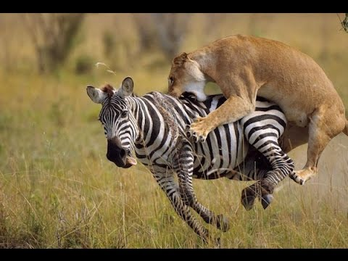
Lion cooperate to hunt (see 2:30)

Slide 5
Related Work
Cooperative hunting model:
A model that mimics the scenario of three lions hunting among a flock of zebras
Modeling the Dynamics of Cooperative Predators
Fredrik Lannsjo, Lionel Nurweze, Kristina Sorensen

Slide 6
Related Work
Hunting strategy: Hunting strategy of lions can be separated into two phases:
Stalking
Attacking
Modeling agents

Slide 7
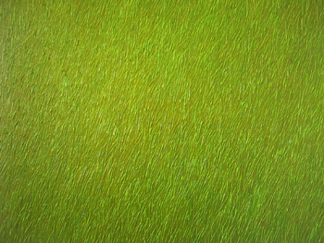
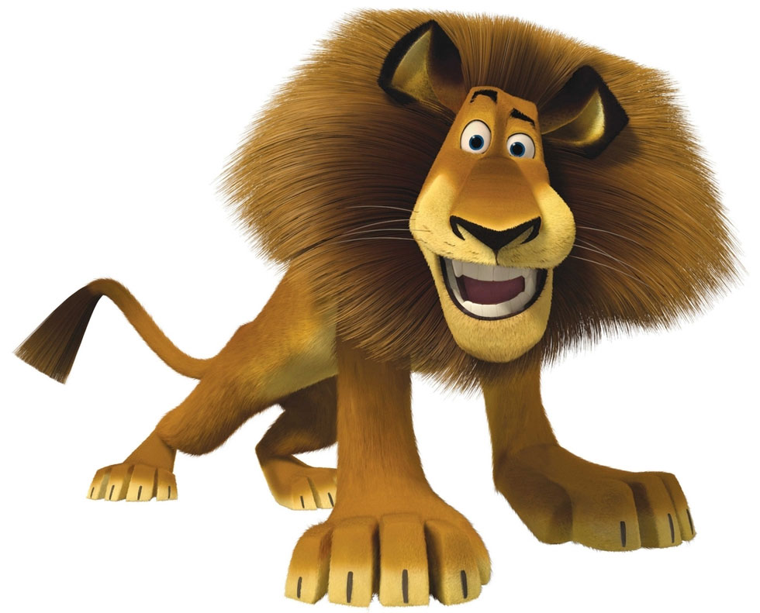

Past Goal: Cooperative hunting

Slide 8
Main Goal: Cooperative hunting

Slide 9
Current Design - Settings
2D-Map with boundaries
Simulated Animats as dots:
Predator number [3,5]
Prey number [5,10]
Constraints: Energy, Area

Slide 10
Current Design - Settings
Attributes for each experiment:
Predators’ current energy
random walk of animats
Moving speed (Maximum speed based on energy & grounded truth)

Slide 11
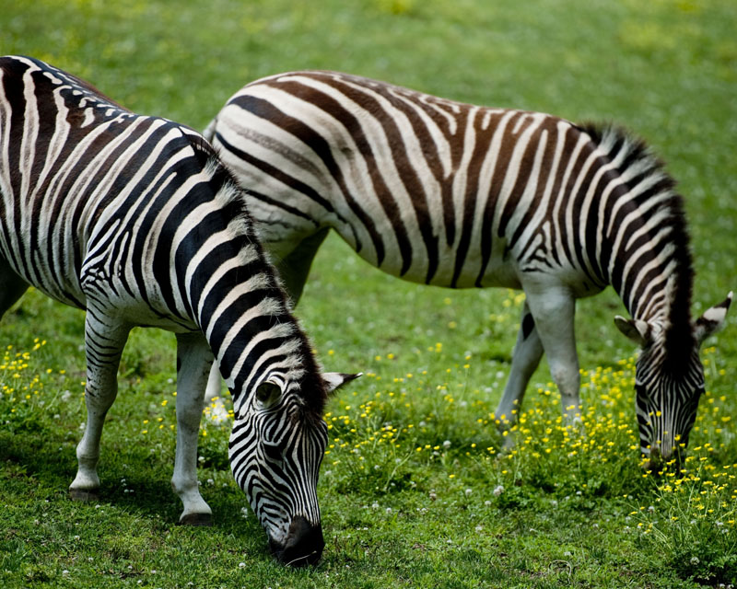
Current Design - Prey Model Design
Sensors: vision
Motors: feet, mouth
Basic Behaviors
Eating
Walking
Avoiding

Slide 12
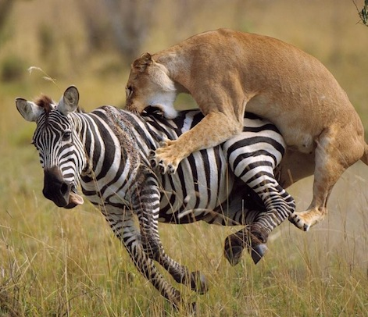
Current Design - Predators Model
External Sensors: vision
Inner Sensors:
Energy level (decrease by time and actions)
Motors: mouth, feets
Basic Behaviors:
Stalking
Running
Stay same position

Slide 13
Learning Methods - Neural Network
With evolution learning Fitness: Min(-cost(Energy) - distance(predator - preys))
Input nodes:
position of every lion
position of potential hunting preys
Self energy
Output nodes for actions

Slide 14
Neural Network
self position
lion 2 position
lion 3 position
Prey position 1
Run to prey
Prey position 2
Stalk
Energy
Stay
self state
.
.
.
.
lion 2 state
lion 3 state

Slide 15
Progress
Define the basic settings of the project
Design the hunting Model
Design the learning Methods for cooperative hunting
Decide Expected delivery platform
Tools: The Nature of Code for Javascript
Delivery Platform: The Web Browser

Slide 16
Thank you very much!
& Question?

Slide 17
References
[1] Visual Communication and Social Structure - The Group Predation of Lions
[2] Blender predator prey simulation with boids particle system
[3] Modeling the Dynamics of Cooperative Predators
[4] The Nature of Code
[5] The Nature of Code Sample
[6] Q-Learning

Slide 18

Learning Methods - Q Learning
Learn
It works by learning an action-value function that ultimately gives the expected utility of taking a given action in a given state and following the optimal policy thereafter.
The problem model consists of an agent, states S and a set of actions per state A.
The Q_{t} (s_{t},a_{t}) is the value for the status and the action at time t with estimated optimal value.

