Slide 1

NYSE BUSINESS-ANALYSIS BY OLUBENGA FELIX, AJIGA

Slide 2

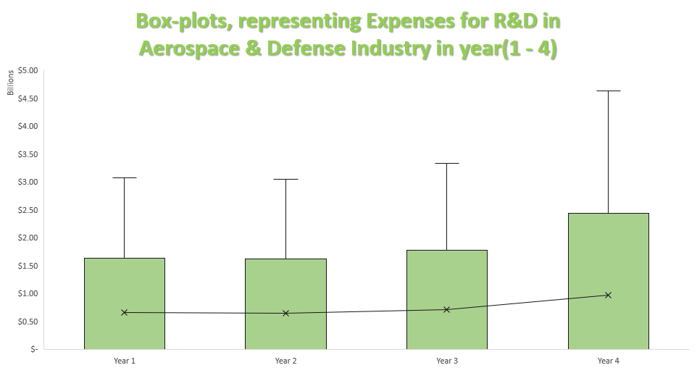
R&D Expenses for Aerospace & Defense Industry in year 1 to year 4

Slide 3
Box plot interpretations
Each mean is greater than the median resulting to box-plots that is rightly skewed.
50% of the companies do not spend on R and D hence median for all the years is $0
There is substantial increment on R and D in year 3 to 4 (from $3.5 to $4.5 Billion)
Looking at the standard deviation values (Between 1,20 and 1,32 billion for years 1,2 and 3, and more than 1,8 billion for year 4)
Notes:
Develops and oversees day-to-day operations of software applications, maintaining policies and procedures according to SLA.
Manages a team of consultants, testers, and analysts, data insight platform, and other applications.
Reports on performance metrics to identify opportunities for improvement conducts research on emerging technologies and recommends solutions.
Focuses on customer satisfaction by ensuring excellent and timely service delivery with maximum uptime and reviewing and adjusting processes to meet Valpak customers' needs while maintaining business standards.

Slide 4
Box plot interpretations
This can also be seen in in the values of the range and interquartile range
This behavior will make investors to likely going to be more careful
Year 4 has higher variability compare to year 1, year 2 and year 3
when the values for range and standard deviation are very high because of the risk involved.
Notes:
Develops and oversees day-to-day operations of software applications, maintaining policies and procedures according to SLA.
Manages a team of consultants, testers, and analysts, data insight platform, and other applications.
Reports on performance metrics to identify opportunities for improvement conducts research on emerging technologies and recommends solutions.
Focuses on customer satisfaction by ensuring excellent and timely service delivery with maximum uptime and reviewing and adjusting processes to meet Valpak customers' needs while maintaining business standards.

