Slide 1
Dynamic Rails

Slide 2
Action Cable
Broadcasting is the concept of using websockets to communicate real time updates from a server. So the concept works by client subscribing to an action cable channel this will be done on js side once subscribing is done in network we see that a connection will be established with cable and channel once this is done now the client will wait for a broadcast from server which can be anything from anywhere in the server for e.g a background worker in this case we are saving our resources. For e.g we make a request to server with an image and then do all the processing on the image in background once done we broadcast image url and record id back to be associated to the form.
Demo:

Slide 3
What is Hotwire turbo
Hotwire turbo is a way to pass html directly over the wire(from the server( to a certain frame. Which can help as in creating dynamic and interactive components(partials) faster with few lines of code and be less resource intensive to browser. The format used to communicate with server used when trying to make server respond to turbo is turbostream.

Slide 4
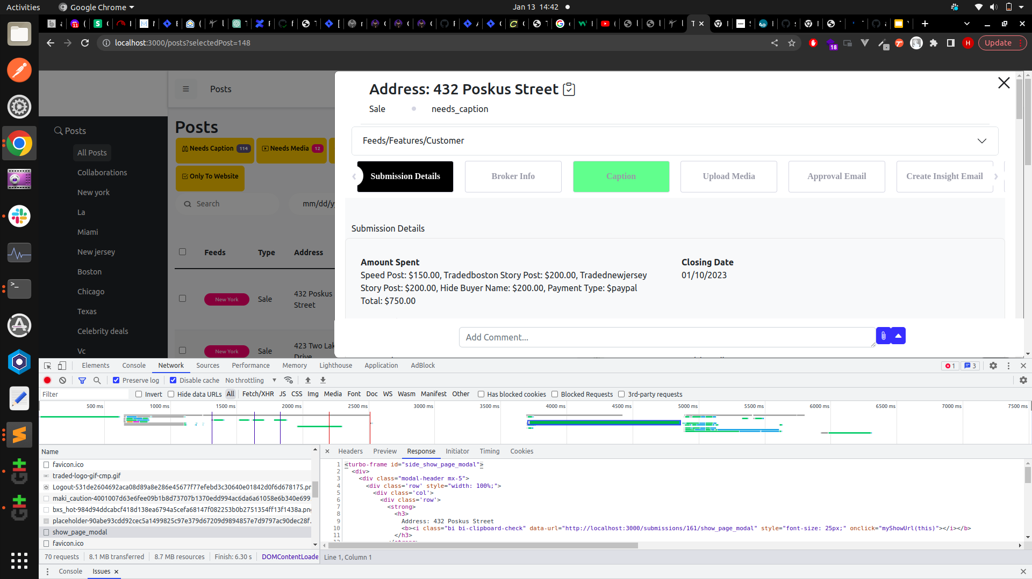

Slide 5
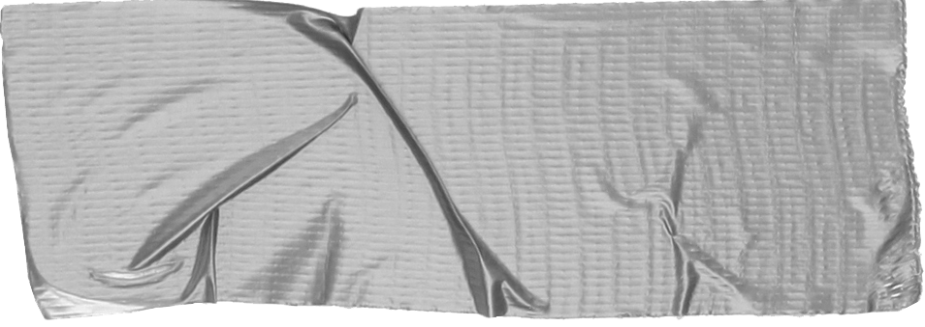

What is turbostream
TurboStreams is a feature in Rails that allows for real-time streaming of data between the server and the client.
The server can respond to turbo stream request and do interactions to dom via turboframes.
The interactions can be update, replace, append, remove
If a turbostream tag is used in html it can be used to broadcast real time updates via Action Cable.
I

Slide 6
How does the server responds?

Slide 7
The server communicates via the dom updates via these
turbo_stream.update("#{dom_id(@article)}_final_images",
partial: 'articles/final_images/final_images_preview', locals: { article: @article })
turbo_stream.update_all("#{dom_id(@article)}_final_images",
partial: 'articles/final_images/final_images_preview', locals: { article: @article })
turbo_stream.replace("#{dom_id(@article)}_final_images",
partial: 'articles/final_images/final_images_preview', locals: { article: @article })
turbo_stream.append("#{dom_id(@article)}_final_images",
partial: 'articles/final_images/final_images_preview', locals: { article: @article })
turbo_stream.prepend("#{dom_id(@article)}_final_images",
partial: 'articles/final_images/final_images_preview', locals: { article: @article })
This is basically a turbostream html tag that is returned with the partial as a template which will perform the action attribute defined on any tag with target id.

Slide 8
Perform Dynamic actions on a dom via turboframes
Another way we can use turbo frames is when we need to perform for e.g an inline editable table. What we can do in this case is to wrap the td item in link to tag which would hit a path and based on params passed we can fetch what field to replace the cell with in the path without handling anything at controller level.
Demo:

Slide 9
One of my personally experience data tag
Data-turbo-frame: This attribute if placed on a link tag or a form tag allows you to fetch a frame from the link path and replace a frame in the your dom with that.
In a form like in case we want to display a result card after a quiz is completed once the form is submitted we can show the result in a turboframe tag anywhere in the dom.
Demo:

