Slide 1
Gene
Environment

Slide 2
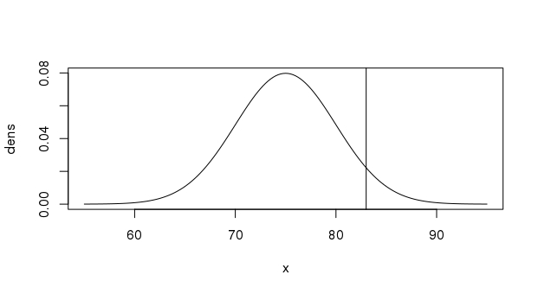
Threshold
Unaffected
Affected
Liability

Slide 3
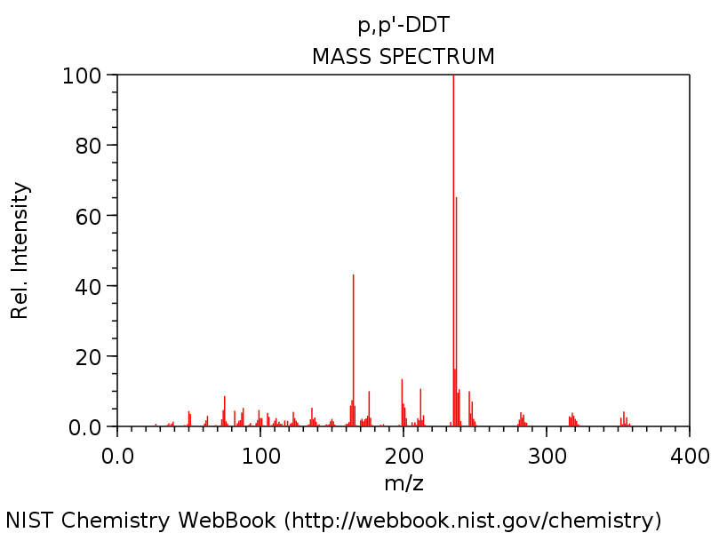
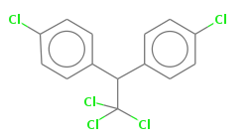

Slide 4
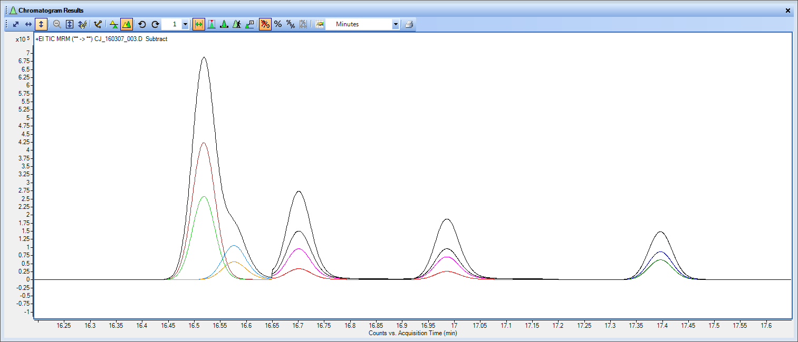
Compound 1
Compound 2

