Slide 1
AUT Shuttle Ticketing System
By Hayden Woodhead, Izaac Crooke & Dominic Porter

Slide 2
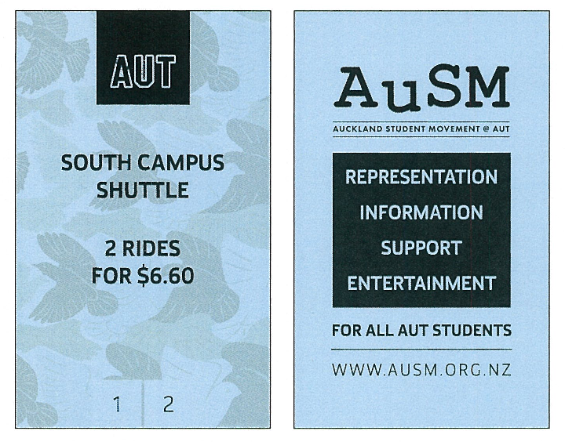
Current System
Paper Tickets
No means of verification
Slow boarding experience
Driver collects passenger numbers
Lack of live business metrics
Frustrating user experience

Slide 3
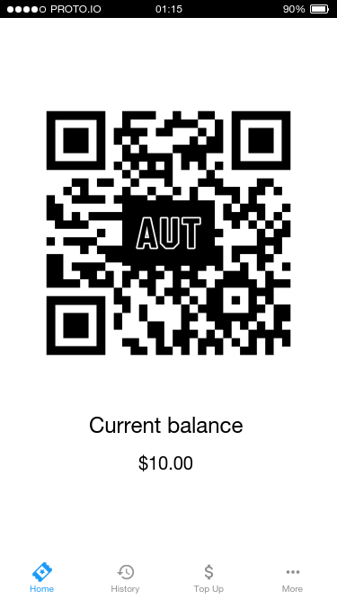
Our Goal
Create a passenger app with virtual tickets represented by QR codes
Add QR codes to paper tickets to verify authenticity
Eliminate ticket fraud
Allow topping up a balance in app or online
Produce a driver app to scan these new tickets
Provide valuable business metrics to transport administrators

Slide 4
Project Approach
Project Plan
Agile methodology
Three week sprints
Mini sprint to plan other sprints
Week 5: 26 - 30 March: Sprint 0
Week 6: 2 April: Start of Sprint 1 & Development Start
Week 9 → Sprint 2 onwards

Slide 5
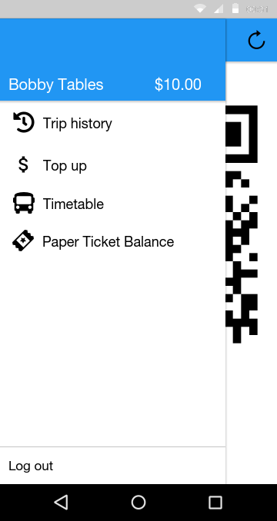
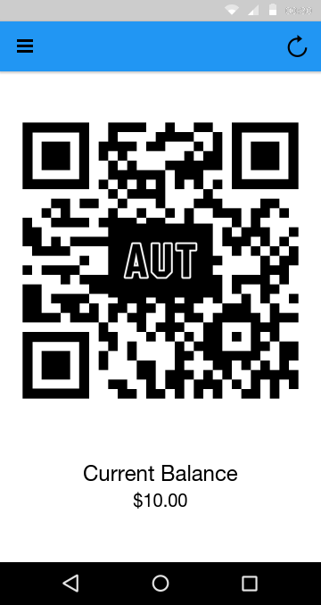
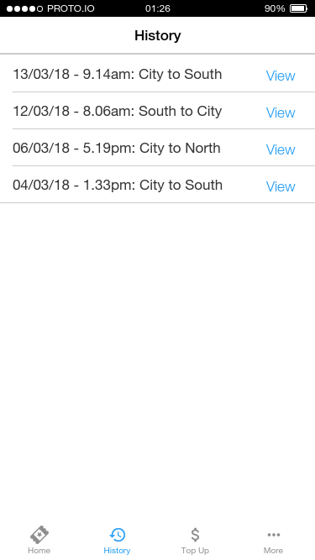
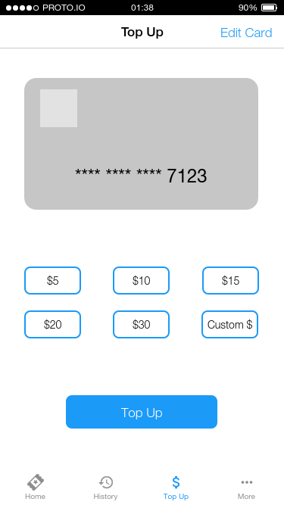
Mockups

Slide 6
Skills and Knowledge
Quality Assurance
Extensive knowledge in Java and Android development
Network sysadmin and linux system administrator
Python and Django experience
Need to upskill iOS and Swift
Automated testing of pull requests on GitHub
Manual review of pull requests by team members before merging

