Slide 1


Name: DHANASURIYAN M
NMid:autleme003
Department: Mechanical Engineerin College:AMCET

Slide 2


Slide 3


Slide 4


Slide 5


Slide 6


Slide 7
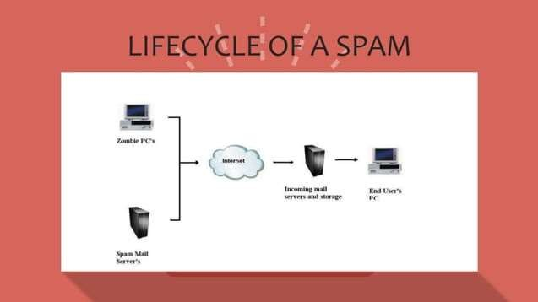

Slide 8


Slide 9
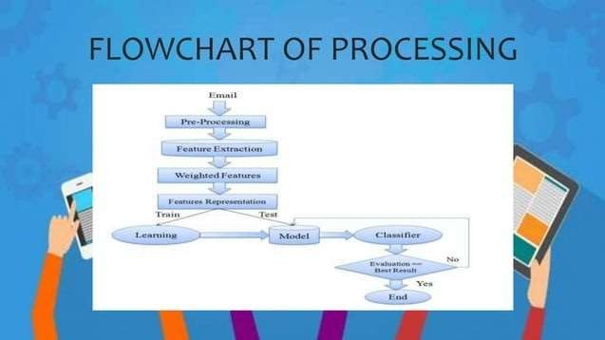

Slide 10


Slide 11


Slide 12


