Slide 1
Scheduler

Slide 2
Functional Requirements
REST endpoint to schedule timer, containing
  Time 24h format
  Message text
Scheduler job executing timers
  Calling REST endpoint to log message

Slide 3
Architecture Requirements
Spring-boot application
Persistence: Mongo DB
Multiple instances running parallel

Slide 4
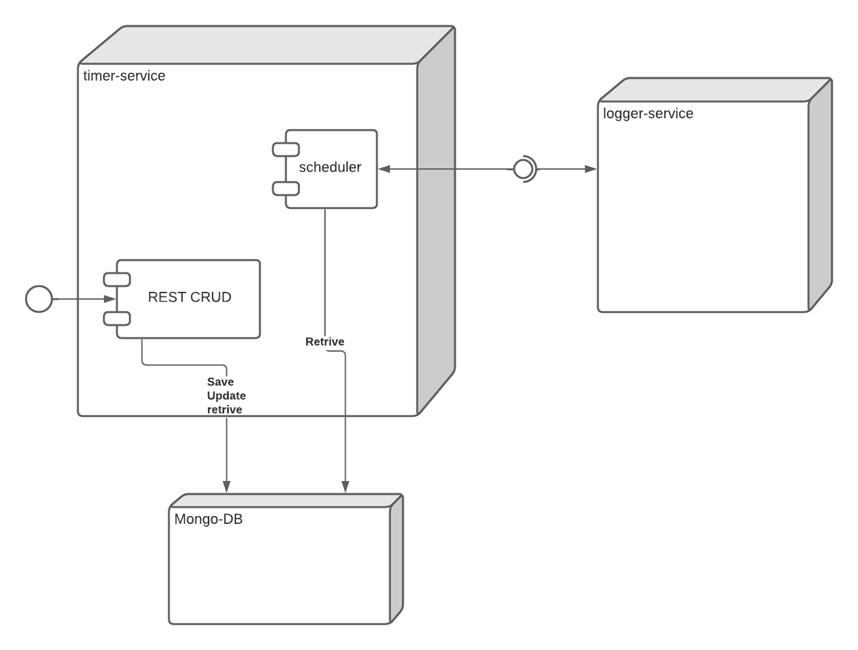
Overview

Slide 5
Synchronization I
Avoid handling of multiple timer execution
  Processing each minute
    Each instance asks DB about not running tasks (status)
    Before actual execution lock per findAndModify()
      Set status to RUNNING
      Send REST request with message
      Set status to TODO
  Pro: Easy to setup, Well known feature for a DB
  Con: amount of DB calls

Slide 6
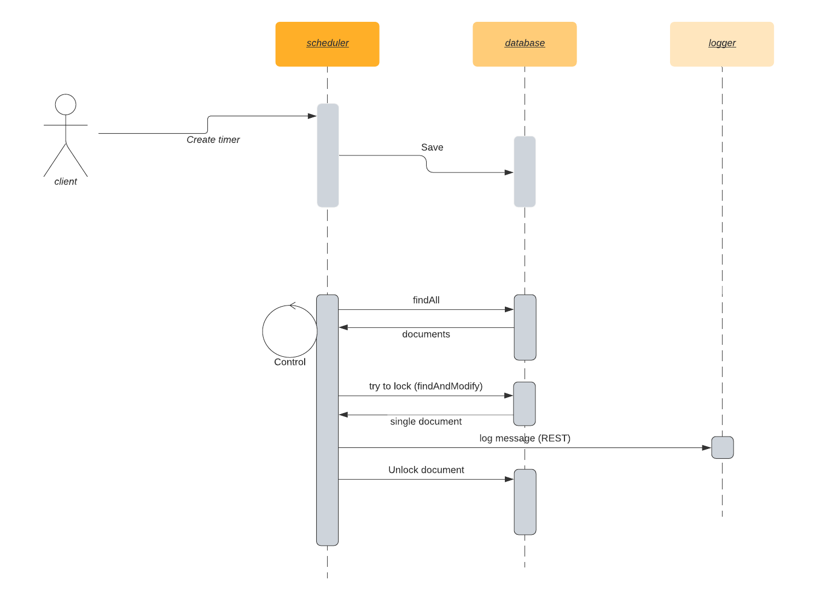
Synchronization II

Slide 7
Synchronization III
Alternatives:
  distributed cache (e.g. Redis)
  Master
    Fetch all
    Distribute processing to others

Slide 8
Synchronization IV
Things we miss
  Error handling
    Retries ?
  Security
    Authentication
    Authorization
  Performance tests
    How many timer can one instance handle?

Slide 9
Challenging requirements
Calling logger service via message instead of REST
Spring-boot
persistence

