Slide 1
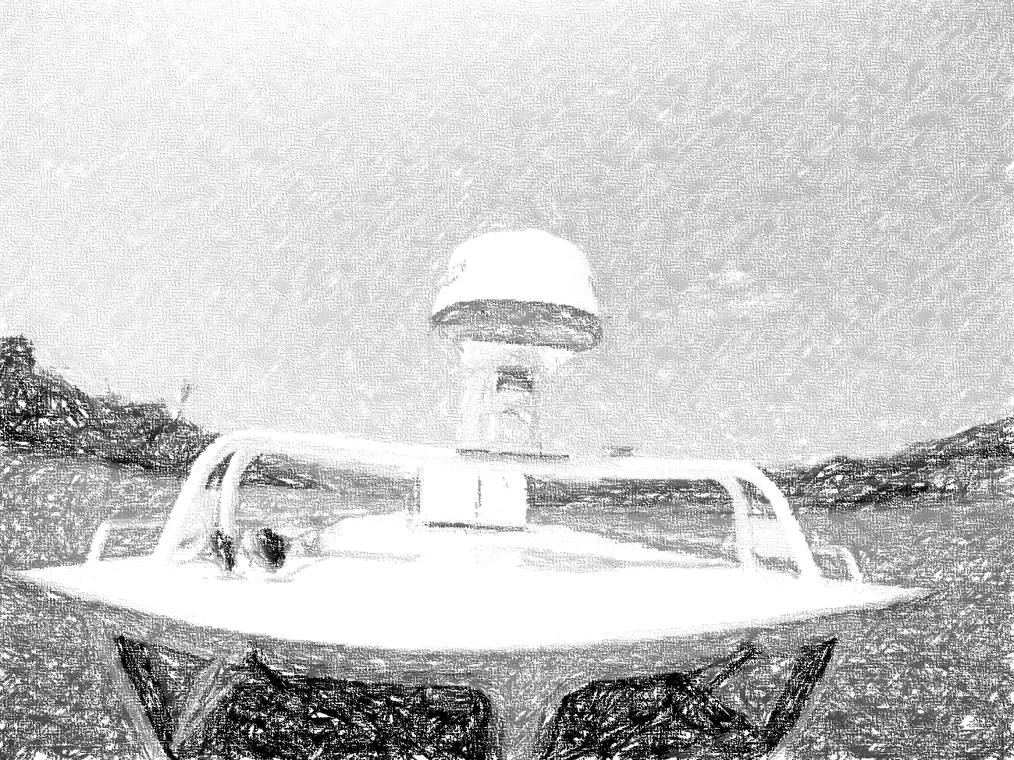


Autonomous Water Taxi
System Engineering: Updates
By: AutoPirates
Date: 19th November 2015
Project Sponsors:
Team B: Tushar, Shiyu, Bikramjot, Tae-Hyung, William

Slide 2
Project Updates | Current Status | Updates

Slide 3
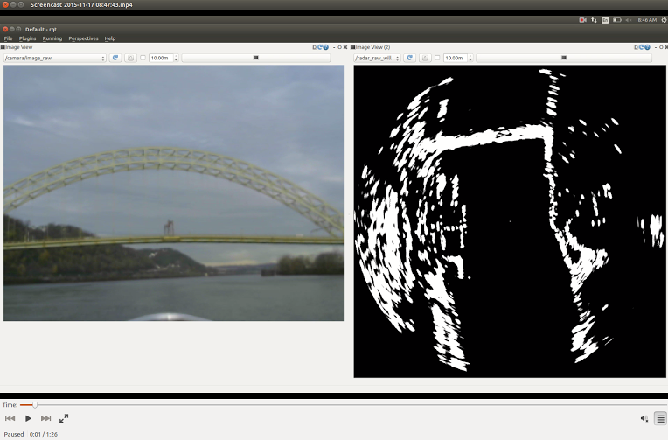
Project Status: Latest Updates | Perception
First Field test Successful
Tons of data collected for processing
Radar data is of good quality so

Slide 4
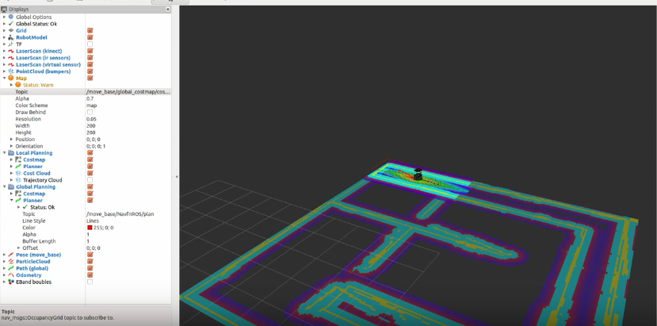
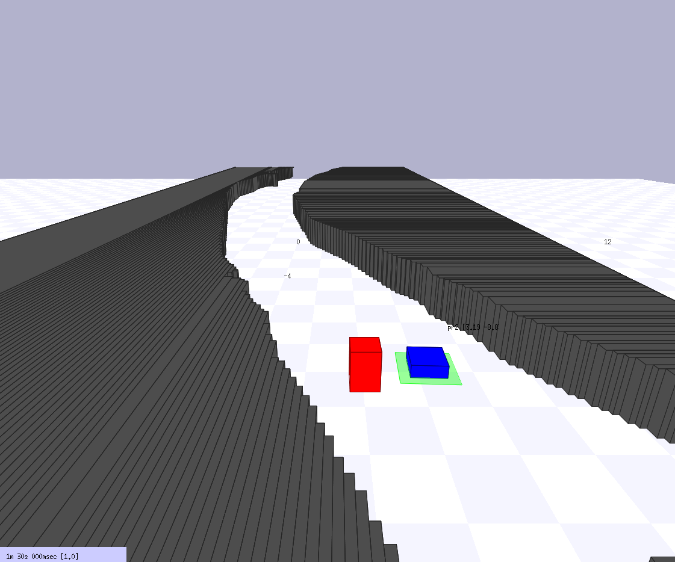

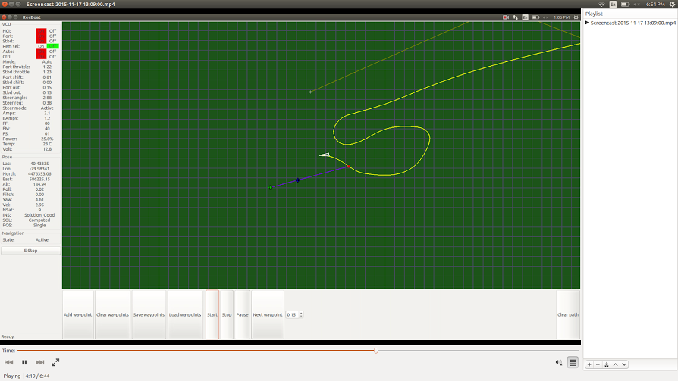
Project Status: Latest Updates | Path Planning and Simulation
Waypoint following tested
Created Occupancy Grid Map
Tested STAGE Simulation

Slide 5
Project Status: WBS Milestones for FVE
Perception
Path Planning
Acquire data using OpenCPN
10/12
Tests and Demo’s
Interface with IMU
10/12
Interface Radar with ROS
10/29
PR1
10/15
Build and explore SBPL
10/26
Legend
Basic Data Filtering
11/07
PR2
10/12
Generate Occupancy Grid Map
11/10
Finished
Morphological operation
11/14
PR3
10/12
Test Occupancy Grid Map on STAGE Simulator
11/13
In progress
Contour Extraction
11/18
PR4
10/12
Run planner on OGM to plan the path
11/24
Not started
Object Detection (Boundary box)
11/24
Field Test1
11/17
Create waypoint following interface
11/28
Start with overlaying radar data on maps
12/01
FVE
12/03
Tune motion primitives and OGM
12/02

Slide 6
Project Status: Challenges and delays
DELAYS
Challenges
Path planning needs more efforts to complete tasks before FVE
Navigating through bridges. Radar only gives 2D data
Shifting one person from perception to path planning
Resolution of OGM created from Google Maps is not high
More visits to NREC planned

Slide 7
Updates on Systems Engineering/PM
RISKS MITIGATED
RISKS ADDED
Radar performance (It was our biggest risk)
Navigating the boat under the bridges
Will add a RGB camera. This would be tackled in spring
Add the data of bridges to OGM beforehand
Creating OGM from radar data would be challenging and time consuming
Create our own OGM map using Radar data
No changes in requirements and FVE

Slide 8
Questions?

Slide 9
Fall Validation Experiments: Perception
Step ID | Step Description | Success Criteria | Conditions
PE.1 | Start RGB video of field test | This is our ground truth | Location: NSH Demonstration on laptop (Simulation), Projector required
PE.2 | Simultaneously replay and visualize saved raw radar data in ROS | We can see plots of the radar image
PE.3 | Show filtered data | The filtered image has less noise than the raw image
PE.4 | Demonstrate obstacle detection | Draw bounding box around the obstacles.
PE.5 | Show detected objects from radar image while showing recorded video | The radar should detect obstacles that are in the video, at least the boats

Slide 10
Fall Validation Experiments: Path Planning and Simulator
Step ID | Step Description | Success Criteria | Conditions
PL.1 | Interfacing with IMU/GPS | Display logged data from IMU/GPS which we would be collecting during a field test | Location: NSH Demonstration on laptop (Simulation), Projector required
PL.2 | Generate Environment Map | Display occupancy grid map for 2 miles with filled blocks depicting obstacles (For one of the rivers of Pittsburgh)
PL.3 | Demonstrate Path Planning | Boat successfully navigates from Point A to Point B in simulator which are 1 mile apart
PL.4 | Show obstacle avoidance | Boat successfully avoids obstacles in simulator in the above task. Obstacles are static and are simulated through occupancy grip map

