Slide 1
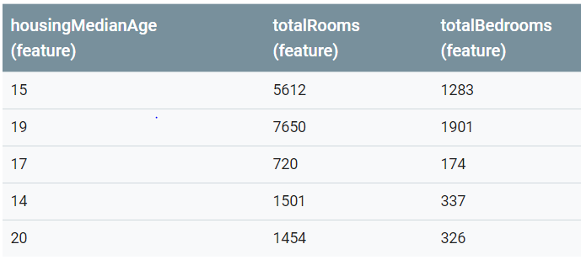
Feature scaling:
Map each feature’s values to range -1 -> 1 or 0 -> 1
Why do that? Because in practice, features vary on their value compare to others
Ex: housingMedianAge only takes values not larger than 20, but totalRooms can be thousands
=> This may lead to slow computation of optimal value of parameter of h(x), or sometimes you get cost function = nan

Slide 2
There are many method to scale feature
Min max scaling
Mean normalization
Standard scaling
But I focus on Standard scaling first
Compute mean and standard deviation of each feature
- Using np.mean() and np.std()
How to perform standard scaling?
With each feature, minus every values in it with its mean and then divide it by stddev(standard deviation)

Slide 3
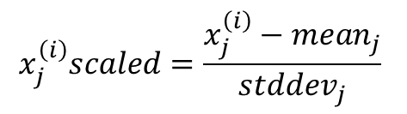
j = 1
j = 2
j = 3
mean | 17.0 | 3387.4 | 804.2
stddev | 2.28 | 2739.714 | 674.73
Step 1:
Housing median age | Total rooms | Total bedrooms
-0.877 | 0.81 | 0.71
0.877 | 1.56 | 1.63
0 | -0.97 | -0.93
-1.32 | -0.69 | -0.69
1.32 | -0.71 | -0.71
Step 2:

