Slide 1

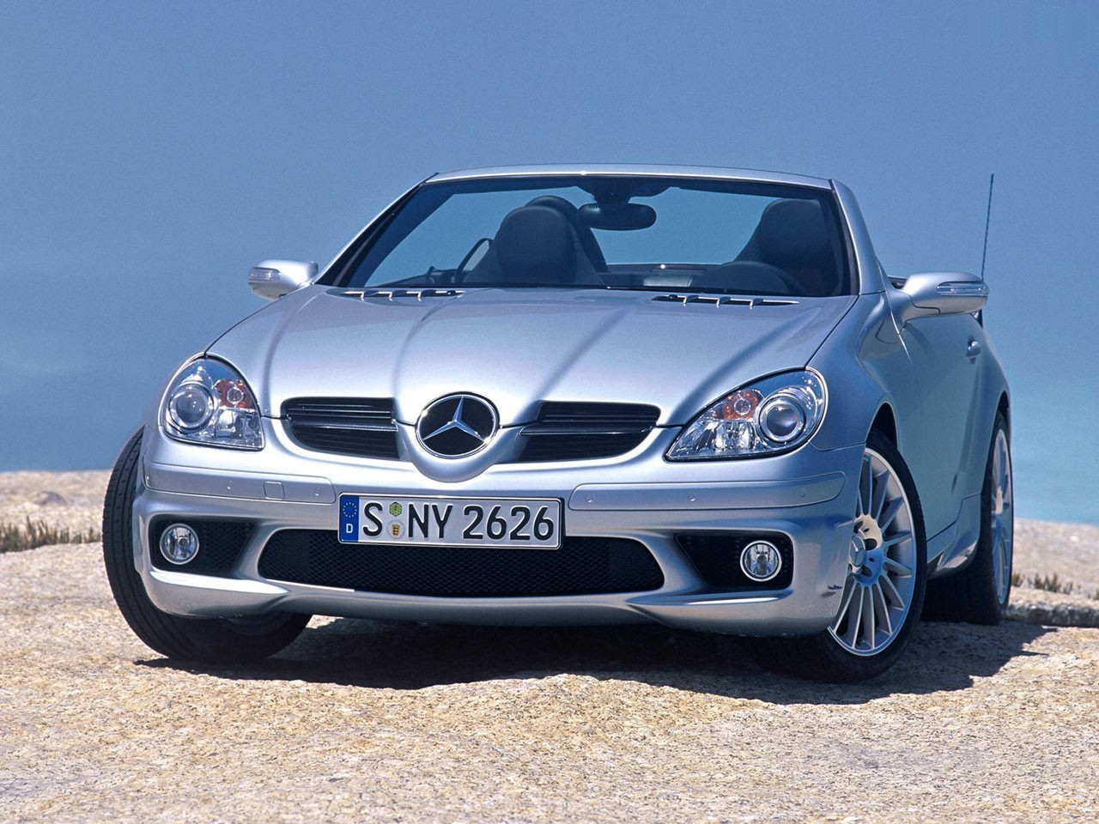
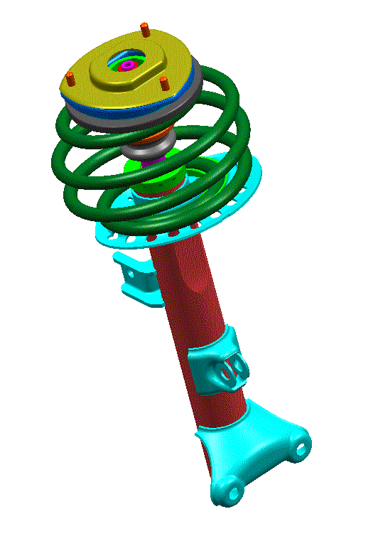

Shock absorbers from Krosna
DC R171 – Mercedes SLK
Customer
Quantities – 800 000

Slide 2
The Delphi cooperates with Daimler Chrysler Concern
In 2004 Delphi started to supply suspension components to a new model Mercedes SLK. Delphi was reliable for construction and putting into practice front modules and rear shock absorbers. The front suspension uses twin-tube strut and in rear suspension was applied mono-tube shock absorbers. Production of this products located in Delphi plant in Krosno. Rear shock absorbers determine development of famous deCarbon technology (mono-tube shock absorbers creator) which owner and continuator is Delphi Company. Splendid of adoption this car by market has ground for further development cooperation

